Slide 1

National Core Indicators (NCI)-Informational Meeting
January 18, 2024

Slide 2
Agenda
Introduction and purpose of NCI
NCI-IDD Project Scope
Survey Scheduling
Consent Process
About the project management organization: Knowledge Services
Survey Management Experience and Approach
Implementation timelines
Questions

Slide 3
Background and Introductions
Developmental Disabilities (DD) and Aging Services are participating
ND advocacy organizations advocated for implementation of NCI
ND State Council on Developmental Disabilities granted funding for the first two years of NCI survey cycles
Collaborative effort
HHS contracted with Knowledge Services for project management

Slide 4



Slide 5
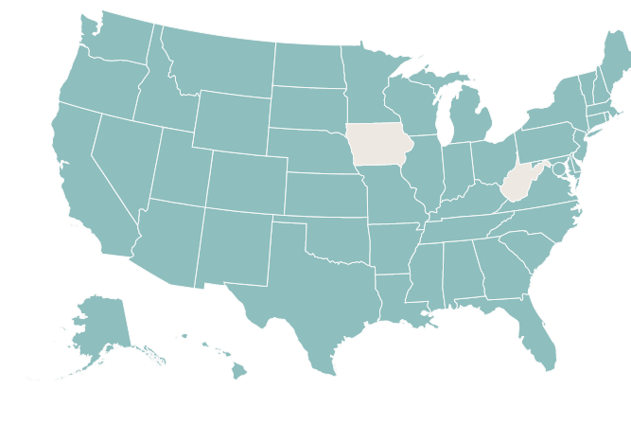
NCI-IDD Participating States
Been in use for 25 yrs.

Slide 6
Purpose of NCI-IDD
Hear directly from people receiving services
Assess quality of life, service satisfaction, experiences, and outcomes of people receiving long term services and supports
Track key outcomes across multiple years, measure performance, and improve systems and quality of supports
Compare outcomes to other states and to the average across states

Slide 7
NCI Indicators
Person-centered service planning
Rights
Choices
Decision making
Relationships
Health
Welfare
Safety
Service coordination
Community inclusion
Employment
Goals

Slide 8







    Data are used to…
Compare outcomes to other states
Compare specific groups or geographic regions within states
Identify areas for quality improvement
Share outcomes with stakeholders for feedback and strategic planning
Benchmark and track progress toward quality improvement
Researchers also use data to look more closely at specific topics

Slide 9
About NCI-IDD
Collaboration of National Association of State Directors of Developmental Disabilities Services (NASDDS) and Human Services Research Institute (HRSI)
Surveys with people with intellectual and developmental disabilities
  IID/DD HCBS Waiver
  Intermediate Care Facilities for Individuals with Intellectual Disabilities (ICF/IID)
Administered at the state-level
  States determine their sample strategy with support from NCI team
Adult Family surveys (2023 survey cycle)
  Mailed to families with an adult family member with IDD living in the family home
Child Family surveys (2023 survey cycle)
  Mailed to families with a child with IDD living in the family home
Family/Guardian surveys (2024 survey cycle)
  Mailed to family/guardian with an adult family member with IDD living outside of the home
In-person surveys (2024 survey cycle)
  Face-to-face or videoconference intended for adult individuals with IDD who is receiving service

Slide 10
NCI-IDD Family/Guardian Survey
Survey with family members and/or Guardian’s of people’s experiences with services from Developmental Disabilities
  The NCI-IDD Family/Guardian Survey is administered to families who have an adult family member (18 years or older) with an intellectual or developmental disability who does not live in the family home and receives at least one service other than case management
Questions on the survey:
  Family Member Information
  Respondent Information
  Services and Supports Received
  Information and Planning
  Access and Delivery of Supports
  Additional Supports Needed
  Choice, Decision-making, and Control
  Involvement in the Community
  Health and Safety
  Satisfaction
Survey modality
  Survey is mailed to the family member/Guardian and can be completed online or on-paper and mailed back in via prepaid return envelope
Timeline
  First round of survey mailings were sent in December. Second and third mailings will be sent to anyone who hasn’t yet completed the survey in January and March, respectively.

Slide 11

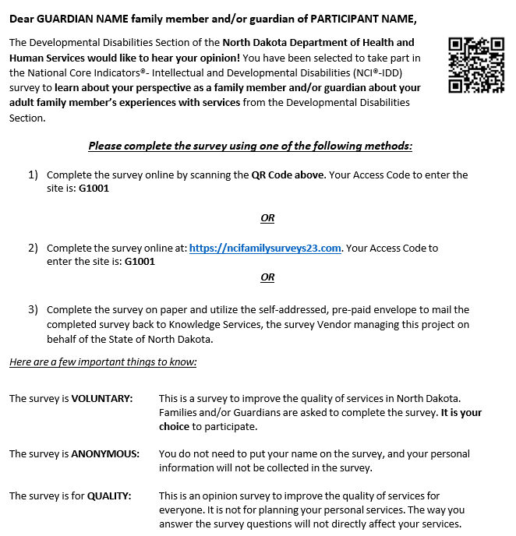
NCI-IDD Family/Guardian Survey Mailing
Initial Informational Mailing
Survey Instructions Mailing

Slide 12
NCI-IDD In-Person Survey
Surveys with people with intellectual and developmental disabilities who are 18 years and older
  If the person receiving services is unable to respond to questions on their own, and proxy may answer questions on their behalf as part of the survey
    A proxy can be a Guardian, other family member or friend, neighbor, or other individual informed enough to answer questions on behalf of the participant
    Only some questions may be answered by a proxy, while some questions must come from the person receiving services
Questions on the survey:
  Employment
  Safety, Health, and Wellness
  Community Participation and Leisure
  Relationships
  Staff
  Service Coordination
  Choices
  Technology
  Access to Services/Supports
  Self-directed Supports Module
Survey modality
  Survey can be conducted via videoconference or in-person

Slide 13
In-Person Survey Scheduling
Knowledge Services will begin outreach to participants and/or guardians the week of February 5th
  Guardians will be contacted first to assist in survey coordination with person receiving services
  The survey is intended to be completed by the person receiving services, as often as possible
  Survey can be completed via videoconference or in-person
  Survey is voluntary
  Participants are selected at random to participate in the survey
  Anticipated number of completed surveys is 400
Provider Staff are not responsible for assisting in the coordination or participation of the survey with the person receiving services
  If provider staff are asked about the survey from their clients, we ask that they validate the legitimacy of the NCI Survey and Knowledge Services as the Vendor facilitating the survey data collection
  Avoiding discouraging people from participating
  Provider Staff will not be involved in the survey process with the participant and/or proxy

Slide 14
In-Person Survey Consent Process
Consent will be obtained verbally and documented for everyone who participates in the survey
  If the person receiving services has a Guardian, Knowledge Services will first contact the Guardian to obtain verbal consent to reach out to the person receiving services
  Once verbal consent is obtained by the guardian and documented, Knowledge Services will reach out to the person receiving services to schedule the survey meeting
  A Guardian may choose to assist the person receiving services with scheduling the survey meeting as well as responding to questions on the survey, if they choose
At the time of the survey meeting, Knowledge Services will obtain verbal consent from anyone participating in the survey

Slide 15


In-Person Survey Mailings
Initial Informational Mailing
Consent Form Mailing

Slide 16



Slide 17

2024 State of North Dakota NCI Survey
Knowledge Services Introduction and Overview

Slide 18


About Knowledge Services
Serving Those Who Serve Others
Founded in 1994, Indianapolis HQ, WBE
Experts in Managed Services
  Survey Management Solutions
  Professional & Technical Business Solutions
  Managed Service Provider (MSP) for Contingent Labor
  MSP for Statement of Work (SOW) Services
  Staffing / Recruiting
  State Government Contracts (AZ, CO, FL, IN, ME, MI, MS, MO, NV, ND, RI, TN, UT & WI)
Proprietary Cloud-based SaaS Platform
  FedRAMP Ready

Slide 19
Survey Management Experience
Survey Management Experience
10+ Years Experience managing survey projects
Experience conducting surveys in 8 states with various populations, including:
  Aging and disabled
  Intellectual and Developmental Disabilities
  Blind and blind/deaf
NCI Survey Experience
Total: 10,000+ NCI surveys completed
  State of North Dakota
  State of Indiana
  State of Michigan
  State of Missouri
  State of Wisconsin
  State of Kansas

Slide 20
NCI-IDD Project Scope
What to Expect
Project education activities
    Mailings to participants and other stakeholders and informational sessions
Survey mailings – Family Guardian Survey
  Mailing of instructions to complete online, if desired, or to complete on paper. Mailings include prepaid envelopes for survey return
  Ensure returned surveys are entered into online data entry system for analysis
Survey training – In-person Survey
    Initial contact to potential participants, scheduling and completing surveys, unmet needs, and abuse/neglect/exploitation procedures
Interview scheduling and coordination
    Outreach to explain purpose of NCI project and ask for participation
      Guardian’s will be contacted first to obtain verbal consent to speak to person receiving services
Interview completion
    In-person or videoconference based upon participant request
Data entry quality assurance
    Daily and monthly QA to ensure data entered accurately
Monthly reporting
    Includes number of completed surveys, number returned to sender, and number remaining in the sample

Slide 21
Our Request
Help spread awareness
    Provide information to individuals receiving service about the survey
    Encourage their participation to garner feedback and improve outcomes for the State
    If an individual receiving service reaches out about a letter or phone call they received, provide information about the survey to legitimize the project as a whole
  Communicate questions or challenges
    If an individual receiving service reaches out with a question or challenge to participation, communicate with Knowledge Services
    If you have a question or challenge about the survey, reach out to Knowledge Services to seek clarification

Slide 22
2024 NCI-IDD In-person Survey Timeline
Week of January 22nd
    Informational letters mailed to NCI-IDD participants
  Week of January 29th
    Official NCI-IDD in-person survey training with surveyors working on outreach
  Week of February 5th
    Outreach begins to participants about NCI-IDD In-person Survey
    Surveys will begin to be completed for NCI-IDD In-person Survey
  June 30th
    All surveys must be completed and entered
  After surveys are completed:
    NCI and HRSI team prepares and distributes annual NCI state and national reports
    Results are posted on the NCI website
    States provide results to the public

Slide 23

Questions & Answers

Slide 24
Contact Information
  To learn more about NCI visit https://idd.nationalcoreindicators.org/
  Karla Kalanek
  DD Quality Assurance Administrator
  kkalanek@nd.gov
  701.328.8930
  Jake Limbach
  Project Manager, Knowledge Services
  jakel@knowledgeservices.com
  317.806.6132

Slide 25
  Thank you.

