Slide 1


2021
North Dakota
2022 State of the Workforce Survey Report | Data Glance
        ND Department of Health and Humans Services, Developmental Disabilities Section

Slide 2

INTRODUCTION
The National Core Indicators® Intellectual and Developmental Disabilities (NCI®-IDD) is a collaboration between the National Association of State Directors of Developmental Disabilities Services, the Human Services Research Institute, and participating state developmental disability agencies.
The State of the Workforce Survey (formerly called the Staff Stability Survey) collects comprehensive data on provider agencies and the Direct Support Professional (DSP) workforce providing direct supports to adults (age 18 and over) with intellectual and developmental disabilities (IDD).
The goal of the survey and the resulting data is to help states examine workforce challenges, identify areas for further investigation, benchmark their workforce data, measure improvements made through policy or programmatic changes, and compare their state data to those of other states and the NCI-IDD average.
  *The data in this report reflects the time period of January to December 2022.

Slide 3
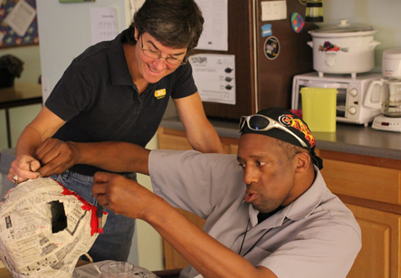
Direct Support Professionals (DSPs)
Direct Support Professionals play a CRITICAL role within the service system.
The role of the DSP is
To help with skills development
To provide prescribed support and supervision
To support people to learn new things
To ensure optimal health and safety
To help with upkeep of the person’s home to assure it is clean, safe, and hazard free
To support people with intellectual and developmental disabilities to experience the quality of life they desire

Slide 4
Challenges Faced by DSP Workforce
Demand for home-based care increases demand for quality DSP workforce; federal regulations impact further
Aging population also require direct support- competing for the same workers
High vacancy rates/turnover rates impact service delivery – staffing ratios, access, trust and delays in progress
High turnover rates: extra incurred costs to providers
Recruitment costs
Onboarding and Pre-Service Training
Additional costs associated with overtime

Slide 5
Data is needed to:
Assess state’s DSP workforce challenges and provide insight for potential improvement opportunities.
Ensure all providers and states are collecting data and calculating indicators (turnover, for example) in the same standardized way.
Create an opportunity for providers to speak in one, unified voice to the state DD system through these survey results.

Slide 6
State of the Workforce (SoTW) Survey:
WHY?
The challenges faced by the DSP workforce have ripple effects and impact the lives and work of:
  DSPs
  Provider agencies and staff
  People receiving supports and their families
With the NCI-IDD SoTW Survey:
Providers communicate their collective voice to the state
  Where have providers faced challenges related to the DSP workforce?
  Where might they be better supported?
This voice is used to make decisions about the future of the system

Slide 7
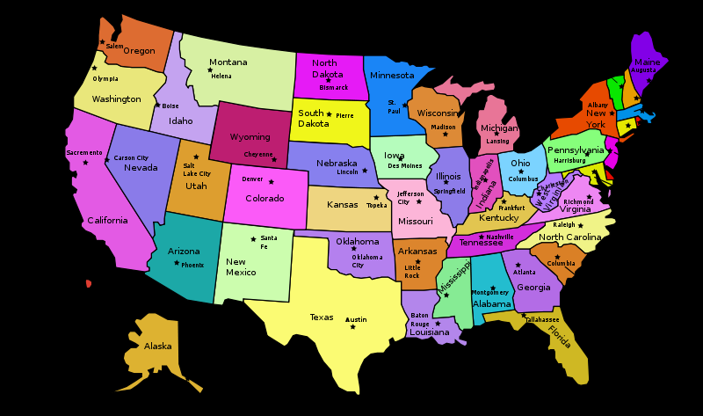


National NCI-IDD State of the Workforce in 2022: Survey Basics
29 States + DC
3,633 Provider Agencies
Estimate 276,000+ DSPs represented
NCI-IDD Avg. is weighted

Slide 8
North Dakota NCI-IDD State of the Workforce in 2022: Survey Basics
The DD Section maintains a current licensed provider list along with the services the providers are licensed to provide and their contact information. Based on this list, DD Section identified the providers who met the requirements for the survey of providing services to adults with intellectual and developmental disabilities.
Prior to the start of the survey, the DD Section sent communications to the provider CEOs which provided background information toward the survey, what to expect, and timelines. The participation in the survey was voluntary and the DD Section sent numerous communications to the provider CEOs as a whole and individually throughout the survey period to encourage participation, give remainders, and provide updates on the completion rate.
 | Valid responses | Total population | Response rate | Margin of Error
North Dakota | 19 | 34 | 55.9% | 15.16%

Slide 9
North Dakota DSP Workforce Demographics: Race/Ethnicity

Slide 10
North Dakota DSP Workforce Demographics: Gender Identity

Slide 11
North Dakota Agency Size Based on Number of DSPs on Dec. 31, 2022
1-20 DSPs
21-40 DSPs
41-60 DSPs
61+ DSPs

Slide 12
North Dakota Percentage of Agencies Turned Away or Stopped Accepting New Service Referrals due to DSP Staffing Issues
Number of provider agencies who responded in state (N)=19

Slide 13
North Dakota Turnover Ratios for DSPs as of Dec. 31, 2022
Number of provider agencies who responded in state (N)=19
State Minimum = 0%
State Maximum = 160%
Each agency’s turnover ratio is calculated as: (Total separated DSPs in past year) divided by (Total DSPs on payroll as of December 31, 2022). Notes: Agencies with turnover rates >= 500% were excluded from this analysis (3 agencies). Agencies were included if they reported the length of tenure of all DSPs reported employed as of 12/31/2022 (or left it blank). Agencies were included if they reported the length of tenure of all DSPs reported to have separated in 2022 (or left it blank)

Slide 14
North Dakota DSP Vacancy Rates as of Dec. 31, 2022

Slide 15
North Dakota Tenure Among Employed DSPs
DSPs on payroll statewide =2,497
Only includes agencies that provided information on both the total number of DSPs employed as of Dec. 31, 2022 and the tenure of those DSPs. State tenure rates are an average of all cases in the state. Only includes the number of DSPs reported by respondents that also reported the tenure of those DSPs.

Slide 16
North Dakota Tenure Among Separated DSPs
DSPs separated statewide =1,157
Only includes agencies that provided information on both the total number of DSPs employed as of Dec. 31, 2022 and the tenure of those DSPs. State tenure rates are an average of all cases in the state. Only includes the number of DSPs reported by respondents that also reported the tenure of those DSPs.

Slide 17
North Dakota Circumstances Under Which DSP Separation Occurred
Percentage of total separations between Jan. 1 and Dec. 31, 2022
“Termination”=Due to performance issues or violation of agency policy. “Laid off” =DSPs were terminated because their position was eliminated

Slide 18
Average Hourly Wage of All DSPs in North Dakota
$7.25/hr is federal minimum wage

Slide 19
North Dakota Agencies Providing Paid Time Off to DSPs

Slide 20
North Dakota Agency Benefits

Slide 21
North Dakota Agency Recruitment and Retention Strategies

Slide 22


To see the complete report, click
HERE

Slide 23


Developmental Disabilities Section
237 W. Divide Ave., Suite 1A
Bismarck, ND 58501-1208
Phone: 701.328.8930
Toll Free: 800.755.8529
E-mail: dhsddreq@nd.gov
https://www.hhs.nd.gov/dd
©2023 National Core Indicators .

