Slide 1

Vendor Training for Stores
Presented by:
Local agency coordinator
WIC Vendor Coordinator
Local agency
Prepared by: Kristi Miller, State WIC Vendor Coordinator

Slide 2
What is WIC?
WIC stands for Women, Infants
and Children.
WIC provides nutritious foods, nutrition education (including breastfeeding promotion and support),and referrals to health and other social services to participants at no charge.
WIC serves low-income pregnant, postpartum and breastfeeding women, infants and children up to age 5 who are at nutrition risk.

Slide 3

What is WIC?
WIC is a Federal program for which Congress authorizes specific funding each year for program operations.
The Food and Nutrition Service, which administers the program at the Federal level, provides these funds to WIC State agencies to pay for WIC foods, nutrition education, breastfeeding promotion and support, and administrative costs.
Currently national funding levels are approximately $7.5 billion annually with about 7 million participants being served each month.

Slide 4

North Dakota WIC Facts and What It Means For You
North Dakota WIC serves approximately 10,000 moms and children each month.
Over 20,000 EBT transactions transpire at local WIC authorized stores each month amounting to over $700,000.
  There are 20 WIC agencies across the state that provide services to families, and approximately 56 clinics

Slide 5
WIC Allowable Foods

Slide 6
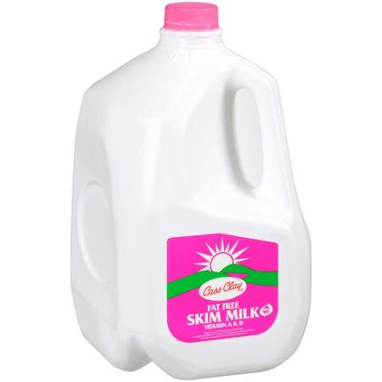
Milk
Gallons or half gallons (some products allowed in quarts)
Whole, 1%, skim, calcium fortified, cultured buttermilk, lactose free, non-fat dry milk powder, evaporated, Goat’s milk
Not allowed: 2%, extra protein, chocolate or flavored, almond, coconut, organic, rice or sweetened condensed milk.

Slide 7
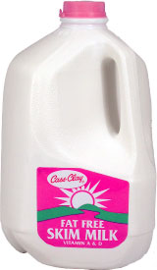
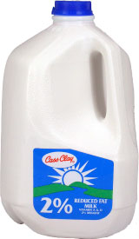
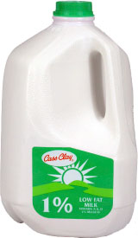
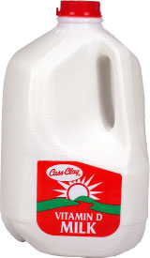
Which item is not a WIC food?

Slide 8
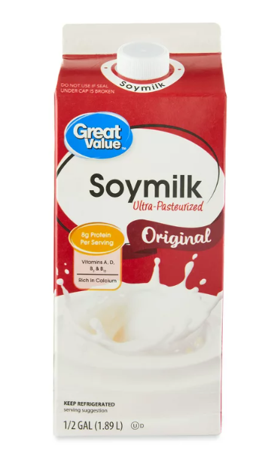
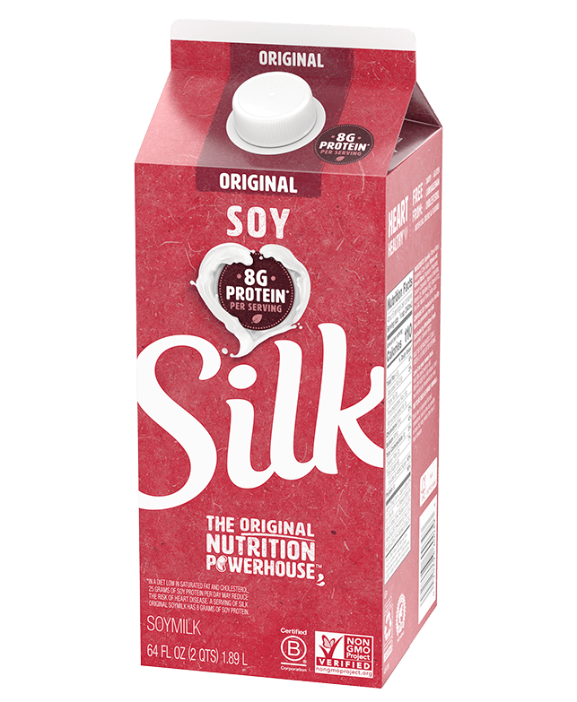
Soy Milk
Half gallons of Great Value or Silk – original flavor only
Not allowed: complete, organic, light, fat-free, chocolate or vanilla

Slide 9

Cheese
8 oz. or 16 oz. size, block or shredded, reduced fat allowed
American, any cheddar variety, Colby Jack, Colby, Swiss, Mozzarella, Marble Jack, Muenster, Provolone, Monterey Jack
String cheese also allowed – (individually wrapped allowed)
  Not allowed: Sliced, cubed, cheese foods, cream cheese, spreads. No Havarti, Gouda, or Farmer, Parmesan, Romano, Asiago and Asadero. No added ingredients, pepper jack, smoked or organic. No random weight or deli cheese

Slide 10
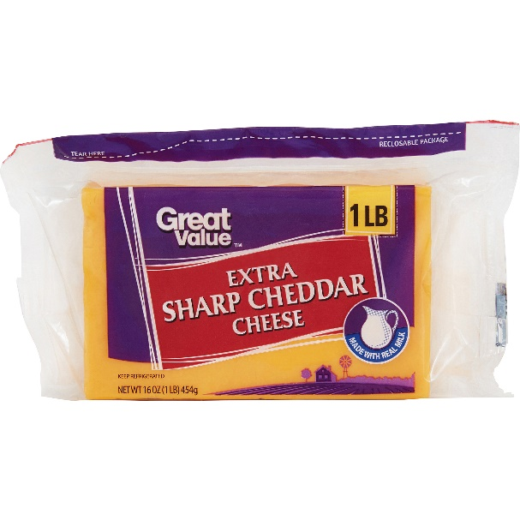
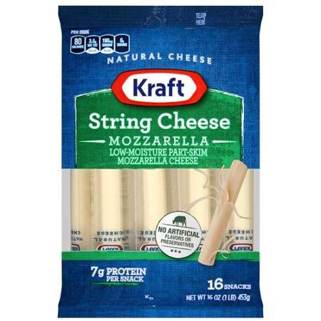
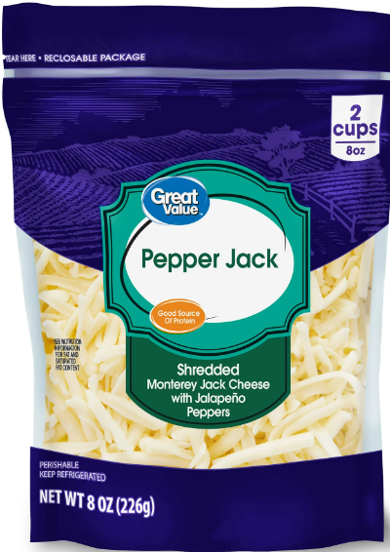
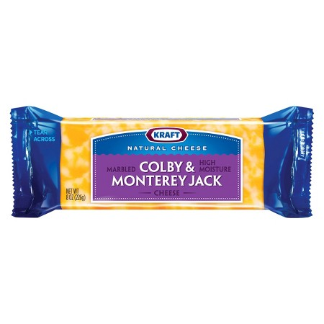
Which item is not a WIC food?

Slide 11
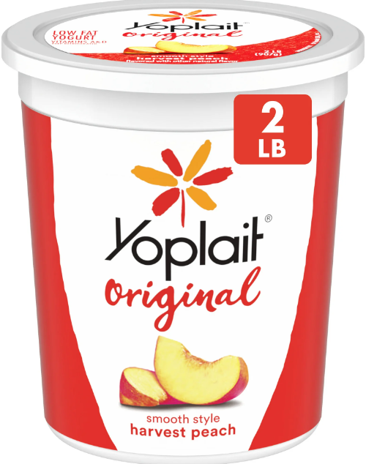
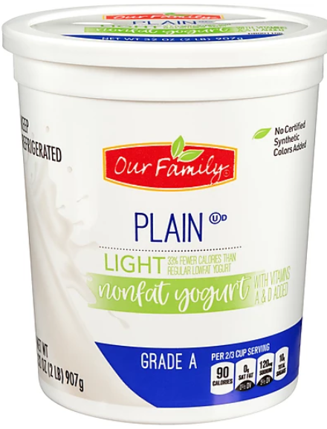

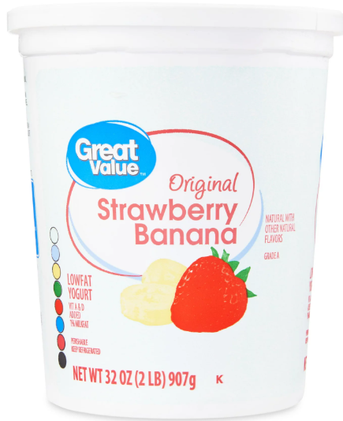
Yogurt
32oz containers only, light/low-fat/Non-fat (use food list for allowed brands/flavors)
Not allowed: Greek or organic

Slide 12
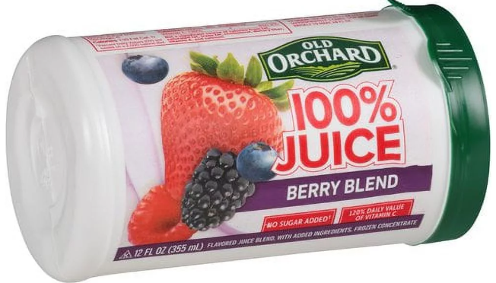
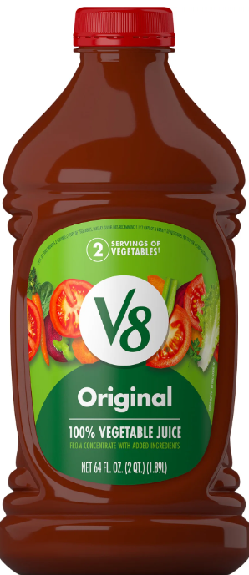
Juice
12 oz frozen concentrate – Apple, grape, orange, and any 100% Dole or Old Orchard juice. (see WIC food list for more specific information)
64 oz. plastic – Apple, pink grapefruit, pineapple, grape/white grape, orange, vegetable or tomato, and any 100% Juicy Juice or Old Orchard juice.
(see WIC food list for more specific
information)

Slide 13
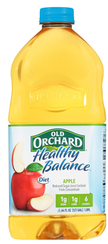
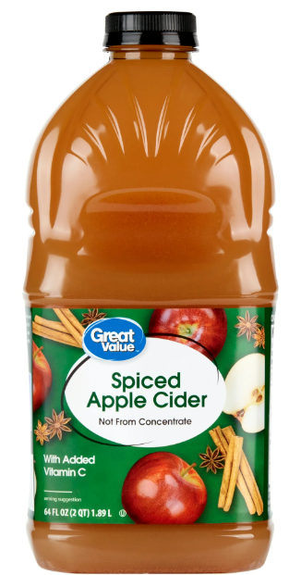
Juice
Must be 100% juice and at least 100% Vitamin C. Can be calcium-fortified.
Not allowed: No 46, 48, 96, or 128 oz. plastic containers. No 46 oz. cans. No organic, cocktails, apple cider, fresh pressed apple juice, fruit drinks, lemonade, prune, single servings or refrigerated.

Slide 14
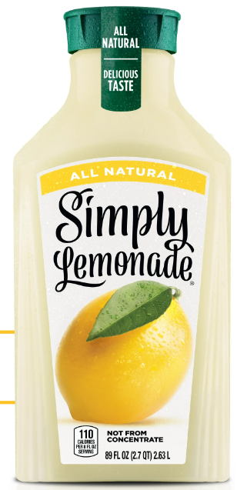
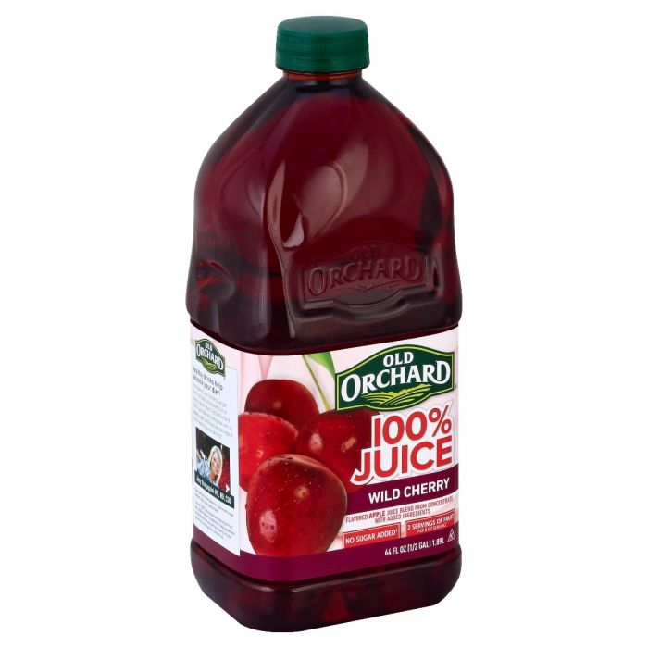
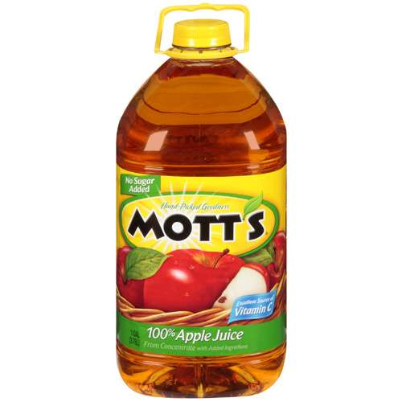

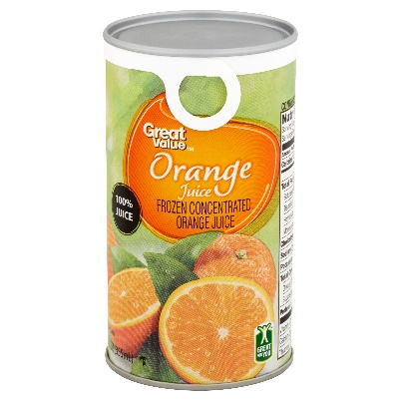
Which item(s) is not a WIC food?

Slide 15

Eggs
Fresh, one dozen package only – medium, large, extra large or jumbo; white or brown
Not allowed: organic, specialty or pasteurized

Slide 16
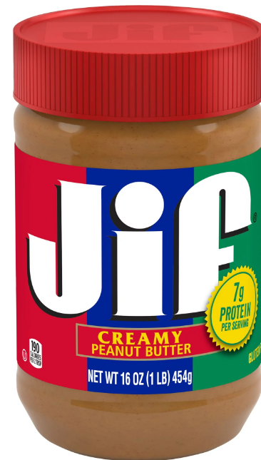
Peanut Butter
Jif, Peter Pan, Reese’s, Skippy or
any store brand
16-18 oz. jar
Creamy, crunchy, or chunky
Not allowed: No reduced fat, spreads, organic, natural, omega-3, or enhanced. No added chocolate, jelly, or honey, or marshmallow.

Slide 17
Fruits and Vegetables
Fresh only – no canned, jarred, dried or frozen
Any potatoes are allowed (Sweet potatoes and yams are also allowed)
No salad bar/deli items, pre-cut or packaged fruits and vegetables with dips or dressings, party trays, fruit baskets, decorative vegetables (gourds, pumpkins) and fruits.
No herbs and spices.

Slide 18
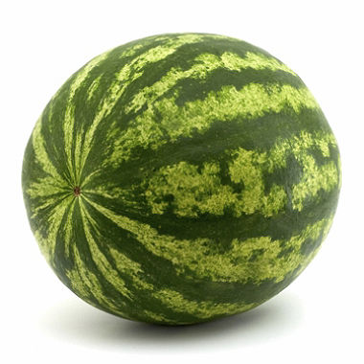
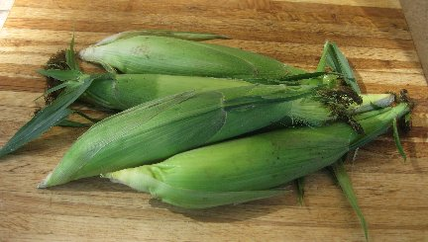
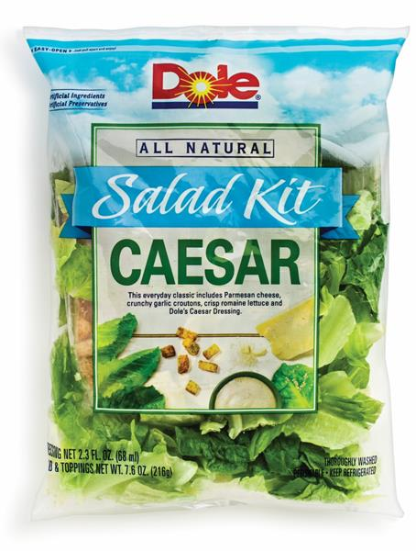
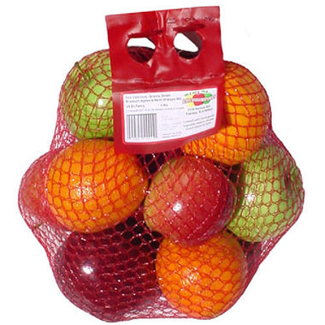
Which item is not a WIC food?

Slide 19
Cash Value Benefit (CVB)
The cash value benefit is a dollar amount of fruits and vegetables that are allowed each month. Participants may purchase any fresh fruits/vegetables (exceptions are noted on the Food list) up to the amount on their food balance.

Slide 20

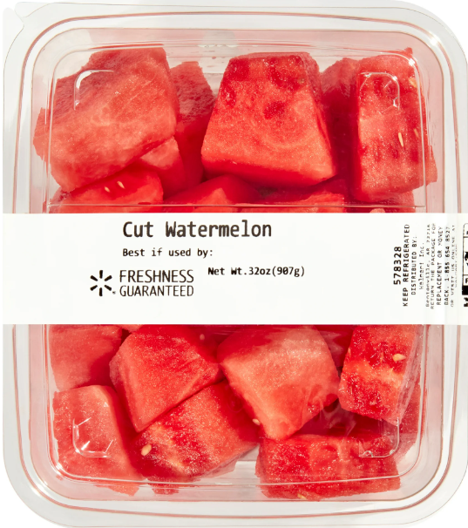
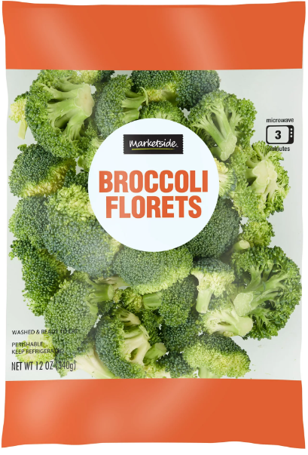


Cash Value Benefit (CVB)
Participant MAY pay the difference if the total amount goes over the maximum value of the CVB
Participant may pay the difference in cash, check, Food Stamps(SNAP),etc.
Scales – does your store have?

Slide 21
Cold Cereals – 12 oz. or larger
General Mills: Kix, Cheerios, Multi-Grain Cheerios, Total Whole Grain, Corn Chex, Rice Chex, Wheat Chex
Kellogg’s: Frosted Mini Wheats (Original + Bite size), Crispix, Corn Flakes, Rice Krispies
  Post: Grape-Nuts, Grape-Nut Flakes, Honey Bunches of Oats, Bran Flakes
  Quaker: Life, Oatmeal Squares
  Malt O Meal: Frosted Mini Spooners, Crispy Rice
  Store brands also available – see WIC Food List

Slide 22
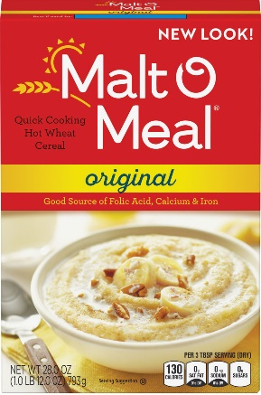
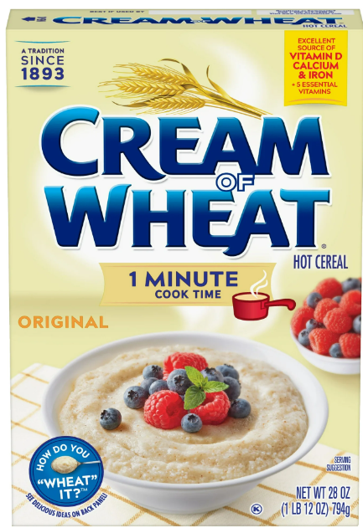
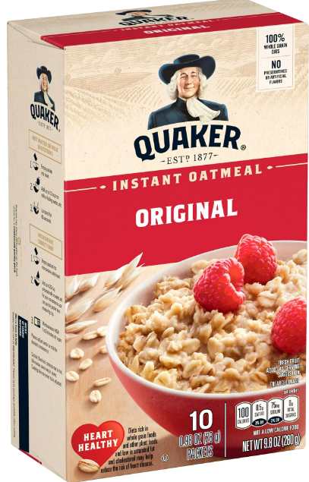
Hot Cereals
Quaker Instant Oatmeal (9.8oz) – original only, packets only (Store brands also available – see WIC Food List) (exception to 12 oz rule)
Malt O Meal – plain (original) or chocolate
Cream of Wheat (1 min, 2 ½ min) and Instant

Slide 23
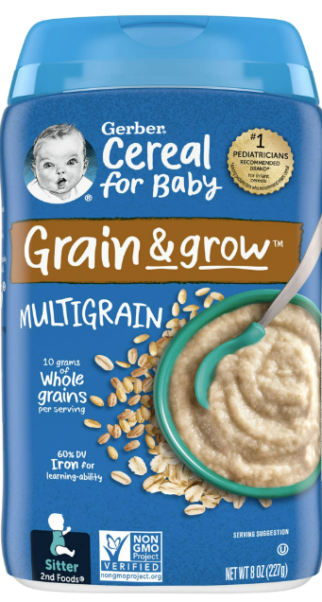
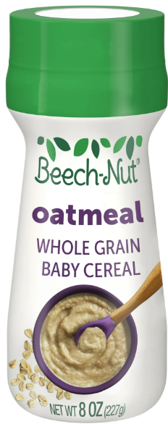
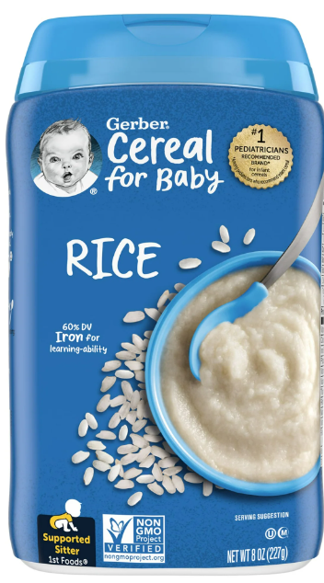
Infant Cereal
8 or 16 oz. container
Rice, oatmeal, multigrain, whole wheat
Not allowed: No added fruit or formula, organic, sensitive, or DHA

Slide 24



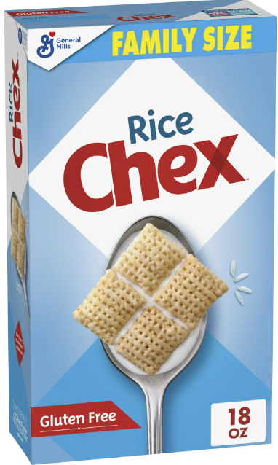
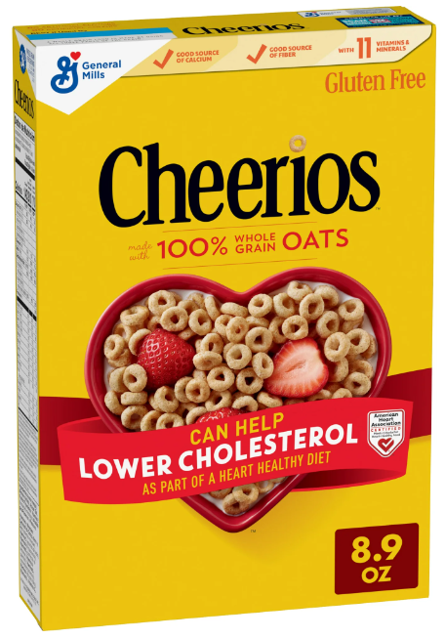
Which item(s) is not a WIC food?

Slide 25
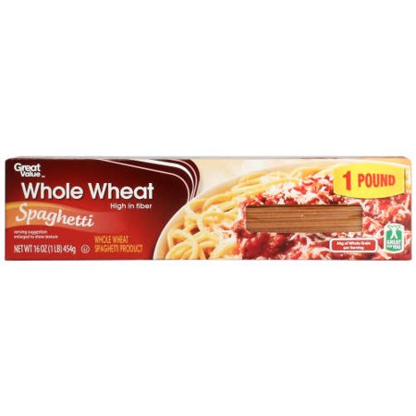
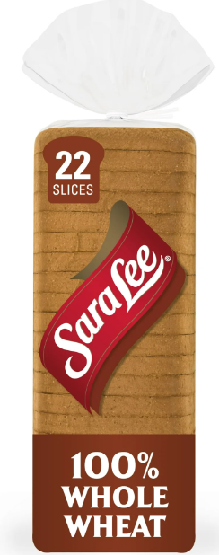
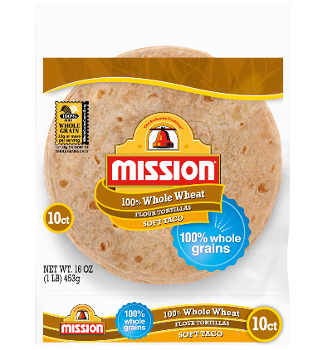
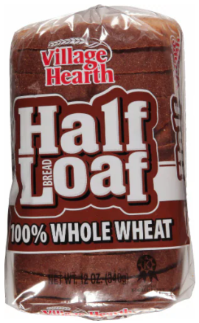
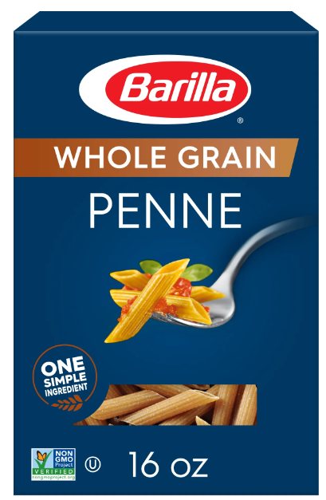
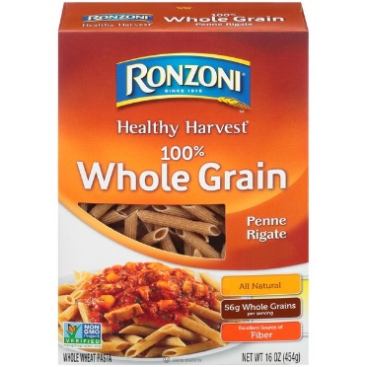
Whole Grains – Breads, Tortillas, Pasta
Whole wheat/grain as primary ingredient
Amount given will be 1 lb. (16oz) or 2 lbs. (32oz).
Breads/buns, tortillas, and pasta are brand specific – see the WIC food list

Slide 26
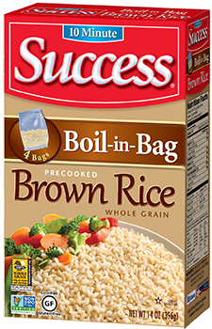
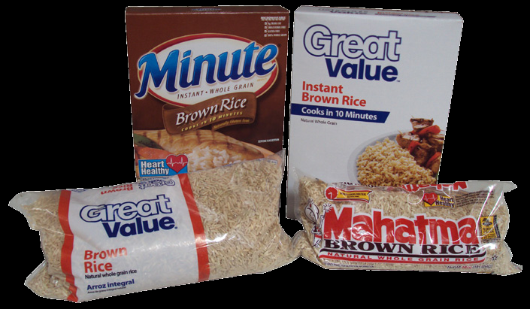
Whole Grains – Brown Rice
Must be plain, whole grain
Bagged or boxed – Boil in bag and instant allowed
Not allowed: No Ben’s original, wild rice, blends, ready rice, or organic

Slide 27
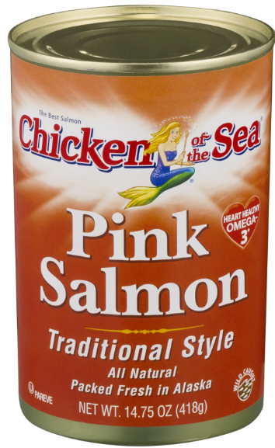
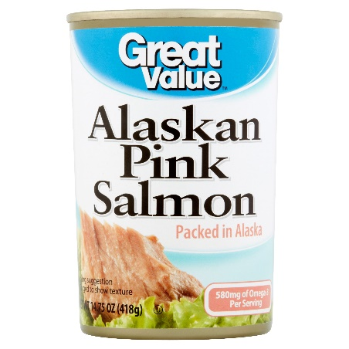
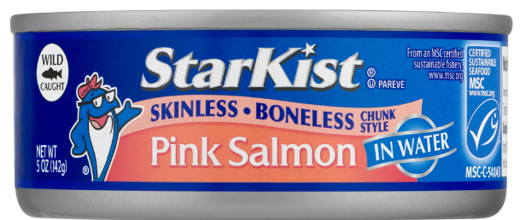
Pink Salmon
  May be packed in water or oil; may include bones or skin and regular or lower in sodium content
  5 or 14.75 oz can
  No red sockeye, smoked, individual serving, pouches, or organic

Slide 28
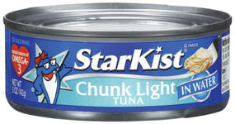
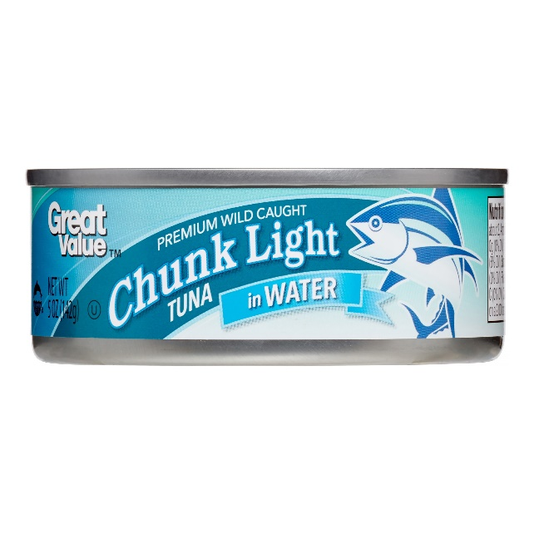

Tuna
Chunk light tuna
5 oz. can, water or oil packed
Not allowed: No organic, albacore, yellowfin, Starkist Selects, individual serving or pouches

Slide 29

Dry Beans, Peas or Lentils
1 or 2 lb. size
Any variety of plain beans, peas or lentils
Not allowed: No baked beans, green beans, sweet peas, chili beans, wax beans, pork and beans, bean mixes/soups or organic. No added sugars, fats, meats or oils

Slide 30

Canned Beans
  15-16 oz cans
  Any variety of plain beans, peas or lentils
  Refried beans (Fat free only)
  No baked beans, green beans, sweet peas, chili beans, waxed beans, pork and beans, or organic.
  No added
  sugars, fats,
  or oils.

Slide 31



Baby Food
Stage 1, 2, 1st or 2nd foods or Intro Foods
Single ingredient only
4 oz. glass jars; 2 or 4 oz. plastic 2 packs (see Food list for brands)
No organics, pouches, dinners, combinations (ex. apple blueberry), or 3rd foods
Meats – in broth or gravy
Babies will get 32 jars (64 jars if exclusively BF)

Slide 32










Slide 33




Infant Formula
Brand and size as indicated on the Food List
No rainchecks, substitutions, returns, or exchanges are allowed
  Only exception is if the product is recalled, spoiled or damaged
  Does your store allow formula returns for customers?

Slide 34

2024 WIC Food List (as of November 1, 2024)
Food lists are updated yearly- the green one is the most recent

Slide 35

EBT card
WIC participants are issued an eWIC card to purchase their WIC foods at the store.
This card has a mag stripe and contains an account that includes what food items and quantities are available to purchase.
These foods remain in their account until the last day of the month and if not spent, drop off
If the participant is using other means of payment, the eWIC card should always be swiped first

Slide 36

EBT card
The participant will have a PIN to enter at checkout
You do not need to check their ID as the PIN functions as a verification
The WIC participant should get all receipts (beginning balance, mid transaction and ending balance receipts) that your POS produces
You should be able to perform a Balance Inquiry, Purchase and Void for eWIC

Slide 37

WIC Store Sign
All Stores should have a WIC store sign

Slide 38


WIC Shopper app
App for WIC participants, but can also be used by stores
Install the WIC Shopper app from your app store
You can scan bar codes to see if products are eligible (exception – does not work with produce items)
Can report items not ringing up as WIC under “I couldn’t buy this”
    Do not report produce items here - you are responsible for mapping those items

Slide 39

APL
The WIC APL (Approved Product List) is a file that contains all the UPC’s and PLU’s of the authorized WIC items for ND WIC.
This list is available for download each night and should be obtained nightly.
The APL changes weekly so it is important to pick up the APL often so participants can get the correct food items.

Slide 40

Mapping produce
It is the store’s responsibility to map their produce items.
It is not possible for WIC to keep up with the 1000’s of new produce items that come into each store, so new produce items or items your store may package – (ex. Cut up fruits/vegetables) need to be mapped
If you need assistance mapping, reach out to your POS provider or Corporate contact that are experts on your store’s POS system.

Slide 41
Minimum Stocking Requirements
Separate requirements for large stores vs. small stores
Both minimum quantity and variety
There is a waiver available if no infants are in the service area
  Infant formula
  Infant cereal
  Baby food

Slide 42

Minimum Stock – Large stores

Slide 43

Minimum Stock – Large stores

Slide 44

Minimum Stock – Large stores

Slide 45

Minimum Stock – Large stores

Slide 46

Minimum Stock – Small stores

Slide 47

Minimum Stock – Small stores

Slide 48

Minimum Stock – Small stores

Slide 49

Minimum Stock – Small stores

Slide 50
Waiver for infants
** Request for Waiver
Stores may request a waiver from stocking infant items (Infant formula, cereal, or baby food) if there is not an infant in the service area that would be purchasing these items. The waiver may be requested from the local WIC office. If an infant comes into the service area and needs these items, the store must obtain these items within 48-72 hours and the waiver becomes null and void.

Slide 51

Sanctions – Mandatory vs. State
Mandatory sanctions – Part of federal regulations
  These sanctions are more serious violations and can result in disqualifications for 1,3, or 6 years or permanently from the WIC Program –see your Vendor contract for more information
State Agency sanctions – Specific to the North Dakota WIC Program
  These sanctions are not quite as serious, but sanction points are accumulated from these that can result in additional training needed or 3 or 6 month or 1 year disqualifications from the Program – see your Vendor contract for more information

Slide 52
Mandatory Sanctions
The WIC State Agency may disqualify a vendor or impose a civil money penalty in lieu of disqualification for reasons of program abuse. The vendor will be provided with prior warning that violations were occurring (for those requiring a pattern of incidence) before imposing any of the sanctions described.
The WIC State Agency shall disqualify a vendor who has been disqualified from the Food Stamp (SNAP)Program. The disqualification shall be the same length of time as the Food Stamp (SNAP)disqualification. Disqualification from the WIC Program may result in disqualification as a retailer in the Food Stamp Program.

Slide 53
State Agency Sanctions
State Agency Point System
5-9 points = noncompliance letter (explains violation(s) committed and offers suggestions for fixing)
10-13 points = additional training required focusing on violation(s)
14-16 points = three month disqualification
17-19 points = six month disqualification
20 or more points = 1 year disqualification

Slide 54
State Agency Sanctions

Slide 55

Vendor Complaint Process
Vendors authorized with the North Dakota WIC Program have the right to voice a complaint with any situation involving a transaction with a participant, or a general complaint about the Program. Vendors are encouraged to call their Local WIC Office, or can contact the State Vendor Coordinator at the State WIC Office at (701) 328-2496, with any concerns.

Slide 56

Vendor Claims Procedures
eWIC transactions happen in real time at the store and are processed immediately. Once the participant swipes their eWIC card, the request for payment is sent directly to WIC’s MIS and eWIC host system.
Once a day, the eWIC host system determines the net Settlement amount due to each retailer minus any reversals, voids or NTE overages.

Slide 57

Vendor Claims Procedures
If the eWIC transaction occurs prior to 6:00 pm CST, the processing day funds will be distributed the next bank day (Monday-Friday).
If the transaction occurs after 6:00 pm CST, it will process with the transactions the following day, and payment will be distributed the following bank day.
For transactions occurring on a Friday, Saturday, or Sunday, payment will be distributed the following Monday (as long as banks are open).

Slide 58
Vendor Claims Procedures
The state agency has the option of delaying payment or establishing a claim on eWIC transactions that contain errors or overcharges or if it is determined that the vendor has committed a vendor violation. The state agency must provide the vendor with an opportunity to justify or correct the error. If the state agency is satisfied with the correction or justification, payment will be provided or the proposed claim should be adjusted accordingly.
The State agency must deny payment or initiate claims collection action within 90 days of either the date of detection of the vendor violation or the completion of the review or investigation giving rise to the claim, whichever is later. Claims collection action may include offset against current and subsequent amounts owed to the vendor.
An authorized vendor may dispute a claim or transaction payment that has been reduced. This must be submitted to dohewic@nd.gov as soon as it is discovered. There is no guarantee that dispute requests will be approved by the ND WIC Program

Slide 59

Price Surveys
We conduct price surveys on an on-going basis as required by WIC regulations.
Please fill these out and return to your local WIC office.
Very important to return these so that your prices get calculated into the averages for your peer group

Slide 60

Infant Formula Wholesaler
Infant formula needs to be purchased from a reputable source – which may include a wholesaler or another store
We are required to identify this information for each WIC authorized store.

Slide 61
Incentive Items
WIC regulations requires WIC-authorized vendors to offer WIC customers the same courtesies that are offered to other (non-WIC) customers.
WIC-authorized vendors may not treat WIC customers differently from non-WIC customers by excluding them from in-store promotions-this includes disallowing the use of coupons or other vendor discounts in WIC transactions that are allowed in non-WIC transactions.
Similarly, WIC-authorized vendors may not treat WIC customers differently by offering them incentive items, vendor discounts, coupons or other promotions that are not offered to non-WIC customers.
Cash back is not permitted as a result of vendor discounts in any WIC transaction.

Slide 62
Vendor Discounts/Promotions
The most common types of discounts and promotions include:
BOGO – Buy one, get one free:
  The WIC-authorized vendor sells one WIC food item and provides a second identical food item or a different item at no additional cost. Ex. - A vendor offers a free box of cereal with each box of cereal that is purchased. Using a BOGO promotion allows WIC participants to get additional quantities of WIC foods or non-WIC items at no cost. If the free item in a buy one, get one free promotion is a WIC food item, it should not be deducted from the participant's WIC benefits.

Slide 63
Vendor Discounts/Promotions
Buy One, Get One at a Reduced Price
  The WIC vendor sells one WIC food item at full price and sells either a second identical WIC food item or a different food item at a reduced price. Ex. A vendor offers a half price box of cereal with each box of cereal that is purchased at regular price. In a transaction that only includes WIC items, this discount type only applies when the second, reduced price item is a WIC food item and the participant has the item in his or her benefits balance.
Free Ounces Added to Food Item by Manufacturer (Bonus Size Items)
  A food manufacturer adds extra ounces to a product at no extra cost to the consumer. Ex. -instead of offering 16 oz. of cereal in a box, a manufacturer may temporarily offer a bonus size 18 oz. box of cereal at the same price.
Transaction Discounts
  This would be either a fixed amount discount or a discount % to the total dollar amount of the purchase. Ex. - the offer may be for $10 off or 10% off when $50 or more in groceries are purchased.

Slide 64
Vendor Discounts/Promotions
Store Loyalty/Rewards Cards
  WIC-authorized vendors may provide a card or token that provides additional vendor discounts for frequent or regular customers. WIC participants are not required to use loyalty/rewards cards, nor are WIC authorized vendors required to scan a "dummy" card for WIC participants who do not have their own cards. These vendor discounts should be processed by vendors as outlined above, according to type.
Manufacturers' Cents Off Coupons
  Manufacturers' cents off coupons allow customers to purchase certain items at a lower price. Ex. - A coupon may offer a price discount of 50 cents off a box of cereal. In a transaction that only includes WIC items, the value of the coupon would be applied to the WIC transaction.

Slide 65
Resources/Training materials
WIC Vendor video
WIC Food List
WIC Shopper app
Training Presentation
Employee Training Checklist
WIC website: https://www.hhs.nd.gov/food-programs/WIC
Local WIC staff
State office

Slide 66
Questions from today’s training???
Please contact for any future concerns or questions:
Your name – Local WIC program
phone number Or
Kristi Miller (Bismarck)
ND WIC Vendor Coordinator
at 701-328-2496 or toll-free at
1-800-472-2286

Slide 67
Thank you for attending!!

