Slide 1
The Social Determinants of Health
Health Care Committee
Tuesday, July 30, 2019
Presented by:
Krissie Guerard, MS
Health Equity Director

Slide 2
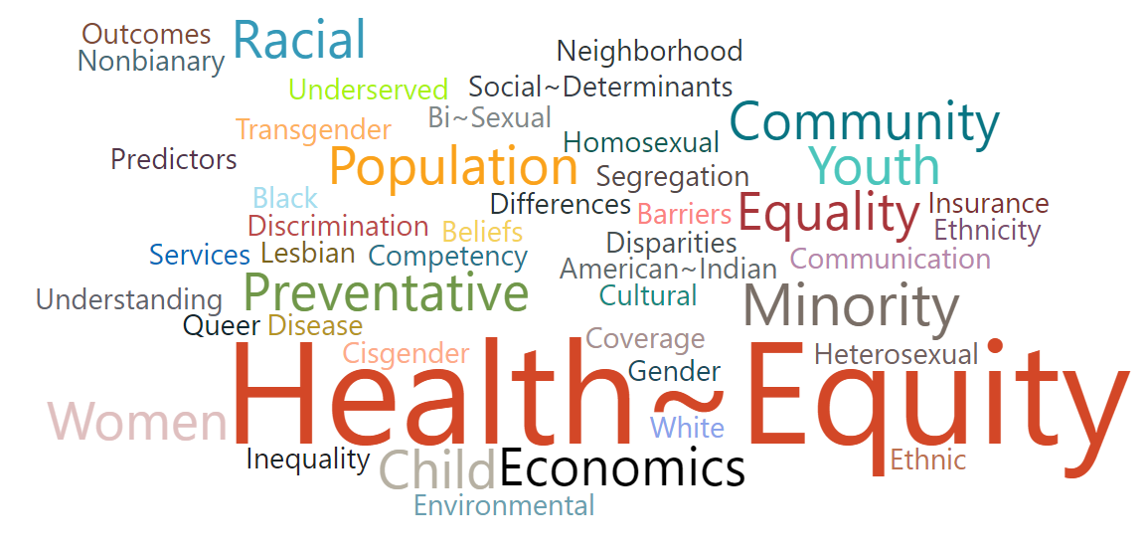

Slide 3
Objectives
To Understand:
The Social Determinants of Health
The Difference Between Health Equity and Health Equality
Health in All Policies
What the North Dakota Department of Health is doing related to the Social Determinants of Health and Health Equity

Slide 4
What are the social determinants of health?

Slide 5
Social determinants of health
In the United States:
1.5 million individuals experience homelessness
3.6 million people can’t access medical care due to lack of transportation
40 million people face hunger
11.8% of households are food insecure
Data Sources:
County Health Rankings: http://www.countyhealthrankings.org/county-health-rankings-model
American Hospital Association: https://www.aha.org/addressing-social-determinants-health-presentation
Social determinants of health are the circumstances in which people are born, grow up, live, work and age, and the systems that are put into place to address illness.
Notes:
**Food insecurity is the limited or uncertain availability of nutritionally adequate and safe foods or limited or uncertain ability to acquire acceptable foods in socially acceptable ways.

Slide 6
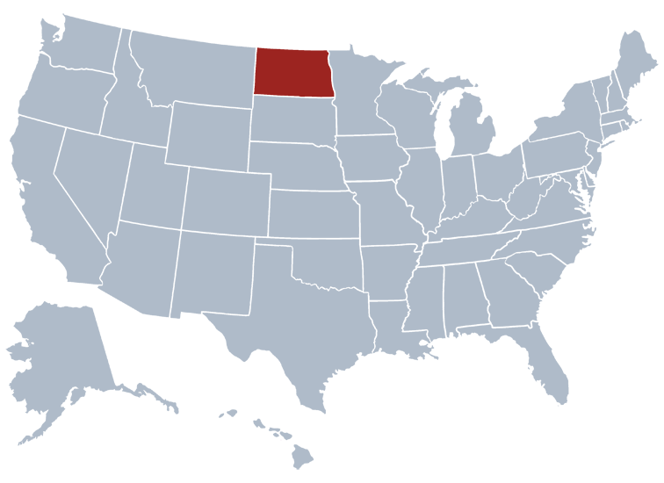
In North Dakota:
As of January 2018, ND had an estimated 542 individuals experiencing homelessness on any given day
22.8% of households were cost-burdened in 2017
In 2018, 8% of North Dakotans were uninsured
28,700 North Dakotans faced hunger (16,130 children) from 2015 to 2017
9% of households were food insecure from 2015 to 2017
Sources:
United States Interagency Council on Homelessness: https://www.usich.gov/homelessness-statistics/nd/
U.S. Census Bureau, Decennial Census and American Community Survey (2017): https://www.census.gov/programs-surveys/acs/
Creating a Hunger Free North Dakota: http://www.hungerfreend.org/
Notes:
**A household is considered housing cost-burdened when 30% or more of its monthly gross income is dedicated to housing. Individuals and families whose housing costs exceed their threshold of affordability are likely to struggle to pay for other basic needs, forcing difficult trade-offs.

Slide 7
Social determinants of health: why are they important?
20% of a person’s health and well-being is related to access to care and quality of services
The social determinants of health, physical environment and behavioral factors drive 80% of health outcomes.
Data Sources:
County Health Rankings: http://www.countyhealthrankings.org/county-health-rankings-model
American Hospital Association: https://www.icsi.org/_asset/w6zn9x/solvcomplexproblems.pdf
Social determinants of health have tremendous affect on an individual’s health regardless of age, race or ethnicity.
Notes:
Only 20% of an individual’s health is tied to clinical care, which includes access to and quality of health care services. 80% of an individual’s health is tied to their physical environment, social determinants – where you live, work and play – and behavioral factors – including exercise or smoking.
More specifically, that 80% can be broken down as follows:
Roughly 40% is attributed to socio-economic factors
10% to physical environment
30% to health behaviors

Slide 8
Notes:
**According to the CDC, population health is defined as the health outcomes of a group of individuals, including the distribution of such outcomes within the group.

Slide 9
Health equity AND Health equality
Notes:
Video can be found at http://www.ndhealth.gov/heo/Trainings.htm

Slide 10
Notes:
This picture describes four individuals of different heights or circumstance attempting to ride a bike. In order to treat them equally, they would all be given the same size bike to ride. However, doing so wouldn't necessarily allow each of the individuals to ride a bike. In order to give equitable treatment, each person would need to be given a bike that would allow them to ride for whatever there needs are.

Slide 11
Health in all policies
Notes:
Video can be found at https://www.youtube.com/watch?v=thYj8AlB3ms

Slide 12
Health in all policies
A collaborative approach to improving the health of all people by incorporating health considerations into decision-making across sectors and policy areas.
An approach to addressing the social determinants of health that are the key drivers of health outcomes and health inequities.

Slide 13
What is the North Dakota Department of Health Doing?

Slide 14
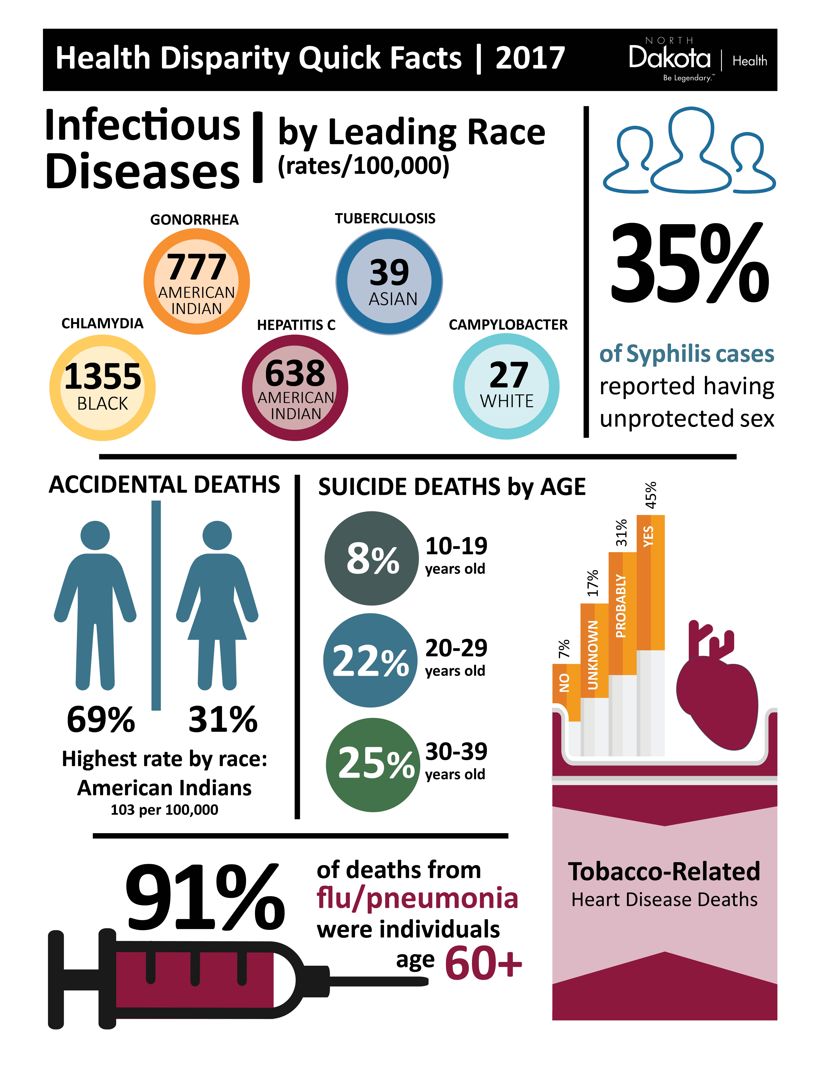
Health Equity Director
Health Disparities Report
Health Equity/Social Determinates of Health: an overarching principal of the Department’s Strategic Plan
Boundary Spanning Braiding and Layering
Notes:
Health Disparities Report can be found at http://www.ndhealth.gov/heo/Publications/Health_Equity_Report.pdf

Slide 15
Trainings
Media Campaigns
Main Street Initiative Summit
Community Collaborations
Health Equity Committee
Work- As-One Needs Assessment Integration
Notes:
Health Impact Symposium can be found at https://www.youtube.com/watch?v=6N3rKMy8d1Y&feature=youtu.be&fbclid=IwAR20dt2TsnF2da7GNZ6x2bUMmWp2jcckibBz9wSsuDo92n_cBQXNsfalJBg

Slide 16
TEAM ND
VALUES
Health Equity

Slide 17
Questions
Krissie Guerard, MS
Health Equity Director
North Dakota Department of Health
Email: kguerard@nd.gov
Phone: 701-328-4528
Website:
www.ndhealth.gov/heo

