Slide 1
How to Complete a Training
Grant Application in PRS

Slide 2
Go to the Program Reporting System (PRS)
https://secure.apps.nd.gov/doh/prs/Security/LoginForm/LoginForm?ReturnUrl=%2fdoh%2fprs%2f
Add to Your Favorites

Slide 3
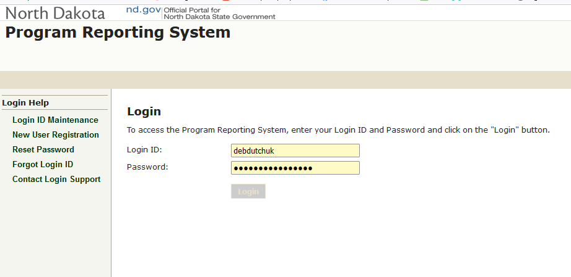
Step 1. Enter in Your Login ID and Password

Slide 4
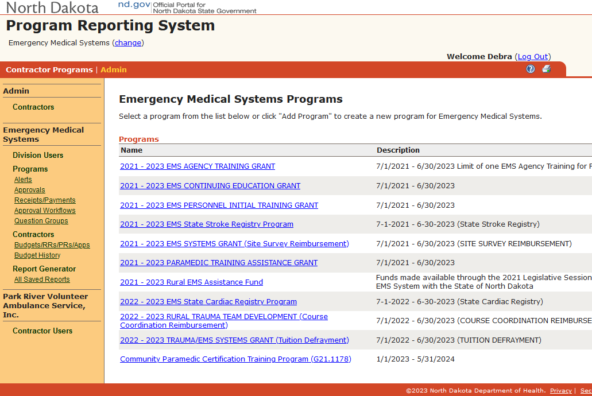
Step 2. Click on “ Contractor Programs”

Slide 5
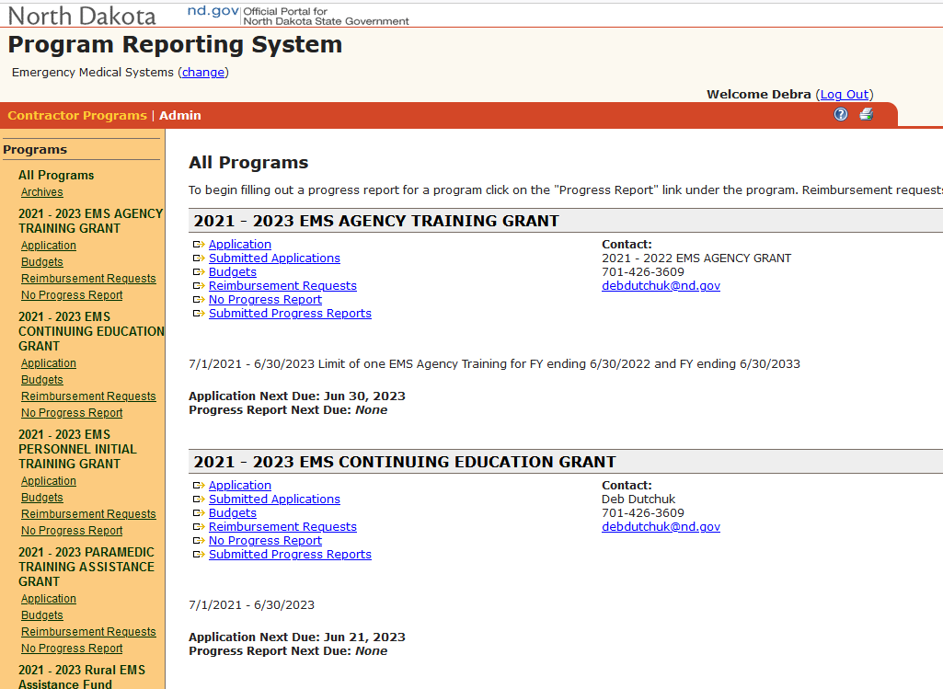
Step 3. Click on “Application”

Slide 6
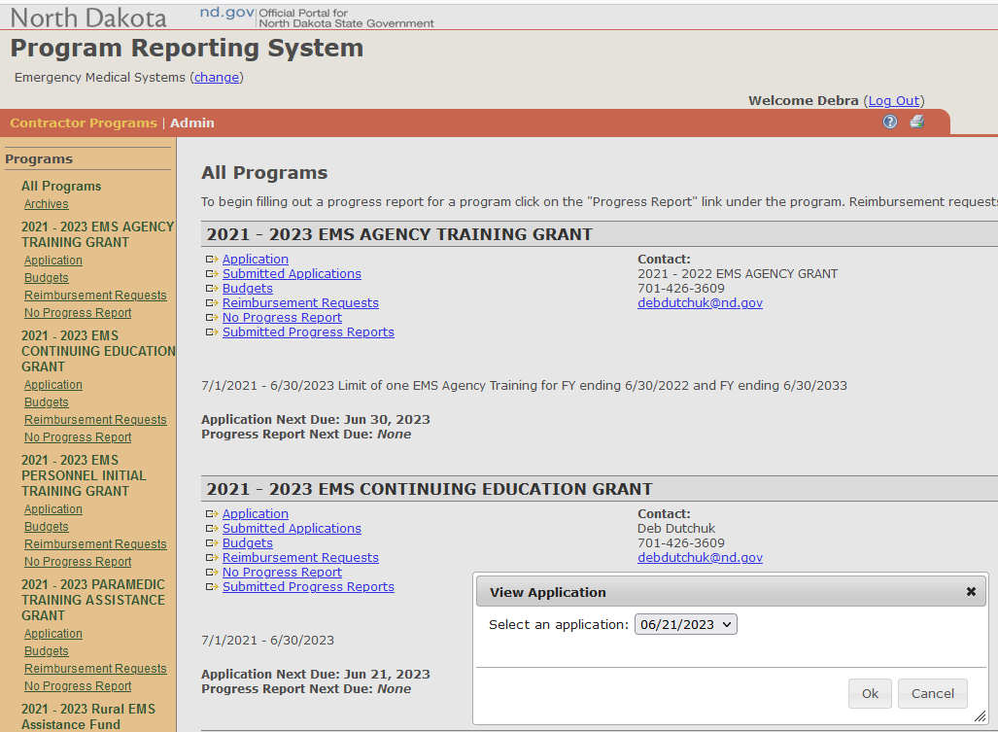
Step 4. Click on the drop-down arrow and select the earliest date listed. Click “Ok”

Slide 7
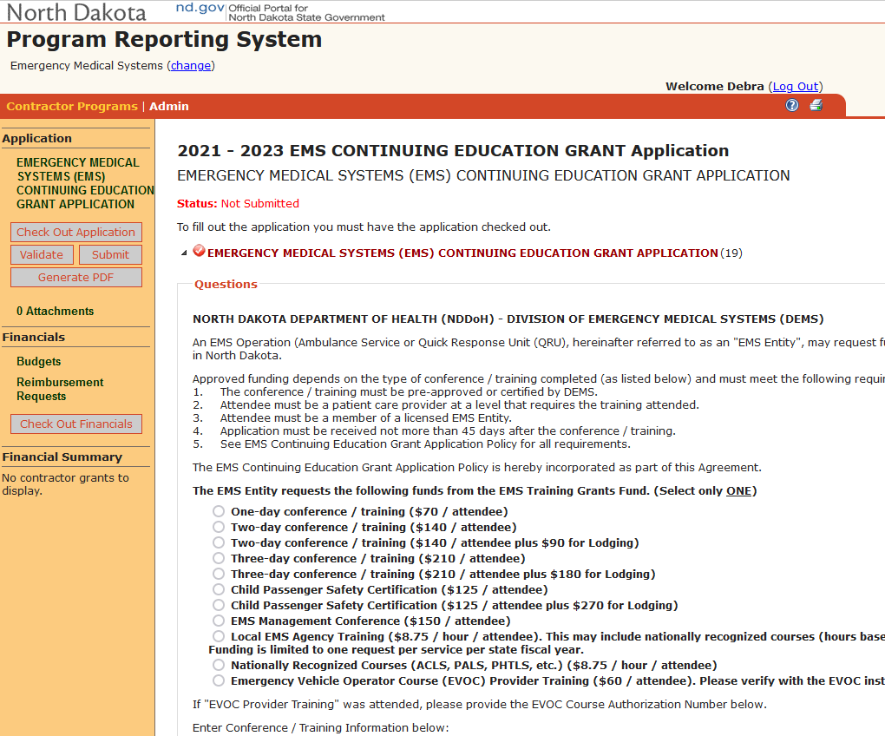
Step 5. See left side of the screen. Click on the
“Check Out Application” button.

Slide 8
Step 6. Complete the information in the application.

Slide 9
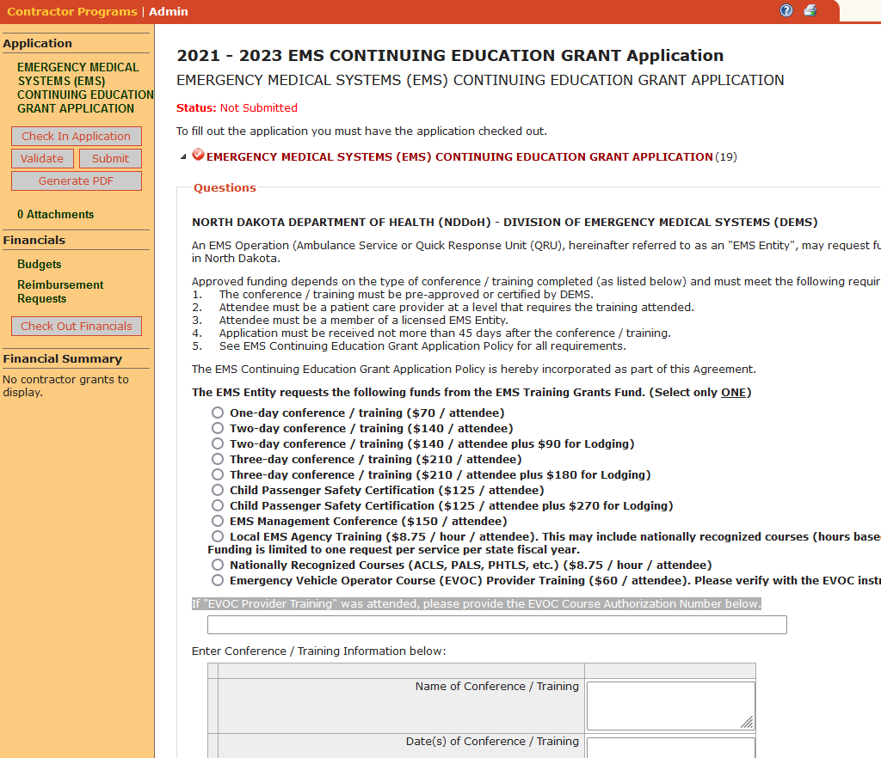

Slide 10
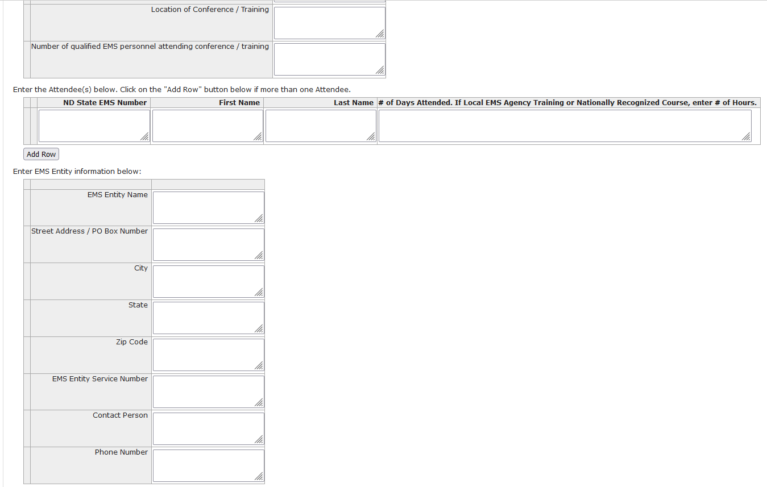

Slide 11
Step 7. Click the “Save” button on the bottom of the page.

Slide 12
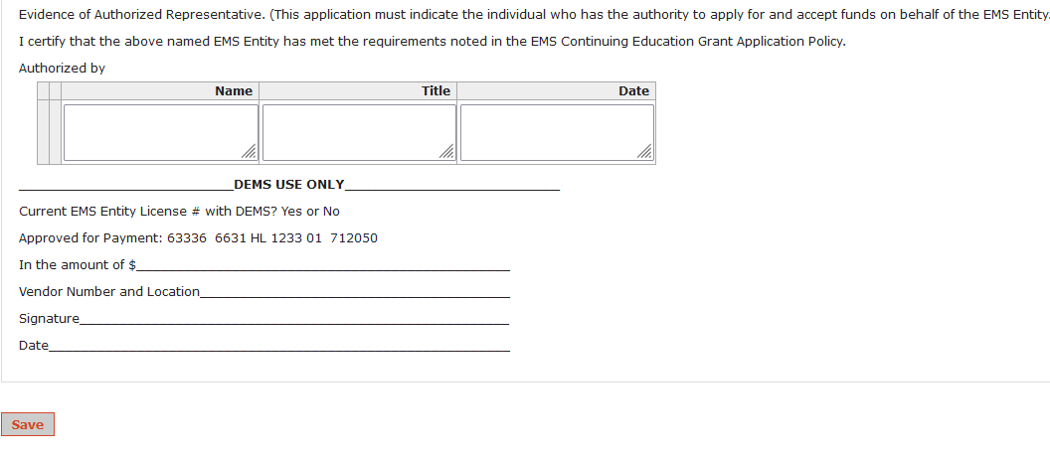

Slide 13
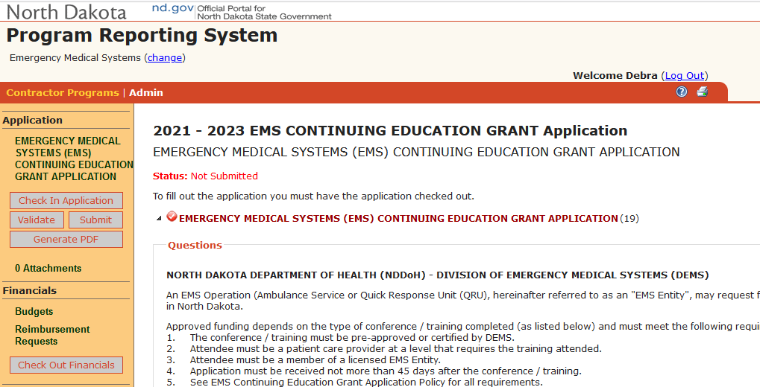
Step 8. If you need to attach a document, click
“Attachments” below “Generate PDF” button

Slide 14
Click on the “ Add Attachment” button.
Click on the “ Browse…” button to locate the
document to attach.
Once you have located the document click on
the document and click on the “Open” button Click “OK” button.
If you have completed the application, Click the “Save” button on the bottom of the page.

Slide 15
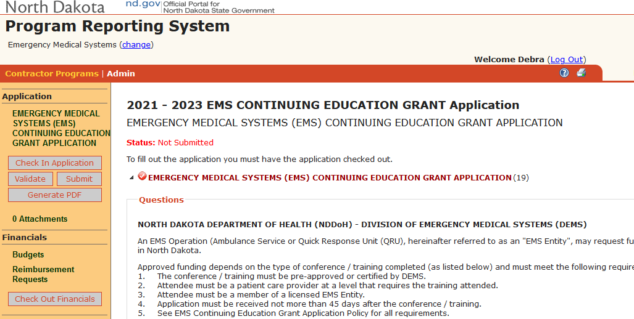
Step 9. See left side of the screen. Click on the “Check in Application” button.

Slide 16
Step 10. See left side of the screen. Click on the “Validate” button.

Slide 17
By clicking the “Validate” button the system will determine if there are any questions that are required to be answered. If no questions are shown, you are ready to submit the application.

Slide 18
Step 11.
Once you are ready to submit the
application make sure that the “Check Out Application” button is displayed on the left side of the screen.
If the “Check In Application” button is displayed, click on the button.
When you are ready to submit the application, click on the “Submit” button.

Slide 19
Step 12. Click on the “Generate PDF” button if you want a printout.
Note: A copy of the report is stored in PRS
and may be accessed at any time.
Step 13. Click on the “Log Out” link located
next to your name to exit PRS.

Slide 20
Questions?

