Slide 1
2018 National Diabetes Prevention Program Standards: A Quick Guide Reference
Adapted from: university of Minnesota extension community of practice call. 4.20.18

Slide 2
Objectives
Learn about the 2018 CDC Standards and Operating Procedures.

Slide 3
Participant eligibility
18 years of age or older
BMI ≥ 25 kg/m² , ≥ 23kg/m² if Asian American
A recent blood test (within the past year)
FBG of 100-125 mg/dl
2 hour plasma glucose of 140-199 mg/dl
A1c of 5.7-6.4
Positive screening based on CDC/ADA risk tests
Cannot have a diagnosis of type 1 or type 2 diabetes

Slide 4
Make-up sessions
Can be delivered in any delivery mode.
Only one make-up session per week.
Can be held on the same day as class.
Content and length should be comparable to regular session.

Slide 5
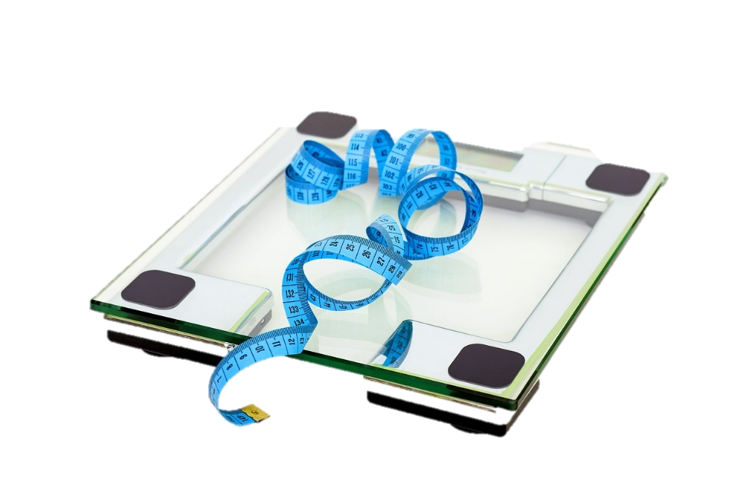
Make-up sessions
Weight recorded should reflect the participant weight on the date of the session make-up.
Example:
Class missed on 4/3.
Session make-up on 4/8.
Weight recorded should reflect weight on 4/8.

Slide 6
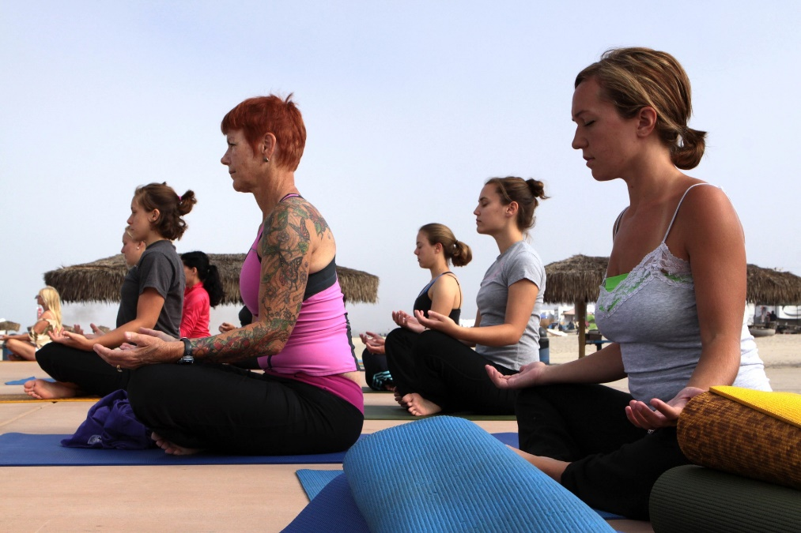
Make-up sessions
Physical activity minutes recorded at make-up session should reflect the number of minutes logged for the week preceding the missed session.

Slide 7
Recognition changes
60% of participants need to attend at least 9 sessions in months 1-6.
60% of participants need to attend at least 3 sessions in months 7-12.

Slide 8
Recognition – session attendance
Participants who have attended at least 3 sessions in months 1-6 and whose time from first session attended to last session of the lifestyle change program was at least 9 months are included in recognition evaluation.

Slide 9
Recognition – body weight
Participants must have body weight documented during at least 80% of the sessions.

Slide 10
Recognition – physical activity
Physical activity minutes must be documented for 60% of sessions.
Zero minutes reported will not count as documented PA minutes.

Slide 11
Recognition – weight loss achieved
Average weight loss across all participants must be a minimum of 5% of starting body weight.
Assessed only at 12 month mark.

Slide 12
Recognition – eligibility requirement
Minimum of 35% of all participants must be eligible for program based on blood test or diagnosis of GDM.
65% of participants can be eligible based on risk test results.

Slide 13
Submission data changes
Data submission will occur every 6 months to CDC.

Slide 14
Submission Changes – Enrollment source
1 Non-primary care health professional (e.g., pharmacist, dietitian)
2 Primary care provider/office or specialist (e.g., MD, DO, PA, NP, or other staff at the provider’s office)
3 Community-based organization or community health worker.
4 Self (decided to come on own)
5 Family/friends
6 An employer or employer’s wellness program
7 Insurance company
8 Media (radio, newspaper, billboard, poster/flyer, etc.), national media (TV, Internet ad), and social media (Twitter, Facebook, etc.)
9 Other
10 Not reported

Slide 15
Submission Changes- Payer Type
1 Medicare
2 Medicaid
3 Private Insurer
4 Self-pay
5 Dual Eligible (Medicare and Medicaid)
6 Grant funding
7 Employer
8 Other
9 Not reported

Slide 16
Submission Changes – Education
Identify and record the highest grade or year of school the participant completed.

Slide 17
Submission changes – session ID
Session IDs in months 1-6 could be numbered 1 through 26 depending on the frequency of weekly offerings.
Session IDs in months 7-12 will all be numbered as 99.

Slide 18
Submission changes – session type
Months 1-6 (scheduled core sessions) should be coded as “C”.
Months 7-12 Core maintenance sessions should be coded as “CM”.
Make-up sessions will be identified as “MU” and should be used with the corresponding Session ID that was previously missed by the participant.
Session ID | Session Type
15 | MU

Slide 19
Umbrella Recognition
Single organization that holds recognition for multiple sites or entities
All member sites and coaches are on a shared database
CDC-recognition is based on the average of collective data for all cohorts
One data submission every 6 months of pooled cohort data
Must be the same delivery mode for all participants

Slide 20
Questions?
The full standards can be found at: https://www.cdc.gov/diabetes/prevention/pdf/dprp-standards.pdf
For questions go to: https://nationaldppcsc.cdc.gov/s/

