Slide 1


Vision Services
By: Aimee Volk, Vision and Independent Living Services Administrator

Slide 2









Learning Objectives
Understanding low vision
Common low vision diagnoses
Understanding low vision programs with VR
Common assistive devices for low vision to maintain independence
How to complete a referral and whom to contact

Slide 3
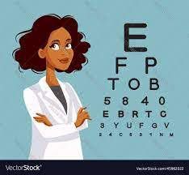
What is Low Vision?
Cannot be fixed with glasses, contact lenses, medication, or surgery
Can occur at any age but tends to affect older adults due to aging of the eyes.
  Best corrected visual acuity 20/40 is low vision and legal blindness is 20/200 in the better eye
Most common causes of Low Vision in aging adults
  Macular Degeneration
  Cataracts
  Glaucoma
  Diabetic Retinopathy
  Brain injuries (Traumatic Brain Injuries – falls, strokes, car accidents, etc.)
Low vision is permanent –
  There are things we can assist with to help vision and to remain safe and independent.
Notes:
Low vision is more common in older adults because many of the diseases that can cause it are more common in older adults. Aging doesn’t cause low vision on its own.
Eye and brain injuries and certain genetic disorders can also cause low vision.

Slide 4
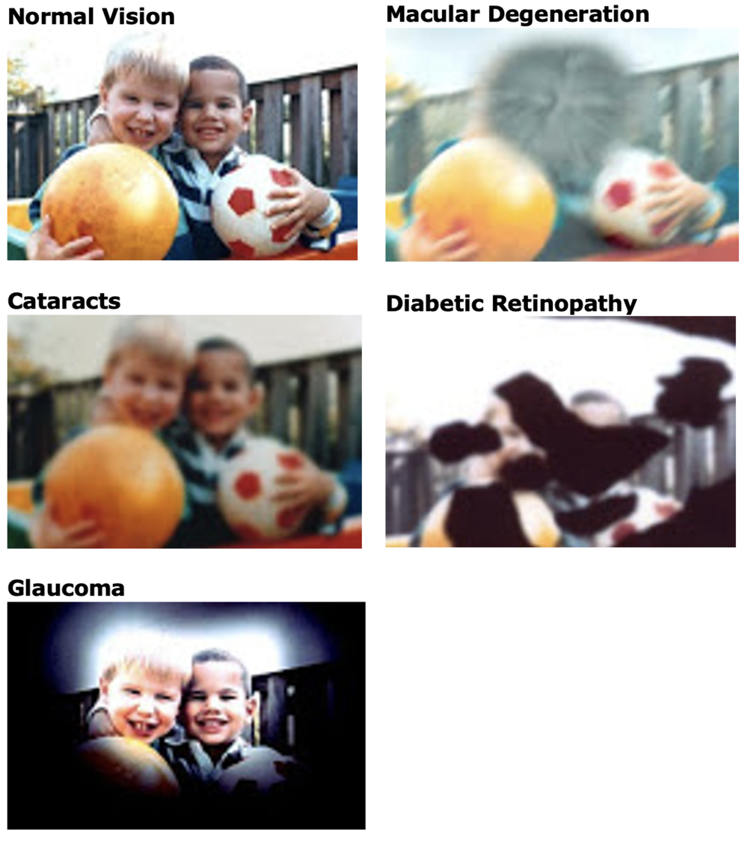
What can Individuals Experience with Low Vision?
Loss of vision impacts are substantial from depression, permanent disability, loss of productivity, and diminished quality of life.
Typically the common struggles for those with low vision are doing daily tasks:
  Reading
  Bill pay
  Medication management
  Cooking
  Shopping
  Driving
  Activities of daily living
  Cleaning
Notes:
With vision loss it can affect central or peripheral vision which will affect what tasks they struggle with.

Slide 5

Low Vision Programs
Through Vocational Rehabilitation we have 3 programs that can assist those with vision deficits
  VR Program if someone wants to work
  Older Individuals who are Blind (OIB) Program
  Senior Community Service Employment Program (SCSEP)
VR is designed to help people with disabilities meet their career goals, from entry-level to professional. It helps people with disabilities get jobs, whether the person is born with a disability, develops a disability or becomes a person with a disability while working.

Slide 6


Older Individuals who are Blind(OIB) Program
Eligibility for OIB program
Age 55+
Have a vision impairment that causes low vision
Not living in a nursing home
Not working (if working referred to VR program
Goal:
Improve the individual's independence in their homes and communities and enhancing their quality of life.
Notes:
Example of vision impairments: macular degeneration, cataracts, glaucoma, diabetic retinopathy, detached retina, retinitis pigmentosa, etc.

Slide 7
Services
Link to video KFYR Low Vision AT in the Kitchen
Comprehensive in home evaluation to determine what will help the client
Advocacy Training
Assistive Technology Devices and Training
Communication Skills
  Telling time
  Use of telephone
  Financial management
  Writing/transcribing
  Computer training
Counseling/education (of vision diagnosis)
Daily Living Skills
  Meal preparation
  Labeling/marking/organizing
  Clothing care
  Leisure activities
  Personal care/grooming
  Home maintenance and cleaning
Information and Referral
Notes:
Due to limited funding our program cannot always purchase everything the client wants as it is a needs based program. There may be some financial contribution for devices.
For Information and Referral we work with many other programs to get maximum benefits for our clients.

Slide 8
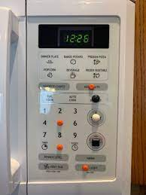
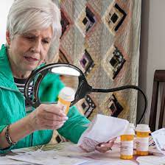
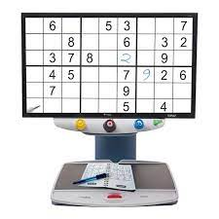
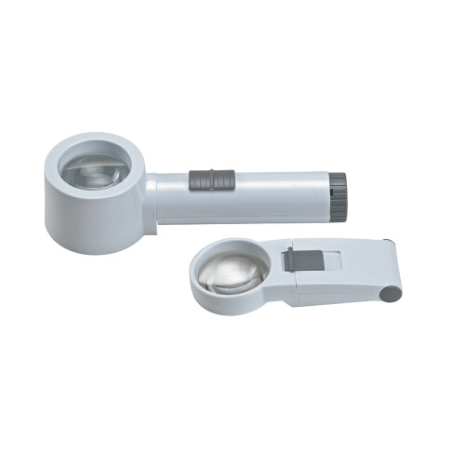
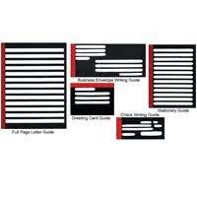
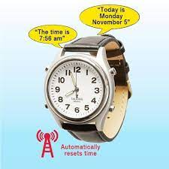
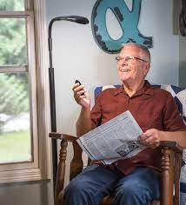

Common Assistive Devices for Low Vision
Magnifying Lamp
CCTV
Magnifiers
Bump Dots
Electronic Video Magnifier
Talking Watch
Various Writing Guides
Lighting

Slide 9

Referrals
Visit Vocational Rehabilitation's Website
You can contact OIB/VR at 1-800-755-2745 and you will be directed the correct regional office.

Slide 10
Regional Contacts
Aimee Volk, Vision & IL Admin.
701-328-8954
alvolk@nd.gov
Mariel Zeller, Minot
701-857-8640
mlzeller@nd.gov
Cathy Bryce, Devils Lake
701-665-2221
cbryce@nd.gov
Annika Stearns, Grand Forks
701-795-3149
astearns@nd.gov
Vacant, Fargo
701-298-4460
Vacant
Jim Drew, Jamestown
701-253-6352
jdrew@nd.gov
Betsy Hermanson, Bismarck
701-328-8800
ehermanson@nd.gov
Rick Haugen, Dickinson & Williston
701-328-8954
richaugen@nd.gov
Notes:
We have 7 Vision Rehabilitation Specialists (VRS) in ND. We have a VRS in every office except for Williston where they share the Minot and Dickinson VRS.

Slide 11

Thank You
If you have questions please contact:
Aimee Volk, Vision and Independent Living Services Administrator, VR
(701) 328-8954
alvolk@nd.gov

