Slide 1
Home Delivered Nutrition Solutions

Slide 2
1
Over 35 Million Americans, between 5 and 10% of the total US population are food insecure. These individuals either reside in a food desert or have insufficient income to afford healthy food.
The Challenge of Food Insecurity
2
Food insecure people have more hospitalizations and ED visits, putting them in the top 10% of all healthcare consumers. In addition, food-insecure people have 20% higher healthcare costs accounting than people who are food secure.
3
The prevalence of chronic disease in food-insecure populations is significant and is concentrated in Diabetes, Coronary Heart Disease, Hypertension, and Chronic Kidney Disease.
1-USDA ERS – Documentation
2-Food Insecurity, Healthcare Utilization, and High Cost: A Longitudinal Cohort Study - PMC (nih.gov)
3-Food Insecurity Was Associated With Greater Family Health Care Expenditures In The US, 2016–17 | Health Affairs

Slide 3
Treating Food Insecurity Can't Wait!
Let's Act Today!
Food insecurity is a Worldwide Epidemic:
Food insecurity is a Worldwide Epidemic:
20% of all deaths related to diet and often the lack of available nutrition solutions for chronic diseases
Food insecurity impacts a large segment of interrelated health conditions, including:
Mental Health, Anxiety, Stress, Heart Disease, Obesity, Diabetes, and Hypertension
Food insecurity correlates directly to:
Food insecurity correlates directly to:
Missed medical appointments and lower medication adherence﻿
Inflation has accelerated the issue:
Inflation has accelerated the issue:
Food inflation has surpassed 10% in the last year according to US labor Bureau. Health foods are projected to be even higher, which crowds out healthy foods from many grocery trips, especially for those in lower socioeconomic groups
1-Poor Diet Associated With 1 In 5 Deaths Globally, More Than Tobacco, High Blood Pressure, Lancet Study Shows | KFF
2-Food Insecurity And Health Outcomes | Health Affairs
3-Amid food inflation, more shoppers turn to dollar stores for groceries (cnbc.com)

Slide 4
The Promise of Food as Medicine & Medically Tailored Meals
4
Medically tailored meals were defined by Tufts as healthy, home-delivered, customized, and fully prepared meals for those living with advanced illnesses including Diabetes, Heart Failure, ESRD, HIV, and Cancer.
4
A Tufts University study found that medically tailored meals can prevent 18M hospitalizations each decade and save the US healthcare system $185 Billion over that same period.
5
Other recent studies found that Medicare and Medicaid could avoid 3.28M cardiovascular disease events, and 120K diabetes cases and save $100 Billion over the life of the current beneficiary population.
5
Furthermore, medically tailored meals can lower cancer cases, and be responsible for 50% fewer hospitalizations, 49% - 70% fewer ED visits, 72% fewer SNF admissions, and 16% - 28% lower healthcare costs overall
4-Medically Tailored Meals Could Save U.S. Nearly $13.6 Billion Per Year | Tufts Now
5- William Blair Article BlueMatrix

Slide 5
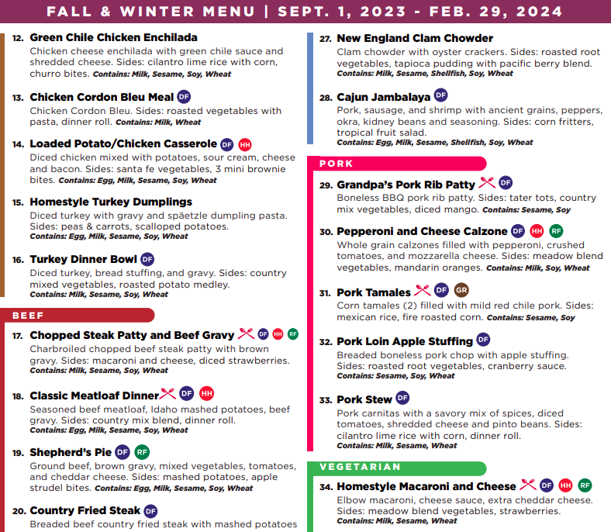
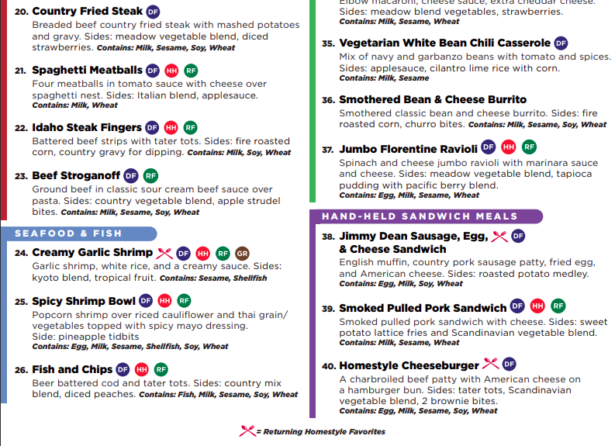
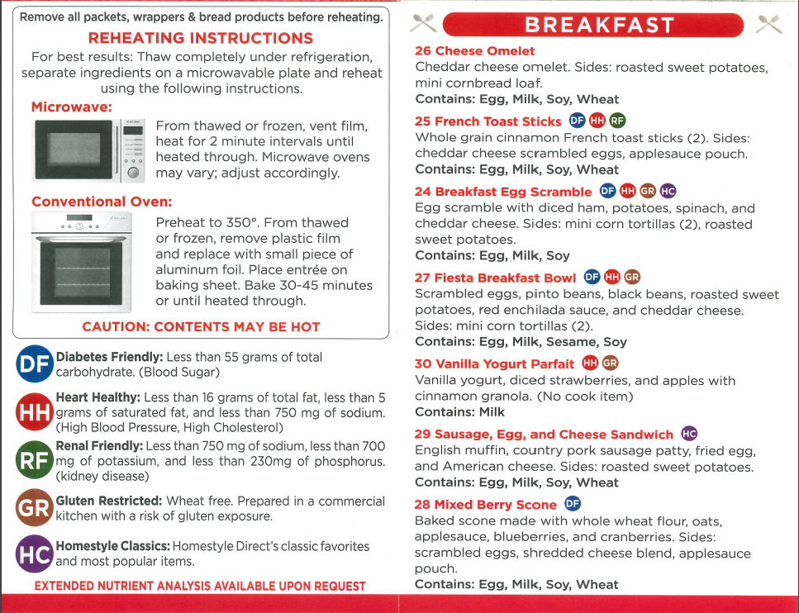
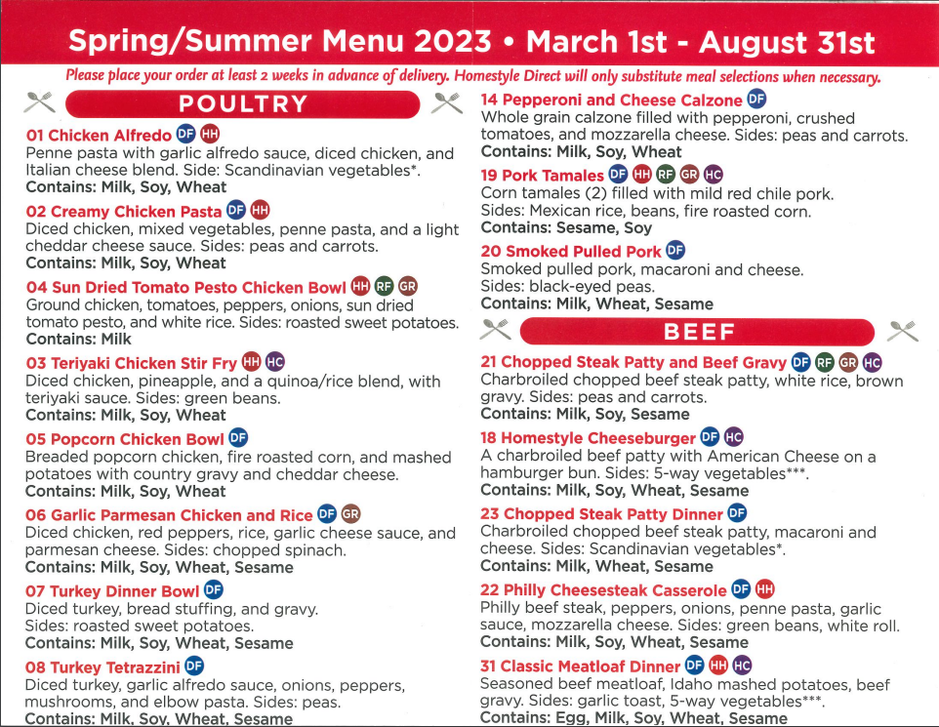
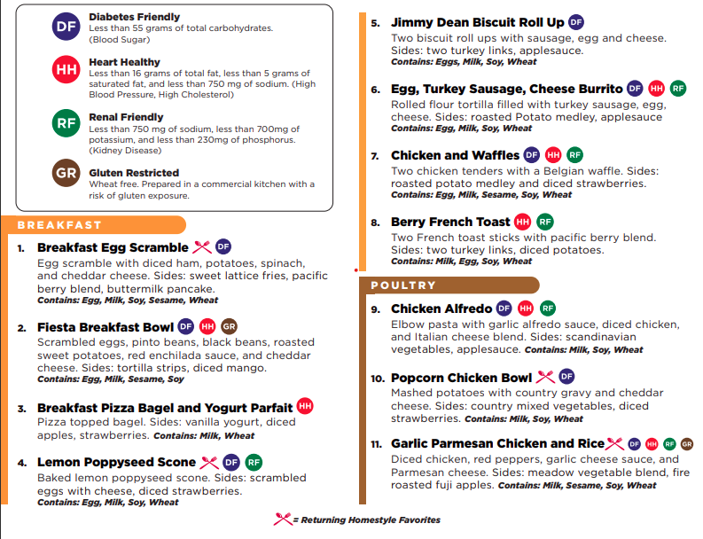
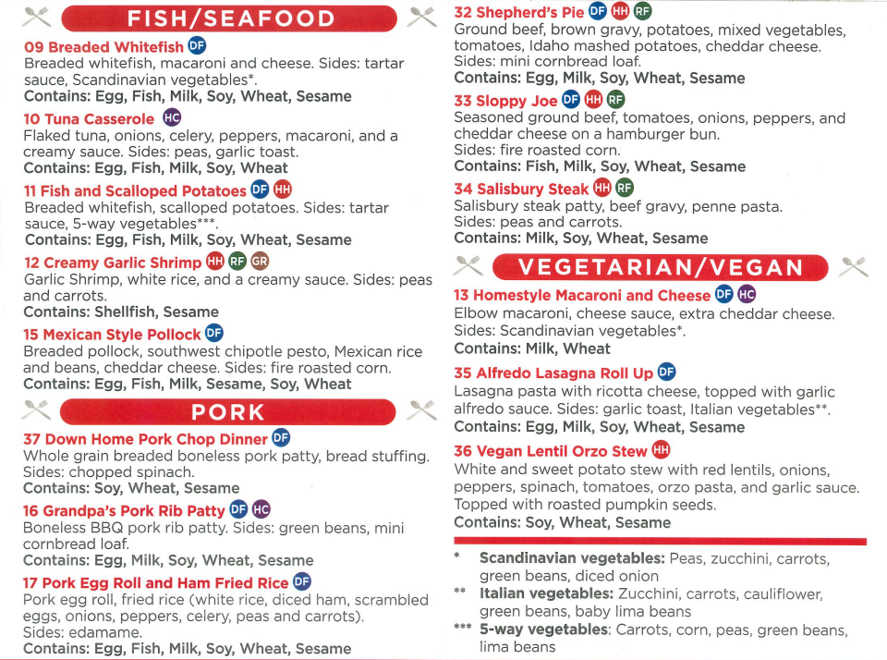
Homestyle Direct Menu
Delicious, Medically Tailored Meals
Diabetes Friendly
< 55 grams of Carbohydrate
Renal Friendly
< 750 mg Sodium
< 700 mg Potassium
< 230 mg phosphorus
Heart Healthy
< 16 grams of fat
< 5 grams of saturated fat
<750mg of sodium
Gluten Restricted
Wheat free. Prepared in a commercial kitchen with a risk of gluten exposure.
Breakfast - 9
Poultry - 8
Fish/Seafood - 5
Pork - 6
Beef - 8
Vegetarian -4
33
18
19
4

Slide 6
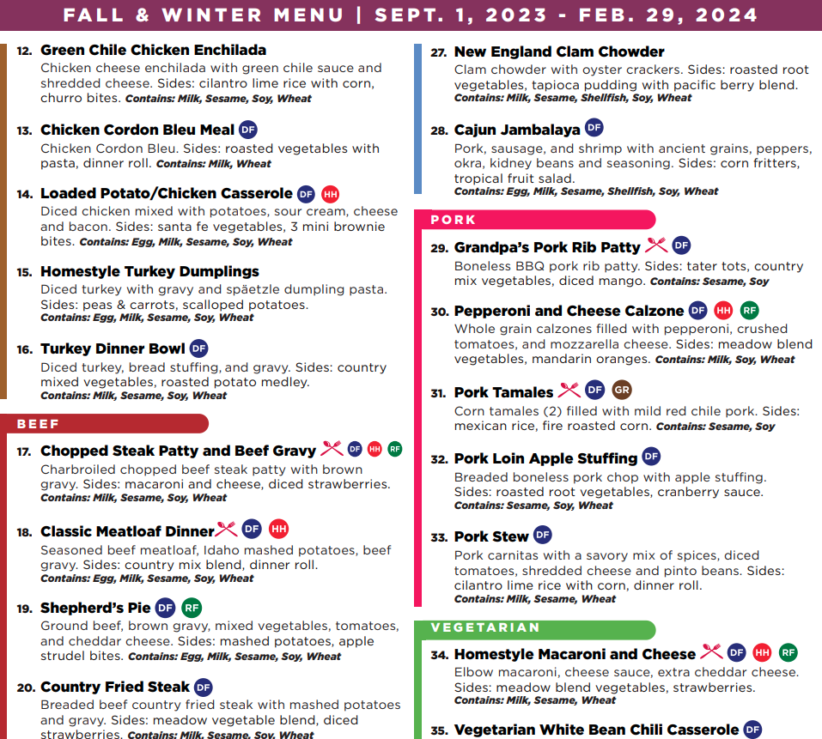
Our Expanded Health Focused Menu Options
Based on Customer Requests
Customer Driven Choices = More Satisfaction
Expanded to 40 menu item choice
Expanded Diabetes Friendly Meal Options to 33
Expanded our Renal Friendly Options to 21
Expanded our Heart Healthy Options to 20
Enhanced our Classic and Cultural Meal Options
Classics
More Health Condition Options
Variety

Slide 7
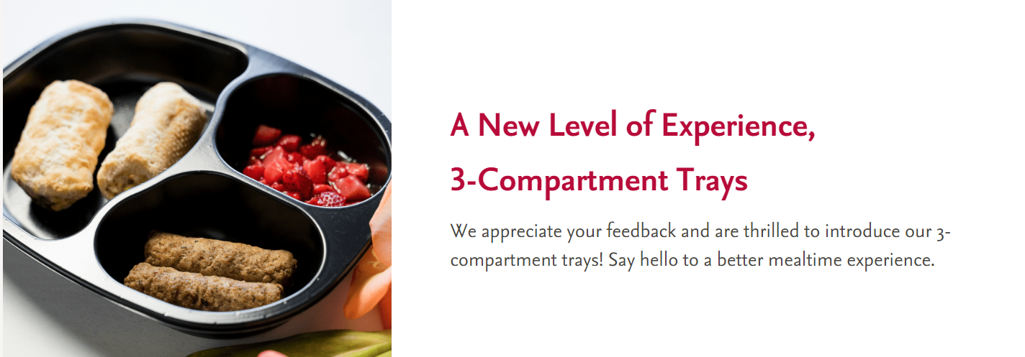
New 3- Compartment Tray
Our new tray launch September 1st 2023
You asked, we listened!

Slide 8
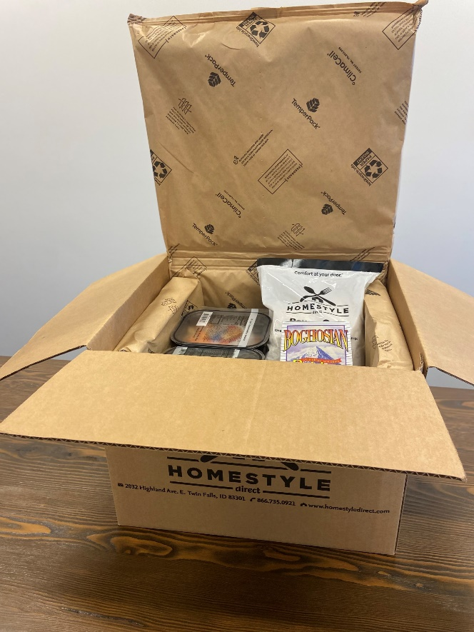
New Innovative ClimaCell Packaging
Helping to Reduce our Carbon Footprint
Recycle in One Step
The liner and the box can be placed in a recycle bin
Emissions
Climacell boxes are estimated to reduce emissions by 30-40% vs EPS packaging
Renewable
Corn starch and paper make up 90% of the material

Slide 9
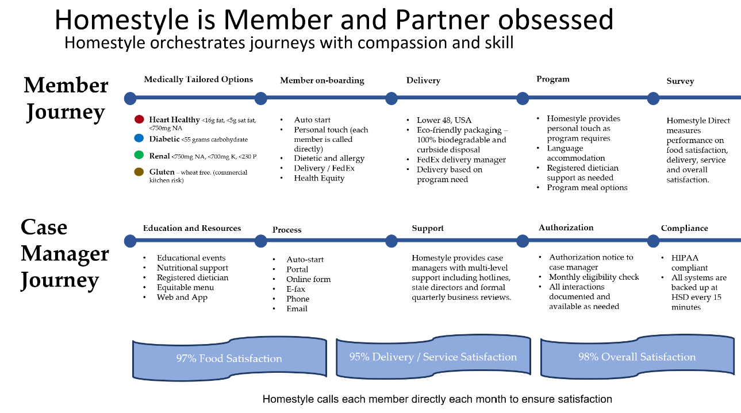

Slide 10
Qualification
To qualify for Homestyle Direct Meals in North Dakota. Members must be on the….
Medicaid Waiver for Home and Community Based Services- Medicaid Waiver(MW)
Service Payments for the Elderly and Disabled (SPED) Program
Homestyle Direct Receives Authorization through the MMIS Portal – With referral we can start member prior to authorization. We check the portal daily.
Medicaid Case Manager can help in getting meals. (North Dakota Health & Human Services, Adults and Aging)
Private Purchase $7.95 for any Meal on the Menu. Minimum order of 12 Meals – No Shipping- No Contracts.
To Order:
www.Homestyledirect.com
866-735-0921

Slide 11
Cyber Security
Complete HIPAA Compliance
Business Associate Agreements with all necessary vendors/partners
PCI DSS Letter of Confidence
All systems backed up every 15 minutes
Annual HIPAA training for all employees with warning policies and restrictions

Slide 12
Storage and Heating Instructions
Storage
Heating
Meals can be heated from frozen
For best results transfer to fridge 1 day before consumption
Microwave:
Vent film, heat for 2-minute intervals until heated through; stirring or flipping between intervals
Conventional Oven:
Preheat oven to 350 F. Remove plastic film and replace with aluminum foil. Place entree on baking sheet. Bake 30-45 mins until heated through
Once Delivered: Meals should be transferred immediately to freezer
Meals are good in the freezer for up to 6 months
Meals are good in the fridge for up to 5 days

Slide 13
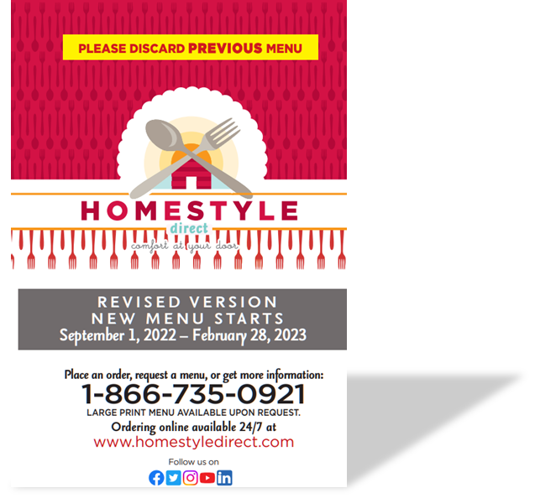
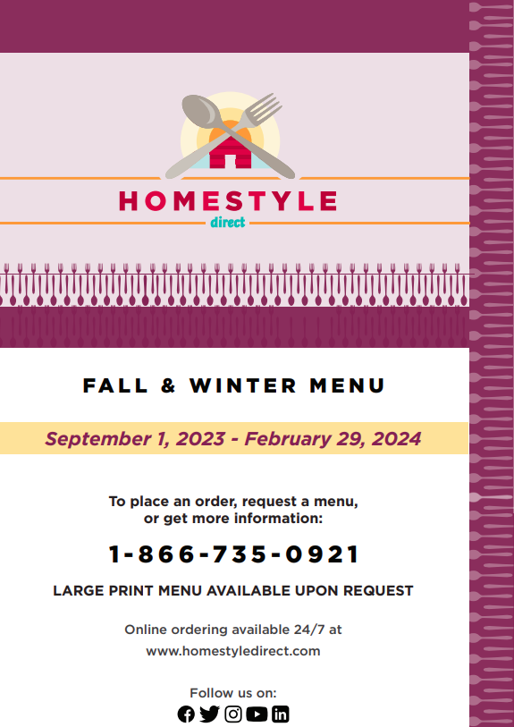
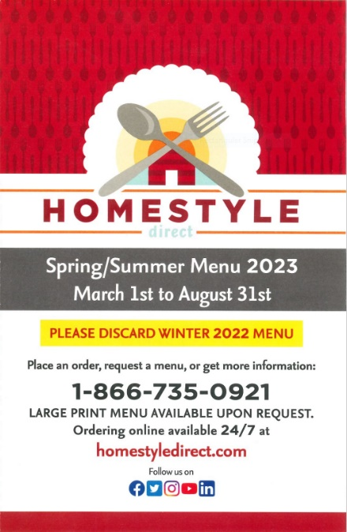
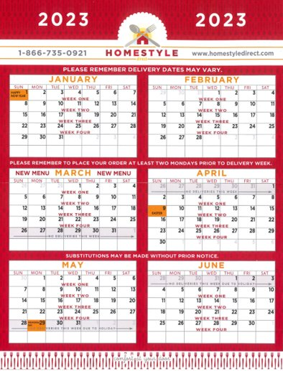
Spring Summer 2023 Menu
Tonna Quesnell
Director of Healthcare Partnerships
208-539-9991
tonna@homestyledirect.com
Shipping Calendar
Download
our App
or Visit our
Website
www.homestyledirect.com
NPI # 1235407420 Tax ID # 51-0462004

