Slide 1
Social Security: With You Through Life’s Journey…
Patty Hoffman
Public Affairs Specialist
June 8, 2023
Produced at U.S. taxpayer expense

Slide 2
Presentation Overview – 2023
How We Define Disability
Substantial Gainful Activity (SGA)
Difference between Social Security Disability Insurance (SSDI) & Supplemental Security Income (SSI)
SSDI & SSI eligibility
Medicare
Online Services
Information contained in this presentation is subject to changes in legislation, policies, or procedures

Slide 3
We’re With You If The Unexpected Happens

Slide 4
Disability Definition 2023
Must have severe medical condition
Expected to last at least one year or result in death
Inability to perform substantial gainful employment
Disability ($1470/month) Blind ($2460/month)
ssa.gov/disability

Slide 5
SSDI vs. SSI
Social Security Disability Insurance | Supplemental Security Income
Payments come from Social Security trust funds and are based on a person’s earnings. | Payments come from the general treasury fund, NOT the Social Security trust funds. SSI payments are not based on a person’s earnings.
Insurance that workers earn by paying Social Security taxes on their wages. | Needs-based program where eligibility depends largely on limited income and resources.
Pays benefits to disabled individuals who are unable to work, regardless of their income and resources. | Pays disabled individuals who are unable to work AND have limited income and resources; pays aged individuals 65 and older with limited income and resources.
Pays benefits for workers and for adults disabled since childhood. Must meet insured status requirements. | Benefits for children and adults in financial need. Must have limited income and limited resources.
Notes:
When you file an application for disability benefits with Social Security, we always check on your eligibility for both of our programs. The same medical requirements apply to both programs, but the non-medical requirements differ.
Staff at your local Social Security field office review your non-medical eligibility. If you meet the non-medical requirements for SSDI, SSI, or both programs, we send your claim – or claims – to a medical examiner who works for the state of ___(your state).
Specifically, the medical examiners work for a state agency called the Disability Determination Service, or DDS. Once the medical examiner makes a medical decision on your application, you receive notification by mail, and your local Social Security field office receives notification electronically. If your claim is approved, you start receiving monthly disability benefits. If denied, you have 60 days to file an appeal.
For SSDI, you must have recent work history in order to receive benefits. Adults must have worked and earned Social Security credits in 5 out of the 10 years prior to the onset of the disability.
For younger workers, however, less work is required. For example:
Before age 24:
1 ½ years of work in a three-year period before becoming disabled
Age 24-31:
work during half the time between age 21 and the time the disability began
Age 31 or older:
work during five out of the 10 years before the disability began
However, since you do not need to work and gain insured status for SSI, babies and older people who have never worked can receive SSI benefits. They just need to be blind, disabled, or age 65 or older and have limited income and resources.
Social Security has a specific set of rules that apply to disability beneficiaries. If you receive Social Security disability benefits or Supplemental Security Income payments, you must report all earnings to Social Security.
Slide Updated: ^OAESP 11/8/2022 (SY/JP)

Slide 6
Social Security
Disability Insurance (SSDI)

Slide 7
Social Security Disability Insurance (SSDI)
What is it?
SSDI provides a monthly benefit to people who are no longer able to work because of a significant disabling condition(s). SSA does not pay partial or temporary disability benefits.
Who is it for?
People who cannot perform substantial work activity may qualify if they:
have medical condition(s) expected to last at least 12 months or result in death
are younger than full retirement age (FRA) and earn less than the substantial gainful activity (SGA) limit
have recent work and a certain number of work credits based on age
ssa.gov/disability
Notes:
Social Security’s disability definition requires you to have a medical condition that prevents you from doing substantial work for at least 12 months or your condition is terminal. This work determination is based on your age, education, and work experience.
Our definition makes the clear distinction between Social Security’s disability requirements compared to other disability programs, such as Veterans and Workman’s Compensation.
In addition to meeting the definition of disability, you must also have worked long enough – and recent enough – to qualify.
The number of work credits you need to qualify for disability benefits depends on your age when you become disabled. Generally, you need 40 credits, 20 of which were earned in the last 10 years ending with the year you become disabled. For younger workers, less work/fewer credits are required.
You can apply for disability benefits in person, by telephone, by mail, or online.
The application is then sent to a State Disability Determination Services for evaluation of disability. The average processing time is three to six months.
After becoming eligible for a disability benefit, the law requires us to conduct a medical review to ensure that the beneficiary still qualifies for the program. This generally occurs every 3 to 7 years, depending on the severity of the disability.
Source: Publication #05-10029 (Disability Benefits)
8/16/2022 - Speaker notes updated (AW)

Slide 8
Rules for Recent Work Test
If you become disabled | You generally need
In or before the quarter you turn age 24 | 1.5 years of work during the three-year period ending with the quarter you become disabled.
In the quarter after you turn age 24 but before the quarter you turn age 31 | Work during half the time for the period beginning with the quarter after you turned 21 and ending with the quarter you become disabled.
In the quarter you turn age 31 or later | Work during five years out of the 10-year period ending with the quarter your disability began.
Notes:
The following table shows the rules for how much work you need for the recent work test, based on your age when your disability began. We base the rules in this table on the calendar quarter in which you turned or will turn a certain age.
The calendar quarters are:
First Quarter: January 1 through March 31
Second Quarter: April 1 through June 30
Third Quarter: July 1 through September 30
Fourth Quarter: October 1 through December 31

Slide 9
When should I apply for disability benefits?
Apply as soon as you become disabled.
Processing an application for disability benefits can take three to five months.
We may be able to process your application faster if you help us by getting any other information we need.
Notes:
Processing an application for disability benefits can take three to five months.
The information we need includes:
Your Social Security number;
Your birth or baptismal certificate;
Names, addresses, and phone numbers of the doctors, caseworkers, hospitals, and clinics that took care of you, and dates of your visits;
Names and dosage of all the medicine you take;
Medical records from your doctors, therapists, hospitals, clinics, and caseworkers that you already have in your possession;
Laboratory and test results;
A summary of where you worked and the kind of work you did; and
A copy of your most recent W-2 Form (Wage and Tax Statement) or, if you’re self-employed, your federal tax returns for the past year.
In addition to the basic application for disability benefits, you’ll also need to fill out other forms. One form collects information about your medical condition and how it affects your ability to work. Other forms give doctors, hospitals, and other health care professionals who have treated you, permission to send us information about your medical condition.
Don’t delay applying for benefits if you can’t get all of this information together quickly. We’ll help you get it.

Slide 10
How do I apply for disability benefits?
Online at ssa.gov/benefits/disability
Or
Call 1-800-772-1213, 8 a.m. to 7 p.m. Monday through Friday, to make an appointment at your local office
Notes:
The quickest and most convenient way is online…
The disability claims interview lasts about one hour. If you’re deaf or hard of hearing, you may call our toll-free TTY number, 1-800-325-0778, between 8 a.m. and 7 p.m. Monday through Friday.
If you schedule an appointment, we’ll send you a Disability Starter Kit to help you get ready for your disability claims interview. The Disability Starter Kit also is available online at ssa.gov/disability – click on “Apply for Benefits.”
You have the right to representation by an attorney or other qualified person of your choice when you do business with Social Security. More information is in Your Right To Representation (Publication No. 05-10075), which is available from Social Security at ssa.gov/pubs (online only).
1/5/2022 – 800# hours changed (due to pandemic) on slide and in speaker notes (JP)
11/15/2022 – Speaker notes updated to clarify location of Disability Starter Kit. (JP)

Slide 11
SSDI: What Happens Next?
Your application will be reviewed to make sure you meet some basic requirements for disability benefits.
We’ll check whether you worked enough years to qualify and evaluate any current work activities.
If you meet these requirements, we’ll forward your case to the Disability Determination Services office in your state.

Slide 12
Disability Determination Services Office - State
This state agency completes the initial disability determination decision for us.
Doctors and disability specialists in the state agency ask your doctors for information about your condition(s). They’ll consider all the facts in your case.
They’ll use the medical evidence from your doctors, hospitals, clinics, or institutions where you’ve been treated.
Notes:
They’ll ask your doctors about:
Your medical condition(s);
When your medical condition(s) began;
How your medical condition(s) limit your activities;
Medical tests results; and
What treatment you’ve received.
They’ll also ask the doctors for information about your ability to do work-related activities, such as walking, sitting, lifting, carrying, and remembering instructions. Your doctors don’t decide if you’re disabled.
The state agency staff may need more medical information before they can decide if you’re disabled. If your medical sources can’t provide needed information, the state agency may ask you to go for a special examination. We prefer to ask your own doctor, but sometimes the exam may have to be done by someone else. Social Security will pay for the exam and for some of the related travel costs.
These conditions are based on information received at public outreach hearings, comments received from the Social Security and DDS communities, counsel of medical and scientific experts, and our research with the National Institutes of Health, or NIH.
In fact, there are more than 225 conditions that qualify for expedited disability claim processing through this program!
To learn more and see if you or someone you know qualifies for this program, visit ssa.gov/compassionateallowances
12/6/2021 – URL updated in speaker notes (JP)

Slide 13
Disability Evaluation Under Social Security
Also known as “The Social Security Blue Book”
Provides physicians and other health professionals with an understanding of the disability programs administered by the Social Security Administration
Explains how each program works, and provides information to help health professionals make sound and prompt determinations and decisions on disability claims
Lists specific criteria under which claimants who suffer from a disabling condition can qualify for Social Security disability benefits.
ssa.gov/disability/professionals/bluebook
Notes:
Disability Evaluation under Social Security has been specially prepared to provide physicians and other health professionals with an understanding of the disability programs administered by the Social Security Administration. It explains how each program works, and the kinds of information a health professional can furnish to help ensure sound and prompt determinations and decisions on disability claims. The Listing of Impairments, which includes listings for both adults and children, appear in the Code of Federal Regulations (CFR) in appendix 1 to subpart P of part 404 . We also provide them at ssa.gov/disability/professionals/bluebook. The listings are just part of how we decide if someone is disabled. For adults, we also consider past work experience, severity of medical conditions, age, education, and work skills. We no longer publish Disability Evaluation Under Social Security in hardcopy because we publish updated versions of the Listing of Impairments electronically. Most Social Security disability claims are initially processed through a network of local Social Security Administration (SSA) field offices and State agencies (usually called Disability Determination Services or DDSs). Subsequent appeals of unfavorable determinations may be decided in a DDS or by an administrative law judge in SSA’s Office of Disability Adjudication and Review.
Social Security representatives in the field offices usually obtain applications for disability benefits in person, by telephone, by mail, or by filing online. The application and related forms ask for a description of the claimant’s impairment (s), treatment sources, and other information that relates to the alleged disability. (The "claimant" is the person who is requesting disability benefits.) The field office is responsible for verifying non-medical eligibility requirements, which may include age, employment, marital status, or Social Security coverage information. The field office then sends the case to a DDS for evaluation of disability.
The DDSs, which are fully funded by the Federal Government, are State agencies responsible for developing medical evidence and rendering the initial determination on whether or not a claimant is disabled or blind under the law.
Usually, the DDS tries to obtain medical evidence from the claimant's own medical sources first. If that evidence is unavailable or insufficient to make a determination, the DDS will arrange for a consultative examination (CE) to obtain the additional information needed. The claimant's treating source is the preferred source for the CE, but the DDS may obtain the CE from an independent source. After completing its development of the evidence, trained staff at the DDS makes the initial disability determination. Then, the DDS returns the case to the field office for appropriate action. If the DDS found that the claimant is disabled, SSA completes any outstanding non-disability development, computes the benefit amount, and begins paying benefits. If the claimant was found not to be disabled, the file is kept in the field office in case the claimant decides to appeal the determination.
Speaker notes updated 12/1/2021 OAESP (JP)

Slide 14
Compassionate Allowances (CAL)
A way of quickly identifying diseases and other medical conditions that invariably qualify under the Listing of Impairments based on minimal objective medical information
Allows Social Security to target the most obviously disabled individuals for allowances based on objective medical information that we can obtain quickly
Is not a separate program from the Social Security Disability Insurance or Supplemental Security Income programs
ssa.gov/compassionateallowances
Notes:
At Social Security, we have a special program called “Compassionate Allowances” which can get you a much faster, or “expedited,” medical decision if you are diagnosed with specific conditions.
These conditions are selected using information received at public outreach hearings, comments received from the Social Security and DDS communities, counsel of medical and scientific experts, and our research with the National Institutes of Health, or NIH.
In fact, there are more than 225 conditions that qualify for expedited disability claim processing through this program!
To learn more and see if you or someone you know qualifies for this program, visit:
ssa.gov/compassionateallowances

Slide 15
Wounded Warriors & Veterans
Wounded warriors and veterans with 100% Permanent & Total disability ratings from the VA may be able to get expedited medical decisions on SSDI and SSI applications.
ssa.gov/veterans
Notes:
At Social Security, we also realize that the effect of military service can be profound and lasting.
There are a number of financial, social, and health issues that result from military service.
Some Wounded Warriors – as well as Veterans Who Have a Compensation Rating of 100% P&T (or, permanent and total) are unaware that we have several programs that may expedite the processing of their disability claims.
To learn more, visit ssa.gov/veterans

Slide 16
How is a Disability Determination Made?
Five-step process:
Are you working?
Is your medical condition “severe” ?
Does your impairment(s) meet or medically equal a listing?
Can you do the work you did before?
Can you do any other type of work?
Notes:
https://www.ssa.gov/disability/professionals/bluebook
We use a five-step process to decide if you’re disabled.
1. Are you working?
If you’re working and your earnings average more than a certain amount each month, we generally won’t consider you to be disabled. The amount changes each year. For the current figure, see the annual Update (Publication No. 05-10003).
If you’re not working, or your monthly earnings average to the current amount or less, the state agency then looks at your medical condition.
2. Is your medical condition “severe”?
For you to be considered to have a disability by Social Security’s definition, your medical condition must significantly limit your ability to do basic work activities — such as lifting, standing, walking, sitting, and remembering — for at least 12 months. If your medical condition isn’t severe we won’t consider you to be disabled. If your condition is severe, we proceed to step three.
3. Does your impairment(s) meet or medically equal a listing?
Our list of impairments (https://www.ssa.gov/disability/professionals/bluebook/listing-impairments.htm) describes medical conditions that we consider severe enough to prevent a person from completing substantial gainful activity, regardless of age, education, or work experience. If your medical condition (or combination of medical conditions) isn’t on this list, the state agency looks to see if your condition is as severe as a condition on the list. If the severity of your medical condition meets or equals the severity of a listed impairment, the state agency will decide that you have a qualifying disability. If the severity of your condition doesn’t meet or equal the severity level of a listed impairment, the state agency goes on to step four.
4. Can you do the work you did before?
At this step, we decide if your medical impairment(s) prevents you from performing any of your past work. If it doesn’t, we’ll decide you don’t have a qualifying disability. If it does, we’ll proceed to step five.
5. Can you do any other type of work?
If you can’t do the work you did in the past, we look to see if there’s other work you can do despite your impairment(s). We consider your age, education, past work experience, and any skills you may have that could be used to do other work. If you can’t do other work, we’ll decide that you’re disabled. If you can do other work, we’ll decide that you don’t have a qualifying disability.
Special rules for blind people
There are special rules for people who are blind. For more information, ask for If You Are Blind Or Have Low Vision—How We Can Help (Publication No. 05-10052).

Slide 17
We’ll tell you our decision…
When the state agency makes a determination on your case, we’ll send a letter to you.
If approved, the letter will show the amount of your benefit, when your payments start, and your reporting responsibilities.
If not approved, the letter will explain why and tell you how to appeal the determination if you don’t agree with it.
Notes:
What happens when my claim is approved?
We’ll send a letter to you telling you your application is approved, the amount of your monthly benefit, and the effective date. Your monthly disability benefit is based on your average lifetime earnings. Your first Social Security disability benefits will be paid for the sixth full month after the date your disability began.
You’ll also receive What You Need To Know When You Get Disability Benefits (Publication No. 05-10153), which gives you important information about your benefits and tells you what changes you must report to us.
What if I disagree?
If you disagree with a decision made on your claim, you can appeal it. The steps you can take are explained in Your Right to Question the Decision Made on Your Claim (Publication No. 05-10058), which is available from Social Security.

Slide 18
Disagree With The Medical Decision?
If you recently applied for Social Security or Supplemental Security Income disability benefits and were denied for medical reasons, you have the right to file an appeal within 60 days of the date on your decision notice.
ssa.gov/benefits/disability/appeal.html
Notes:
ssa.gov/benefits/disability/appeal.html

Slide 19
SSDI: Benefits for the Family
Spouse
At age 62
At any age if caring for child who is under 16 or disabled
Divorced spouses may qualify
Child
Not married under age 18 (under 19 if still in high school)
Not married and disabled before age 22
Notes:
Certain members of your family may qualify for benefits based on your work. They include:
Your spouse, if he or she is age 62 or older;
Your spouse at any age, if he or she is caring for a child of yours who is younger than age 16 or disabled;
Your unmarried child, including an adopted child, or, in some cases, a stepchild or grandchild. The child must be younger than age 18 (or younger than 19 if still in high school);
Your unmarried child, age 18 or older, if he or she has a disability that started before age 22. The child’s disability must also meet the definition of disability for adults.
NOTE: In some situations, a divorced spouse may qualify for benefits based on your earnings, if he or she was married to you for at least 10 years, is not currently married, and is at least age 62. The money paid to a divorced spouse doesn’t reduce your benefit or any benefits due to your current spouse or children.

Slide 20
Supplemental Security Income (SSI)

Slide 21
Supplemental Security Income (SSI)
What is it?
SSI is a federal program that provides monthly payments to people who have limited income and resources.
Who is it for?
People who are 65 or older, as well as for those of any age, including children, who are blind or who have disabilities and have limited income and resources.
ssa.gov/benefits/SSI
Notes:
If you are disabled but do not have enough credits to qualify for SSDI and you have limited income and resources, you may be eligible for Supplemental Security Income.
SSI is a federal income supplement program funded by general tax revenues, not Social Security taxes.
Social Security administers the SSI program, which pays monthly benefits to adults with limited income and resources who are disabled, blind, or age 65 or older. Blind or disabled children may also get SSI.
People who have worked long enough, recently enough, may be able to receive Social Security benefits – such as disability or retirement – and SSI benefits at the same time, if the amount of Social Security benefits in combination with the person’s other income falls below the SSI income limits.
Children
If under 18, the child has a physical or mental impairment (or combination) that results in marked or severe limitation in functioning.
The child must be either blind or disabled. If the child is blind, he or she must meet the same definition of “blind” as applies for adults.
Condition must be expected to last at least 12 months or result in death.
Disabled children living in households with limited income and resources may be eligible to receive SSI benefits.
For eligibility, the income and assets of the disabled child and parent(s) living in the household are assessed.
Children’s income examples:
Child support
Social Security auxiliary benefits
Gifts
Additionally, any household with an individual who receives SSI may be eligible to receive discounted internet service through the Affordable Connectivity Program, or ACP. The ACP is run by the Federal Communications Commission, not by the Social Security Administration. Receiving assistance through the ACP will not affect your eligibility for SSI or your SSI payment. For more information, visit fcc.gov/acp.
Supplemental Security Income publication # 05-11000 -- ssa.gov/pubs/EN-05-11000.pdf
Slide reviewed: OSSIPIP 11/23/2021 (JP) Speaker notes updated: 4/26/2022 (JP/AJ)

Slide 22
SSI Federal Payment Rates 2023
Individual $914/month
Couple $1,371/month

Slide 23
Requirements for Getting SSI
Your income – money you receive such as wages, Social Security benefits, and pensions. Income also includes such things as food and shelter.
Your resources – things you own such as real estate, bank accounts, cash, stocks, and bonds.
Where you live – must live in the U.S., or Northern Mariana Islands. If you’re not a U.S. citizen, but you are lawfully residing in the United States, you still may be able to get SSI.

Slide 24
Income
Earned | Unearned
Wages | SSA benefits
Net earnings from self-employment | Veterans benefits
Payment for services in sheltered workshop | Unemployment benefits
 | Interests
 | Pensions
 | Cash from family/friends

Slide 25
Resources
Included Resources | Excluded Resources
Bank Accounts (CDs, IRAs) | Home in which you live
Stocks, Bonds, 401Ks (Liquid Assets) | First car
Second Car | Burial plots for self & family
Life Insurance | Some resources set aside for burial
Property other than where you live
Individual Limit: $2,000 / Couples Limit: $3,000
Notes:
ssa.gov/ssi/text-resources-ussi.htm

Slide 26
Living Arrangements
Living arrangements are another factor to determine how much SSI a person can get. Benefits may vary depending on where you live:
In someone else’s household
In an institution – generally $30/month maximum
In a group care or board and care facility
Notes:
ssa.gov/ssi/text-living-ussi.htm

Slide 27
What to Report Under SSI
change of address
change in living arrangements
change in earned and unearned income
change in resources
death of a spouse or anyone in your household
change in marital status
change in citizenship or immigration status
change in help with living expenses from friends or relatives
eligibility for other benefits or payments
admission to or discharge from an institution (i.e. hospital, nursing home, jail, etc.)
change in school attendance (if under age 22)
change in legal alien status
sponsor changes of income, resources, or living arrangements for aliens
leaving the U.S. for a full calendar month or for 30 consecutive days or more
an unsatisfied felony or arrest warrant for escape from custody, flight to avoid prosecution or confinement, or flight-escape

Slide 28
Reporting Responsibilities Under SSI
What Things Must You Report To Social Security?
You must report any changes in your status because they may affect your eligibility for SSI and your benefit amount. If you work and get SSI, then you must report your earnings.
When Do You Need To Report?
Report any changes that may affect your SSI as soon as possible and no later than 10 days after the end of the month in which the change occurred.
How Do I Report Wages?
Social Security offers a toll-free automated wage reporting telephone system and a mobile wage reporting application. You can also report your wages through your personal my Social Security account.
Notes:
ssa.gov/ssi/text-report-ussi.htm

Slide 29
How to Apply for SSI
Visit ssa.gov/ssi/start.html to let us know you want to apply
or
Schedule an appointment with us. Call 1-800-772-1213 (TTY 1-800-325-0778) from 8 a.m. to 7 p.m., Monday through Friday or contact your local Social Security office;
Notes:
Updated 4/11/2022 (LF/DRB)

Slide 30
We’re With You Through Life’s Journey
Notes:
Social Security offers much more than just retirement. We provide a safety net of financial protection for your whole family.
We’re with you throughout life’s journey– With retirement, disability, survivors, and other benefits, Social Security is here to help you and millions of others secure today and tomorrow.

Slide 31
Medicare and Medicaid
Medicare – federal health insurance program for people 65 or older and people who have been getting disability benefits for 24 consecutive months.
Medicaid – state health program for people with low incomes and limited resources.
In most states, children who get SSI qualify for Medicaid.
In many states, Medicaid comes automatically with SSI eligibility.

Slide 32
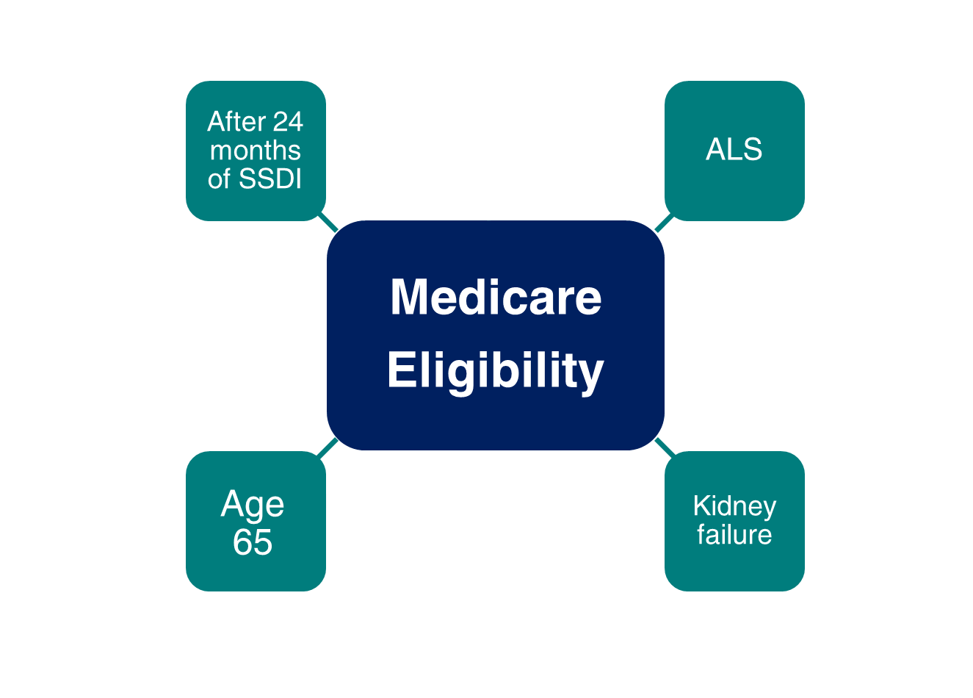
Medicare Eligibility
Notes:
Remember that although the full retirement age has increased above age 65, Medicare eligibility is still age 65. One of the most important things to remember is that you can apply for Medicare online, even if you are waiting past age 65 to apply for Social Security retirement benefits.
You should apply for Medicare 3 months before your 65th birthday, even when you plan to apply for your retirement or spouse’s benefits later.
If you are approved for Social Security disability benefits, you will be eligible for Medicare benefits 24 months from the month you were entitled to receive benefits, not from the first month you receive a payment.
If you are diagnosed with amyotrophic lateral sclerosis (Lou Gehrig’s disease) and you get disability benefits, you can get Medicare right away.
If you have permanent kidney failure and you receive maintenance dialysis or a kidney transplant – you may also be eligible for Medicare.
*Note to speaker: If an audience member asks about Medicare based on exposure to environmental health hazards,
provide this link: ssa.gov/OP_Home/ssact/title18/1881A.htm or HI 00803.001 https://secure.ssa.gov/poms.nsf/lnx/0600803001
Updated – OISP/OEEMP 10/13/2022 (SY/JP)
Speaker Notes updated 12/6/2022 (SY/JP)

Slide 33
Social Security Website
Notes:
The Social Security website is a valuable resource of information about all of Social Security’s programs and is accessible from a computer, tablet and smartphone. We encourage you to use our online retirement planning tools to plan for a secure financial future.
Slide updated 12/6/2022 (SY/JP)

Slide 34
my Social Security
ssa.gov/myaccount
Notes:
my Social Security is a convenient and secure suite of services designed to put you in control of your personal Social Security information, as well as help you manage your benefits when you start receiving them. Your account gives you the information you need at your convenience - all without calling or visiting a local office.
You can only open a my Social Security account for yourself. You cannot open an account for another person, even if you have his or her written consent. You may be unable to open a my Social Security account if you:
• Blocked electronic access to your personal Social Security information; • Recently moved or changed your name; or • Placed a freeze on your credit report.
Your online my Social Security account provides a variety of information to help you and your family.
Speaker notes updated (DRB) 6/8/2022 (JP/AJ)

Slide 35
How to Open/Sign In to a my Social Security Account
Visit www.ssa.gov/myaccount
Select: “Sign In or Create an Account”
If you already have an account, select Sign In and enter:
Existing my Social Security username and password
Existing Login.gov or ID.me credentials
To create a new account, select Create an Account on this and the next screen. You will be directed to Login.gov for next steps.
After creating your Login.gov account, you will be directed back to our website where you will provide personal information so we can verify your identity.
Complete the registration process using the activation code we send you.
Notes:
To open a my Social Security account, you have to be at least 18, have a valid e-mail address, a Social Security number, a phone number, and a U.S. mailing address.
To open your account, go to ssa.gov/myaccount and select “Sign In or Create an Account.”
If you have a my Social Security username and password from prior to 9/18/21 - you will continue to sign in with that same username and password.
You also have the option to sign in through Login.gov or ID.me if you already have an account.
If you don’t have a Login.gov or ID.me account, select the “Create an Account” link to start this one-time registration process.
The first Create an Account button will send you to a page where you will need to click ‘Create an Account’ again. Once you select ‘Create an Account’ it will automatically direct you to Login.gov.
This is the page that shows after the first Create an Account https://secure.ssa.gov/RIL/SiView.action
Once you create a new Login.gov credential, we will still complete the identity verification part, so you will need to provide some personal information to us.
You will also receive an activation code from us to complete the process of creating your personal my Social Security account.
You are given the option to select whether to receive your activation code by postal mail, text message, or automated voice phone call if we can verify at least one of these options.
If you receive your activation code via text message or phone call, you can finish creating your account right away. If you receive your code by mail, you will need to go to www.ssa.gov/myaccount and select “Finish Setting Up Your Account” after receiving the code.
After successfully creating your account, you are redirected to the my Social Security Terms of Service screen prior to accessing your account.
No matter what type of device you use, the my Social Security portal will automatically re-adjust to fit the appropriate screen size, providing you full, easy-to-use access to your personal account!
Updated 03/22/2022 (DRB)

Slide 36
my Social Security Services
If you do not receive benefits, you can:
View retirement benefit estimates at different ages or dates when you want to start receiving benefits;
View possible spouse’s benefits;
Request a replacement Social Security card if you meet certain requirements;
Check the status of your application or appeal;
Get a benefit verification letter as proof that you are not getting benefits;
Get your Social Security Statement to review:
Estimates of your future retirement, disability, and survivor benefits;
Your earnings, to verify the amounts that we posted are correct; and
The estimated Social Security and Medicare taxes you’ve paid.
ssa.gov/myaccount/what.html
Notes:
Slide updated – minor edit - 1/19/2022 (JP)

Slide 37
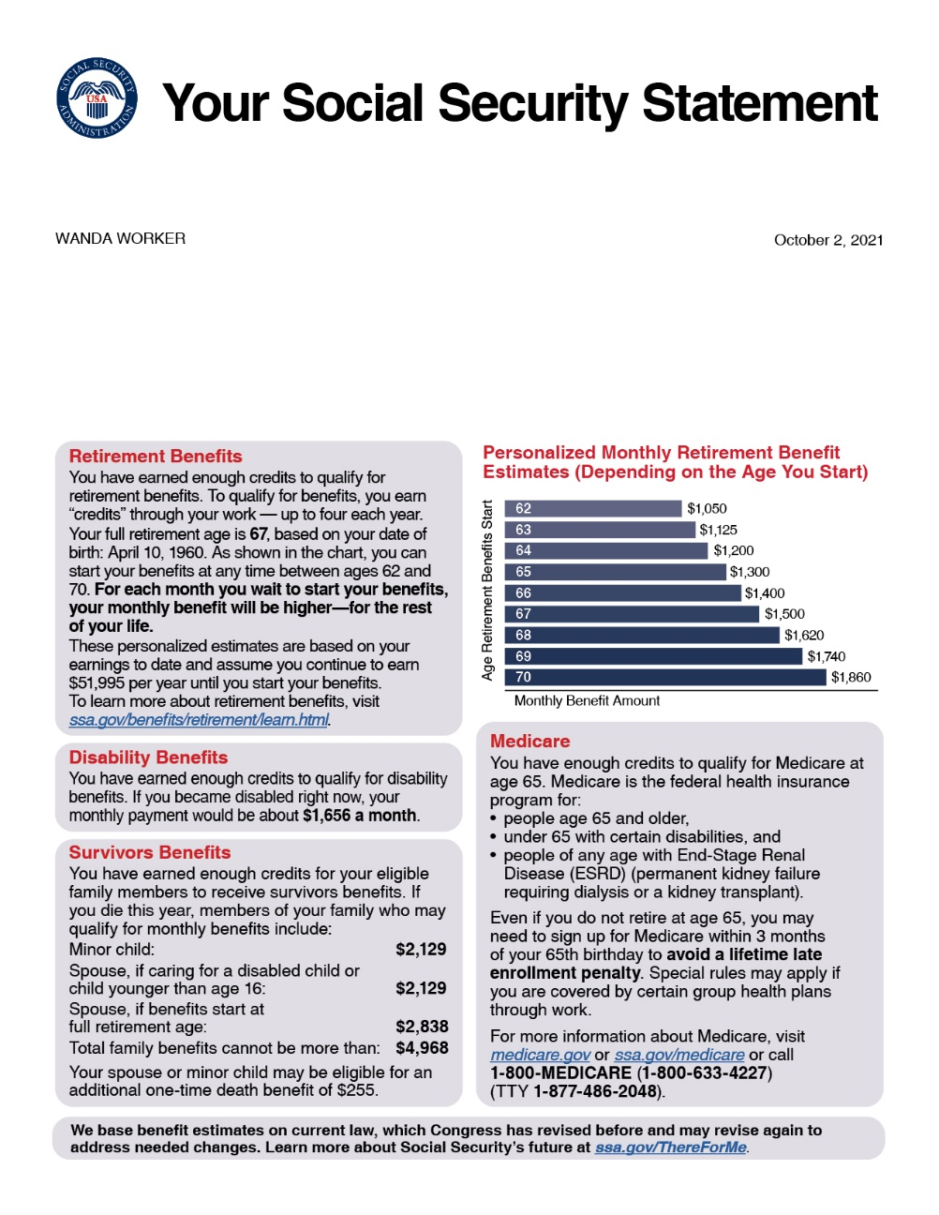
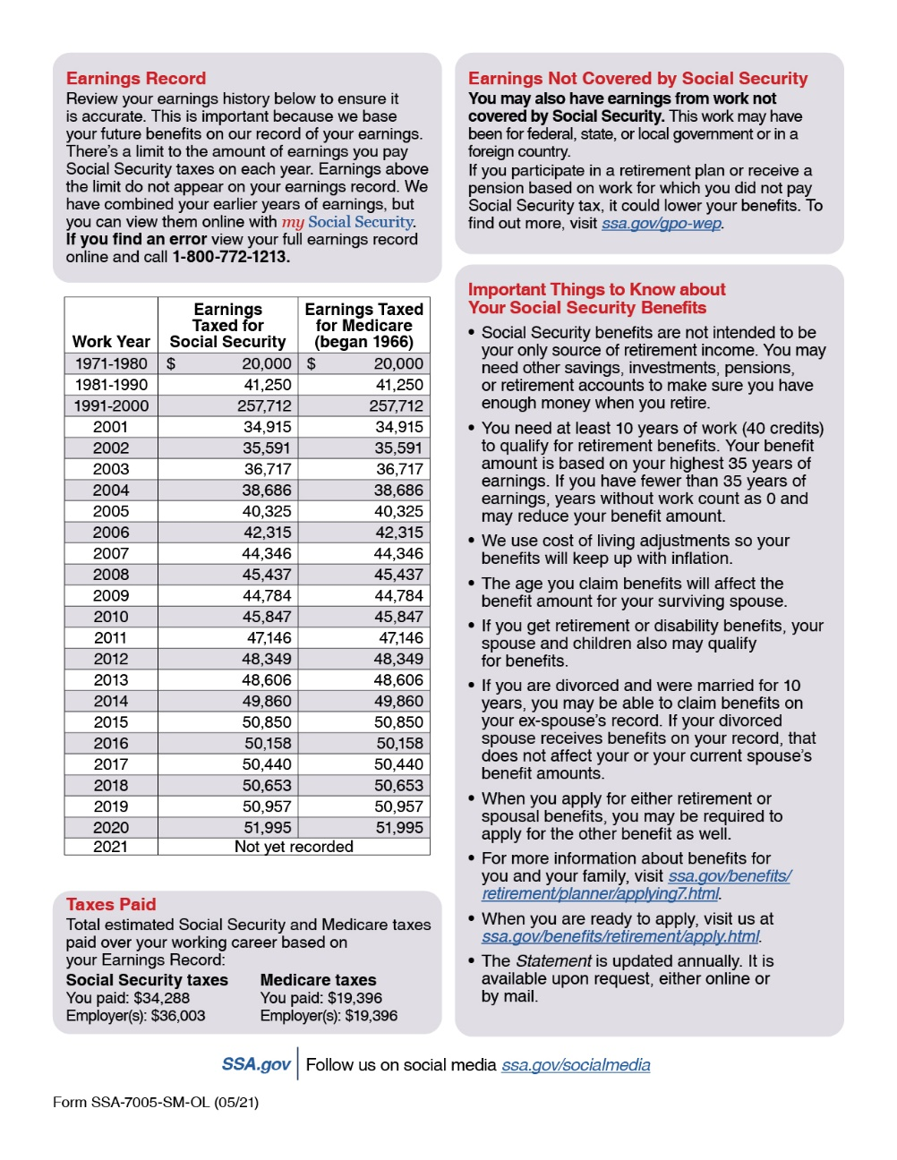
Social Securiaaty Statement
Notes:
* New redesigned Statement:
Plain language, design, and graphics make it easier to find information.
For example, we now provide a graph with retirement benefit estimates for up to 9 ages, depending on when you want benefits to start.
* The Statement is one of Social Security’s most far-reaching educational tools.
- In 2022, we provided more than 38 million Statements in print and online.
* Workers age 18 and older can access their Statement online using my Social Security.
We mail a Statement to workers age 60 and older who do not have an online account.
Anyone can send in a written request to have a Statement mailed to them.
Speaker notes updated 11/3/2022 (SY/JP)

Slide 38
my Social Security Services
If you receive benefits or have Medicare, you can:
Opt out of mailed notices for those available online;
Request a replacement Social Security card if you meet certain requirements;
Report your wages if you work and receive Disability Insurance (SSDI) and/or Supplemental Security Income (SSI) benefits;
Get a benefit verification letter as proof that you are getting benefits;
Check your benefit and payment information and your earnings record;
Change your address and phone number (Social Security beneficiaries only);
Start or change direct deposit of your benefit payment (Social Security beneficiaries only);
Submit your advance designation of representative payee request;
Request a replacement Medicare card; and
Get a replacement SSA-1099 or SSA-1042S for tax season.
ssa.gov/myaccount/what.html
Notes:
So, what can you do with a my Social Security account? Your online my Social Security account provides a wealth of information to help you and your family plan for your financial future
Slide updated 12/2/2022 (SY/JP)

Slide 39
Scam Awareness - 3 Tips to Protect Yourself
Understand the threats.
Exercise caution.
Secure your information.
To report fraud, go to: oig.ssa.gov
Notes:
Speaker Notes:
The Social Security Administration’s Office of the Inspector General continues to receive reports from across the country about fraudulent phone calls from people claiming to be from SSA.
Scam artists go to great lengths to trick you out of your personal information or money.
Here are 3 Tips to Protect Yourself:
Understand the threats. Fraudsters use several forms of impersonation, advance fee, and phishing schemes. They might contact you and claim to be from SSA, the IRS, or another government agency and request your information. They might claim that you have won the lottery or become eligible for an investment if you pay an upfront fee. They might design emails or text messages that look legitimate and request your immediate response. The most recent scam is an automated recording stating that your Social Security number has been suspended for suspicion of illegal activity, and that you must call the number provided or your assets will be frozen. If you call the number and provide personal information, the scammer can then use it to commit identity theft or other fraud. Be aware of these types of schemes, so you can identify them and guard against them.
Exercise caution. In general, no government agency or reputable company will call or email you unexpectedly and request your personal information, or request advance fees for services in the form of wire transfers or gift cards. Build a habit of verifying the identity of anyone who asks for your personal information over the phone, and say you will respond through the entity's customer service channels. If anyone pressures you to provide information or money over the phone, it's a scam and you should just hang up.
Secure your information. Store your Social Security card in a secure location; avoid carrying it with you. Shred documents that list personal information such as your Social Security number and banking information. Avoid opening emails from unknown sources or clicking on suspicious hyperlinks. Equip your computing devices with strong anti-virus software and maintain strong passwords. Regularly check your credit reports for suspicious activity.
-----
To report allegations of fraud, waste, and abuse concerning SSA programs and operations, go to: https://oig.ssa.gov
Related fact sheet: oig.ssa.gov/files/21-540_Protecting_Personal_Information.pdf
Source: ssa.gov/scam
Slide URL and speaker notes updated 12/14/2021 (JP)

Slide 40
Scam Awareness & Social Security
We do contact citizens - generally those who have ongoing business with Social Security - by telephone for customer-service purposes.
Social Security employees will never threaten you for information; we will not state that you face potential arrest or other legal action if you fail to provide information.
In those cases, the call is fraudulent, and you should just hang up. Don’t give out any information.
Notes:
Speaker Notes:
-----
To report allegations of fraud, waste, and abuse concerning SSA programs and operations, go to: oig.ssa.gov/report
Related fact sheet: oig.ssa.gov/files/21-540_Protecting_Personal_Information.pdf
Source: ssa.gov/scam
Speaker notes updated 12/14/2021 (JP)

Slide 41
Q&A Session
Participation in this presentation does not constitute an endorsement by the Social Security Administration (SSA) or its employees of the organizations and information and products not provided by SSA.

