Slide 1
SUPTRS Community Grant
Planning Phase
December 2023

Slide 2
Purpose of the Grant
Support community-level, evidence-based substance misuse prevention by:
Increasing capacity for sustaining effective prevention focused on…
Data-driven priority areas:
Underage drinking
Adult binge drinking
Other substance use/misuse as identified through data (excluding opioids and stimulants)
Notes:
Support community-level evidence-based substance abuse prevention implementation by:
Increasing capacity for sustaining prevention in the public health and behavioral health systems throughout the state
Making positive change in data-driven priority areas including:
Underage drinking
Adult binge drinking
Other substance use/misuse as identified through data (excluding opioids and stimulants)

Slide 3
Funding
Funded through the Substance Abuse and Mental Health Services Administration (SAMHSA)
Substance Use Prevention, Treatment and Recovery Services (SUPTRS) State Block Grant
Notes:
The Substance Abuse Prevention Community Grant program is funded through the primary prevention set-aside from the federal Substance Abuse Prevention and Treatment Block Grant (SAPT BG). The Substance Abuse and Mental Health Services Administration (SAMHSA) requires that states spend no less than 20% of their SAPT BG allotment for primary prevention strategies on substance abuse. These strategies are directed at individuals not identified to be in need of treatment. Funding must be used to develop a comprehensive primary prevention program that includes activities and services provided in a variety of settings. The program must target both the general population and sub-groups that are at high risk for substance abuse.

Slide 4
Substance Abuse and Mental Health Services Administration (SAMHSA)
Center for Behavioral Health Statistics and Quality
Center for Mental Health Services
Center for Substance Abuse Prevention
Center for Substance Abuse Treatment
Federal agency within the U.S. Department of Health and Human Services
Leads public health efforts to advance the behavioral health of the nation.

Slide 5
Community Grantee Funding
ND BHD allocated $5,460,000 total for three years
28 grantees awarded (LPHUs and Tribes)

Slide 6
Scope of Service
General Expectations
Collaborate
Participate in Training and Technical Assistance (T/TA)
State and Growth Partners
Attend/participate in virtual quarterly meetings, in-person quarterly meetings, consultations, webinars, regional events, etc.
Complete a Substance Abuse Prevention Skills Training (SAPST)
Submit Monthly Reporting
Notes:
􀁸 Collaborate with existing substance abuse prevention organizations and programs in order to maximize benefit, avoid duplication and leverage, redirect and realign resources.
􀁸 Participate in required Training and Technical Assistance (T/TA) opportunities provided by the State, to include trainings and onsite TA visits. (Will describe more in-depth later)
􀁸 Participate in a minimum of quarterly meetings with the requirement of presenting accomplishments and activities.
􀁸 Ensure at least one individual working under this grant has completed the Substance Abuse Prevention Skills Training (SAPST), a training offered by the state, within the last 5 years.
􀁸 Submit monthly reports on or before the 10th of each month to the State using the Monthly Reporting Excel document provided by the State. (Will describe more in-depth later)

Slide 7
Scope of Service
Four Phases:
1. Assessment Phase
October 1, 2023 – November 30, 2023
2. Planning Phase
December 1, 2023 – December 31, 2023
3. Implementation Phase
January 1, 2024 – July 31, 2026
4. Evaluation Phase
August 1, 2026 – September 30, 2026

Slide 8
Scope of Service
Four Phases:
1. Assessment Phase
October 1, 2023 – November 30, 2023
2. Planning Phase
December 1, 2023 – December 31, 2023
3. Implementation Phase
January 1, 2024 – July 31, 2026
4. Evaluation Phase
August 1, 2026 – September 30, 2026

Slide 9
Assessment Phase
ASSESSMENT
Notes:
It is best to think of a logic model when discussing the assessment and planning phase. In the assessment phase, you will review the problem, intervening variable, and local condition. During the planning phase, you will select a strategy and activities to implement.

Slide 10
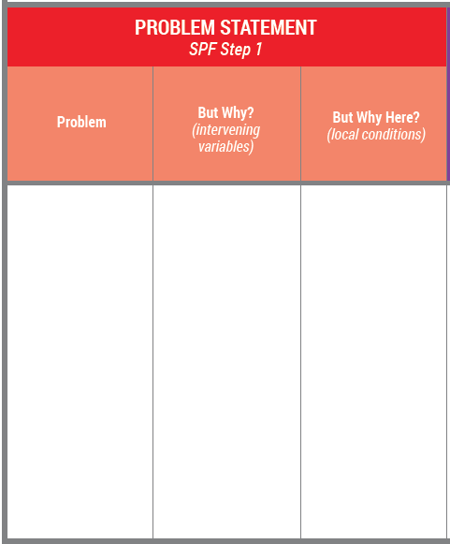
Assessment Phase
Problems and Consequences
State/Regional Data
Underage Drinking
Adult Binge Drinking
Notes:
Most of what was provided came from statewide or regional data. Most of you stated underage drinking was going to be the area of focus based on this data.

Slide 11
Assessment Phase
Intervening Variable (but why?)
Regional/County Data
High retail access of alcohol
High social access of alcohol
Notes:
Now that you have identified underage drinking or adult binge drinking as the problem, the next step is to identify why it is an issue. Is underage drinking a problem because there is high retail access? Or, is it high social access? Is it the community norms? During the assessment, we will peel back the layers of the onion.

Slide 12
Assessment Phase
Local Condition (but why here?)
Community/Local Data
Draw a picture of what retail access looks like in the community
Draw a picture of what social access looks like in the community
Notes:
Once we have identified why underage or adult binge drinking is a problem, we have to go one step further and ask “but why here?” Why is underage drinking a problem in this community? What does social access look like in Jamestown…or Watford City? What specific behavior is occurring? This is referred to as the local condition.

Slide 13
Assessment Phase
Assess Local Conditions
Describe the specific behavior:
Conduct focus groups
Interview key informants (12 sectors)
Surveys
Environmental scans
Notes:
You need to be very specific on what your local condition is and be able to measure it. You can do this by conducting key informant interviews, focus groups, surveys, etc. Speaking with the youth might be one of the best way to determine what the local condition looks like within the community. COVID has changed a lot of things and you may have to get creative on how you do this. When we review your assessments, we will look for how well you identified, measured and described your local condition.
Don’t jump ahead to planning until after you have completed the assessment.

Slide 14
Assessment Phase
Deadlines & Monthly Reimbursements
Logic Model (first three columns filled out)
By November 30, 2023
Monthly Reimbursement
Submitted to Kali by December 10th (unless extension requested)
$5,000/month - $10,000 maximum
SFN1763
https://www.nd.gov/eforms/Doc/sfn01763.pdf

Slide 15
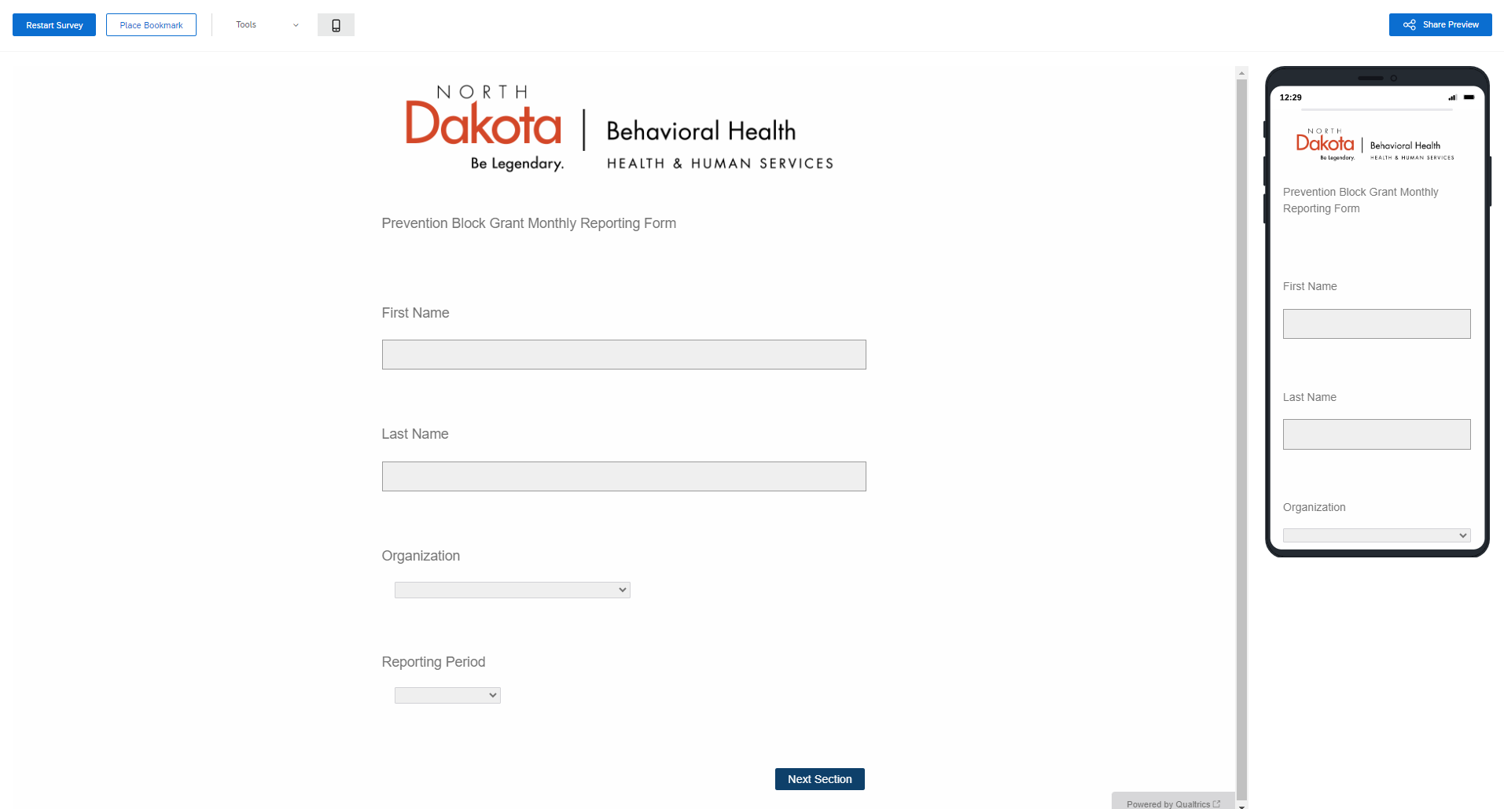
Assessment Phase
Monthly Reporting
Online Reporting – link provided by Kali

Slide 16
Scope of Service
Four Phases:
1. Assessment Phase
October 1, 2023 – November 30, 2023
2. Planning Phase
December 1, 2023 – December 31, 2023
3. Implementation Phase
January 1, 2024 – July 31, 2026
4. Evaluation Phase
August 1, 2026 – September 30, 2026

Slide 17
Planning Phase
PLANNING
Notes:
After completing your assessment, the next step is to start planning. What are you going to do to address the local condition?

Slide 18
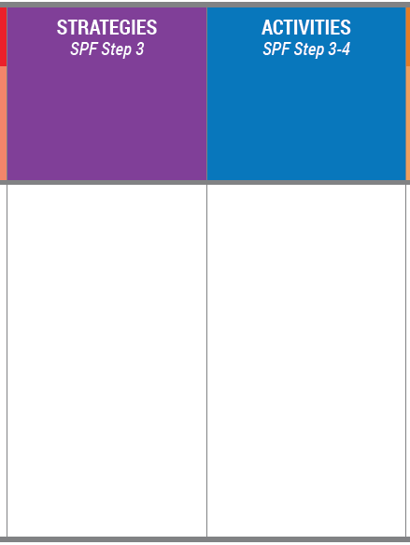
Planning Phase
Environmental Strategy
“Efforts aimed at changing or influencing community conditions, standards, structures, systems and policies.”
Notes:
The contract requires you to select ONE environmental strategy to focus your implementation efforts on. An environmental strategy is one that will lead to long-term outcomes.

Slide 19
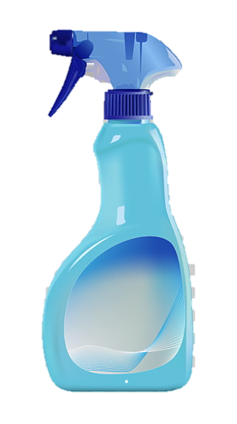
Focus
Have a clear vision.
Activities you do should be specific to the environmental strategy you are attempting to implement and the behavior you are attempting to change.
Notes:
We are asking for only ONE strategy because, we have learned that if there is one clear, obtainable goal, you will be more likely to succeed and see outcomes.
Think about if you have a candle that you want to put out. If we use the spray bottle, our water is a mist spread and scattered and does not put out the candle.
But a small amount of water in an eye dropper, concentrated and working together is enough to put the candle out. We want our community-based efforts to have the effect of that eye dropper, not the spray bottle; to have a clear vision and ensure that the activities you do are specific to the environmental strategy you are attempting to implement and the behavior you are attempting to change.

Slide 20
Planning Phase
Activities
The individual actions or steps completed to implement the environmental strategy.
Notes:
Once you select an environmental strategy to implement within your community, you will begin implementing activities through a comprehensive approach following CADCA’s 7 strategies for community change (which we will discuss in a later slide). Breaking down the steps to implement an environmental strategy will increase the likelihood of success and outcomes.

Slide 21
Scope of Service
Planning Phase Contract language:

Slide 22
Planning Phase
Strategic Plan
The document that describes the goals and objectives to reach your outcome.
SMART
Importance/Changeability
Strategy linked to the data
Activities related to environmental change
Notes:
The contract requires a plan to be created based on the data you collected. We will look for SMART goals, the selection of your strategy and how that relates to your problem, intervening variable and local condition. We need to ensure the activities you plan to implement will impact the intervening variable and ultimately your identified problem.
SMART: Specific, Measurable, Achievable, Relevant, and Time-Bound
We will also review for Importance and Changeability.
Importance = “how much an intervening variable impacts the substance abuse problem/priority in a community”.
• Will the intervening variable impact other behavioral health issues?
• Does the intervening variable directly impact the specific developmental stage of the population group that is experiencing the problem?
Changeability = “a community’s capacity to influence a specific intervening variable and local condition”:
Do we have the resources and readiness to address this factor?
Does a suitable intervention exist to address this factor?
Can we produce outcomes within a reasonable timeframe?

Slide 23
Planning Phase

Slide 24
Planning Phase
Deadlines & Monthly Reimbursements
Strategic Plan (with completed logic model)
By December 31, 2023
Monthly Reimbursement
Submitted to Kali by January 10th
$5,000 maximum
SFN1763
https://www.nd.gov/eforms/Doc/sfn01763.pdf

Slide 25
Planning Phase
Monthly Reporting
Online Reporting – link provided by Kali
Notes:
Example of the monthly report

Slide 26
1st Quarterly Presentation
January 10th, 10am-12pm
Present a very brief (3 minute) summary of your logic model

Slide 27
Scope of Service
Four Phases:
1. Assessment Phase
October 1, 2023 – November 30, 2023
2. Planning Phase
December 1, 2023 – December 31, 2023
3. Implementation Phase
January 1, 2024 – July 31, 2026
4. Evaluation Phase
August 1, 2026 – September 30, 2026

Slide 28
Implementation Phase
Activities
Do what you said you were going to do.
Implement the activities to support the environmental strategy.
Notes:
The implementation phase is where the rubber meets the road. You created a plan of all the activities you wanted to implement, and this is where you put the plan into action. Again, this is done following CADCA’s 7 strategies for community change.

Slide 29
Implementation Phase
Strategy Implementation Guide (Attachment A)
CADCA’s 7 Strategies for Community Change
Provide information
Enhance capacity or skills
Provide support
Enhance access/reduce barriers
Change consequences
Physical design
Environmental change
Notes:
CADCA’s 7 strategies are a proven effective in implementing an environmental change and is a multifaceted approach to prevention.
The goal in planning is to work from #7 backwards. All activities should be focused on the environmental change.

Slide 30
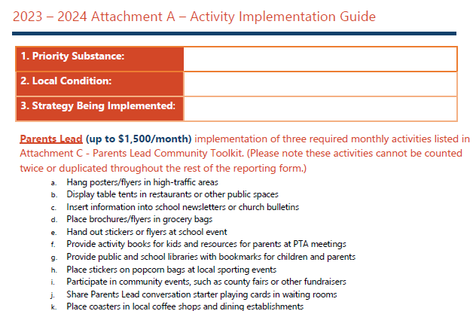
Implementation Phase
Attachment A
Notes:
Attachment A was developed based on CADCA’s 7 strategies. The contract will reimburse based on the individual activities implemented following Attachment A. This will be new for PFS grantees and probably the biggest change. It will take time to adapt to this style of reimbursement structure.
This method of reimbursement was developed approximately 3 years ago and has been highly successful. Grantees were able to accomplish more which allowed us to report more in 1 year than we were able to report in 10.
Again, this is new for PFS grantees. It is not a flat monthly reimbursement but rather a reimbursement based on the specific deliverables completed.

Slide 31
Implementation Phase
Provide Information
Local condition is: “Youth are getting alcohol from adults age 21 and older and drinking it at shop parties.”
Environmental change is: “Increased penalties for adults who provide alcohol to youth.”
Radio messages about the laws on providing alcohol
Facebook posts about laws and penalties for providing alcohol
Community Forum about alcohol and penalties
Share information at coalition meeting about increased penalties
Not in My House campaign materials on laws and not proving alcohol
Parents LEAD materials on being a good role model
Not in My House Campaign materials on the laws and consequences for providing alcohol to minors
Notes:
So let’s look at a few examples of the 7 strategies… Step 1 is providing information. Providing information is just that…it is usually 1-way communication efforts. Most expensive/least effective. Providing information would be things like educational presentations, workshops or seminars or other presentations of data (e.g., public announcements, brochures, dissemination, billboards, community meetings, forums, web-based communication).
So by this time, you have already identified your local condition and one environmental strategy to implement. The activities are the individual steps to complete to implement the 1 environmental strategy.

Slide 32
Implementation Phase
Enhance Capacity or Skills
Local condition is: “Youth are getting alcohol from adults age 21 and older and drinking it at shop parties.”
Environmental change is: “Increased penalties for adults who provide alcohol to youth.”
Law enforcement training on Source Investigations
Webinar for coalition members on effective penalties for adults who provide alcohol
Attend a training on effective penalties for adults
Collect new data on the local condition
Host a conference on laws and penalties around alcohol
Notes:
In order to implement an environmental strategy such as increased penalties, you have to build capacity…community capacity and key stakeholder capacity. The goal of capacity building is to increase the skills of participants, members and staff needed to achieve population level outcomes. If your local condition is…

Slide 33
Implementation Phase
Provide Support
Local condition is: “Youth are getting alcohol from adults age 21 and older and drinking it at shop parties.”
Environmental change is: “Increased penalties for adults who provide alcohol to youth.”
Alternative events for youth during high-risk times of use
Evidence-based curriculum for youth on good decision making/alcohol prevention
Parent classes
Notes:
Providing support is creating opportunities to support people to participate in prevention efforts/activities/strategies that reduce risk or enhance protection. Providing support could look like…

Slide 34
Implementation Phase
Enhancing Access/Reduce Barriers
Local condition is: “Youth are getting alcohol from adults age 21 and older and drinking it at shop parties.”
Environmental change is: “Increased penalties for adults who provide alcohol to youth.”
Childcare
Transportation
Notes:
Enhancing access/reducing barriers is anything related to improving systems and processes to increase the ease, ability and opportunity to utilize those systems and services (e.g., assuring healthcare, childcare, transportation, housing, justice, education, safety, special needs, cultural and language sensitivity). This step can include identifying barriers and possible strategies to overcome those barriers. These have to be preapproved by the state.

Slide 35
Implementation Phase
Change Consequences
Local condition is: “Youth are getting alcohol from adults age 21 and older and drinking it at shop parties.”
Environmental change is: “Increased penalties for adults who provide alcohol to youth.”
Texting Tipline – promoted as a tool to report adults who are providing alcohol
Incentive for adults who submit tips about other adults who are providing alcohol
Disincentives – name published for illegally providing alcohol to youth
Notes:
Changing consequences are strategies that increase or decrease the probability of a specific behavior that reduces risk or enhances protection by altering the consequences for performing that behavior. So, if your local condition is… what would be ways to change the consequences in this situation? It could be things like implementing or promoting a texting tipline to report parties or adults who provide alcohol. Or, you could provide incentives for those who submit tips leading to an arrest.

Slide 36
Implementation Phase
Physical Design
Local condition is: “Youth are getting alcohol from adults age 21 and older and drinking it at shop parties.”
Environmental change is: “Increased penalties for adults who provide alcohol to youth.”
Permanent signs up at retail establishments – “It is illegal to purchase alcohol for minors.”
Cameras in retail establishment parking lots – increase prosecution of adults providing alcohol
Not in My House Sticker Shock campaign materials – education on the laws and consequences for providing alcohol to minors
Notes:
Changing the physical design or structure of the environment to reduce risk or enhance protection. These are usually permanent changes.

Slide 37
Implementation Phase
Environmental Change
Local condition is: “Youth are getting alcohol from adults age 21 and older and drinking it at shop parties.”
Environmental change is: “Increased penalties for adults who provide alcohol to youth.”
Increased penalties for adults who provide alcohol to youth.
Law enforcement adopts new protocols on enforcing the laws for providing alcohol
Court makes it a requirement of minimum fine and community service
Law enforcement adopts new protocols on source investigations
Notes:
The environmental change is that formal change in written procedures, by-laws, proclamations, rules or laws with written documentation and/or voting procedures. You would have identified this in your planning phase. These strategies are the lease expensive/most effective. They lead to real outcomes.

Slide 38
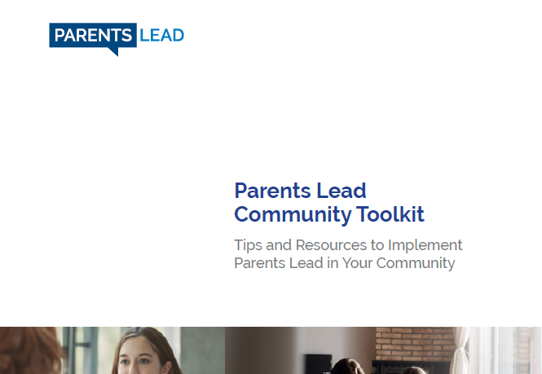
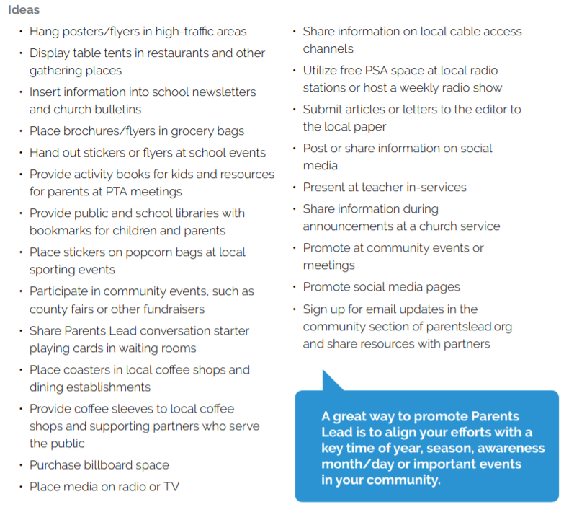
Parents Lead
Implementation of Community Toolkit (Attachment C):
Notes:
One more thing to mention about the AOD prevention contract, it requires the implementation of Parents LEAD activities. You can find a community toolkit online which provides context on what to implement. Understandably there are tactics that you won’t be able to be utilize due to the lack of in-person events, but the toolkit provides plenty of ideas to tweak to fit your community’s needs, while falling within CDC guidelines.

Slide 39
Implementation Phase
Monthly Reimbursements
Submit all monthly reimbursements to Kali
Submit by the 10th of each month
$8,000 LPHU/$14,000 Tribal maximum/month
encourage year long implementation of activities
SFN1763 https://www.nd.gov/eforms/Doc/sfn01763.pdf
Pay attention to activity monthly maximums
Notes:
*** Does not reimbursement for administration fees, administration is built into activities
You must submit both your RFR and Monthly Report in order to be reimbursed.

Slide 40
Scope of Service
Four Phases:
1. Assessment Phase
October 1, 2023 – November 30, 2023
2. Planning Phase
December 1, 2023 – December 31, 2023
3. Implementation Phase
January 1, 2024 – July 31, 2026
4. Evaluation Phase
August 1, 2026 – September 30, 2026

Slide 41
Evaluation Phase
EVALUATION
Notes:
The best way to think about evaluation is by referring back to the logic model. Each measure is tied back to the problem statements. So, if your local condition was “youth are obtaining alcohol by purchasing it with fake IDs”…then the short-term measure would be a reduction in the use of fake IDs – number of IDs captured…number of IDs checked, number of training held on how to check for fake IDs…etc. These measures are being captured in your monthly reports. The short-term measures let us know that you are working towards the long-term outcomes.

Slide 42
Evaluation Phase
PROCESS MEASURES
Notes:
The short-term/process measures are related to the specific steps that lead to a particular outcome and measures whether an activity has been accomplished. Answers the question: “Did we do what we said we would do?”
These are things like: number of people reached, number of IDs checked, number of flyers handed out, number of face-to-face meetings, etc. Again, the process measures are being collected in your monthly reports.

Slide 43
Evaluation Phase
INTERMEDIATE MEASURES
Notes:
Your intermediate measures are tied to your intervening variables. Was there a “reduction in social access of alcohol”…less kids are reporting using fake IDs to purchase alcohol, less kids are reporting obtaining alcohol from underage friends, etc. We don’t expect to see large changes in these measures, but some may see changes in these measures.
Intermediate outcomes:
•Are the effects of your strategies at some point after they are completed
Depend on the short-term outcomes and how well you implemented your activities.

Slide 44
Evaluation Phase
OUTCOME MEASURES
Notes:
the outcome measures are tied to the identified problem. Did you see a behavior change? This could be a decrease in underage drinking and drunk driving. You might not see changes in this area for years.

Slide 45
Evaluation Phase
Process and Outcome Measures
Determine what worked well and what could be improved on.
Process measures – short-term (local data collection, based on the local condition)
Outcome measures – long-term (environmental changes, decrease in underage drinking, adult binge drinking and the consequences)
Notes:
You will collect baseline data during the assessment phase. During the evaluation phase, you will be collecting data to see if there were changes in your baseline data. It will be critical for you to have a good baseline measure and post implementation measure to determine your successes.
The contract requires you to provide an evaluation report which analyzes both your process and outcome measures.

Slide 46
Evaluation Phase
Deadlines and Monthly Reimbursements
Evaluation Report
By September 30, 2026
Monthly Reimbursements
Submitted to Kali on September 10th and October 10th
$5,000 maximum/month
SFN1763
https://www.nd.gov/eforms/Doc/sfn01763.pdf
Notes:
You will write an evaluation report and submit to BHD. There is no template for this.
This is your chance to show all the wonderful work and progress you made in your community.
The application Guidance does break this down into the specific parts we would like to see in your written assessment plan.
Monthly reports submitted on September 10 and October 10. These reports are to make sure your evaluation is on track and letting us know barriers you are encountering and any TA you are needing. If you do not submit this form and an RFR you will not be reimbursed the $5,000/month. This form is a text only form – you will not have to select specific activities to be reimbursed. These do not reimbursement for administration fees, administration is built into activities.

Slide 47
Technical Assistance
State Staff
Prevention Website: https://www.hhs.nd.gov/behavioral-health/prevention
Grantee Portal: https://www.hhs.nd.gov/behavioral-health/prevention/current-grantee-overview
Videos and Resources (State)
What is Prevention?
Past training/recorded meetings
Virtual Quarterly Grantee Presentations (State)
Topic-Specific Recorded and Live Webinars (GP)
In-Person Quarterly Training Events (GP)
Regional Capacity Building Events (GP)
State Capacity Building Event (GP)

Slide 48
Questions?

