Slide 1
2022-2023 Quarterly Meeting #3
July 11th, 2023

Slide 2
TODAY’S AGENDA
Updates – Federal and State
Harm Reduction Vending Machine in Fargo – Robyn Litke Sall
Naloxone distribution – Jails and Leave Behind Program
Resources
Successes and Questions from grantees

Slide 3
Updates – Federal and State
SAMHSA approved the purchasing of xylazine test strips with SOR funding
Reminder: Per ND Century Code 23-01-44, in ND only registered Syringe Service Programs can distribute test strips (fentanyl and xylazine)
Legislative Updates – Meeting on July 12th
HB 1447 removed the requirement for individuals to be trained prior to receiving nasal naloxone
Save the Date – The Behavioral Health & Family Services Conference
October 24-26 in Bismarck
Dr. Jermaine Jones from Columbia University to talk about fentanyl, Narcan, and importance of education and training

Slide 4
Updates – Federal and State
Medicaid is increasing access to buprenorphine products
Educational letters to prescribers – how Sublocade can be used and how often their peers are prescribing it.
Allowing 8/2 and 2/0.5 tablets to be used together for more tailored dosing
Opioid Settlement Advisory Committee
Listening session June 29th in Fargo with another one in Bismarck August 22nd
Next committee meeting is July 26th
Upcoming SOR grant
We anticipate continuing the SOR grant from October 1, 2023 – September 29, 2024
President Biden’s Executive Budget Request to increase the 2024-2025 SOR grant by 425 million

Slide 5
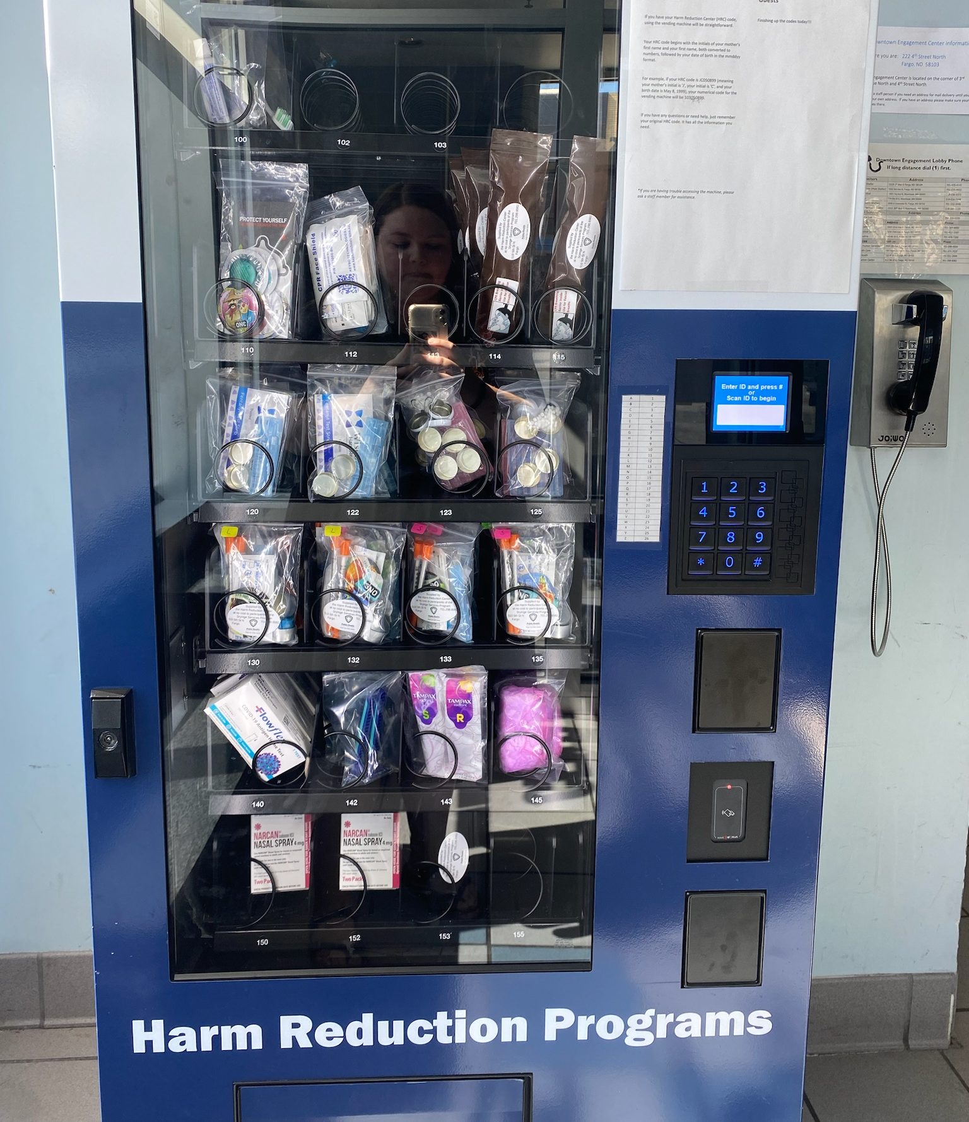
Harm Reduction Vending Machine
Fargo Cass Public Health will share an update on their recent implementation of a harm reduction vending machine

Slide 6
Naloxone Distribution – Jails and leave behind program
Naloxone distribution upon release from a county jail
16 respondents
10 have jails in their counties
6 of those 10 jails are currently distributing naloxone
Identified barrier: lack of knowledge surrounding this topic (both LPHU and jails)
Leave Behind Program implementation
16 respondents
5 utilize a Leave Behind Program
Of those 5 it is either ambulance or fire. 1 respondent listed fire, ambulance, and LE
Barriers:
Volunteer services,
Decrease knowledge of the program (both LPHU and first reponders)
Nature of calls and call volume

Slide 7
Leave Behind Program
What is it?
Naloxone leave behind programs are designed for first responders to educate and equip high risk individuals to respond to opioid overdose scenarios. These programs enable first responders to leave naloxone kits with the family, friends, or bystanders at the scene of a non-fatal overdose. Survivors are at high risk for repeated overdose and providing naloxone to these individuals and their loved ones is especially important.
Additional opportunities
Connecting individuals with a Peer Support Specialist
Initiating MOUD at the scene of a non-fatal overdose

Slide 8
Naloxone distribution Continued
Strategies to implement to reach high risk individuals
Connect with county jails
Connect with ambulance, fire, and law enforcement
Connect with other entities that further distribute naloxone to individuals
Charlotte Williams, Public Health Analyst with the CDC Foundation, Opioid Response Strategy can assist in these efforts.
williamscharlotte@nd.gov

Slide 9
Resources
Mountain Plains Rural Opioid Technical Assistance Center - Newsletter Sign Up - Mountain Plains Rural Opioid Technical Assistance Center (mprotac.org)
Opioid Response Network (ORN) Opioid Response Network

Slide 10
Next Meeting
Wednesday, September 6th at 10am

Slide 11
Success or questions

