Slide 1

NORTH DAKOTA
SUBSTANCE USE PREVENTION GRANT KICKOFF MEETING
October 16, 2023

Slide 2
Welcome!
01
Introduction of BHD Prevention Team & Roles
02
Purpose & Background
03
Introduction of Grantees
04
Scope of Service
05
Timeline & Important Dates
06
Reimbursement & Reporting Processes
07
Technical Assistance
08
Q & A
Notes:
Tom

Slide 3
Behavioral Health Division
Prevention Team
General Grant Management & Contract Administration
Reporting & Reimbursement
Early Intervention Program Administration
Kali Bauer
kalibauer@nd.gov
Training & Technical Assistance
Tobacco Synar Program & Compliance
Forensic ID Scanners
NDTip System
Tom Volk
tmvolk@nd.gov
Tori Nelson
Prevention Campaign Media & Materials
Website Resources
tknelson@nd.gov
Notes:
Tom

Slide 4
Behavioral Health Division
Prevention Team
Amy Lies
State Opioid Response (SOR) Grant Management
Opioid Settlement Committee Liaison
amlies@nd.gov
Sara Kapp
Parents Lead Program Management
skapp@nd.gov
Behavioral Health School Grant Funding
Kognito
B-HERO
Kayla Stastny
kastastny@nd.gov
Leah Jangula
Resource Order Fulfillment & Inventory Oversight
ljangula@nd.gov
Notes:
Tom

Slide 5
Behavioral Health Division
Prevention Team
James Knopik
Manager, Addiction/Prevention Program and Policy
Early Intervention Program Manager
jknopik@nd.gov
Laura Anderson
BHD Policy Director
Strategic Planning
Statewide Behavioral Health Prevention Infrastructure
National Prevention Network Representative
lauranderson@nd.gov
Notes:
Tom

Slide 6

WELCOME!
PLEASE INTRODUCE YOURSELF IN CHAT
YOUR NAME
NAME OF ORGANIZATION
ROLE
Notes:
Tom (or James?)
BHD falls under the Department of Health and Human Services.
We are part of the executive branch of government.

Slide 7
BEHAVIORAL HEALTH DIVISION
PURPOSE & BACKGROUND
Notes:
Tom (or James?)
BHD falls under the Department of Health and Human Services.
We are part of the executive branch of government.

Slide 8

OUR VALUES
Trauma Informed
Reccovery Oriented
Person Centered
Integrated
Data Driven
Best Practices
Transparency
Accountability
Notes:
Tom (or James?)
The Behavioral Health Division is a policy division responsible for:
Reviewing and identifying service needs and activities in the state’s behavioral health system in an effort to ensure:
health and safety
access to services,
and quality services
Establishing quality assurance standards for the licensure of substance use disorder program services and facilities;
and Providing policy leadership in partnership with public and private entities.

Slide 9

North Dakota
Behavioral Health
Principles
Behavioral health is health:
· Stop the shame and stigma around behavioral health
· Ensure integration and parity of health and behavioral health
Support the full continuum of care across prevention, early intervention, treatment and recovery
Ensure person-centered care:
· Meet people where they are
· Engage in individual and family-driven care
· Provide trauma-informed services
· Provide services focused on recovery
Ensure behavioral health services and supports are available in the community: avoid institutionalizing and criminalizing
Be efficient and effective:
· Leverage best practices
· Monitor and evaluate outcomes
· Measure the return on investments
Develop, recruit, and retain a competent behavioral health workforce
Notes:
Tom (or James?)

Slide 10

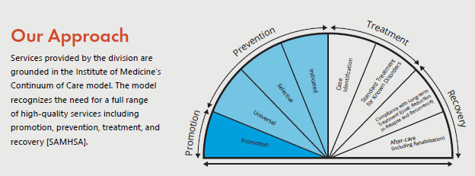
Promotion and Prevention
Strategies create an environment that promotes the health and well-being of individuals and communities; which prevents problems before they occur.
Notes:
Tom (or James?)
BHD's responsibilities include:
administration:
regulation:
collaboration and partnerships:
and training and technical assistance
BHD identifies goals and administers over 70 programs and projects in these areas:
Prevention and Promotion
Children's Behavioral Health
Adult Addiction
Adult Mental Health
Community Supports

Slide 11
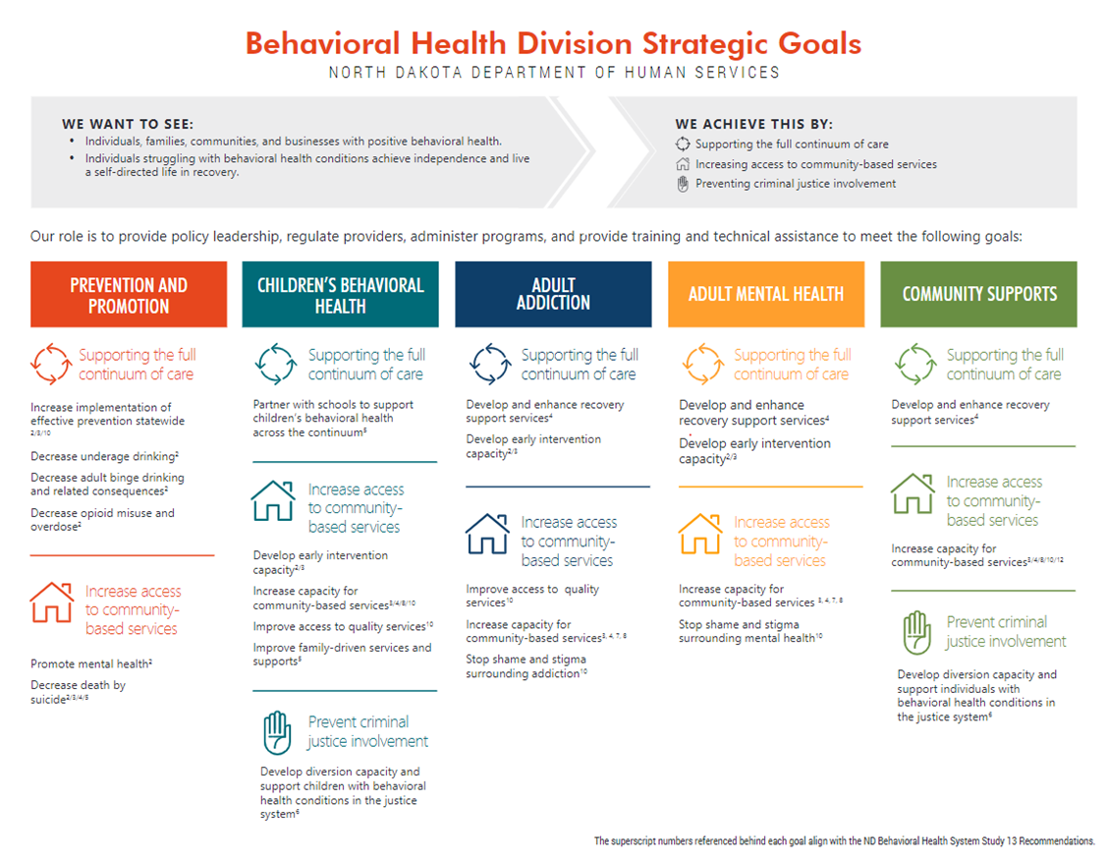
Notes:
Tom (or James?)
BHD's Strategic Plan is guidance in order to provide policy leadership, regulate programs, administer programs, and provide training and technical assistance.

Slide 12
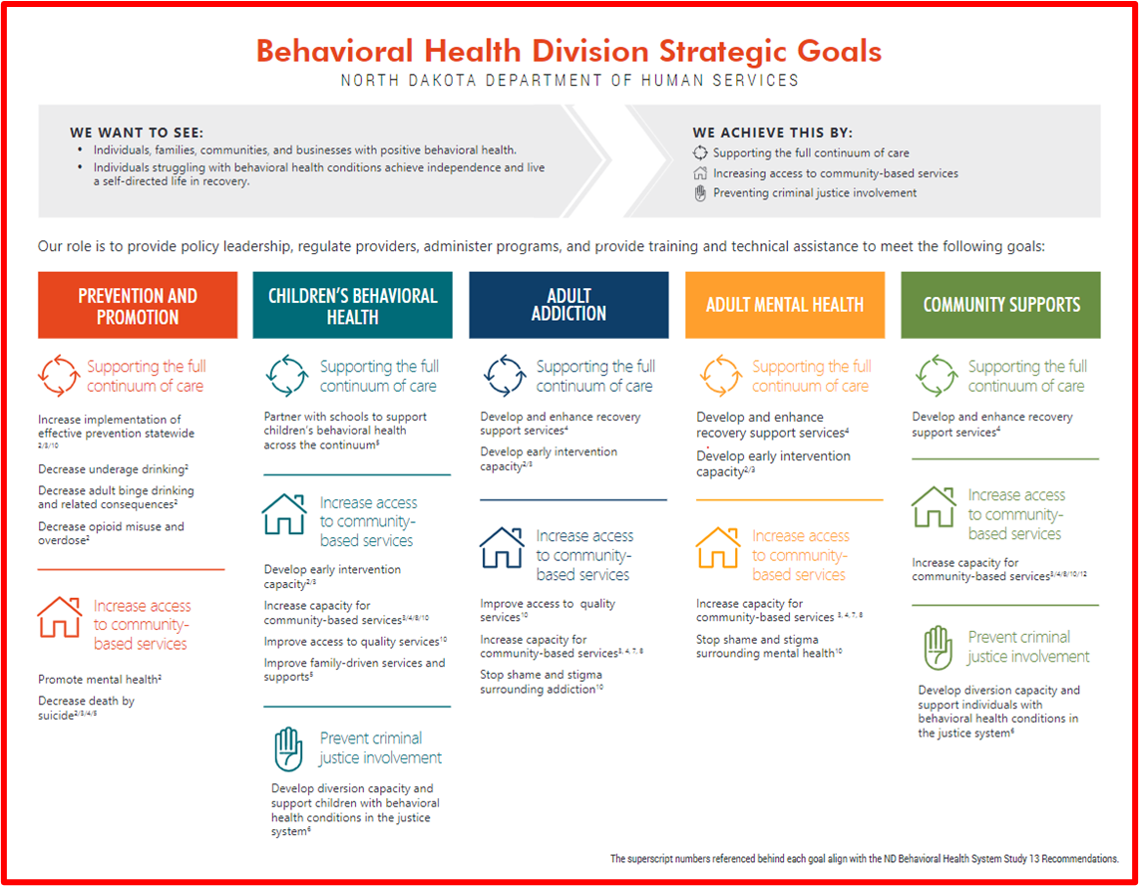

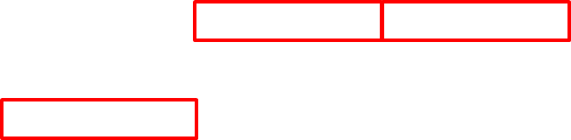
Notes:
Tom (or James?)
The Prevention and Promotion part of the strategic plan focuses on the following highlighted in red:

Slide 13

PREVENTION WORKS WHEN:
it follows the Public Health Model and focuses on population-level change
it follows a data-driven process known as the Strategic Prevention Framework (SPF)
it focuses on reducing risk factors, strengthening protective factors, and building resiliency
it requires a multi-faceted approach by implementing a variety of evidence-based strategies
it is relevant to the community, including local conditions and demographics
it impacts individuals across the lifespan
Notes:
Tom (or James?)

Slide 14
SUBSTANCE USE PREVENTION,
TREATMENT AND RECOVERY (SUPTRS) BLOCK GRANT
Notes:
Tom
SAMHSA is a federal agency within the U.S. Department of Health and Human Services
Leads public health efforts to advance the behavioral health of the nation.

Slide 15

PURPOSE
The purpose of the 20% minimum prevention set-aside of the SUPTRS Block Grant is to support community and tribal level evidence-based substance use prevention implementation by increasing capacity for sustained prevention efforts in data-driven priority areas:
Underage Drinking
Adult Binge Drinking
Other Substances
Adult Binge Drinking
Underage Drinking
Other Substances
(excluding opioids or stimulants)
Notes:
Tom

Slide 16
FUNDING
Community Grantee Funding
24 total grantees awarded
3 year contract awarded to Local Public Health Units
$187,500 total ($62,500 per year)
Tribal Grantee Funding
4 total grantees awarded
3 year contract awarded to Tribal Governments
$240,000 total ($80,000 per year)
Notes:
Tom

Slide 17
NORTH DAKOTA BLOCK GRANT RECIPIENTS
Bismarck Burleigh Public Health
Cavalier County Health District
Central Valley Health District
City-County Health District
Dickey County Health District
Emmons County Public Health
Fargo Cass Public Health
First District Health Unit
Foster County Public Health
Grand Forks Public Health
Kidder County Public Health
Lake Region District Health Unit
LaMoure County Public Health Department
McKintosh District Health Unit
Nelson-Griggs District Health Unit
Pembina County Health Department
Ransom County Public Health
Richland County Health Department
Rolette County Public Health District
Sargent County District Health Unit
Southwestern District Health Unit
Spirit Lake Tribe
Standing Rock Sioux Tribe
Steele County Public Health
Three Affiliated Tribes (MHA Nation)
Towner County Public Health
Traill District Health Unit
Turtle Mountain Band of Chippewa
Upper Missouri District Health Unit
Walsh County Health District
Wells County District Health Unit
Western Plains Public Health
Notes:
Tom
24 local public health units
4 tribes

Slide 18
Scope of Service
General Expectations:
  Collaboration
  Training and Technical Assistance (TTA)
    Growth Partners
  Quarterly Meetings
  Substance Abuse Prevention Skills Training (SAPST)
  Monthly Reporting & Reimbursement Requests
Notes:
Tom
collaboration: with existing prevention organizations and programs to maximize benefit, avoid duplication of efforts, and redirect or realign resources
TTA: Participate in required Training and Technical Assistance (TTA) opportunities provided by the State, to include trainings and onsite visits. This may include Pre- and post- capacity assessments, Quarterly in-person training events, Statewide prevention conference; Assist in planning, promoting and implementing a regional capacity building event.
Quarterly Meetings: Participate in quarterly virtual meetings with the State with the requirement of providing a brief presentation on recent activities, accomplishments, and barriers.
SAPST: Ensure at least one individual working under this grant has completed the Substance Abuse Prevention Skills Training (SAPST), a training offered by the state, within the last 5 years.
Monthly Reporting & Reimbursement: Submit monthly reports on or before the 10th of each month to the State using the Monthly Reporting process developed by the State.

Slide 19
Important Documents & Resources
  Contract Resource Guide - coming soon!
  Logic Model Template
  Attachment A - Activity Implementation Guidelines - new items added!
  Attachment B - Funding Requirements
  Attachment C - Parents Lead Community Toolkit - requirement of 3 related activities per month
  Monthly Reporting & Reimbursement Process
    Link to Qualtrics - to submit monthly forms online
    Updated Monthly Reporting Form - utilize before submitting online and keep for your records
    SFN 1753 - Request for Reimbursement Form
    Supplemental Planning Templates
Notes:
Kali
copies of all documents listed here will be e-mailed to you as well as located on our Grantee Resources website:
https://www.hhs.nd.gov/behavioral-health/prevention/current-grantee-overview

Slide 20
Timeline & Important Dates
The contract will run from October 1, 2023, through September 30, 2026 and will be broken into four phases:
  Phase 1 - Assessment Phase (October 1, 2023 - November 30, 2023)
    Initial Assessment due on November 30th at 5:00pm
    First in-person Quarterly Training is scheduled for November 14th and 15th in Bismarck, ND
  Phase 2 - Planning Phase (December 1, 2023 - December 31, 2023)
    Strategic Plan due on December 31st at 5:00pm
    Assessment & Planning Overview Meeting (first virtual Quarterly Meeting) is scheduled for Wednesday, January 10th at 10:00am
  Phase 3 - Implementation Phase (January 1, 2024 - July 31, 2026)
    Monthly Reporting and Reimbursement Requests due each month on or before the 10th at 5:00pm
    Optional Monthly Q&A Meetings scheduled for the first Tuesday of every month at 10:00am
    Quarterly Presentation Meetings scheduled for the second Wednesday of each quarter at 10:00am
  Phase 4 - Evaluation Phase (August 1, 2026 - September 30, 2026)
    Final Evaluation due on Wednesday, September 23rd at 5:00pm
    Final Evaluation Overview Meeting scheduled for Wednesday, September 30th @10:00am
Notes:
Kali
all meetings will be recorded and posted online here:
https://www.hhs.nd.gov/behavioral-health/prevention/current-grantee-overview
first in-person meeting is on a Tuesday and Wednesday - please refer to email from Tom for more information.
If a grantee cannot make the mandatory in-person meeting, please schedule a 1-hour meeting with us. Going forward, it is a contract requirement for at least one person to be at these in-person events. We will try our best to provide 1-2 months notice to accommodate traveling.

Slide 21

ASSESSMENT PHASE
Step 1: Self-Assessment (Questions found in the Contract Resource Guide pg 12-13)
Step 2: Data Collection & Review
Step 3: Identify and Develop Problem Statements (Column 1-2-3 of the Logic Model)
Key Deliverables:
  a completed assessment will have clear problem statements, have identified intervening variables, and have a comprehensive description of local conditions or behaviors
  The first section of the Logic Model may be submitted as a completed assessment, with additional pages or attachments as needed to include links/screenshots of data sources or other information
Notes:
Kali
State & Regional Data identify underage drinking & adult binge drinking as key focus areas

Slide 22
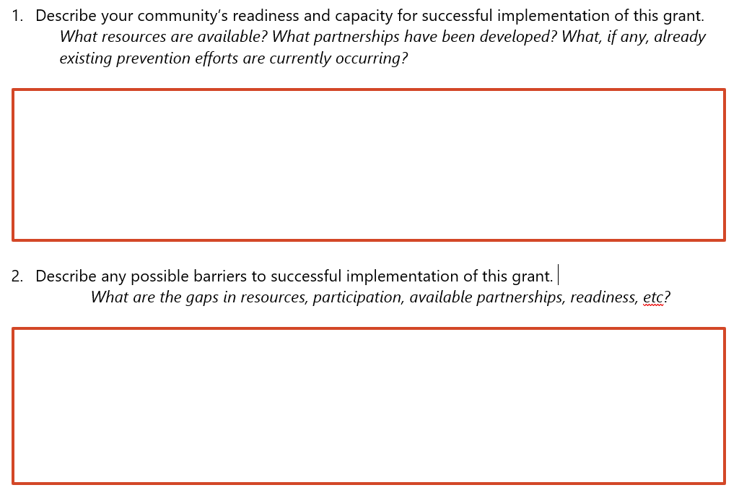
SELF-ASSESSMENT
Notes:
Kali

Slide 23
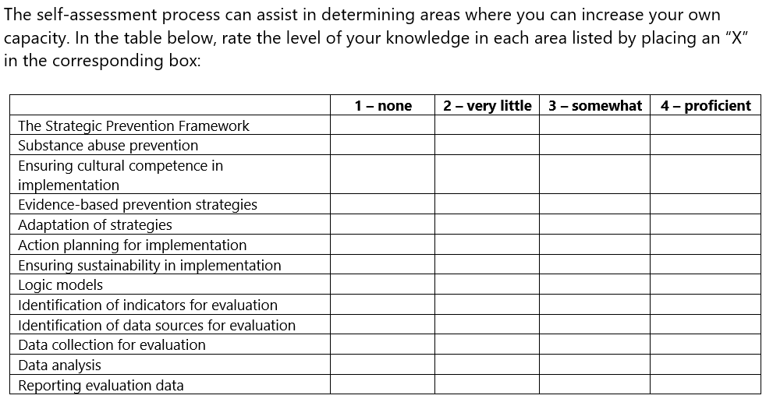
Notes:
Kali

Slide 24
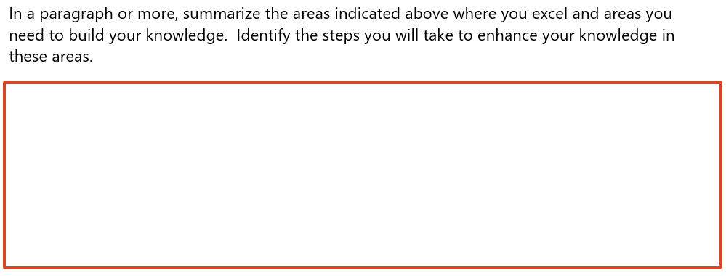
SELF-ASSESSMENT
Notes:
Kali

Slide 25
DATA COLLECTION
The assessment process involves gathering the following data:
• Nature and extent of substance use problems and related behaviors
• Risk and protective factors that influence substance use problems and related behaviors.
• Available resources and readiness of the community to address these problems.
Using data allows for a more objective decision-making process. The assessment should be able to answer the following questions about substance use:
• What problems and related behaviors are occurring?
• How often are the problems and related behaviors occurring?
• Where are these problems and related behaviors occurring?
• Which population groups experience more of these problems and related behaviors?
Notes:
Tom

Slide 26
DATA COLLECTION
Since so much data is available, it is important to be strategic about the data you collect:
• Purpose. What is your rationale about how the data you want to collect relate to the substance use problems and to the work of your coalition? What will this data tell you about community substance use problems in your community and especially where (the settings) the problems occur?
• Validity. Does the indicator measure what it says it does? For example, to what extent do the number of DUI arrests measure the prevalence of drinking while driving as opposed to the aggressive enforcement of local laws by police?
• Reliability. Is the indicator reported the same way each year or are there variances that could affect totals and make data comparison impossible?
• Availability. Are the data available year to year and at the needed geographic level (neighborhood, city, county)?
• Obtainability. Can the data be collected easily? Will the agency that tracks the data release them?
• Stability. How long has the agency been collecting the data? It is most useful to use indicators that have been collected for at least five years to identify trends.
• Cost. Can data be provided at no cost, or will the agency charge a fee? Is the fee reasonable and affordable?
• Relevance. Does the coalition think that the indicator accurately represents a major aspect of the community’s substance use problem(s)?
Notes:
Tom

Slide 27
DATA COLLECTION
Some readily available data sources may include:
•2023 North Dakota Data Booklet
•2022 North Dakota Behavioral Health Epidemiological Profile
•2021 North Dakota Youth Risk Behavior Survey (YRBS)
•2022 North Dakota Survey of Young Adults
•2022 North Dakota Community Readiness Survey
•2021 North Dakota Attorney General Crime in North Dakota Report
•2020 North Dakota Crash Summary
•2022 North Dakota Behavioral Risk Factor Surveillance System (BRFS)
•2021 SAMHSA’s National Survey on Drug Use and Health (NSDUH)
The most updated versions of each data source are featured on the North Dakota Department of Health and Human Services website at https://www.hhs.nd.gov/behavioral-health/data
Notes:
Tom

Slide 28
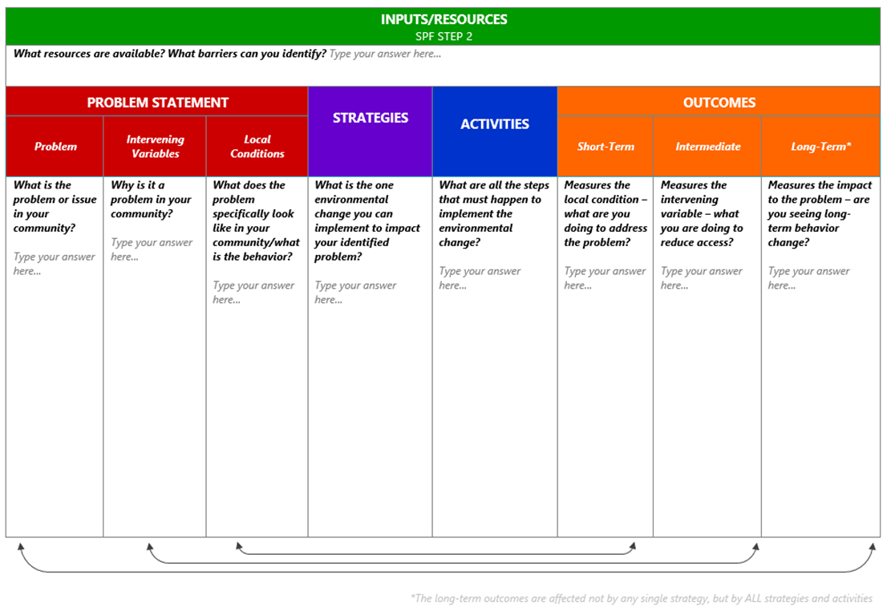
Notes:
Tom
During the assessment phase, you will be required to complete the first three columns of a logic model.
Logic Model - A roadmap or high level overview of the strategic plan, which is developed in the assessment and planning phases.
Self assessment questions include:

Slide 29
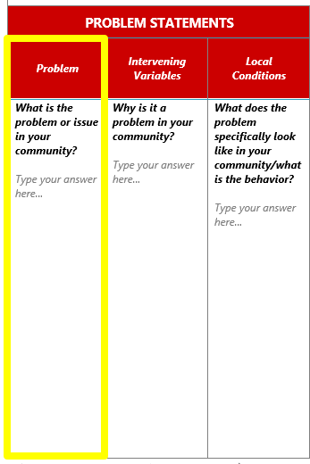
ASSESSMENT PHASE
Problems and Consequences:
State/Regional Data:
  underage drinking
  adult binge drinking
Notes:
Tom
Your assessment will look at all of the data in an objective way. What we need in the logic model is the prioritized/selected problem statement(s).
Underage drinking is a problem becasuse...30% of youth report binge drinking in the past 30 days...25% of arrests are for DUI...etc.

Slide 30
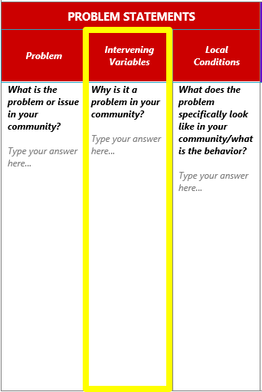
ASSESSMENT PHASE
Intervening Variables (but why?)
Regional/County Data:
  high retail access of alcohol
  high social access of alcohol
Notes:
Tom
The intervening variable is the "but why." Why is underage drinking occurring?
This data is related to the risk and protective factors identified to impact alcohol consumption.
Examples are social access, retail access, etc.
You will need to identify through data what IVs are contributing to alcohol consumption.

Slide 31
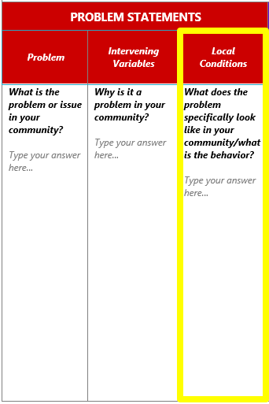
ASSESSMENT PHASE
Local Conditions (but why here?)
Community/Local Data:
  what does retail access look like in your community specifically?
  what does social access look like in your community specifically?
How to identify local conditions:
    conduct focus groups
    interview key informants (12 sectors)
    surveys
    environmental scans
Notes:
Tom
The local condition is the "but why here." What does "social access" look like in my community?
It must describe a specific behavior.
You will need to do the best you can to gather this data. The better you do here, the better you will do overall with implementation and evaluation.

Slide 32
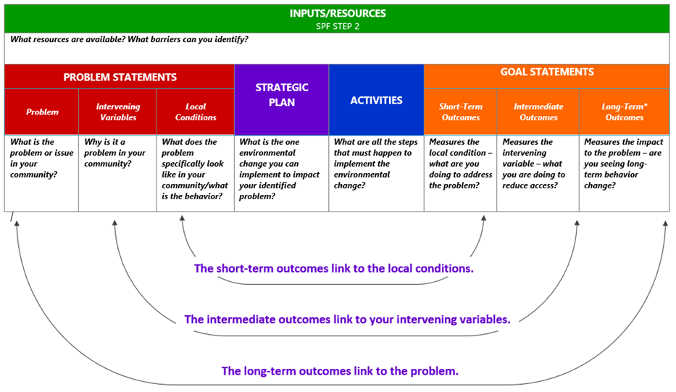
Notes:
Tom
When completing your logic model, your goals will align with your problem statements.
Environmental Strategy:
efforts aimed at changing or influencing community conditions, standards, structures, systems and policies
The planning phase will focus on completing a strategic plan, using the logic model template, and developing the activities and outcomes related to the identified problem statements in the assessment phase.

Slide 33
PLANNING PHASE
Step 1: Identify Goals
Step 2: Identify Objectives
Step 3: Prioritize Local Conditions
Step 4: Identify Evidence-Based Strategies
Step 5: Finalize and Communicate
Notes:
Tom
You will complete the 4th and 5th column of the logic model.

Slide 34
PLANNING PHASE
Environmental Strategy:
  “Efforts aimed at changing or influencing community conditions, standards, structures, systems and policies.”
Action Planning:
  The individual actions or steps completed to implement the environmental strategy.
Strategic Plan:
  The document that describes the goals and objectives to reach your outcome.
  SMART goals
  Importance/Changeability
  Strategy must be linked to the data
  Activities must be related to environmental change
Notes:
Tom
Its important to have a clear vision and to focus on activities that are specific to the environmental strategy you are attempting to implement and the behavior you are attempting to change.

Slide 35
IMPLEMENTATION PHASE
Attachment A - Activity Implementation Guidelines
Resource Materials Requests & Ordering
Notes:
Kali
we will be going over the implementation phase during the first virtual quarterly meeting scheduled for Wednesday, January 10th at 10:00am via Teams
Tori - we are working on migrating the Prevention Resource Center over to X-cart to streamline the ordering process for both digital and physical campaign materials. This will also include Narcan, Deterra and DisposeRX for SOR!

Slide 36
EVALUATION PHASE
Final Evaluation
  A detailed summary of progress made for the implemented strategy utilizing pre- and post- assessment data
  A clear summary of process measures (total people reached, number of resources disseminated, etc.), outcome measures based on identified priority areas,
  Identification of communication points to share with local stakeholders,
  Identified barriers to implementation for activities and possible solutions
  Plans for sustaining outcomes
Notes:
Kali
Won't be until August-September 2026, but the evaluation process needs to be kept in mind throughout the implementation

Slide 37
Monthly Reporting & Reimbursements
New Process:
  continue to utilize updated Excel spreadsheet to track activities
    only previously sustained activities may be done during the Assessment and Planning Phases
  we will be setting up a separate virtual training toward the end of October to go over the new online reporting process through Qualtric
    The in-progress assessment questions and logic model will also be submitted online
Notes:
Kali
Something to be aware of is that the reporting structure will need to be changed going forward. SAMHSA requires a specific structure for federal reporting, which coincides with the CSAP 6 strategies, as opposed to the CADCA 7 strategies that we utilize. When we started the block grant, it was easy for us at the state to manually translate the monthly activities, but now we have 28 total grantees and it has become a much more time consuming task. This change is needed to help with efficiency.
The current solution to this issue is utilizing a program called Qualtrics to submit monthly reporting and reimbursement requests online through a form, with the ability to upload documents as needed. This is a temporary improvement, and we are working on an even better permanent solution for monthly reporting.
For now, you can continue to utilize the excel spreadsheet for your own records and tracking. I will be sending out a new version with updated months and dropdown selections.
The virtual training in October we will go over the actual submission process through Qualtrics, including how to translate activities into SAMHSA's required reporting format.

Slide 38
Training & Technical Assistance
BHD Prevention Team
  available via e-mail, phone, or 1:1 Teams meetings
BHD Website
  https://www.hhs.nd.gov/behavioral-health/prevention/current-grantee-overview
  location for data sources, recorded meetings, resource materials, and more
Growth Partners:
  contracted to provide additional TTA focused on capacity building
Mountain Plains Prevention Technology Transfer Center Network
  self-paced online courses
  recorded and live webinars
Notes:
Tom

Slide 39

QUESTIONS?

