Slide 1

NORTH DAKOTA
PARTNERSHIP FOR SUCCESS (PFS) GRANT KICKOFF MEETING
October 23, 2024
Notes:
Tori

Slide 2

WELCOME!
PLEASE INTRODUCE YOURSELF IN CHAT
YOUR NAME
NAME OF ORGANIZATION
ROLE
Notes:
Tori

Slide 3
OVERVIEW
Introduction of PFS Team & Roles
Purpose & Background
Introduction of PFS
Funding
Scope of Service
Deliverables & Deadlines
Data Agreements
Monthly Reporting & Reimbursement Process
Resources
Q & A
Notes:
Tori

Slide 4
Behavioral Health Division
PFS Team
Tori Nelson
General Grant Management & Contract Administration
Reporting & Reimbursement
Prevention Campaign Media & Materials
tknelson@nd.gov
701.328.4700
Tom Volk
Training & Technical Assistance
Forensic ID Scanners
NDTip System
tmvolk@nd.gov
701.328.8943
Notes:
Tori

Slide 5
PFS Evaluation and Training and Technical Assistance Team
Evaluation
Wyoming Survey and Analysis Center (WYSAC)
Lead Data Evaluator
Federal Evaluation Activities
Community and State-Level Evaluation Activities
Eric Canen
ecanen@uwyo.edu
Training and Technical Assistance (TTA)
Youth Connections (YC)
Community and State-Level TTA Activities
Notes:
Tori

Slide 6
BEHAVIORAL HEALTH DIVISION
PURPOSE & BACKGROUND
Notes:
Tom

Slide 7

OUR VALUES
Trauma Informed
Recovery Oriented
Person Centered
Integrated
Data Driven
Best Practices
Transparency
Accountability
Notes:
Tom

Slide 8

North Dakota
Behavioral Health
Principles
Behavioral health is health:
· Stop the shame and stigma around behavioral health
· Ensure integration and parity of health and behavioral health
Support the full continuum of care across prevention, early intervention, treatment and recovery
Ensure person-centered care:
· Meet people where they are
· Engage in individual and family-driven care
· Provide trauma-informed services
· Provide services focused on recovery
Ensure behavioral health services and supports are available in the community: avoid institutionalizing and criminalizing
Be efficient and effective:
· Leverage best practices
· Monitor and evaluate outcomes
· Measure the return on investments
Develop, recruit, and retain a competent behavioral health workforce
Notes:
Tom

Slide 9

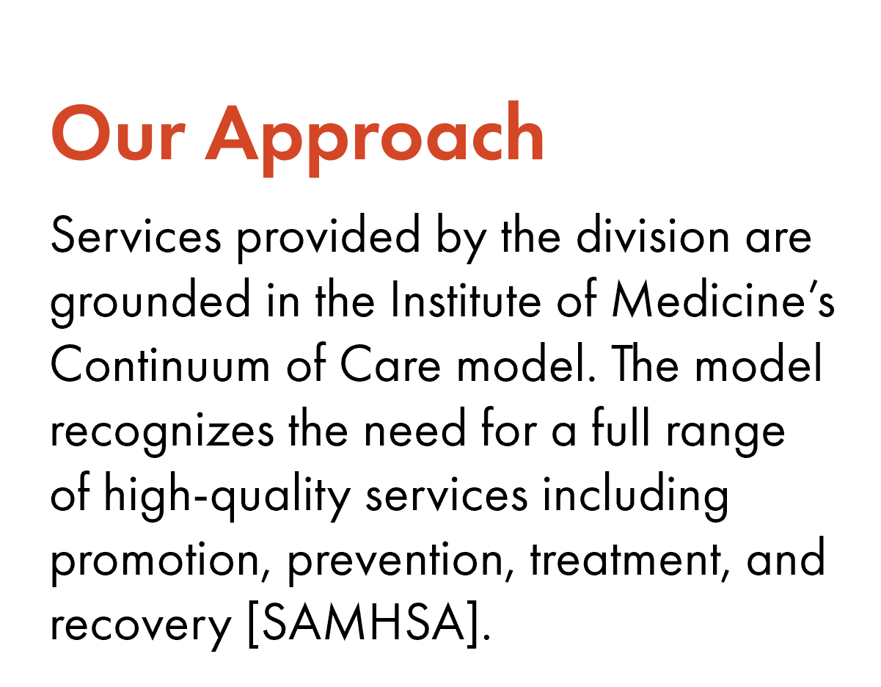
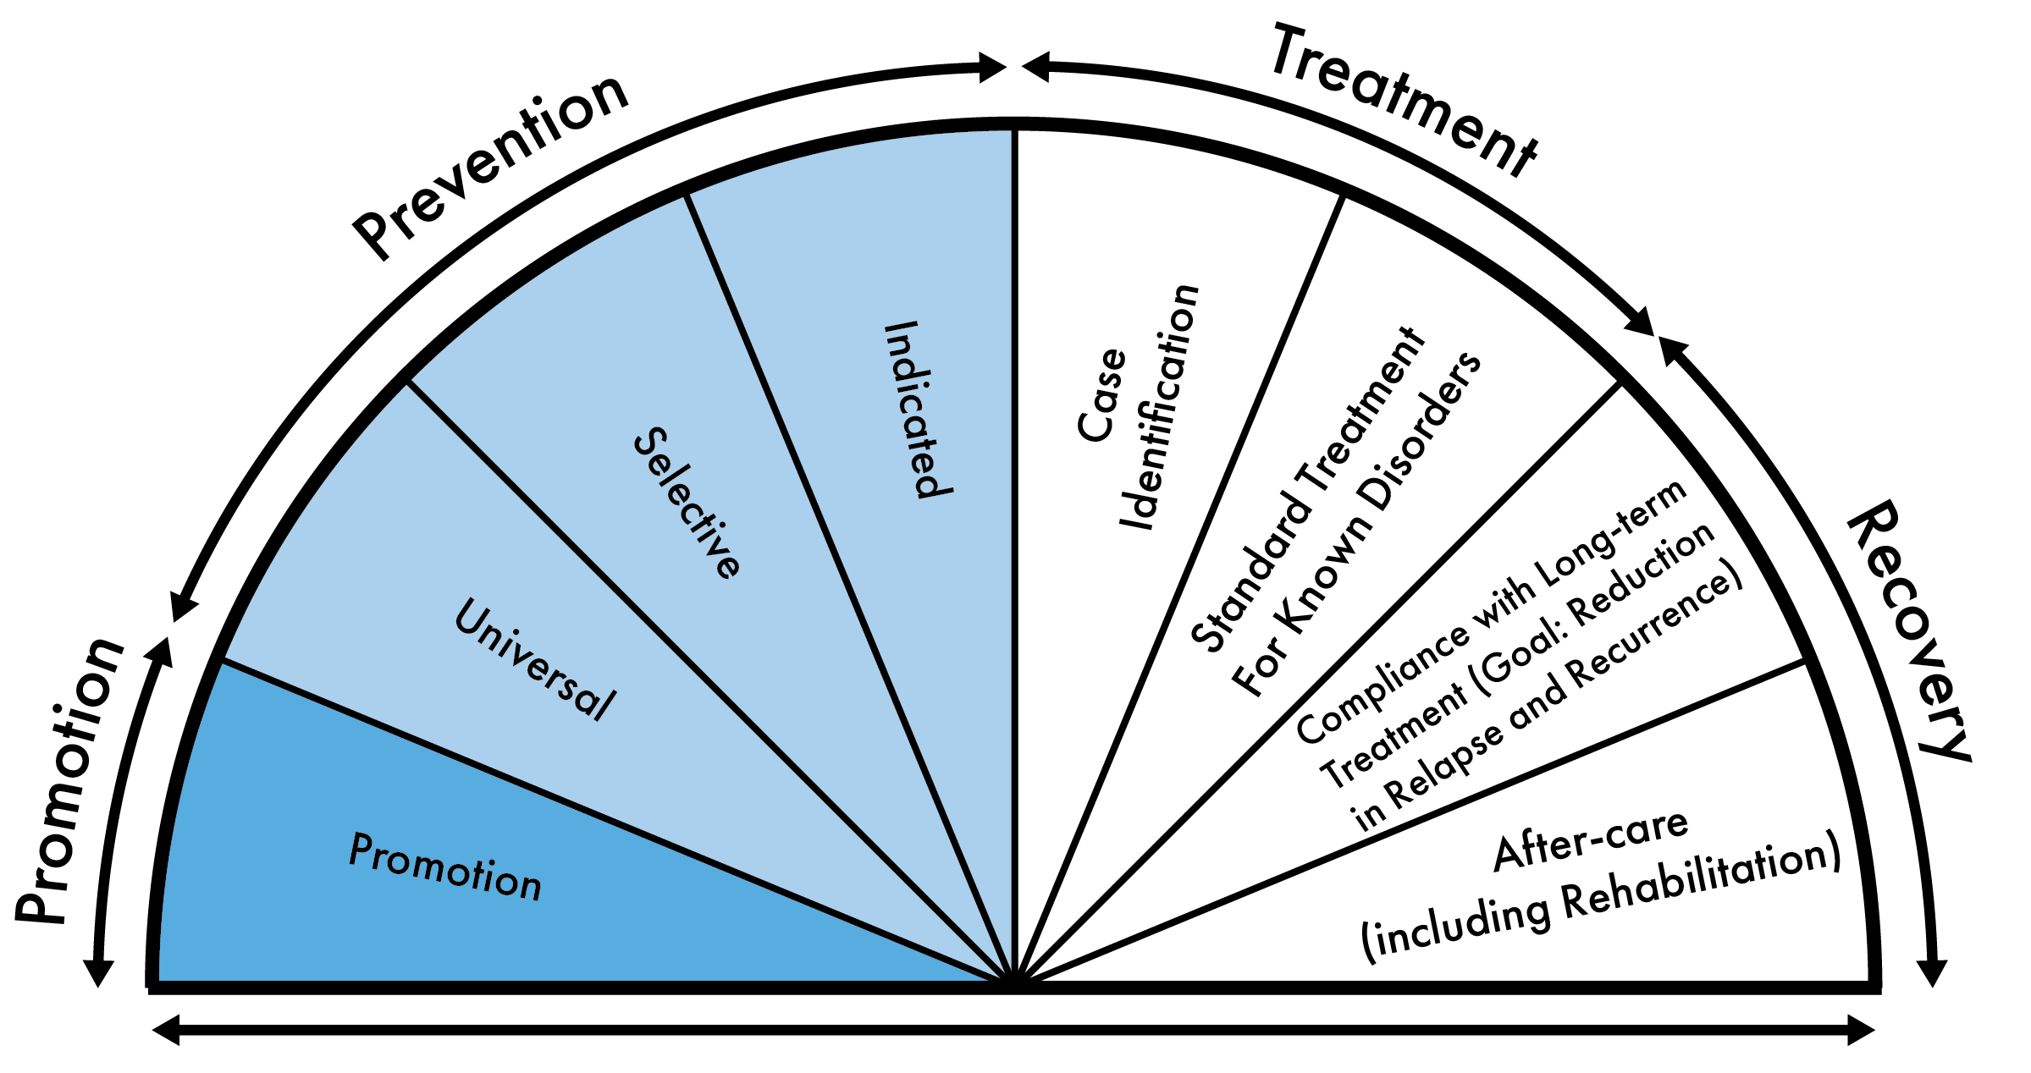
Promotion and Prevention
Strategies create an environment that promotes the health and well-being of individuals and communities; which prevents problems before they occur.
Notes:
Tom

Slide 10

PREVENTION WORKS WHEN:
it follows the Public Health Model and focuses on population-level change
it follows a data-driven process known as the Strategic Prevention Framework (SPF)
it focuses on reducing risk factors, strengthening protective factors, and building resiliency
it requires a multi-faceted approach by implementing a variety of evidence-based strategies
it is relevant to the community, including local conditions and demographics
it impacts individuals across the lifespan
Notes:
Tom

Slide 11
PARTNERSHIP FOR SUCCESS (PFS) GRANT
Notes:
Tom

Slide 12

WHAT IS PARTNERSHIP FOR SUCCESS (PFS)?
A foundational investment that focuses on substance use prevention
Supports the development and implementation of comprehensive, evidence-based prevention strategies
Strengthens prevention capacity and infrastructure at both state and community levels
Grounded in the Strategic Prevention Framework (SPF)
Addresses locally identified priorities using data driven processes
Enhances protective factors and reduces risk factors
Other Substances
Notes:
Tom

Slide 13
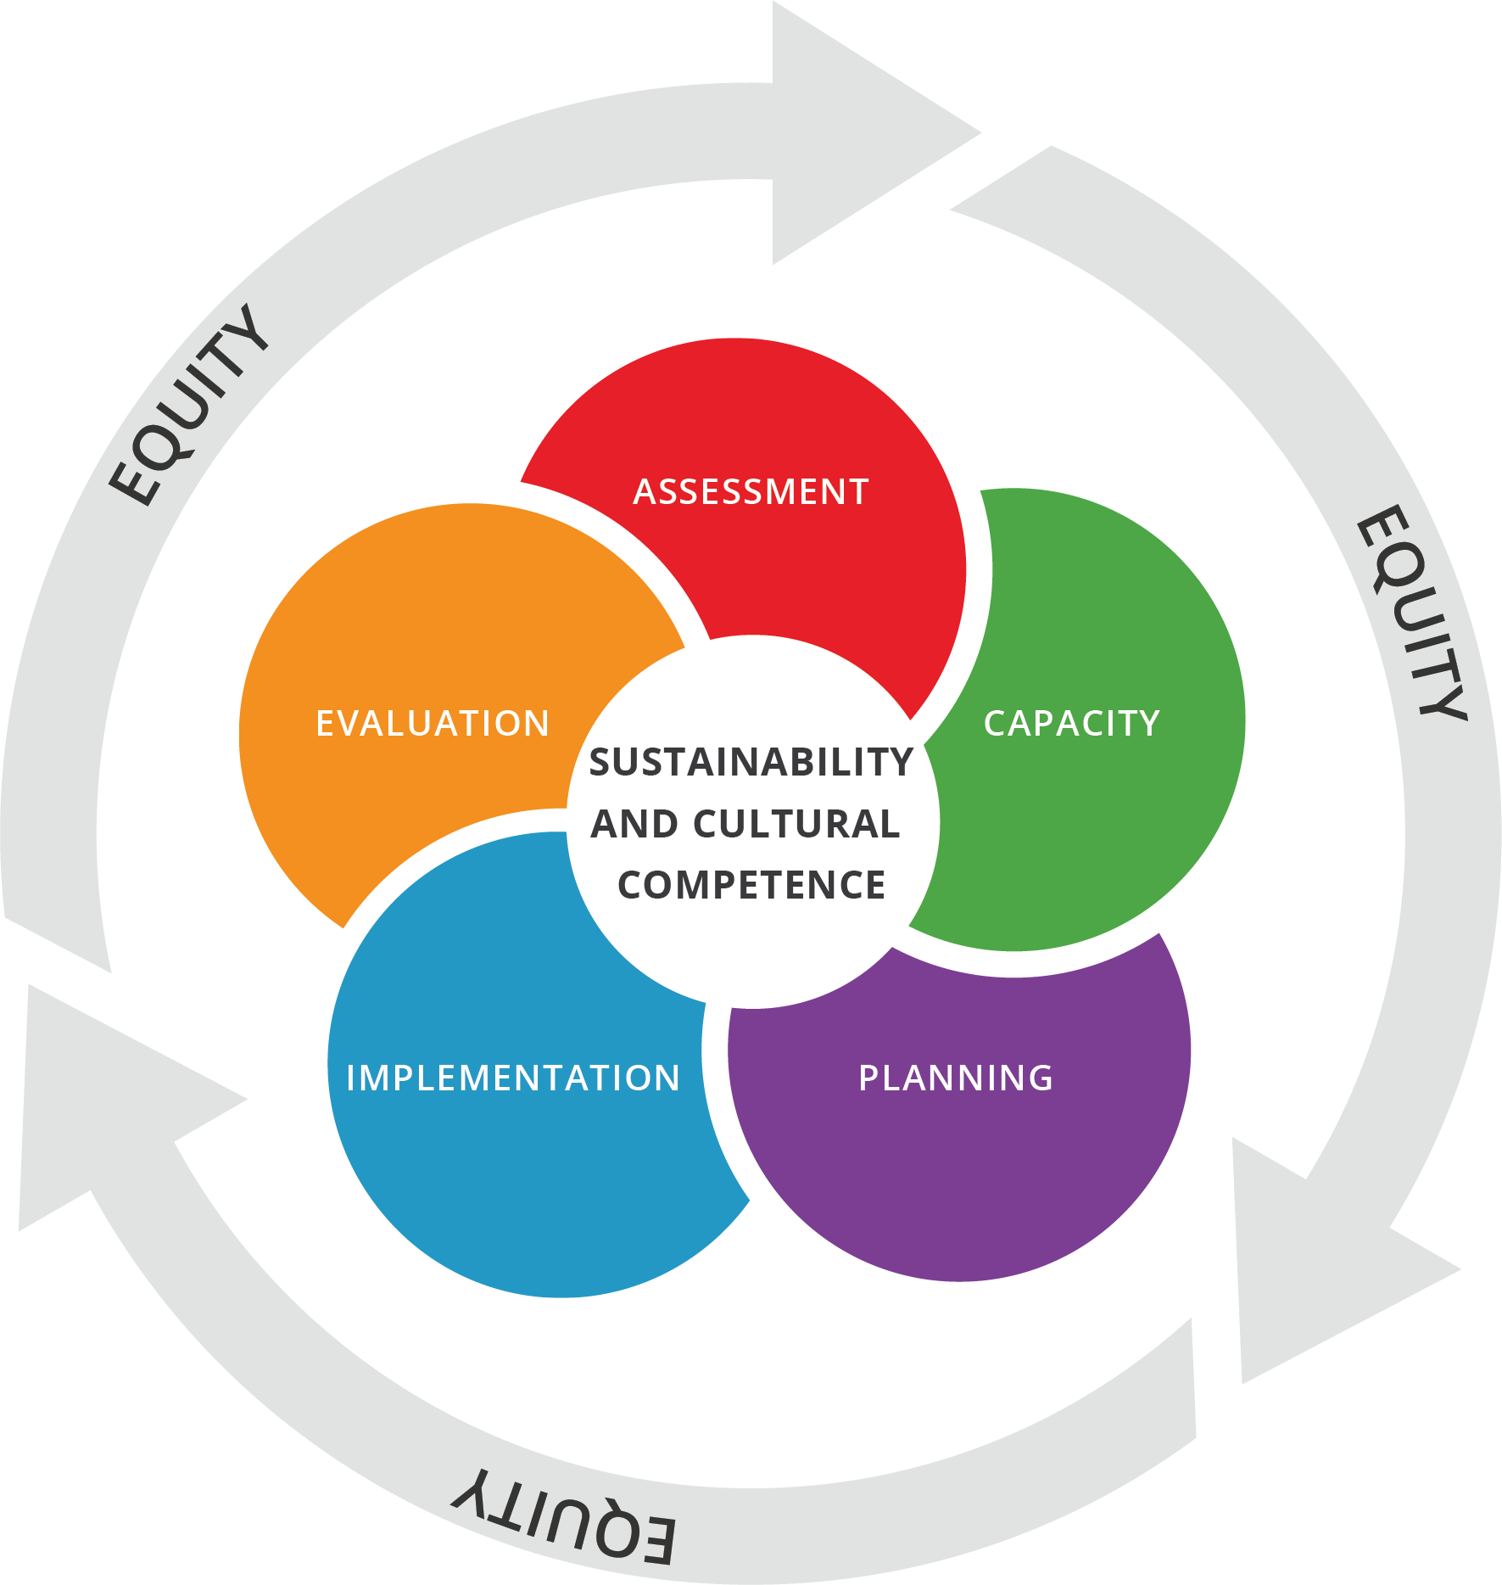
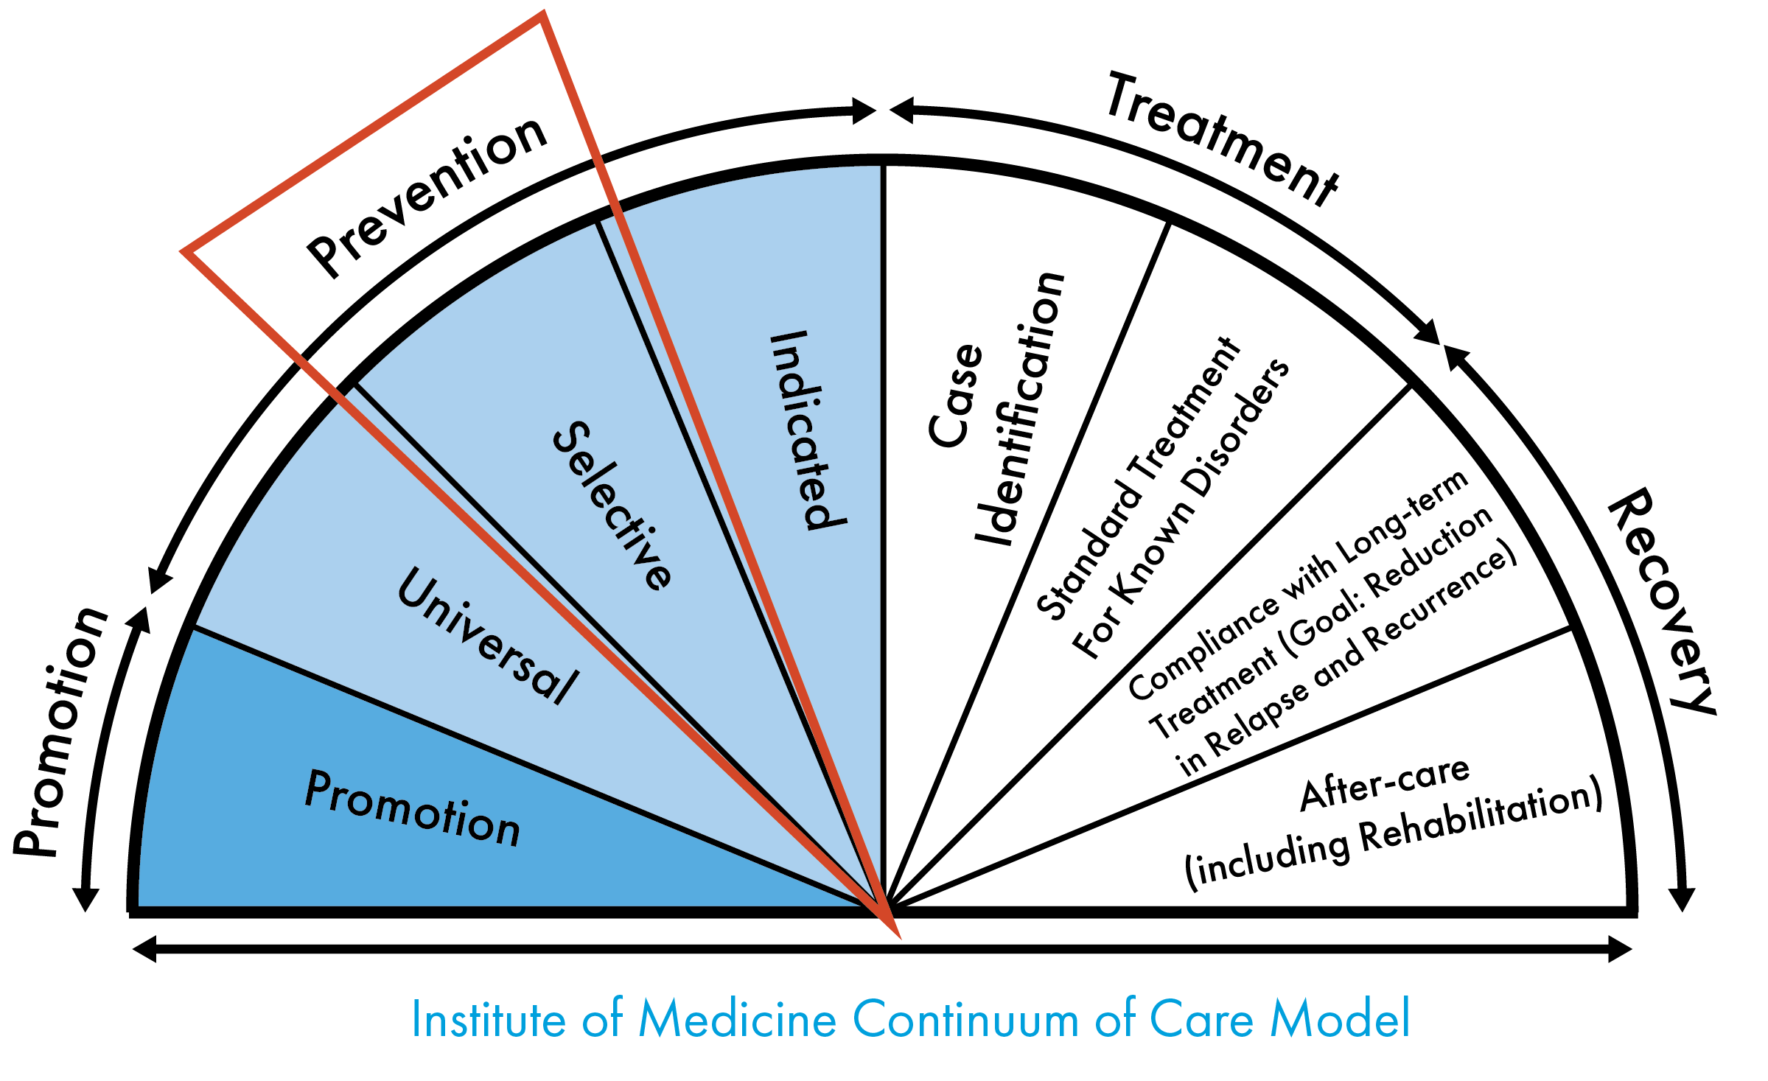
PFS IN NORTH DAKOTA
Using the Strategic Prevention Framework, the ND PFS aims to reduce the onset and progression of alcohol misuse and its related consequences through implementation by local community prevention providers focusing on selective populations.
Strategic Prevention Framework
Other Substances
The North Dakota PFS project will address youth alcohol use by focusing on selective prevention efforts. Selective prevention measures target subsets of the total population that are considered at-risk for substance use/misuse.
Notes:
Tom

Slide 14
PFS IN NORTH DAKOTA
In collaboration with the Lead Data Evaluator North Dakota identified three (3) subgroups at greater risk of substance use/misuse. These subgroups were identified through a date driven process and a Statewide Community Health Needs Assessment. The subgroups identified as target populations of the PFS in North Dakota are:
Active-duty military members and their families
Children of parents with a substance use disorder or mental health condition
College students
Goals:
Build upon the North Dakota Prevention infrastructure
Support implementation of the SPF and Evidence-Based Prevention Strategies
Build capacity of local prevention providers to apply for future funding
Notes:
Tom

Slide 15
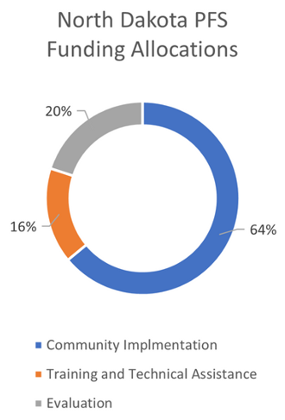
FUNDING
The North Dakota Department of Health and Human Services’ Behavioral Health Division (BHD) was awarded the Partnership for Success grant in October of 2023 ($1,250,000 per year, for up to 5 years) from the Substance Abuse and Mental Health Services Administration (SAMHSA).
64% of the funding will be allocated to support community level providers. Funding will also be used to contract with the project Lead Evaluator and a Training and Technical Assistance vendor.
Notes:
Tom

Slide 16
HIGH NEED COMMUNITY FUNDING
$800,000 per year is designated to fund high need communities within North Dakota to support and implement evidence-based prevention strategies and to build local prevention provider capacity. This funding will be paid out to communities at a flat monthly rate based on tiered funding distribution.
Funding Distribution
Base Funding Amount Per Year = $130,000
Enhancement Amount Per Point = $50,000
  Enhancement Scores 1 Point:
    College Population over 10,000
    Military Base
Notes:
Tom

Slide 17
PFS HIGH NEED COMMUNITIES
North Dakota identified five high need communities to fund using a high need community formula. Measures used in the high need community formula included capacity, consequences, consumption, intervening variables, and target populations.
First District Health Unit
Grand Forks Public Health
Lake Region District Health Unit
Richland County Health Department
Upper Missouri District Health Unit
Notes:
Tom

Slide 18
SCOPE OF SERVICE
General Expectations:
  Strategic Prevention Framework (SPF) Process
  Evidence Based Strategy Implementation
  Capacity Building
  Training and Technical Assistance (TTA)
  Collaboration with a Coalition
  Quarterly Meetings
  Equivalent to One Full Time Effort
  Monthly Reporting & Reimbursement Requests
Notes:
Tori

Slide 19
DELIVERABLES & DEADLINES
The contract will run through September 30, 2028.
  Meetings:
    Kickoff Meeting (Virtual) – October 23, 10:00 am
    Community Needs Assessment Training (In Person) – TBD (December 11-12, 2024)
    Strategic Plan Training (In Person) – TBD (3rd week of February 2025)
  Strategic Prevention Framework Deliverables and Deadlines:
    Community Needs Assessment – Due February 7, 2025
    Strategic Plan – Due May 23, 2025
    Data Driven Implementation – Ongoing
    Review Strategic Plan and Implementation – Annually in October
  Reporting and Evaluation Deliverables and Deadlines:
    School Data Agreements for YRBS – Due November 22, 2024
    School Data Agreements for YS and NCHA – June 30, 2025
    Military Data Agreements --- Work with Eric
    Monthly Reporting and Reimbursement Forms – 10th of Every Month
Notes:
Tori

Slide 20
DATA AGREEMENTS
Data collection, sharing, and use agreements will be required as a deliverable of the PFS Project.
The YRBS and the ND PFS Youth Survey (YS) will follow similar survey data collection and results reporting procedures to safeguard the confidentiality and to ensure the student responses remain anonymous and not be personally identifiable. Additionally, to protect against an unauthorized release, the evaluation team will encrypt the data during collection, transfer, and storage, as well as have a specific minimum number of respondents before reporting data results for that group.
*If additional IRB, oversight board, or local or tribal government approvals are needed, additional agreements should be created and established.
Notes:
Tori

Slide 21
SCHOOL DATA AGREEMENTS
Agreements should include:
School district in 2025 and 2027 will administer the opt-in option of the YRBS to their students in grades 7 - 12. School will collaborate with BHD and YRBS contractor to collect the data.
School district will authorize the PFS team to use the deidentified school district's student data from the 2023, 2025 and 2027 YRBS. School agrees to allow results from analyses to be released to SAMHSA for reporting and included in project evaluation reports.
School district in 2026 and 2028 will administer the PFS Youth Survey to their students in grades 7 - 12. School will collaborate with BHD and PFS team to administer the survey.
School district agrees to allow the PFS team to use and analyze the student data from the PFS Youth Survey for the project evaluation and data reporting requirements. School authorize the release of data results to SAMHSA for grant reporting and include them in the project evaluation reports.
Notes:
Tori

Slide 22
COLLEGE DATA AGREEMENTS
If a college or university is located in your service area, it will be required to secure written data sharing and use agreements with those institutions to provide the institution’s National College Health Assessment (NCHA) results.
The PFS evaluation team and collaborators will follow all NCHA requirements to ensure proper use of data and to safeguard the confidentiality of the student responses when reporting results.
Agreements should include:
School will authorize the release of the 2023, 2025, and 2027 National College Health Assessment (NCHA) results for their institution as available. School authorizes the PFS team and collaborators to release the alcohol-related NCHA results for project evaluation reports and to SAMHSA for reporting.
Notes:
Tori

Slide 23
MILITARY DATA AGREEMENTS
If a military base is located in your service area, it is encouraged to develop relationship with the military bases and to secure written data sharing and use agreements to use the results for the Defense Organizational Climate Survey (DEOCS).
The PFS evaluation team and collaborators will follow all survey requirements to ensure proper use of results and to safeguard the confidentiality of the responses when reporting results.
Agreements should include:
Military base will authorize the release of the Defense Organizational Climate Survey (DEOCS) results for their base as available. Base authorizes the PFS team and collaborators to release the alcohol-related DEOCS results for project evaluation reports and to SAMHSA for reporting.
Notes:
Tori

Slide 24
MONTHLY REPORTING & REIMBURSEMENT
MONTHLY REPORTING:
  online reporting process through Qualtrics
  request for reimbursement form (SFN 1763)
  due the 10th of every month
  must be submitted to receive reimbursement
  *Training will be held at a later date to go over online reporting system.
Notes:
Tori

Slide 25
RESOURCES
BHD Prevention Team
  available via e-mail, phone, 1:1 Teams meetings, or in person visits
BHD Website
  https://www.hhs.nd.gov/behavioral-health/prevention/north-dakota-prevention-provider-portal
  location for data sources, recorded meetings, resource materials, and more
Youth Connections (YC)
  contracted to provide TTA
Wyoming Survey and Analysis Center (WYSAC)
  data and evaluation TTA
Notes:
Tori

Slide 26
NEXT STEPS
  Contracts:
    Contracts have been submitted to finance
    Look for an email from Julie Huwe to review and sign
  Data:
    Work to obtain data agreements (sample MOU to be provided)
    Collect local recent high school, college, and military data report
  Needs Assessment:
    Community Needs Assessment workbook will be supplied
    Community Needs Assessment Training – December
  Monthly Reporting:
    Monthly Reporting via Qualtrics – Due 10th of Every Month
    SFN 1763 Reimbursement Form emailed to Tori (tknelson@nd.gov) – Due 10th of Every Month
    Monthly Reporting and Reimbursement Training to be held at a later date (virtual)
Notes:
Tori

Slide 27

QUESTIONS?
Notes:
Tori

