Slide 1
State Opioid Response (SOR) Grant
Quarter 3 Meeting – April 4, 2024
Notes:
Meeting will be recorded

Slide 2
Agenda
State updates
Data
GPRA requirement for transportation
Opioid Harm Reduction Products – update and review
Resources
MOUD Resources
Stimulant Resources
Kognito
Next Meeting

Slide 3
Data updates

Slide 4
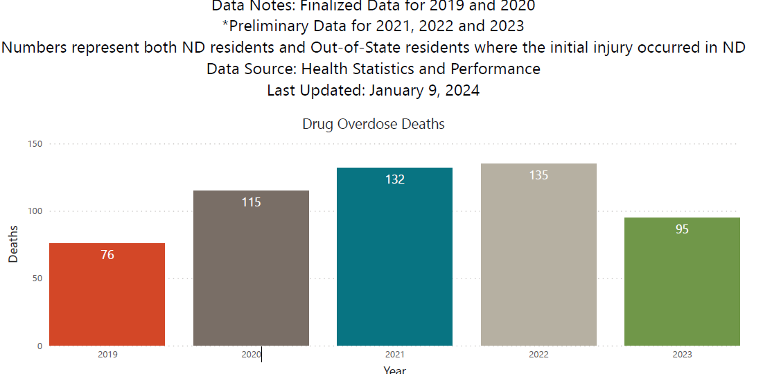

Slide 5
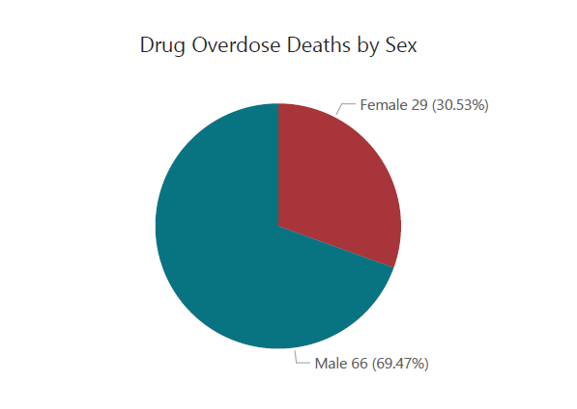
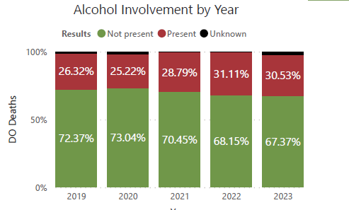
Data for 2023

Slide 6
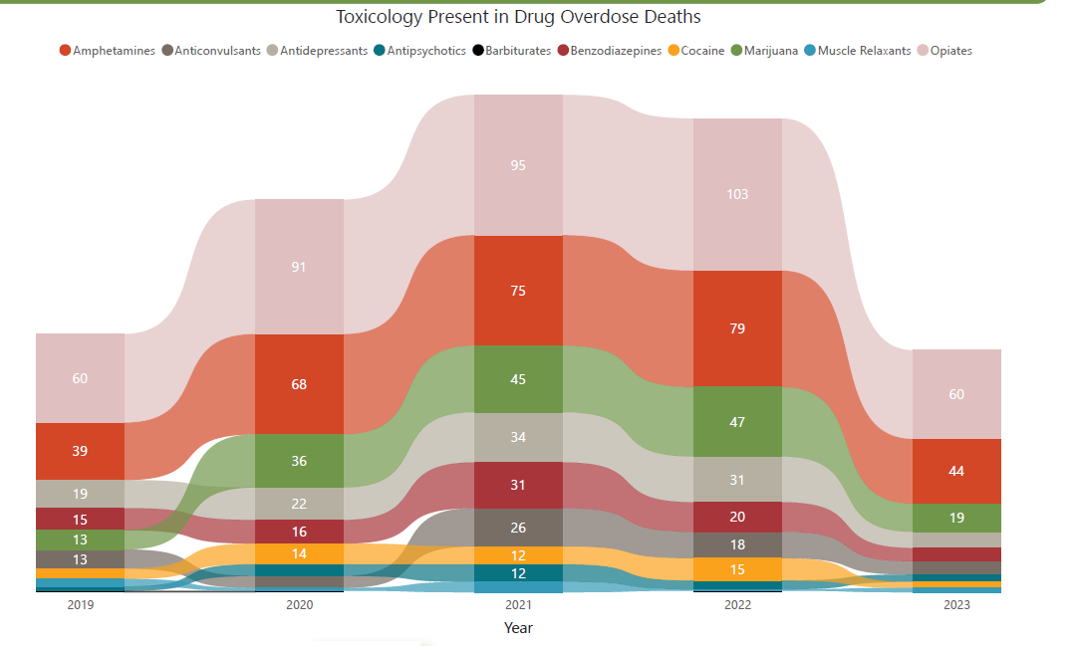

Slide 8
For context – Alcohol related data

Slide 9
GPRA for Transportation
SOR funds may be utilize to cover the cost of transportation for individuals to access opioid or stimulant focused treatment and recovery services.
- Transportation services DO NOT require GPRA completion

Slide 10
Opioid Overdose Reversal Products
naloxone
Narcan (4mg nasal spray) - available over-the-counter (OTC)
RiVive (3mg nasal spray) – available OTC
Kloxxado (8mg nasal spray) – prescription only
Zimhi (5mg intramuscular injection) – prescription only
nalmefene
Opvee (2.7mg nasal spray) – prescription only
BHD is only able to purchase Narcan to provide at no cost
Precipitated withdrawal is a concern with higher doses: https://www.cdc.gov/mmwr/volumes/73/wr/mm7305a4.htm#:~:text=No%20significant%20differences%20were%20observed%20in%20survival%2C%20mean,4-mg%20intranasal%20naloxone%20product%20%2895%25%20CI%20%3D%201.51%E2%80%934.18%29.

Slide 11
Opioid Harm Reduction – Test Strips
Fentanyl test strips – allowable with SOR funds
Xylazine test strips – allowable with SOR funds
Nitazene test strips – not allowable with SOR funds
We have not received reports of nitazine or nitazine containing products being seized nor has there been reported deaths in ND
Naloxone can be effective for nitazene overdoses
*Test strips can only be provided to syringe service participants by a Syringe Service Program.

Slide 12
Resources

Slide 13
MOUD Resources
8-hour DEA training for prescribers: Home - Providers Clinical Support System-Medications for Opioid Use Disorders (PCSS-MOUD) (pcssnow.org)
Mentoring program for prescribers: Clinical mentoring for treating OUD - PCSS-MOUD (pcssnow.org)
Integrating MOUD in Clinical Care: Integrating Opioid Use Disorder Treatment in Clinical Care - Providers Clinical Support System-Medications for Opioid Use Disorders (pcssnow.org)
Implementing SBIRT in Primary Care: Screening, Brief Intervention, Referral to Treatment (SBIRT) for Substance Use Disorders in Primary Care Settings - Providers Clinical Support System-Medications for Opioid Use Disorders (pcssnow.org)

Slide 14
Continued
SUD for the Healthcare Team is an introductory-level course on substance use disorders designed to provide fundamental information for all staff working within a health care setting. The four modules, taken together, present information on SUD, its history and its treatment, including alcohol and opioid use disorders. https://pcssnow.org/education-training/sud-for-the-healthcare-team/
Initiating Buprenorphine for Patients Using Fentanyl (recorded webinar) - https://pcssnow.org/courses/initiating-buprenorphine-for-patients-using-fentanyl/
Short Training Modules that offer CEUs on all aspects of Opioid Use Disorder – https://www.cdc.gov/opioids/healthcare-professionals/training/index.html
Informational Pages on Opioid Basics https://www.cdc.gov/opioids/basics/index.html

Slide 15
Stimulant Resources
Treatment of Stimulant Use Disorders Resource Guide: Treatment of Stimulant Use Disorders (samhsa.gov)
Contingency Management Course: Home: All courses (healtheknowledge.org)

Slide 16
School Resource
Kognito: Kognito - Fostering Safe and Supportive School Communities through virtual learning | Health and Human Services North Dakota

Slide 17
Other Resources
BHD Opioid webpage: Opioids | Health and Human Services North Dakota
BHD Grantee Webpage: Current Grantee Overview | Health and Human Services North Dakota
Updated SAMHSA Toolkit - SAMHSA Overdose Prevention and Response Toolkit

Slide 18
Next meeting
July 3, 2024
Presentations from all LPHUs on what you are working on, what is going well, what are some barriers you have run into

Slide 19
Needs from grantees
How can BHD Help

Slide 20
Questions
amlies@nd.gov
701-328-8933

