Slide 1
State Opioid Response (SOR) Grant
Kick-Off meeting 11-1-2023

Slide 2
Agenda
Overview of the SOR Grant
Statewide opioid efforts
Community opioid efforts
SOR Specific Information for Grantees
Reporting and reimbursement
Links
Resources
Questions

Slide 3
Overview of the SOR grant

Slide 4
North Dakota SOR Team
Laura Anderson, DHHS BHD Policy Director
SOR grant Project Director
James Knopik, Manager Addiction Programs
SOR grant Project Director
Amy Lies, Opioid Addiction Administrator
SOR Project Coordinator
Tom Volk – Prevention Administrator
Kali Bauer – Prevention Administrator
Tori Nelson – Prevention Administrator
PIRE – Karen Friend, Martha Waller, Alan Stein-Seroussi
Data Coordinator

Slide 5
State Opioid Response (SOR) Grant
Award amount to ND: $4,000,000
Timeframe: 9/30/2023 to 9/29/2024
Purpose:
Address the opioid overdose crisis by providing resources to states and territories for increasing access to FDA-approved medications for the treatment of opioid use disorder (MOUD);
Support the continuum of prevention, harm reduction, treatment, and recovery support services for opioid use disorder (OUD) and other concurrent substance use disorders;
Support the continuum of care for stimulant misuse and use disorders, including for cocaine and methamphetamine.
Reduce unmet treatment needs and opioid-related overdose deaths across America.

Slide 6
ND SOR Grant Goals
Prevent substance (mis)use
specifically focused on opioids and stimulants
Reduce harm related to opioids and stimulants
Improve access to evidence-based treatment
Increase access to recovery support services

Slide 7
SOR Funding Allocations

Slide 8
SOR Grantees
Bismarck-Burleigh Public Health
Cavalier County Health District
Central Valley Health Unit
City-County Health Department
Dickey County Health District
Emmons County Public Health
Fargo Cass Public Health
First District Health Unit
Foster County Public Health
Grand Forks Public Health Department
Lake Region District Health Unit
LaMoure County Public Health Department
McIntosh District Health Unit
Nelson-Griggs District Health Unit
Pembina County Health Department
Ransom County Public Health Department
Richland County Health Department
Rolette County Public Health District
Sargent County District Health Unit
Southwestern District Health Unit
Steele County Public Health Department
Towner County Public Health District
Traill District Health Unit
Upper Missouri District Health Unit
Walsh County Health District
Wells County District Health Unit
Western Plains Public Health
Standing Rock Sioux Tribe
Three Affiliated Tribes
Spirit Lake Behavioral Health
NDSU ONE Program
DOCR
Lighthouse Central Registry
PIRE

Slide 9
Statewide Opioid Efforts

Slide 10
Goal 1: Prevent substance (mis)use specifically focused on opioids and stimulants
Enhance evidence-base communication efforts
Opioids: Fill with Care
Parents Lead
Purchase safe medication disposal products
Deterra bags
DisposeRX packets
Partner with the North Dakota State University (NDSU) School of Pharmacy ONE Program

Slide 11
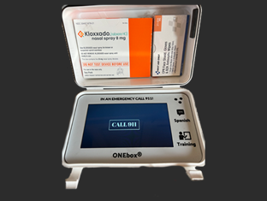
NDSU ONE Program
Provide opioid misuse and overdose risk assessment screenings and medication safety education
Pharmacies, home health, paramedics, jails/prisons
Distribute naloxone
Distribute ONE Boxes
Be the ONE program – naloxone rescue boxes and education to university students
Integrate evidence-based opioid education into curriculums in university programs
Environmental Scan phase 2
Tribal community integration
Resource for over-the-counter (OTC) naloxone
Contact: Heidi.Eukel@ndsu.edu

Slide 12
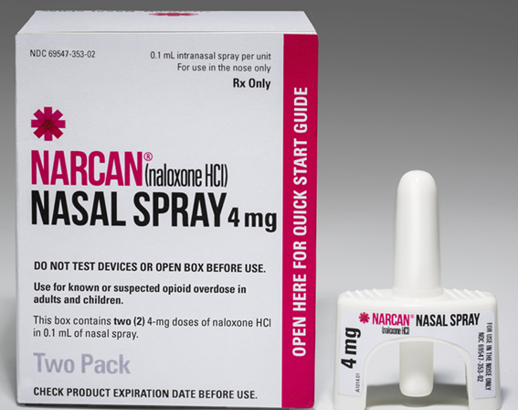
Goal 2: Reduce harm related to opioids and stimulants
Purchase and distribute naloxone
Identify gaps in naloxone distribution
Training on recognition of opioid overdose and appropriate use of naloxone
Update: During the 68th Legislative Assembly, HB1447 removed part of NDCC 23-01-42 that requires individuals to be trained prior to receiving naloxone
New naloxone distribution agreements will be sent out for signatures with the contracts.

Slide 13
Goal 3: Improve access to evidence-based treatment
Increase capacity of treatment providers to provide evidence-based treatment including medications for opioid use disorder (MOUD) and contingency management
SUD Voucher*
Provide treatment transition and coverage for individuals reentering communities from criminal justice settings or other rehabilitative settings
Partner with the ND Department of Corrections and Rehabilitation (DOCR) for the implementation of the MOUD Program which provides MOUD to individuals prior to being released from a prison
*These efforts are not funded by the SOR Grant

Slide 14
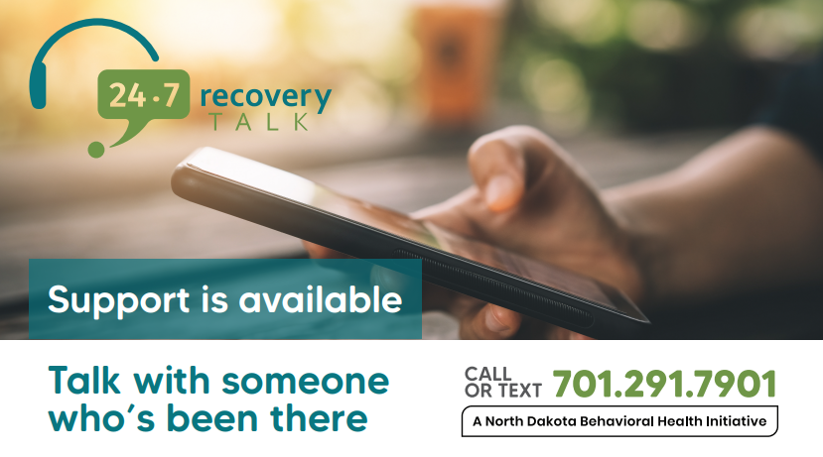
Goal 4: Increase access to recovery support services
Recovery Housing Assistance Program (RHAP)*
Recovery Talk*
Community Connect*
Free Through Recovery*
Peer Support Specialist Certification*
*These efforts are not funded by the SOR Grant

Slide 15
Community Efforts

Slide 16
Goal 1: Prevent substance (mis)use specifically focused on opioids and stimulants
24 grantees are preventing opioid misuse by promoting safe medication practices
9 grantees are hosting Take Back events and/or promoting Take Back events and locations
22 grantees are distributing Deterra bags and DisposeRX packets
1 grantee is supporting prescribing best practices
5 grantees are utilizing the Opioids: Fill with Care campaign to provide education and awareness of safe medication practices
1 grantee is purchasing and distributing medication lock boxes

Slide 17
Goal 2: Reduce harm related to opioids and stimulants
30 grantees are increasing access to naloxone and providing training on the recognition of opioid overdose and the appropriate use of naloxone
29 grantees are reducing stigma surrounding opioid use disorder, the use naloxone, and harm reduction efforts through the Opioids: Fill with Care campaign
5 grantees are purchasing and distributing fentanyl and xylazine test strips
1 grantee has purchased and is managing a harm reduction vending machine
3 grantees are working on establishing a Syringe Service Program (SSP)
5 grantees are partnering with an existing SSP

Slide 18
Goal 3: Improve access to evidence-based treatment
9 grantees are increasing access to medications for opioid use disorder (MOUD)
1 grantee is grantee is working with an OTP to establish a medication unit
2 grantees are partnering with a prescriber and pharmacist to reduce financial barriers
3 grantees are educating prescribers on prescribing MOUD
2 grantees are increasing access in the Emergency Department (buprenorphine inductions)
2 grantees are increasing access in jails
2 grantees are reducing barriers to treatment such as transportation and childcare costs
5 grantees are reducing stigma surrounding MOUD through Opioids: Fill with Care campaign
2 grantees are supporting implementation of Contingency Management
3 grantees are linking SUD voucher providers with jails

Slide 19
Goal 4: Increase access to recovery support services
13 grantees are increasing availability and access to Peer Support Specialist (PSS) services
2 grantees are reducing barriers to accessing recovery services such as transportation or childcare costs
6 grantees are reducing stigma surrounding recovery of OUD and stimulant use disorder through Opioids: Fill with Care campaign

Slide 20
Important Information for Grantees

Slide 21
Reporting and Reimbursement
Monthly reporting and reimbursement
The monthly reporting form (MRF) and request for reimbursement (RFR) are due by the 10th of the following month (ex. December’s MRF and RFR are due by January 10th)
MRF will be completed and submitted online
RFR can be emailed to amlies@nd.gov
The first MRF and RFR will include both October and November and are due by December 10th
Government Performance and Results Act (GPRA)
GPRA will need to be completed for any treatment and recovery efforts where an end user is easily identified (This does not include individuals receiving services at an SSP)
Examples of applicable situations:
Utilizing SOR funds to cover the cost of sublocade for an individual
Utilizing SOR funds to provide Peer Support Specialist services to an individual
Utilizing SOR funds to provide transportation to an individual
Q & A session will be held on November 16th 9:00-9:30
GPRA Training will be held on November 16th 9:30-10:00

Slide 22
Links
Grantee Portal: Current Grantee Overview | Health and Human Services North Dakota
Monthly reporting form (MRF) Coming soon!
Request for reimbursement (RFR) SFN 1763
SOR Funding Restrictions https://www.hhs.nd.gov/sites/www/files/documents/BH/Opioids/SOR%202022-2024%20Funding%20Restrictions.docx
Meeting recordings and PowerPoints
Grantee contact list
Resources
Ordering supplies and resource materials: https://behavioralhealth.x-shops.com/
Narcan
DisposeRX and Deterra
Resource materials

Slide 23
Resources
BHD Opioid webpage: Opioids | Health and Human Services North Dakota
Parents Lead: Home | Parents Lead North Dakota
ONE Program: Landing Page - (one-program.org)
Free Through Recovery: Free Through Recovery | Health and Human Services North Dakota
Peer Support: Peer Support | Health and Human Services North Dakota
Community Connect: Community Connect | Health and Human Services North Dakota
Recovery Talk: Recovery Talk | Health and Human Services North Dakota
SUD Voucher: Substance Use Disorder Voucher | Health and Human Services North Dakota
RHAP: Recovery Housing | Health and Human Services North Dakota

Slide 24
Questions
amlies@nd.gov
701-328-8933

