Slide 1
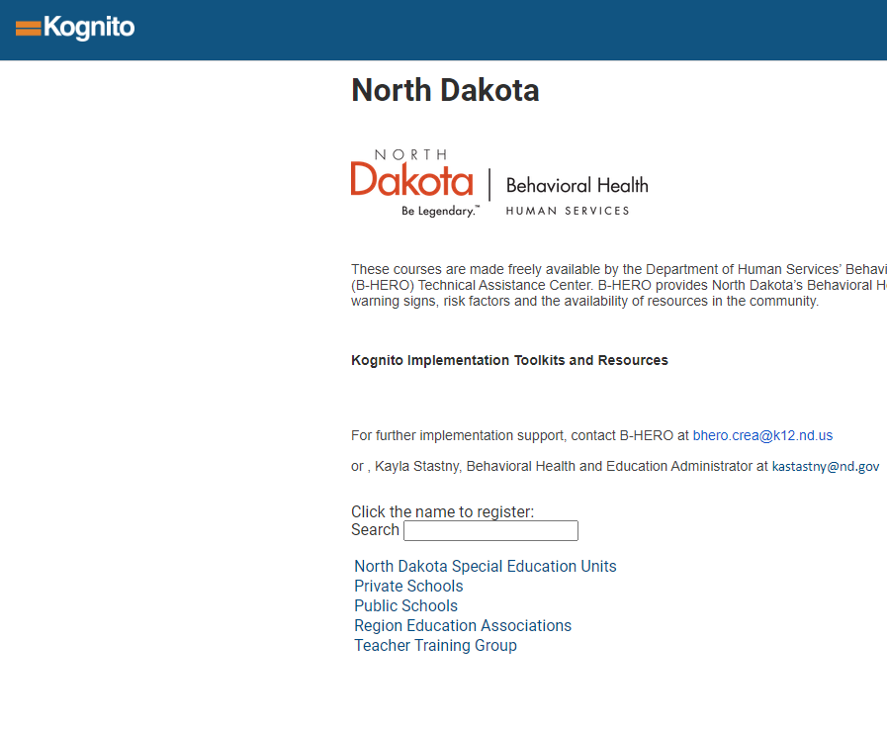

Go to NorthDakota.Kognito.com
Select your option from the list

Slide 2
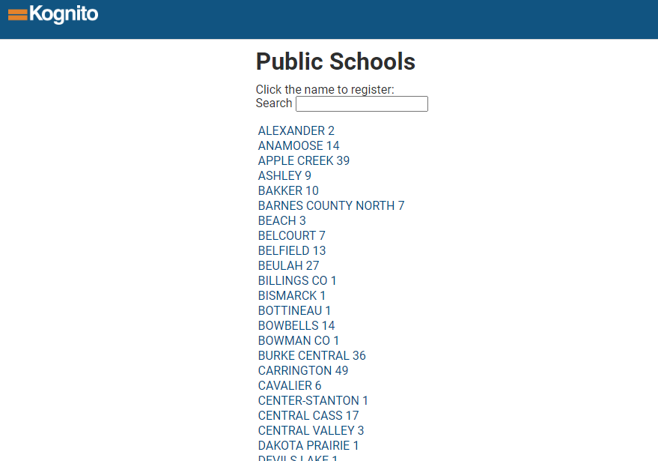
Select your District

Slide 3
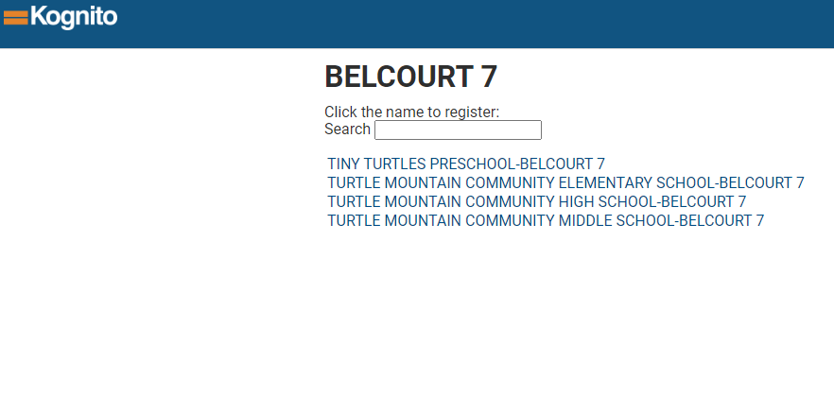
Select your School

Slide 4
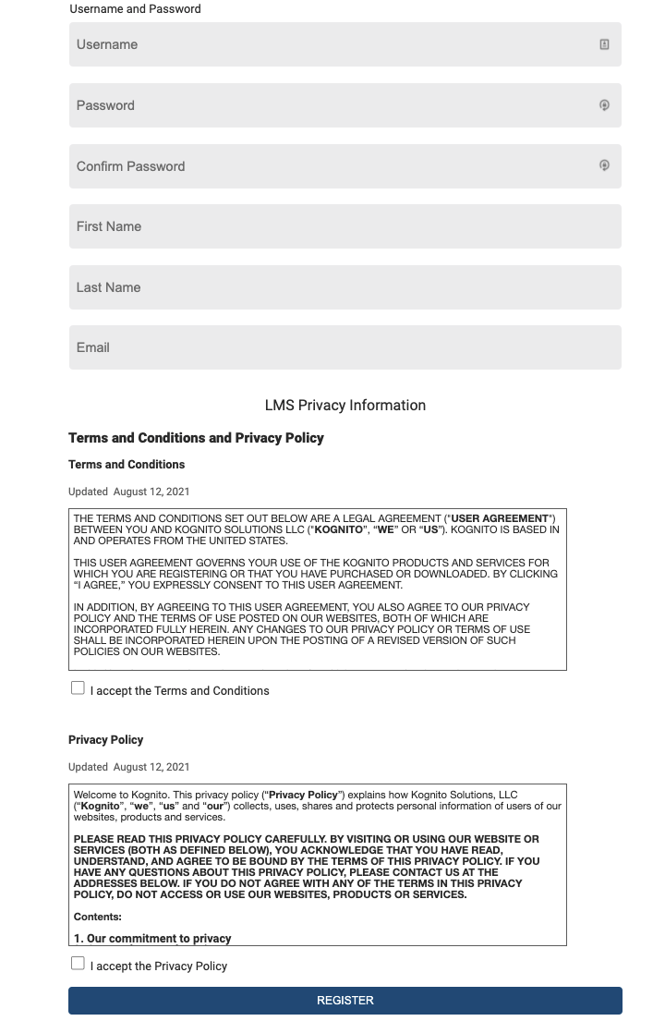
Create your username and password. Accept the Terms and Conditions and Agree to the Privacy Policy

Slide 5
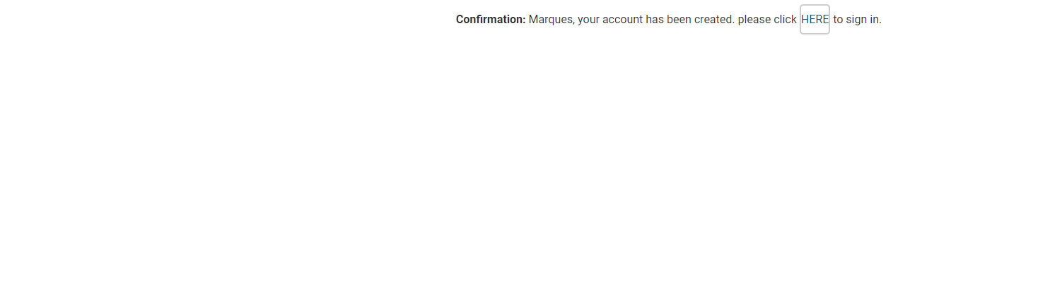
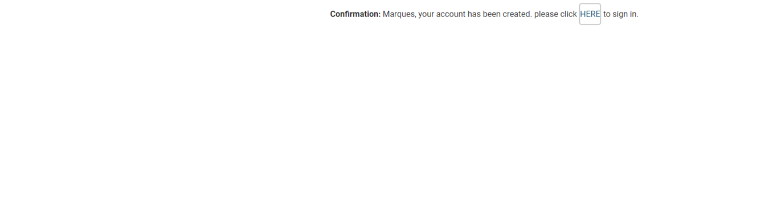
Click on the blue HERE button

Slide 6
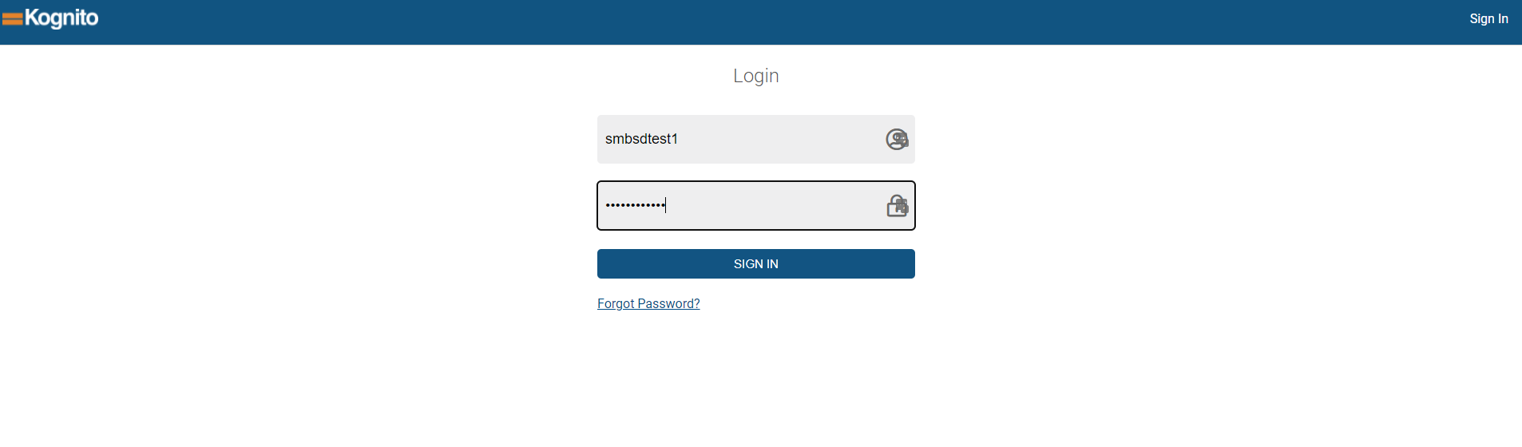
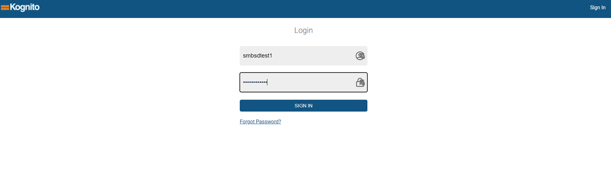
Sign in with the username and password just created

Slide 7
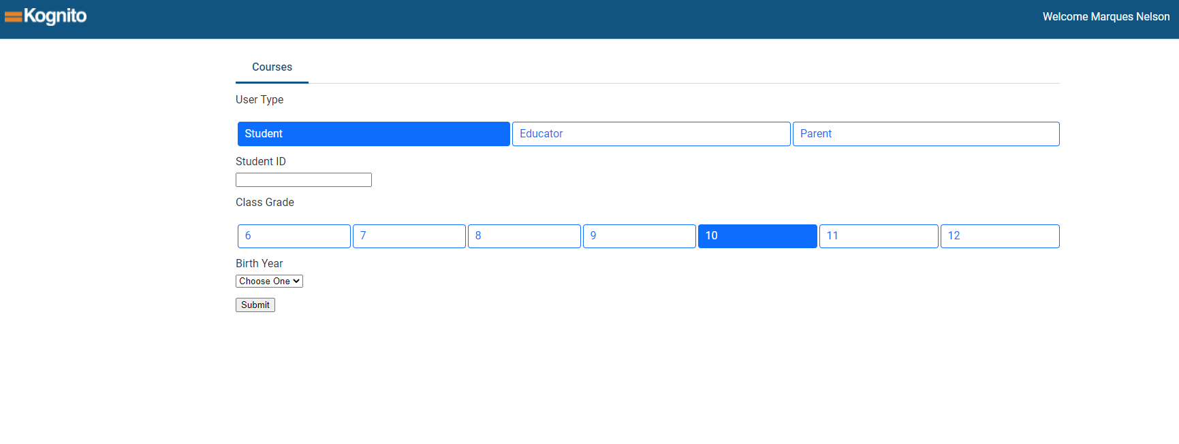
Continue to Complete your demographics information
Do not fill out Student ID or Birth year

Slide 8
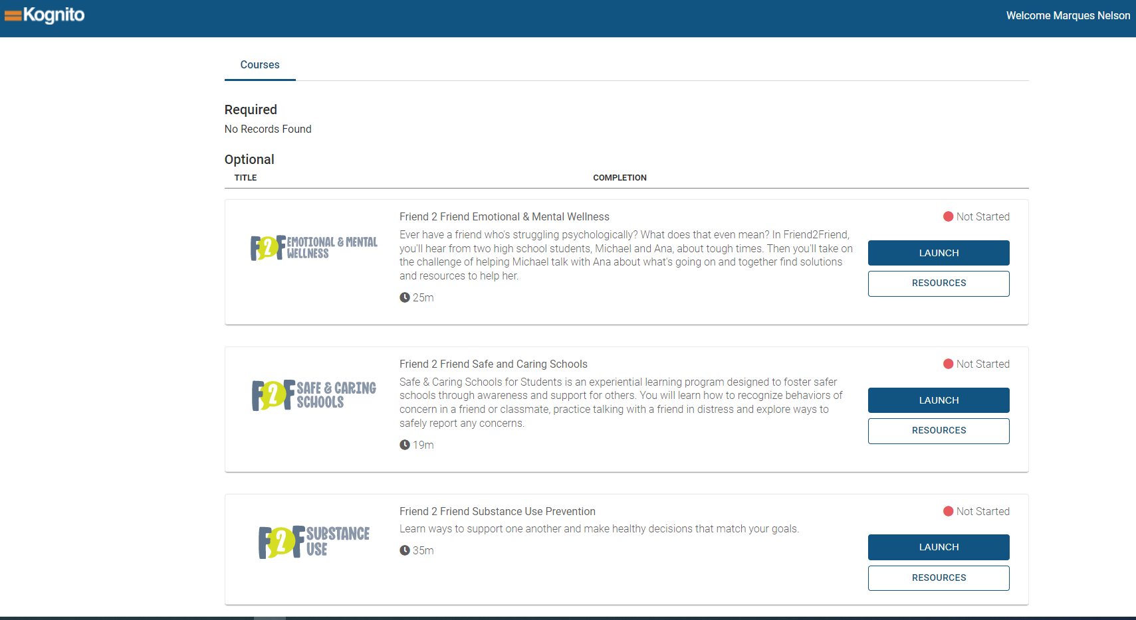
Select your training by clicking Launch.

Slide 9
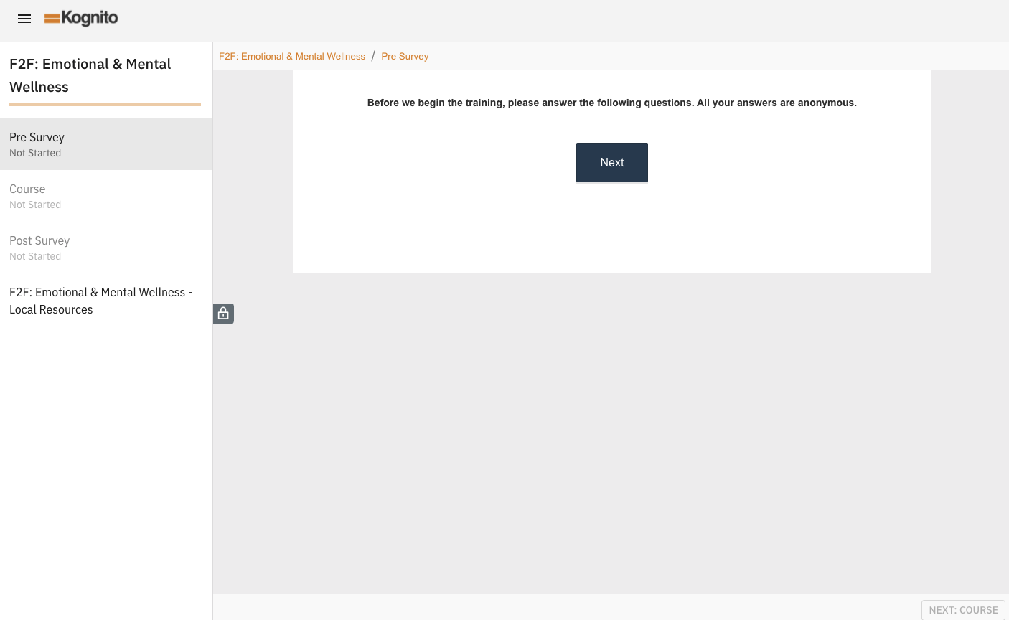
Your training will begin.

