Slide 1

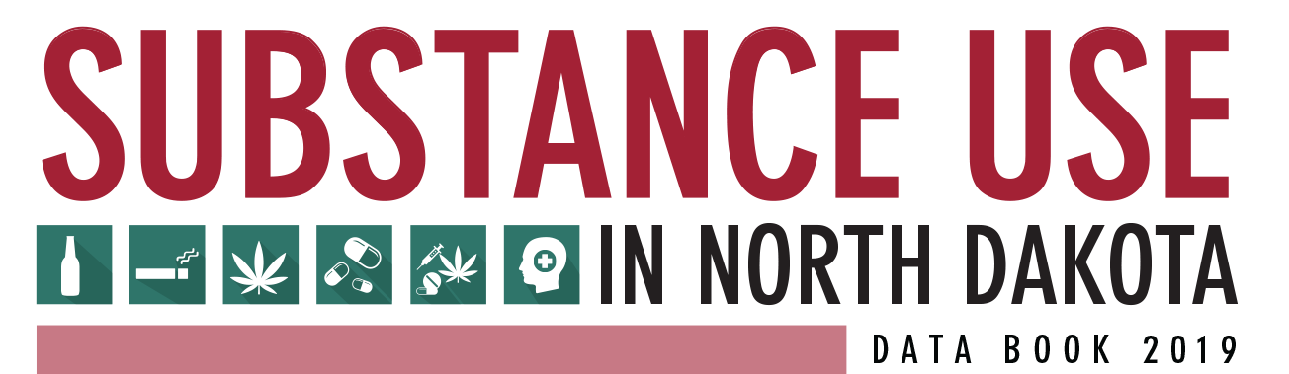

Slide 2
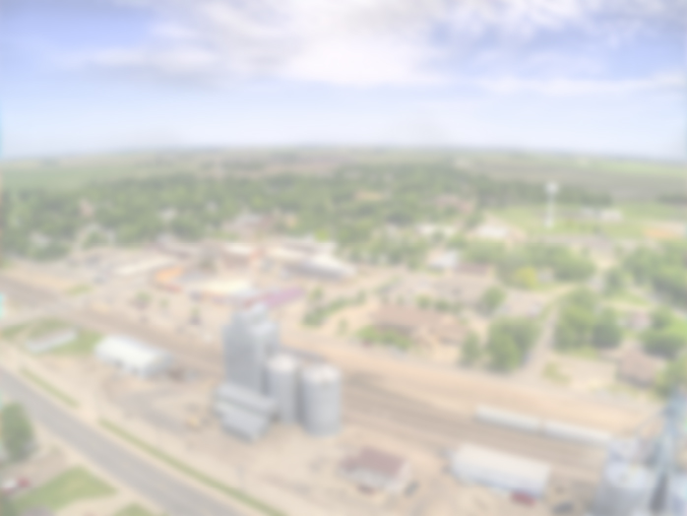
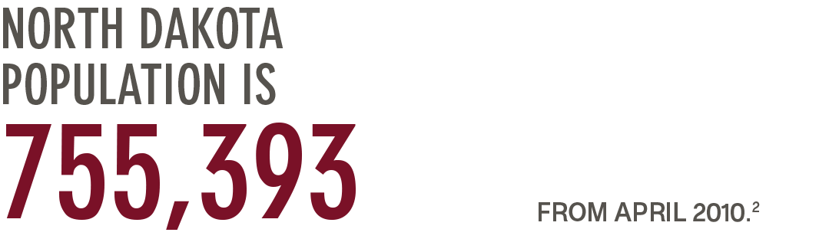
North Dakota Demographics Overview
White
87.5%
Black or African American
3.1%
American Indian and Alaska Native
5.5%
Asian
1.6%
Native Hawaiian and other Pacific Islander
0.1%
Two or more races
2.2%
ND Census; estimate July 2017

Slide 3







North Dakota Demographics Overview
3.7% of North Dakotans identify as Hispanic or Latino.
There are 49,560 veterans in North Dakota, which is 6.6% of the state’s adult population.
49.6% of North Dakota residents live in rural areas, compared to 14.1% nationwide.
One in eight (13.4%) North Dakotans are currently living in poverty.
There are five federally recognized Tribes and one Indian community located at least partially within the state.
23.3% of North Dakotans are under age 18 and 15.0% are over age 65.
North Dakota has a 2.6% unemployment rate.
ND Census; estimate July 2017
North Dakota Indian Affairs Commission
Economic Research Service, United States Department of Agriculture. (2018) State Fact Sheets.

Slide 4
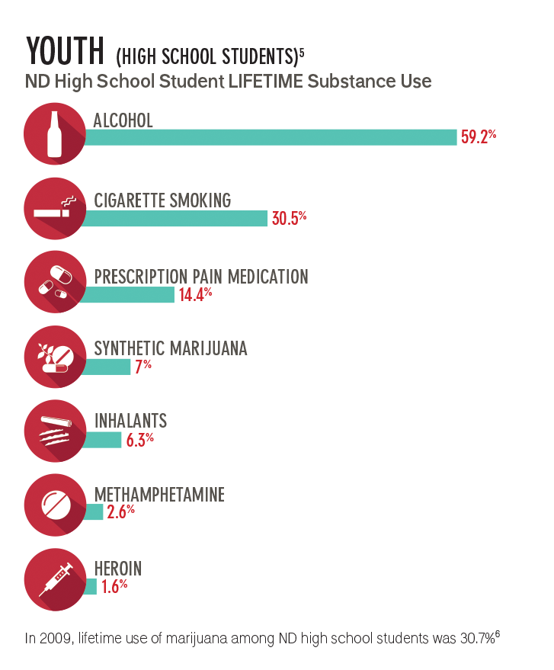
Overview of Substance Use in North Dakota
YOUTH (HIGH SCHOOL STUDENTS)
ND High School Student LIFETIME Substance Use
In 2009, lifetime use of marijuana among ND high school students was 30.7%⁶
ND Youth Risk Behavior Survey (YRBS), 2017

Slide 5
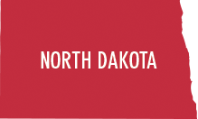
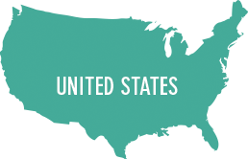
Overview of Substance Use in North Dakota
ADULTS (AGES 18+)
Adults Age 18 and Older PAST 30-DAY Substance Use
binge alcohol use
tobacco
marijuana
illicit drugs
35.2%
30.7%
5.6%
2.8%
binge alcohol use
tobacco
marijuana
illicit drugs
26.5%
25.6%
8.8%
3.5%
National Survey on Drug Use and Health (NBSDUH), 2015-2016

Slide 6


Behavioral Health

Slide 7



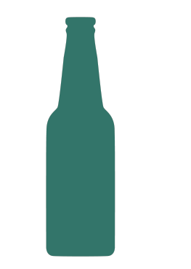
Behavioral Health in North Dakota: Youth
In the past 30 days, 16.4% of North Dakota high school students engaged in binge drinking.
In the past month, 7.3% or 4,000 ND youth (age 12-17) used illicit drugs.
In the past month, 5.4% or 3,000 ND youth (age 12-17) with a Substance Use Disorder (SUD).
ND Youth Risk Behavior Survey (YRBS), 2017
National Survey on Drug Use and Health (NBSDUH), 2015-2016

Slide 8

Behavioral Health in North Dakota: Youth
ND Middle School Students
ND High School Students
Major depressive episode in the past year, among ND youth age 12-17.
19.2%
16.7%
seriously thought about killing them self in their life.
seriously considered attempting suicide in the past year.
9.7%
10.5%
7.3%
8.0%
6.3%
13.5%
tried to kill themselves at least once in their life.
attempted suicide one or more times in the past year.
2011-2012
2012-2013
2013-2014
2014-2015
ND Youth Risk Behavior Survey (YRBS), 2017
National Survey on Drug Use and Health (NBSDUH), 2015-2016

Slide 9
Behavioral Health in North Dakota: Adults (Age 18+)
9% or 52,145 adults had a Substance Use Disorder (SUD) in the past year.
Substance Use Disorder (SUD): Individuals with alcohol or illicit drug dependence or abuse are defined as having SUD. The questions used to measure dependence and abuse are based on criteria in the fourth edition of the Diagnostic and Statistical Manual of Mental Disorders (DSM-IV).
In the past month, 34% or 198,150 adults engaged in binge drinking.
In the past month, 7% or 40,557 adults used illicit drugs.
National Survey on Drug Use and Health (NBSDUH), 2015-2016

Slide 10
Behavioral Health in North Dakota: Adults (Age 18+)
17% or 98,843 adults have Any Mental Illness (AMI) in the past year.
Any Mental Illness (AMI) is defined as individuals having any mental, behavior, or emotional disorder in the past year that met DSM-IV criteria (excluding developmental and substance use disorders).
4% or 23,175 adults have Serious Mental Illness (SMI) in the past year.
Serious Mental Illness (SMI) is defined as adults with any mental, behavior, or emotional disorder that substantially interfered with or limited one or more major life activities.
National Survey on Drug Use and Health (NBSDUH), 2015-2016

Slide 11

Behavioral Health in North Dakota: Adult (Age 18+)
19,699
adults have a
co-occuring behavioral health disorder (SUD & AMI).
Based on National 2016 NSDUH Prevalence

Slide 12
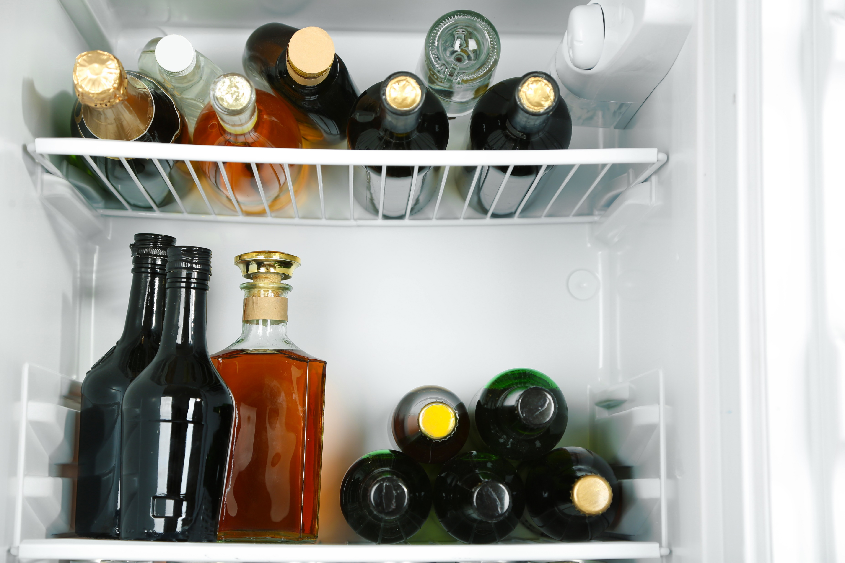

Alcohol

Slide 13
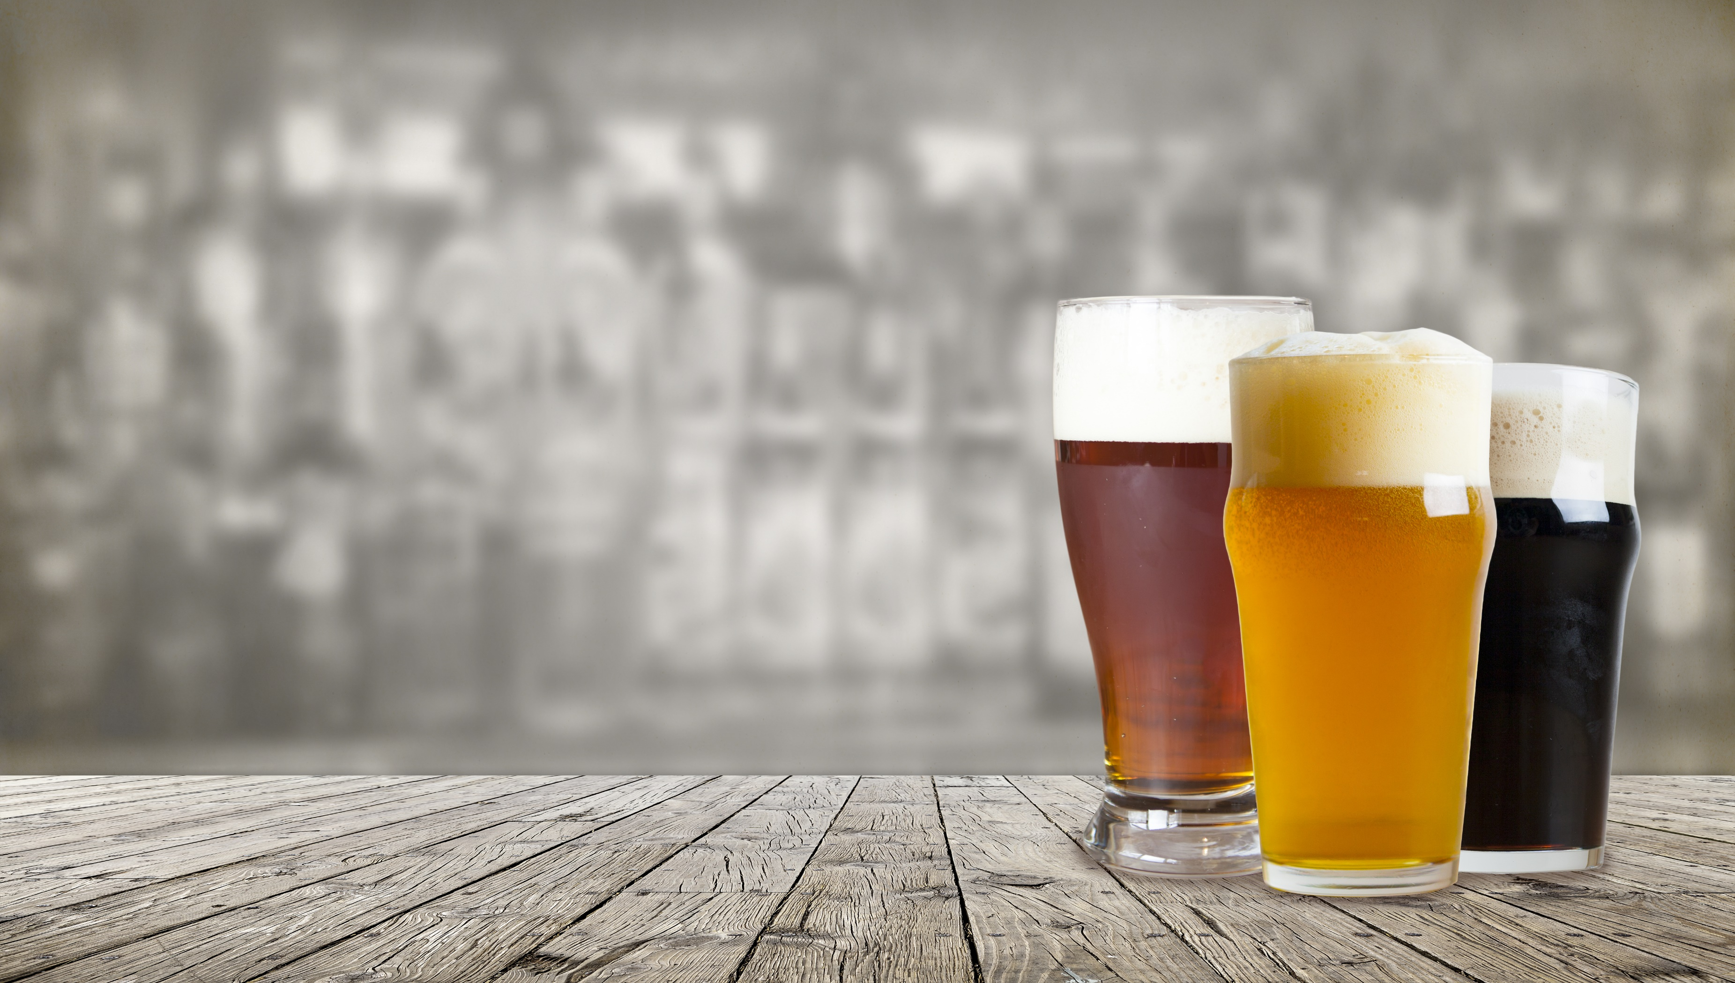

Alcohol:
Underage Drinking
of ND MIDDLE school students report alcohol use in their lifetime.
19.2%
a decrease from 40.6% in 2003.
of ND HIGH school students report current alcohol use (within the past 30 days).
29.1%
a decrease from 54.2% in 2003.
of ND HIGH school students report current binge drinking* (within the past 30 days).
16.4%
a decrease from 40% in 2003.
16.4% is equivalent to approximately 5,041 students, or the number of enrolled students at Bismarck High School, Fargo South High School, Grand Forks Central High School, Williston High School, and Dickinson High School combined.
ND Department of Public Instruction, Public School District Fall Enrollment 2017-18
*Binge drinking: 5 or more drinks of alcohol in a row within a couple of hours
ND Youth Risk Behavior Survey (YRBS), 2017
Notes:
Great strides have been made in the prevention of underage drinking over the past decade, but there is still more work to do.

Slide 14
Alcohol: Underage Drinking
6.5%
16.5%
11.5%
2.8%
6.5% of ND high school students report driving after drinking alcohol within the past 30 days.
1 in 6 (16.5%) ND high school students report riding with a driver who had been drinking alcohol within the past 30 days.
11.5% of juvenile arrests are alcohol-related (DUI and liquor law violations).
Approximately 2.8% of ND youth ages 12-17 met the criteria for alcohol use disorder in the past year.
a decrease from 26.7% in 2003.
a decrease from 42.8%.
ND Youth Risk Behavior Survey (YRBS), 2017
Crime in ND, 2017
National Survey on Drug Use and Health (NBSDUH), 2015-2016
Notes:
Not only is underage drinking against the law, but there are also many consequences to underage drinking impacting health and safety.

Slide 15
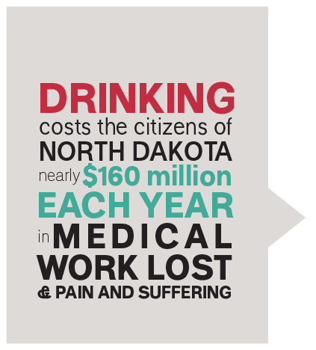



Alcohol: Underage Drinking
SOME OF THESE
COSTS INCLUDE:
VIOLENCE = $83.8 MILLION
TRAFFIC CRASHES = $40.3 MILLION
INJURY = $7.0 MILLION
TREATMENT = $4.6 MILLION
In 2013, this was $2,327 for each youth in the state or $3.70 per drink consumed underage.
Pacific Institute of Research and Evaluation (PIRE) 2013
Notes:
Tobacco is the leading preventable cause of death in the United States and takes a tremendous toll on lives in North Dakota. When we prevent tobacco use and exposure to secondhand smoke, we prevent disease, suffering and death, and save money on healthcare expenditures and productivity losses.

Slide 16
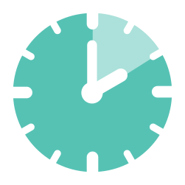
Alcohol: Young Adult/College Students
of ND college students report using alcohol in the past 30 days.
75.4%
27%
59.4%
of ND young adults age
18-29 report using alcohol in the past 30 days
of ND young adults age 18-29 report driving within two hours of drinking in the past 30 days.
40.6%
of ND young adults age 18-29 report binge* alcohol use in the past 30 days
*Binge drinking: 5 or more drinks on an occasion or in a row
ND Young Adult Survey (NDSOYA), 2018
ND Alcohol, Tobacco and other Drug Survey, 2016
Notes:
ALCOHOL: YOUNG ADULT/COLLEGE STUDENTS
Two out of five ND young adults binge drink and a quarter report driving after drinking. This age group often overestimates how frequently their peers are binge drinking, which can influence personal decisions surrounding alcohol use.

Slide 17
PERCEIVED VERSUS ACTUAL BINGE* DRINKING
BEHAVIOR AMONG ND YOUNG ADULTS (age 18-29)
(Number of days in past 30 days)
A significant misperception is revealed when perceptions of how frequently peers binge drink are compared to actual binge drinking rates.
Actual use
Perceived peer use
*Binge drinking: 5 or more drinks on an occasion or in a row
ND Young Adult Survey (NDSOYA), 2018
Notes:
ALCOHOL: YOUNG ADULT/COLLEGE STUDENTS
Two out of five ND young adults binge drink and a quarter report driving after drinking. This age group often overestimates how frequently their peers are binge drinking, which can influence personal decisions surrounding alcohol use.

Slide 18
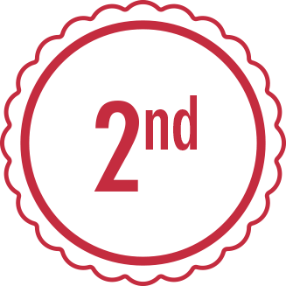


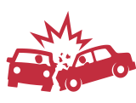

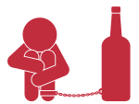


Alcohol: Adult
ND ranks 2nd in the nation for current binge alcohol use (past 30-days) among adults age 26 and older (30.7%).
6.4% (equivalent to 48,345 individuals) of ND adults report drinking and driving in the past 30 days.
More than one in six (16%) adult arrests in ND are for driving under the influence.
49% of fatal crashes in ND are alcohol-related.
42% of new domestic violence cases in ND involve alcohol.
Approximately 6.2% of ND adults age 26 or older met the criteria for alcohol use disorder in the past year.
Approximately 78% of the ND inmate population has a substance use disorder diagnosis.
Nationally, excessive alcohol use led to approximately 88,000 deaths and 2.5 million years of potential life lost each year from 2006 – 2010, shortening the lives of those who died by an average of 30 years.
National Survey on Drug Use and Health (NSDUH), 2015-2016; Crime in ND, 2017; ND Behavioral Risk Factor Surveillance System (BRFSS), 2016;
ND Department of Transportation (DOT), 2017; ND CAWS, 2016; ND Department of Corrections, 2015-2017; CDC Alcohol-Related Disease Impact
Notes:
ALCOHOL: ADULT
Adult binge drinking in North Dakota is a serious public health issue, resulting in many consequences impacting individuals, families and communities.

Slide 19

+
89.5%
of ND Adults believe adult alcohol use is a problem in their community.
$487
MILLION
The economic costs of excessive alcohol consumption in the ND are estimated at $487 million, which is $725 per person or $1.40 a drink.
Sacks JJ, Gonzales KR, Bouchery EE, Tomedi LE, Brewer RD. 2010 National and State Costs of Excessive Alcohol Consumption. Am J Prev Med 2015; 49(5):e73-e79.
ND Community Readiness Survey (CRS), 2017
Notes:
ALCOHOL: ADULT
Adult binge drinking in North Dakota is a serious public health issue, resulting in many consequences impacting individuals, families and communities.

Slide 20


Alcohol: Risk Factors
Research shows that individuals who start drinking before the age of 15 are four times more likely than individuals who start drinking at the age of 21 to meet the criteria for alcohol use disorder at some point in their lives.
14.5%
of ND high school students report their first use of alcohol before the age of 13.
a decrease from 25.4% in 2003.
Generally, binge drinking rates are higher when individuals do NOT believe binge drinking is risky.
The majority of ND high school students (70%) and ND young adults age 18-29 (70.8%) believe binge drinking one or two times a week does NOT pose a great risk.
70%
70.8%
National Institute on Alcohol Abuse and Alcoholism (NIAAA)
ND Young Adult Survey (NDSOYA), 2018
ND Youth Risk Behavior Survey (YRBS), 2017
Notes:
There are many risk factors that influence a person’s likelihood of engaging in illegal or risky substance use. Effective prevention focuses on reducing these risk factors.

Slide 21



Alcohol: Risk Factors
The more easily alcohol is to obtain, the higher likelihood for use and abuse.
North Dakota ranks highest in the nation for the number of bars per capita, with 1 bar for every 1,809 people. Compare this to Virginia with 1 bar for every 64,773 people.
There is 1 alcohol beverage license (restaurant serving alcohol, bar or liquor store) in ND for every 460 people.
of ND adults believe it is not at all difficult for youth to buy alcohol at a store themselves.
of ND adults believe it is not at all difficult for youth to get an older person to buy alcohol for them.
of ND adults believe it is not at all difficult for youth to sneak alcohol from their home or a friend’s home.
12%
43.1%
60.3%
ND Community Readiness Survey (CRS), 2017
U.S. Census Bureau, 2016 County Business Patterns, U.S. Census Bureau, Population Division 2018
ND Attorney General, 2018

Slide 22
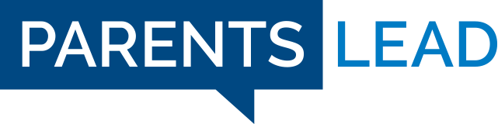
Alcohol: Prevention Works
Protective parental behaviors such as ongoing conversations, healthy role-modeling, monitoring, support and engagement.
Increased awareness of the risks associated with underage drinking and adult binge drinking.
CHANGE
COMES
FROM
Enforcement of laws and policies related to alcohol.
Strengthened policies to reduce access to alcohol.
80.1%
of ND adults support the legal drinking age of 21.
Shifting community norms to be supportive of healthy decisions, and not supportive of excessive alcohol consumption.
77%
of ND high school students report their parents or other adults in their family most of the time or always ask where they are going and with whom.
64.4%
of ND adults believe that alcohol servers and bartenders should be specially trained.
72.7%
of ND adults support DUI checkpoints.
2016
78%
of ND high school students report their parents or other adults in their family have clear rules and consequences for their behavior.
84.4%
of ND adults support compliance checks.
79.9%
of ND adults support compliance checks.
Parents are the #1 influence in their child’s life. Visit parentslead.org.
ND Community Readiness Survey (CRS), 2017
ND Youth Risk Behavior Survey (YRBS), 2017
Notes:
Prevention is a proactive approach; creating an environment that promotes the health and well-being of individuals, families and communities, which prevents problems before they occur.

Slide 23
Alcohol: Prevention Works
70.5%
71.7%
Of ND adults believe it is possible to reduce alcohol and other drug problems through prevention.
Of ND adults believe that prevention programs are a good investment.
ND Community Readiness Survey (CRS), 2017
Notes:
Prevention is a proactive approach; creating an environment that promotes the health and well-being of individuals, families and communities, which prevents problems before they occur.

Slide 24
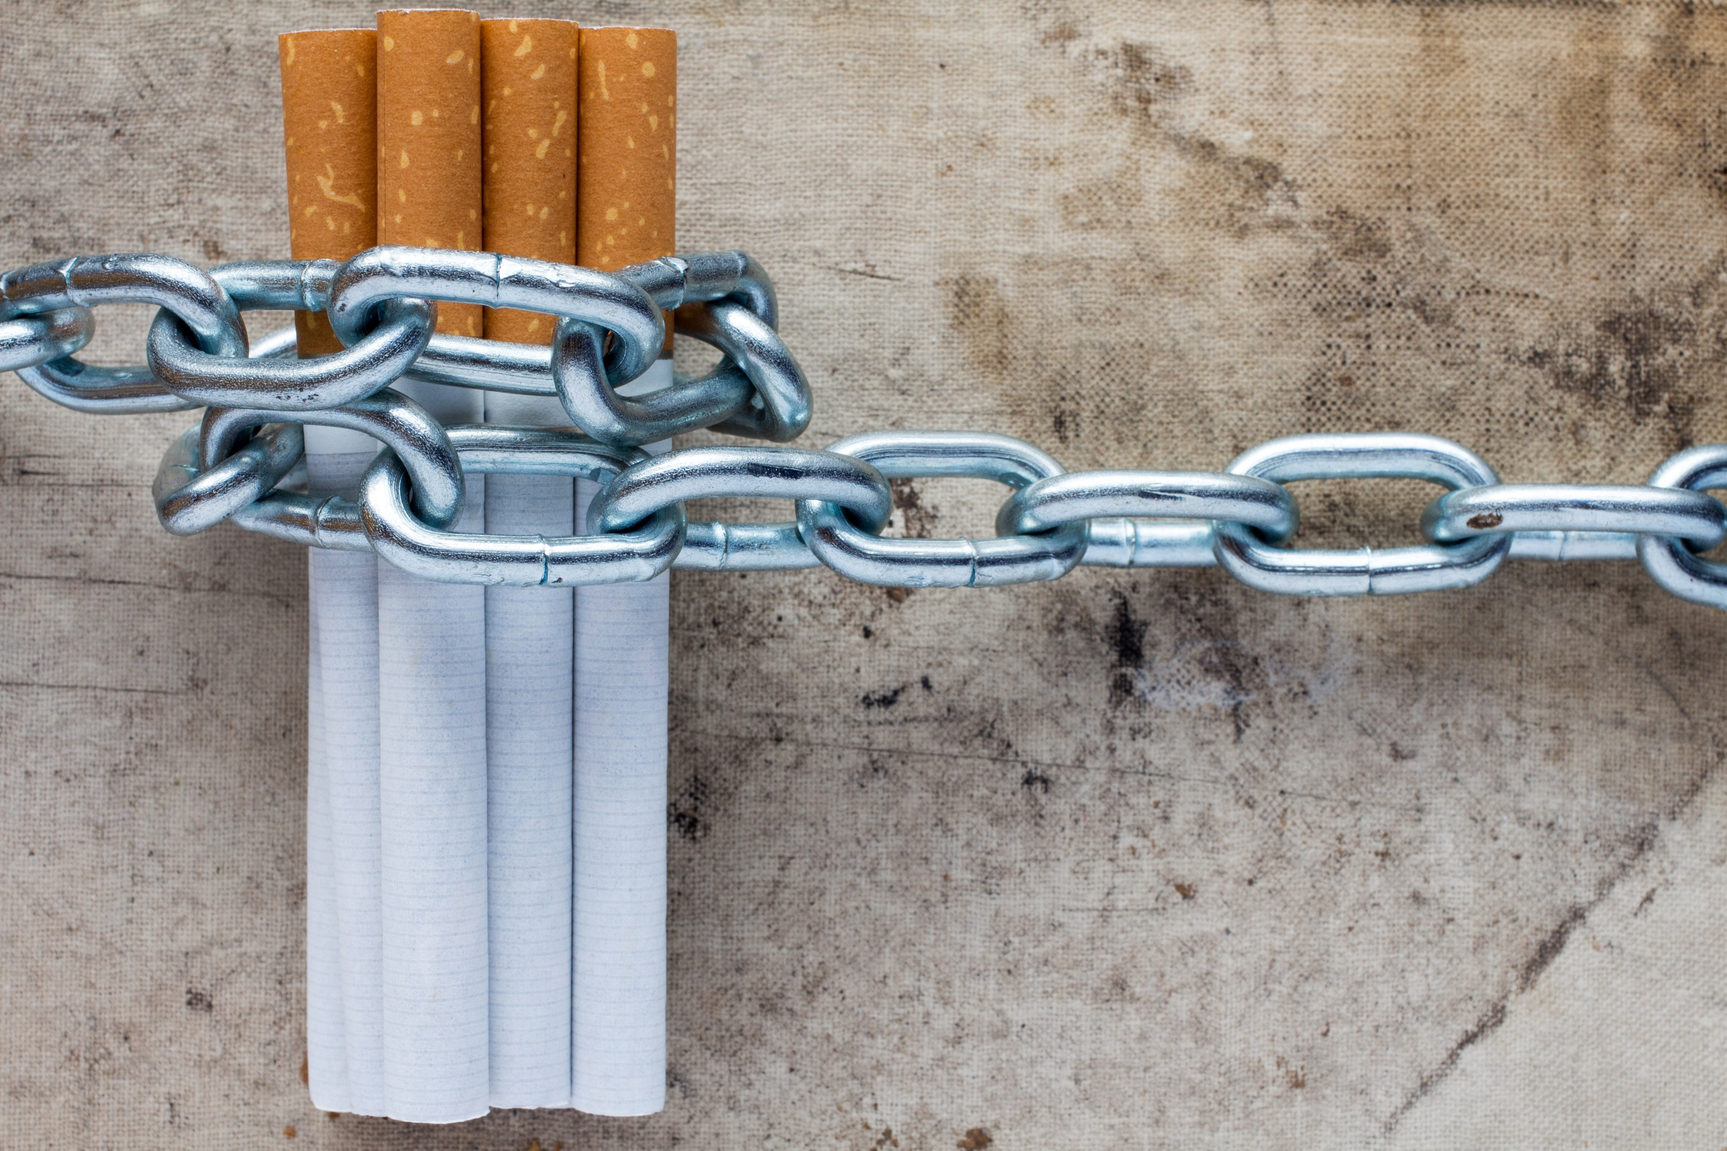

Tobacco

Slide 25
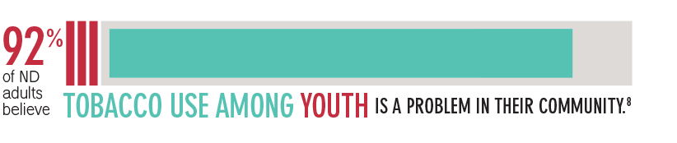
Tobacco: Youth
of ND middle school students report trying cigarette smoking (even one or two puffs) at one point in their life.
of ND middle school students report using electronic vapor products at one point in their life.
10.9%
13.1%
ND Community Readiness Survey (CRS), 2017
ND Youth Risk Behavior Survey (YRBS), 2017
Notes:
Generally, cigarette use is declining among youth in the state. However, use of other tobacco products has remained steady or increased.

Slide 26
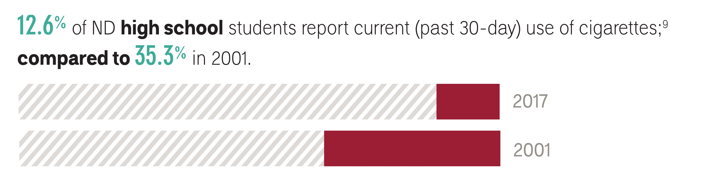
Tobacco: Youth
of ND high school students report current (in the past 30 days) use of tobacco.
28.8%
of ND high school students report current use of electronic vapor products.
20%
of ND college students used tobacco within the past 30 days.
19.1%
an increase from
1.6% in 2011.
ND Youth Risk Behavior Survey (YRBS), 2017
ND Alcohol, Tobacco, and Other Drug Survey, 2016
ND Youth Tobacco Survey (YTS), 2017

Slide 27
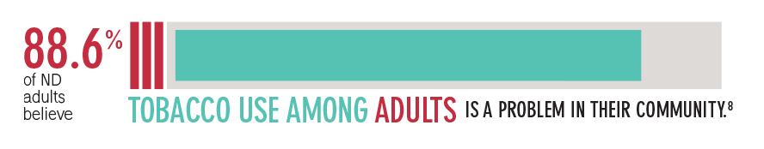
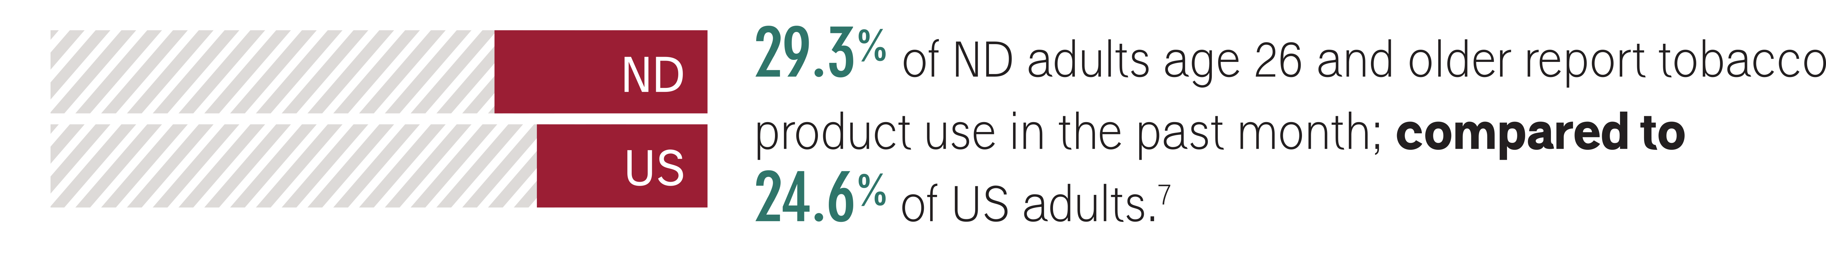
Tobacco: Adult
ND Community Readiness Survey (CRS), 2017)
National Survey on Drug Use and Health (NSDUH), 2015-2016

Slide 28
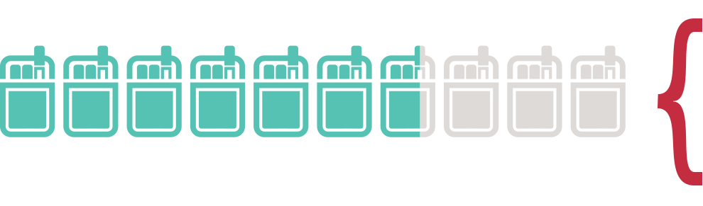
Tobacco
67%
of North Dakotans age 12 or older believe smoking one or more packs of cigarettes per day poses great risk.
The majority
41.6%
of ND high school students report it would be very easy to get tobacco products if they wanted some.²⁴
7.5%
of ND high school students usually obtain their own cigarettes by buying them in a store or gas station.*
6%
of ND high school students usually obtain their own electronic vapor products by buying them in a store.*
*During the 30 days before the survey, among students who were less than 18 years old and who currently smoke or use electronic vapor products.
ND Youth Risk Behavior Survey (YRBS), 2017
National Survey on Drug Use and Health (NSDUH), 2015-2016

Slide 29
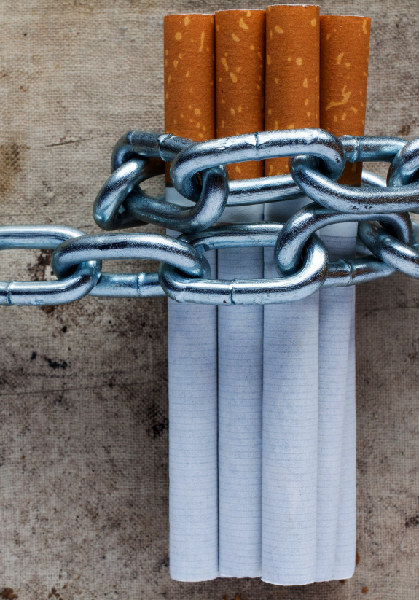


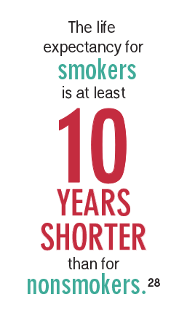

Tobacco costs us all, even those who do not use tobacco. North Dakota smoking-caused monetary costs include:
In the 2014-2015 school year, 421 North Dakota students were expelled or suspended because of tobacco-related incidents, resulting in 1,052 days removed from school.
Annual health care costs directly caused by smoking: $326 million
Medicaid costs caused by smoking: $56.9 million
Residents' state and federal tax burden from smoking-caused government expenditures: $758 per household
Smoking-caused productivity losses: $232.6 million
Exposure to secondhand smoke causes more than 41,000 deaths each year among adults in the United States.
Campaign for Tobacco-Free Kids; US Department of Health and Human Services. The Health Consequences of Smoking – 50 Years of Progress. A Report of the Surgeon General, 2014; ND Department of Public Instruction, 2017-18; American Lung Association
Notes:
Tobacco is the leading preventable cause of death in the US and takes a tremendous toll on lives in ND. When we prevent tobacco use and exposure to secondhand smoke, we prevent disease, suffering and death, and save money on healthcare expenditures and productivity losses.

Slide 30


Marijuana

Slide 31
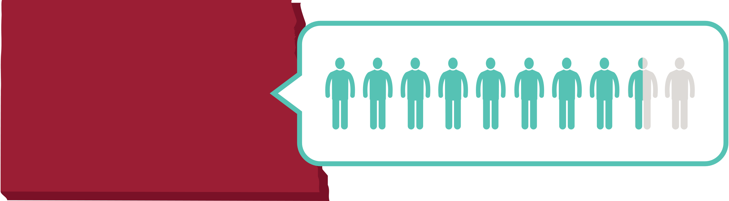
Marijuana: Youth
85.8%
of ND middle school students have used marijuana one or more times in their lifetime.
8.2%
The majority
85.8%
of ND adults believe YOUTH marijuana use is a problem in their community.
of ND high school students have used marijuana one or more times in the last 30 days, compared to 19.8% in U.S.
15.5%
ND Community Readiness Survey (CRS), 2017
ND Youth Risk Behavior Survey (YRBS), 2017
Notes:
Marijuana Use in ND is higher among youth than adults. When compared to national rates, marijuana use in the state is generally lower. Young adults often overestimate how frequently their peers are using marijuana which can influence personal decisions surrounding marijuana use.

Slide 32
Marijuana: Young Adult
13.1%
13.1%
of ND college students report using marijuana in the past 30 days.
of ND young adults age 18 to 29 report marijuana use in the past 30 days.
ND Young Adult Survey (NDSOYA), 2018
ND Alcohol, Tobacco, and Other Drug Survey, 2016
Notes:
Marijuana Use in ND is higher among youth than adults. When compared to national rates, marijuana use in the state is generally lower. Young adults often overestimate how frequently their peers are using marijuana which can influence personal decisions surrounding marijuana use.

Slide 33
PERCEIVED VERSUS ACTUAL MARIJUANA USE
AMONG ND YOUNG ADULTS (age 18-29)
(Number of days in past 30 days)
A significant misperception is revealed when perceptions of how frequently peers use marijuana are compared to actual marijuana use rates.
ND Young Adult Survey (NDSOYA), 2018
Notes:
Marijuana Use in ND is higher among youth than adults. When compared to national rates, marijuana use in the state is generally lower. Young adults often overestimate how frequently their peers are using marijuana which can influence personal decisions surrounding marijuana use.

Slide 34
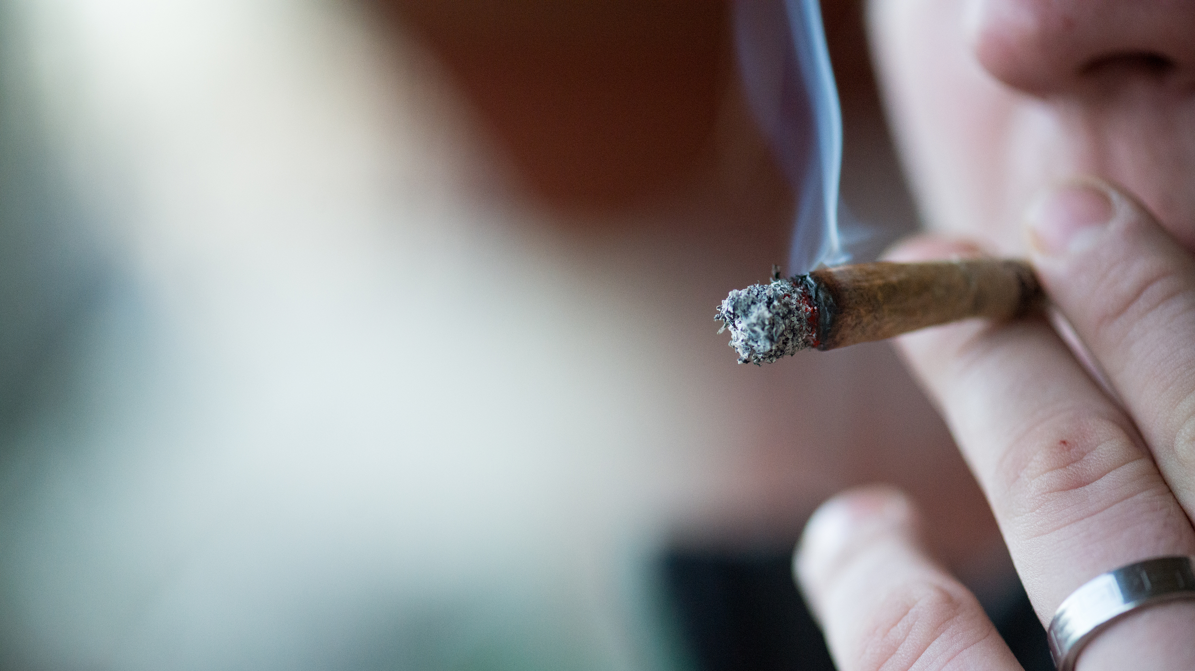
Marijuana: Adult
6.9%
+
The majority 75.6%
of ND adults believe ADULT marijuana use is a problem in their community.
of ND adults age 26 and older report using marijuana in the past month, compared to 3.8% in the U.S.
National Survey on Drug Use and Health (NSDUH), 2015-2016
Notes:
Marijuana Use in ND is higher among youth than adults. When compared to national rates, marijuana use in the state is generally lower. Young adults often overestimate how frequently their peers are using marijuana which can influence personal decisions surrounding marijuana use.

Slide 35
Marijuana
Youth initiation of marijuana use is associated with adverse health consequences
Generally, marijuana use is higher when individuals do not believe marijuana use is risky.
The more easily marijuana is to obtain, the higher likelihood for use and abuse.
5.6%
69.1%
42.6%
12.1%
73.4%
of ND high school students tried marijuana for the first time before the age of 13.
5.6% is equivalent to approximately 1,724 students, or the number of enrolled students at Grand Forks Red River High and Jamestown High School combined.
69.1% of ND youth age 12-17 and 73.4% of ND adults age 18 or older do NOT perceive great risk in smoking marijuana once a month.
of ND adults believe it is not at all difficult for adults or youth to access marijuana in their community.
of ND high school students were offered, sold, or given an illegal drug on school property during the year before the survey.
ND Youth Risk Behavior Survey (YRBS), 2017; National Survey on Drug Use and Health, 2015-2016
ND Community Readiness Survey (CRS), 2017; ND Department of Public Instruction, Public School District Fall Enrollment, 2017-18
Notes:
As efforts to legalize marijuana continue, there is an increasing perception that marijuana is not harmful or addictive.
The reality is that marijuana can cause major health, safety, social, and learning problems - especially in adolescents.

Slide 36
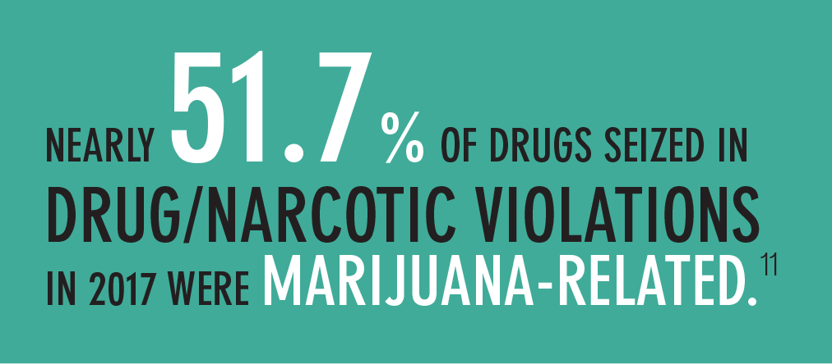
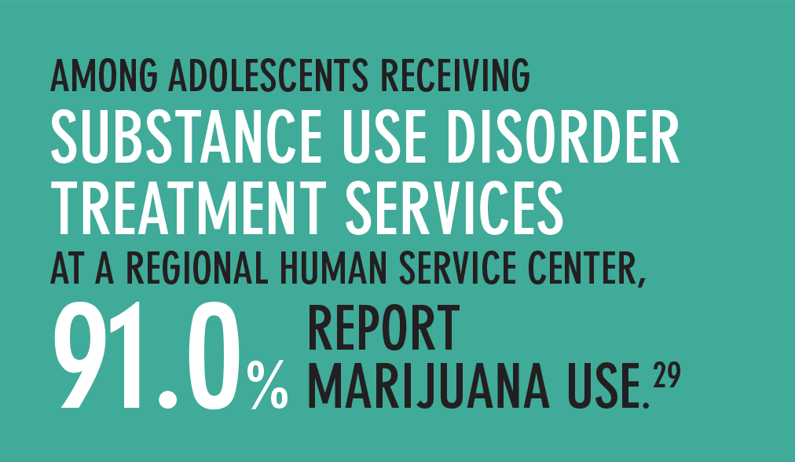
Marijuana
Crime in ND, 2017
ND Attorney General’s Office, 2016 Comprehensive Status and Trends Report
Notes:
As efforts to legalize marijuana continue, there is an increasing perception that marijuana is not harmful or addictive.
The reality is that marijuana can cause major health, safety, social, and learning problems - especially in adolescents.

Slide 37


Prescription Drugs

Slide 38
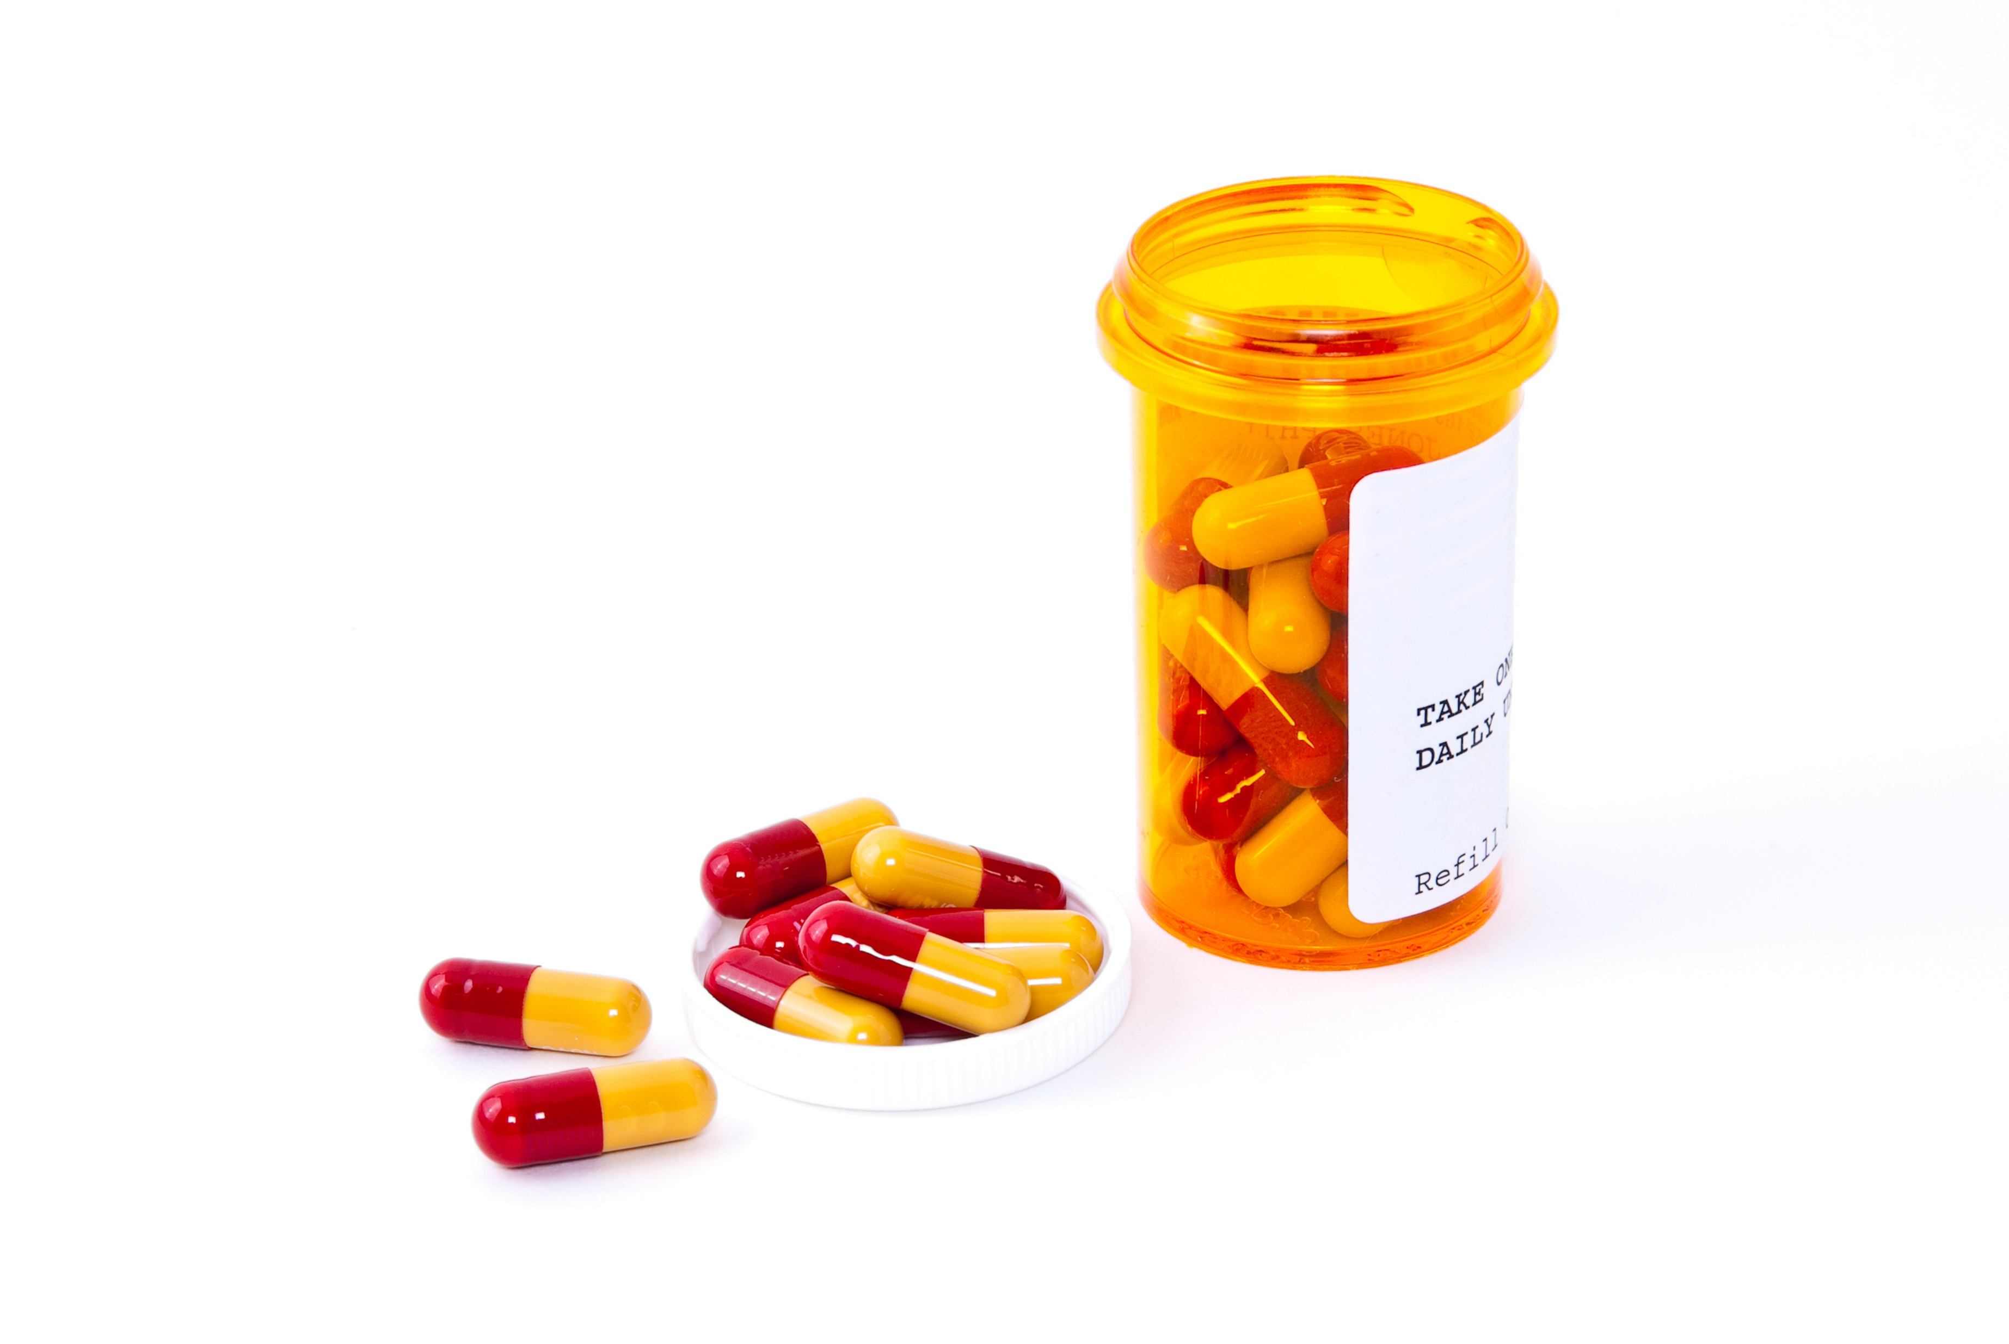
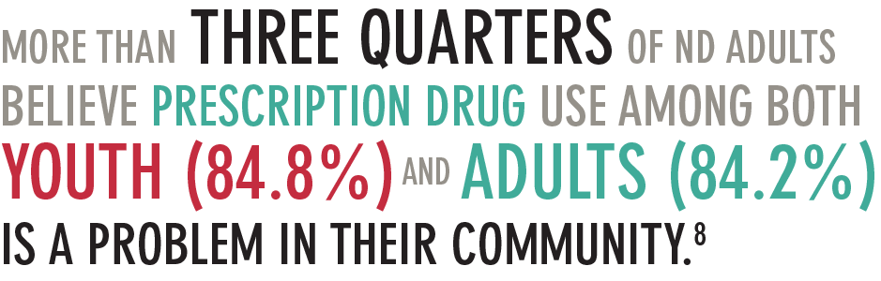
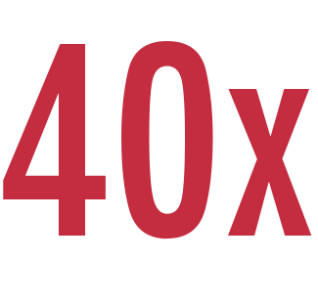
Prescription Drugs
84.8%
84.2%
People who are addicted to prescription pain killers are 40x more likely to become addicted to heroin.
The majority of heroin users report that they began abusing prescription drugs before using heroin.
ND Community Readiness Survey (CRS), 2017; Key substance use and mental health indicators in the US: Results from the 2016 National Survey on Drug Use and Health; National Survey on Drug Use and Health (NSDUH), 2015-2016
Notes:
Prescription opioid misuse and overdose is a growing concern across the nation and in ND communities.

Slide 39
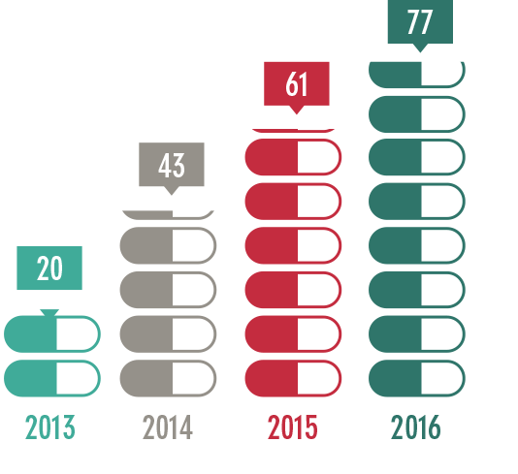
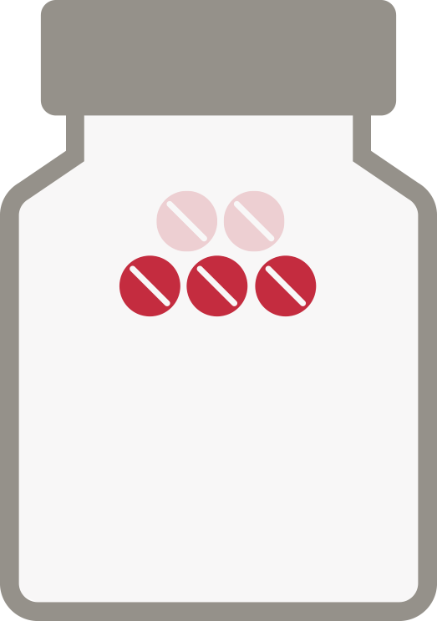
Prescription Drugs
More than three out of five drug overdose deaths in the United States involve an opioid (42,249 deaths) and nearly half of those deaths were from prescription opioids.
In North Dakota, the number of overdose deaths has increased from 20 in 2013 to 77 in 2016.
National Center for Health Statistics
Center for Disease Control (CDC) Wonder, 2016

Slide 40

Prescription Drugs
4.3% of ND middle school students and 14.4% of ND high school students report using prescription pain medication without a doctor’s prescription one or more times during their lifetime.⁵
of ND college students used a prescription drug non-medically one or more times during their lifetime.¹⁴
6.1%
4.3%
14.4%
of ND young adults age 18-29 report use of prescription medication in the last 30 days to get high.¹³
of ND adults age 26 or older report non-medical use of pain relievers in the past year, compared to 4% in the U.S.⁷
1.4%
4%
ND Youth Risk Behavior Survey (YRBS), 2017; National Survey on Drug Use and Health 2015-2016; ND Young Adult Survey (NDSOYA), 2018; ND Alcohol, Tobacco, and Other Drug Survey, 2016

Slide 41

Prescription Drugs
The more prescription opioid medication is available, the higher likelihood of misuse.
of people (age 12+) who misuse pain relievers obtain them from a friend or relative.
53%
of ND adults believe it is NOT at all difficult for youth or adults to access prescription drugs in their community.
16.5%
SAMHSA Center for Behavioral Health Statistics and Quality, National Survey on Drug Use and Health, 2016; ND Community Readiness Survey, 2017
Notes:
Access to prescription medications is a key risk factor relating to the misuse of and addiction to prescription opioid medication.

Slide 42
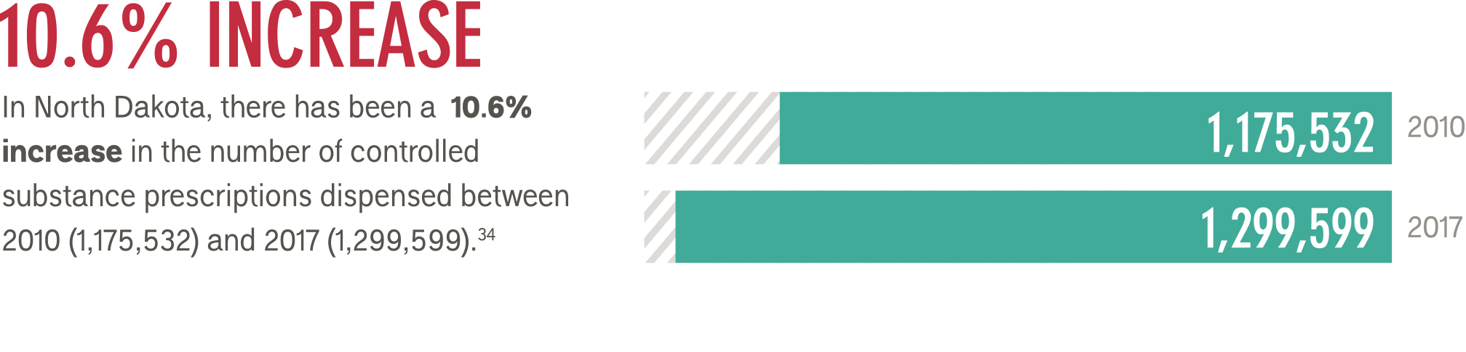
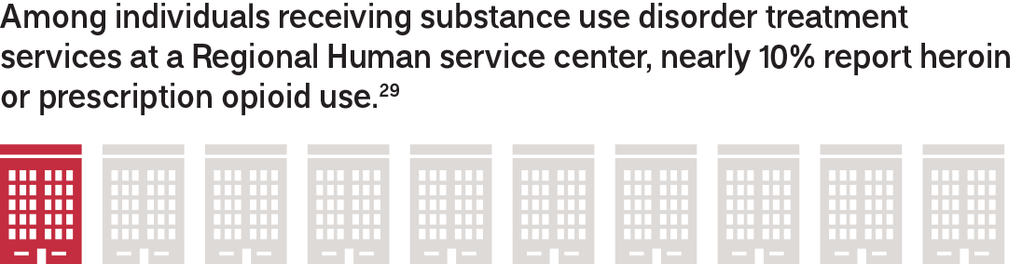
Prescription Drugs
ND Board of Pharmacy, PDMP Report 2017 Q4
ND Attorney General’s Office, 2016 Comprehensive Status and Trends Report
Notes:
Access to prescription medications is a key risk factor relating to the misuse of and addiction to prescription opioid medication.

Slide 43
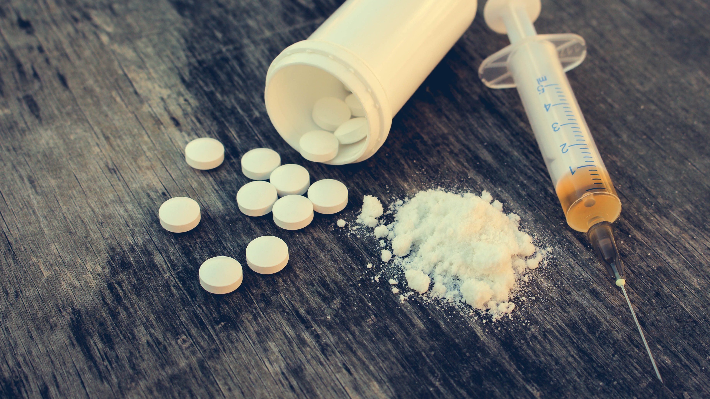

Other Illicit Drugs

Slide 44

Other Illicit Drugs: Youth
7% of ND high school students report using synthetic marijuana one or more times in their life.
2.6% of ND high school students report using methamphetamine one or more times in their life compared to 2.5% in the U.S.
1.4% of ND high school students report using heroin one or more times in their life compared to 1.7% in the U.S.).
Order or download free prevention materials.
ND Youth Risk Behavior Survey (YRBS), 2017
Notes:
Illicit drug use is relatively low in ND.

Slide 45
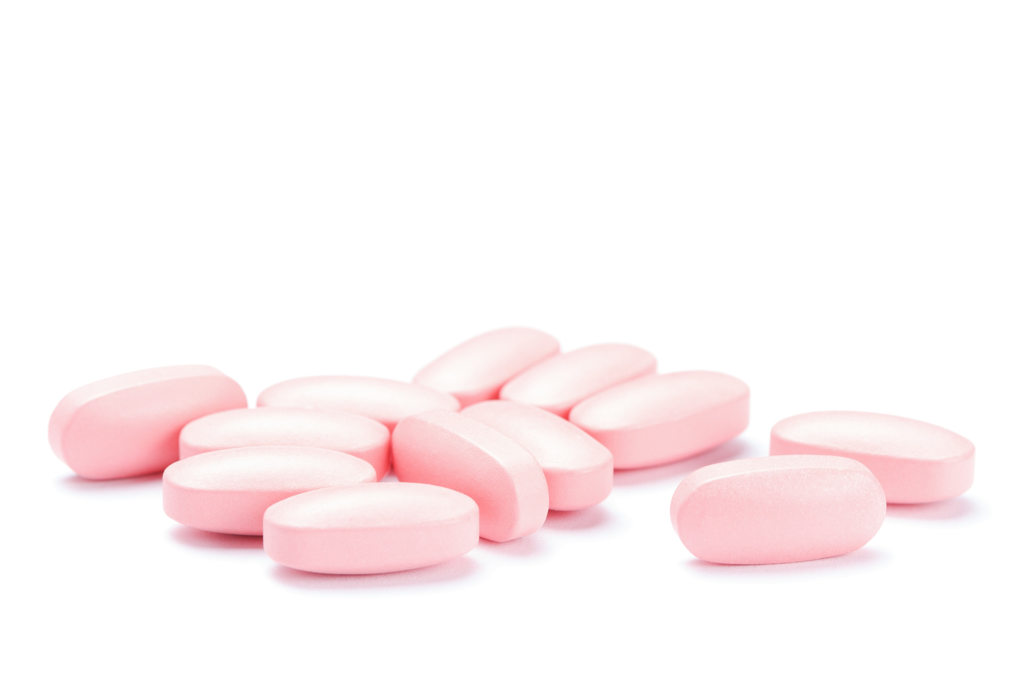
Other Illicit Drugs
YOUNG ADULT
of ND college students report use of amphetamines in the past year.
1.8%
ADULT
of ND college students report use of other illegal drugs in the past year (heroin, inhalants, synthetic drugs, etc.).
of ND adults age 26 and over report using illicit drugs (other than marijuana) in the past month.
2.1%
2.2%
ND Alcohol, Tobacco, and Other Drug Survey, 2016
National Survey on Drug Use and Health (NSDUH), 2015-2016
Notes:
Illicit drug use is relatively low in ND

Slide 46
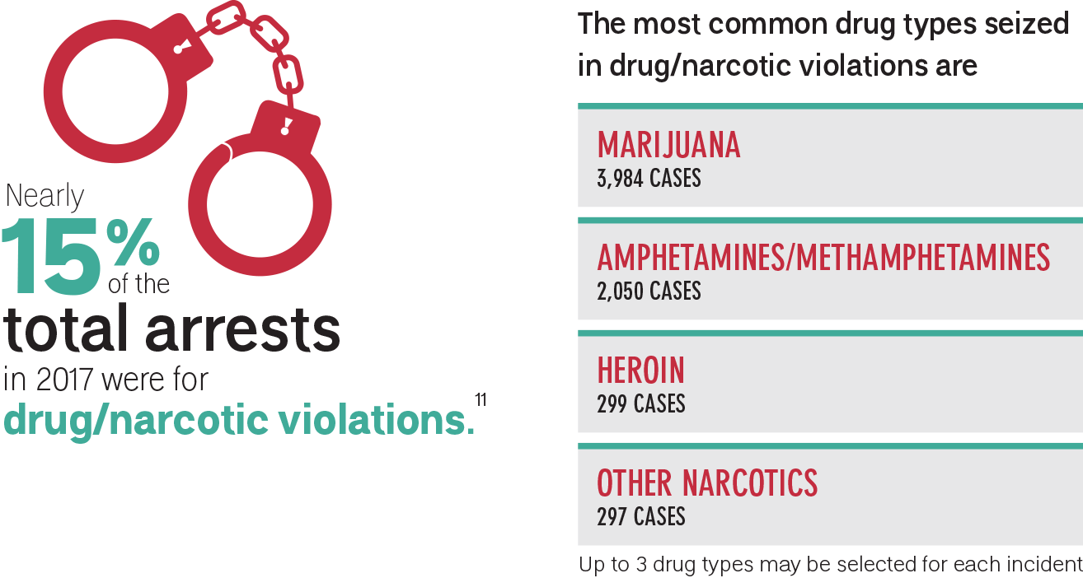
Other Illicit Drugs
Crime in ND, 2017
Notes:
The consequences of illicit drug use impact our families and communities

Slide 47
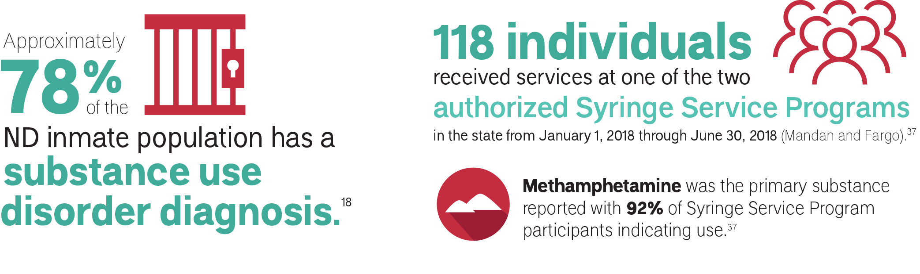
Other Illicit Drugs
ND Department of Corrections and Rehabilitation, 2015-2016
ND Syringe Service Program Biannual Report. Last Updated August 2018

Slide 48
Other Illicit Drugs
5.4%
7.6%
of youth age 12-17 met criteria for substance use disorder in the past year.
of adults age 26 and older met criteria for substance use disorder in the past year.
National Survey on Drug Use and Health (NSDUH), 2015-2016

Slide 49


Prevention Works

Slide 50
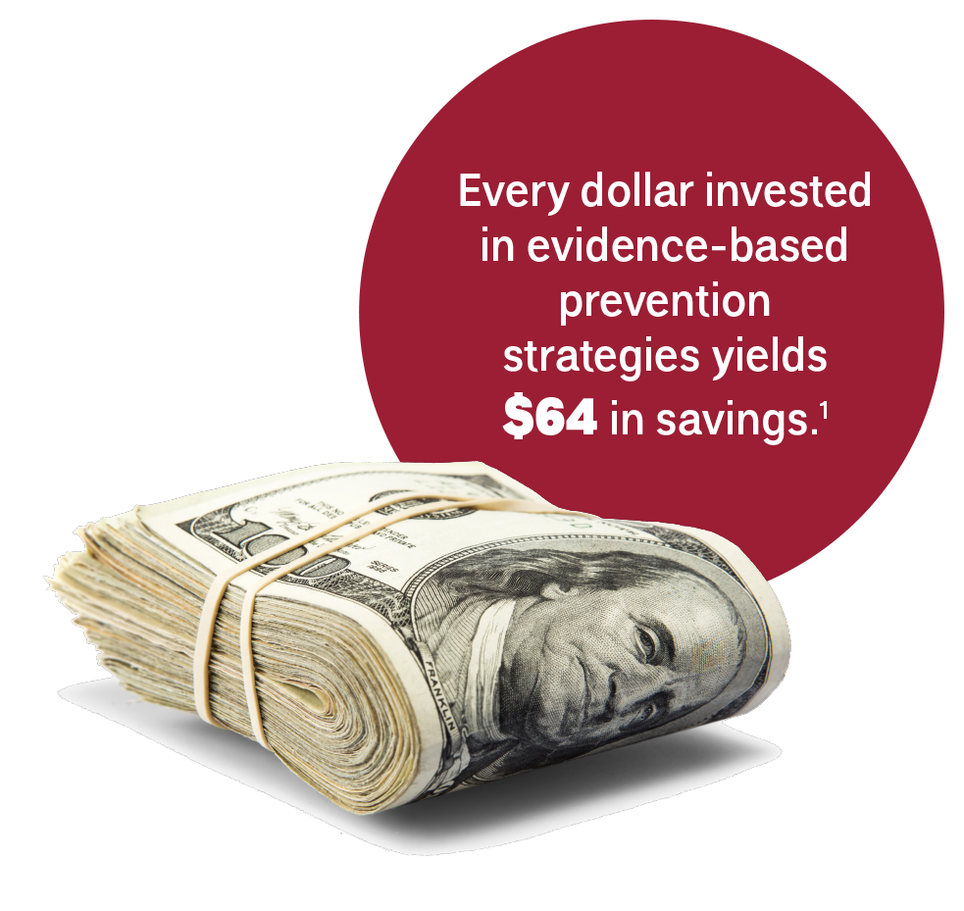

Prevention is Proactive
Prevention creates an environment that promotes health and well-being of individuals and communities, which prevents problems before they occur.
Evidence-based prevention strategies decrease the likelihood of disease, suffering and death – saving lives and money.
ND Community Readiness Survey (CRS), 2017
Washington State Institute for Public Policy (2016) Benefit-cost results.

Slide 51
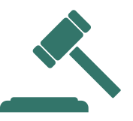

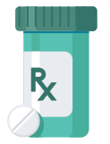


Effective Prevention Looks Like…
Law enforcement implementing alcohol and tobacco compliance checks to enforce the laws related to youth access to substances.
Parents and other adults engaging with the children in their life and role-modeling healthy behaviors.
Taking medication as prescribed and safely disposing of any unused or unwanted medication.
Policy-makers having conversations about policy changes that can help support healthy communities.
Community coalitions being active in community efforts and promoting healthy and safe messages and activities.

Slide 52


Prevention Resources

Slide 53







Get Involved!
Your community can work together to become a healthier, more vibrant place to live by investing time, energy and money in prevention. In fact, it is one of the best investments we can make in our state's future - creating safe and healthy individuals, families, businesses and communities.
Follow these steps to build a healthier community:
Target the Problem
The North Dakota Department of Human Services’ Behavioral Health Division has a team of prevention experts ready and willing to help communities get started with implementing effective prevention.
Find Resources
Build Support
Do What Works
Request assistance from our training and technical assistance team.
Order or download free prevention materials.
Learn more at www.prevention.nd.gov/get-involved
Notes:
TARGET THE PROBLEM: Prevention research shows using data to inform decision-making is critical to making effective change.
FIND RESOURCES: For prevention to be effective, it takes time and collaboration with others committed to addressing community-specific issues.
BUILD SUPPORT: Well-supported prevention efforts with adequate resources are more likely to succeed.
DO WHAT WORKS: Identifying and implementing a comprehensive set of strategies proven to work leads to the greatest chance at making positive community change.

Slide 54



Comprehensive communication is an important component of prevention.
The Behavioral Health Division has developed four statewide programs/ campaigns to address the statewide data-driven prevention priorities:
underage drinking
adult binge drinking, and
prescription drug misuse and opioids.
Each campaign offers a wide variety of easy-to-access tools and resources designed to assist your community with local implementation.
FREE materials and resources are also available for order or download at prevention.nd.gov/materials

Slide 55





69% of youth report their parents as being the greatest influence in their decision not to drink alcohol.
Parents Lead supports parents in promoting the behavioral health of their children by providing resources and materials based on four evidence-based parental behaviors:
Ongoing communication
Effective monitoring
Positive role-modeling
Support and engagement
For more information, visit www.parentslead.org and engage on social media.

Slide 56
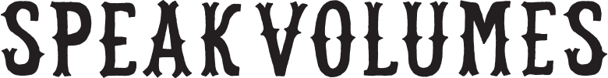
1 in 3 ND adults age 26 and older currently binge drink.
Speak Volumes addresses adult binge drinking and related consequences through comprehensive messaging about binge drinking, standard drink sizes, and alcohol volume.
For more information, visit speakvolumes.nd.gov

Slide 57
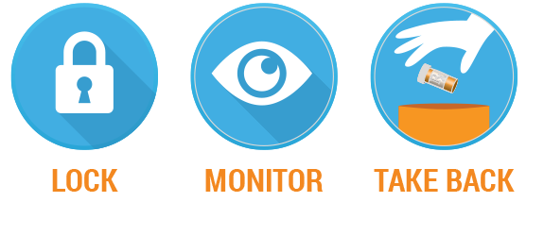
53% of adults who misuse prescription drugs obtain them from a friend or relative.
Lock. Monitor. Take Back. seeks to reduce access to prescription drugs, especially opioids, by promoting safe use of medication, including safe storage and utilization of statewide take back locations.
To learn more or download campaign materials, visit prevention.nd.gov/takeback

Slide 58
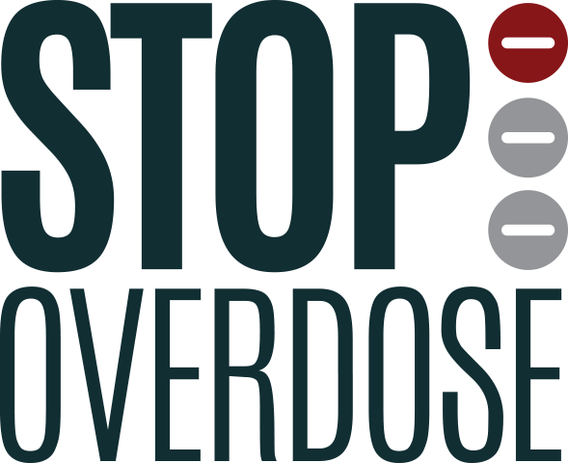
Over the course of three years, the number of ND overdose deaths nearly quadrupled.
Stop Overdose supports individuals and communities impacted by opioid abuse and overdose through education of evidence-based overdose prevention, including the North Dakota Good Samaritan Law and use of naloxone.
To learn more or download campaign materials, visit prevention.nd.gov/stopoverdose

Slide 59
