Slide 1
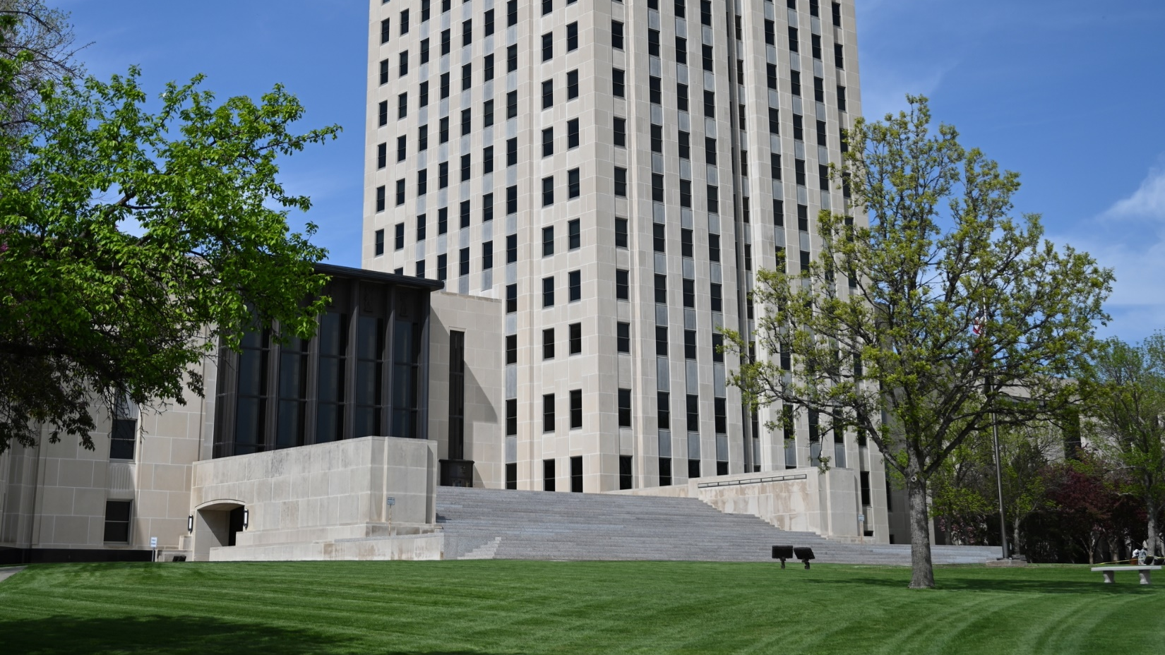



DOJ IMPLEMENTATION PLAN
KEY PERFORMANCE INDICATORS
ADULT & AGING SERVICES
Reporting Period June 14, 2025 – September 30, 2025
1
Notes:
In order to report on the most meaningful performance indicators associated with the North Dakota US Department of Justice Settlement Agreement (US DOJ SA), the State will report, on a quarterly basis, the Key Performance Indicators (KPIs) included in this presentation. The KPIs have been revised and reduced in number from previous years to focus on the most relevant indicators of performance.
The report contains data points and notes that highlight the State’s progress as well as challenges and will be posted on the ND Department of Health and Human Service’s (HHS) website. Data collection methods have been developed to track the critical issues facing Target Population Members (TPMs) who want to receive care in the most integrated setting appropriate to their needs.
KPIs in the report include:
Individuals Referred to HCBS Case Management
Average HCBS Case Manager Weighted Caseloads
TPMs Served in a Skilled Nursing Facility (SNF)
TPM Transitions
TPMs Using State or Federally Funded HCBS
New TPMs Diverted
SFY24 Annual Cost Comparison HCBS SNF Care
Average Length of Time to Approve QSP Applications
New Individual QSPs Enrolled
New Agency QSPs Enrolled
QSP Retention
QSPs Providing 24/7 Care
QSPs by County

Slide 2
HOME AND COMMUNITY BASED SERVICES (HCBS) CASE MANAGEMENT
1,427
INDIVIDUALS REFERRED TO
HCBS CASE MANAGEMENT IN QUARTERS 1 - 3 OF 2025
ANNUAL COMPARISON DATA
2024 - 1,807
2023 – 1,592
2022 – 1,854
2021 – 1,893
Notes:
There were 1,427 referrals to HCBS in the first three (3) quarters of 2025. Forty-eight (48) percent or 691 of the referrals sent to the HCBS Case Managers during this timeframe became an open case. An average of 76 cases are opened per month and the demand for in-home and community-based services remains high.

Slide 3
CASE MANAGEMENT
CASE LOADS
120
AVERAGE MONTHLY WEIGHTED CASELOAD
PER HCBS CASE MANAGER IN QUARTER 1 - 3 OF 2025
ANNUAL COMPARISON DATA
2024 - 117
2023 – 119
2022 – 117
2021 – 110
Notes:
There are 75 HCBS Case Managers who currently carry an average weighted caseload of 120 cases. There are eleven (11) part-time and sixty-four (64) full time case managers including eight (8) supervisors.
The State continues to monitor the weighted caseloads of HCBS Case Managers. To keep up with the demand for services Adult and Aging Services is in the process of hiring four additional HCBS Case Managers.

Slide 4
TARGET POPULATION MEMBERS (TPMs) in a skilled nursing facility (snf)
2,280
TPMs SERVED IN A SNF in
JULY of 2025
ANNUAL COMPARISON DATA
2024 – 2,147
2023 – 2,412
2022 – 2,438
2021 – 2,376
Notes:
There were 2,280 Medicaid eligible individuals who received services in a skilled nursing facility in July of 2025. This number includes all Medicaid eligible individuals who were approved for a short or long-term stay. Individuals who receive care in a Skilled Nursing Facility for less than 90 days are not considered a Target Population Member under the Settlement Agreement, but they are all at risk of a long-term placement which is 90 or more days.

Slide 5
TPMs WHO TRANSITIONED TO
AN INTEGRATED SETTING
60
TPMs TRANSITIONED IN
QUARTERS 1 - 3 OF 2025
ANNUAL COMPARISON DATA
2024 - 139
2023 – 118
2022 – 121
2021 – 91
Notes:
In the first three (3) quarters of 2025, 60 TPMs have moved back to the community. None of these individuals have previously transitioned. Multiple transitions to the community can happen and it's often the result of a change in condition that requires another rehabilitation stay in the SNF because of a new or worsening medical issue. The US DOJ SA requires that TPMs be transitioned within 120 days of requesting transition support services. Some transitions take more time because there are significant barriers that must be overcome before a TPM is ready to move to the community. The State staffs transitions that have been pending for 90 or more days with transition team members i.e., Transition Coordinator, HCBS Case Manager and the Housing Facilitator, to ensure that all steps are taken to allow for a safe and efficient move back to the community.
The State is committed to helping eligible TPMs transition back to the community, however long it takes, if that is their preference and not until a transition plan is in place to ensure safe transition. Access to accessible and affordable housing is the biggest barrier to community living. The State is developing and implementing additional strategies to further address these issues.

Slide 6
TPMs UTILIZING STATE OR FEDERALLY
FUNDED HCBS
988
TOTAL OF
UNDUPLICATED TPMs
SERVED IN QUARTER 3 OF 2025
ANNUAL COMPARISON DATA
2024 - 961
2023 – 666
2022 – 494
2021 – 273
Notes:
There are 988 unduplicated TPMs who are currently receiving HCBS. This number continues to increase as more TPMs are choosing home and community-based services.
All 988 individuals meet the functional requirements to receive care in the nursing home and are Medicaid eligible and choose to receive care in the most integrated setting that meets their needs. The State strives to divert as many TPMs as possible, so they can avoid institutional placement, even for a short period of time.

Slide 7
New TPM Unduplicated Diversions
234
NEW UNDUPLICATED HCBS TPMs WERE DIVERTED AND SERVED IN QUARTERS 1 - 3 OF 2025
53 DIVERTED FROM A SNF ON SPED
204 DIVERTED FROM A SNF ON MW
34 DIVERTED FROM A SNF ON MSP B OR C
ANNUAL COMPARISON DATA
2024 – 390 (108 ON SPED, 304 ON MW, 89 ON MSP B OR C)
2023 – 321 (52 ON SPED, 250 ON MW, 89 ON MSP B OR C)
2022 – 308 (92 ON SPED, 221 ON MW, 52 SNF ON MSP B OR C)
2021 – 273 (104 ON SPED, 144 ON MW, 65 ON MSP B OR C)
Notes:
In the first three (3) quarters of 2025, 234 new TPMs were diverted from a Skilled Nursing Facility and are receiving necessary care in the home. The number diverted by funding source reflects that TPMs may receive services under more than one program. The HCBS 1915(c) Medicaid waiver continues to be the most utilized program for newly diverted TPMs. The State is closely monitoring the number of people utilizing the waiver to accurately project the number of people we may need to serve in the future on the waiver to meet the growing demand for this service.

Slide 8

SFY25 AVERAGE ANNUAL INDIVIDUAL COST COMPARISON BY HCBS FUNDING SOURCE AND AVERAGE ANNUAL COST OF SNF CARE
~
XXX
= Number of recipients
106
1,675
642
630
1,404
2,483
Notes:
There are many benefits to providing HCBS. HCBS is the preferred option of most people who require some type of long-term services and support (LTSS) to live safely and take care of their daily needs. It is also generally less expensive and requires fewer federal and state resources to provide.
The high cost of skilled nursing facility care is part of the reason that approximately 50% of the residents of Skilled Nursing Facilities are Medicaid beneficiaries. If an individual needs services long-term, it does not take long for the average citizen to spend down their resources and need financial support to pay for their care in a Skilled Nursing Facility.
As the number and needs of people eligible for services grows with the aging baby boom population HCBS waiver costs have also increased. The increase in the annual cost of the waiver is due to the fact that many of the TPMs who are utilizing waiver services, have a need for one to one care because of cognitive issues, functional impairments, complex medical needs, and behavioral health issues.

Slide 9
HCBS Qualified service providers (qsp) Enrollment
8 days – Individual
36 days - Agency
AVERAGE LENGTH OF TIME TO APPROVE QSP APPLICATIONS IN QUARTER 3 OF 2025
Notes:
There were a total of 200 applications processed in the third quarter of 2025. 171 individual applications were submitted and reviewed, 117 were approved within an average of 15 days. Twenty-nine agency applications were submitted and reviewed, and two (2) were approved within an average of 15 days. The average combined time for individual and agency applications to be approved is 12 days.
The State now manages the QSP enrollment process and uses an online portal for enrollment and revalidation. Three (3) State staff handle applications through the portal, streamlining the previously paper-based process. The system guides users through eligibility questions and includes video tutorials and tooltips to support first-time application completion. Required training, such as Fraud, Waste, and Abuse training and the QSP orientation, is also included within the portal.
The system is also used for reenrollment and to add or change a provider’s personal information, service array, or service territory.
Processing times were longer in the first three quarters of 2025 due to an increased volume of applications and a higher number of providers applying for services with more complex enrollment requirements. Enrollment staff report seeing an increase in applications for residential habilitation and community support agencies, nursing services and from individuals seeking to offer respite care in adult foster care homes which requires the extra step of getting a criminal background check.

Slide 10
HCBS individual
Qualified service providers (qsp)
110
NEW INDIVIDUAL QSPs
ENROLLED IN QUARTER 3
OF 2025
1,225
TOTAL ENROLLED INDIVIDUAL QSPs IN QUARTER 3 OF 2025
ANNUAL COMPARISON DATA
2024 - 334
2023 – 280
2022 – 441
Notes:
Access to an adequate supply of available Qualified Service Providers (QSPs) is critical to serving people in the home. At a minimum it takes at least one (1) person to provide care for every unduplicated individual served under HCBS. TPMs who require 24-hour support to reside in the community may require at least five (5) people to ensure their care needs are met every day of the year.
Various recruitment and retention strategies have effectively encouraged individuals and agencies to enroll as QSPs. The number of new individual QSP enrollments increased by 19% from 2023 – 2024. The State continues to see growth in provider participation. Recruitment strategies include enhancing systems that support providers in meeting enrollment, documentation, and claims submission requirements.

Slide 11
HCBS agency
Qualified service providers (QSP)
20
NEW AGENCY QSPs
ENROLLED IN QUARTER 3 OF 2025
229
TOTAL ENROLLED AGENCY QSPs IN QUARTER 3 OF 2025
ANNUAL COMPARISON DATA
2024 - 45
2023 – 34
2022 – 11
Notes:
There are currently 229 QSP agencies enrolled to provide various types of care across the State. This is the largest number of QSP agencies that have ever been enrolled since the inception of HCBS for older adults and adults with physical disability. The State awarded incentive grants to entities willing to start or expand a QSP agency that has helped increase the number of available providers. Modernizing the QSP enrollment process has also significantly increased the number of agencies who are willing to enroll with ND Medicaid.
Agencies choose their service territory and the type of services they want to provide. Agencies will be able to better market their services to the citizens of North Dakota by the QSP registry. The registry is called Connect to Care ND and is available on the HHS website as a tool to assist people in finding an HCBS provider. The State held Agency Quality and Capacity Training in October to help QSPs understand the benefits of the new system. The meetings were well attended and they will likely be repeated to ensure we are continually talking about quality and compliance.

Slide 12
Hcbs
Qualified service providers (qsp) Retention
226
AGENCY
1,180
INDIVIDUAL
NUMBER OF QSPs RETAINED IN QUARTER 3 OF 2025
Notes:
The number of new individual and agency QSPs enrolled each month can vary. Many of the individual QSPs are caring for someone they had a close personal relationship with prior to them needing care. If that person is no longer receiving services, the individual QSPs often close their QSP status. Despite having many enrolled providers some TPMs struggle to find a QSP that provides the type of care they need in their chosen community. Future recruitment efforts will be targeted at certain communities where qualified providers are hard to find. There has been an upward trend in QSP retention of new providers. These higher retention numbers indicate sustained provider engagement and more efficient reimbursement for services rendered. This suggests that the State’s investments in system improvements have had a positive impact on the HCBS system. Some QSPs will receive a targeted rate increase for certain services on 01/01/2026. The chart below shows the number of providers retained each year since 2020.

Slide 13
Hcbs
Qualified service providers (qsp)
24/7 care
24
QSP AGENCIES PROVIDING 24/7 CARE IN QUARTER 3 OF 2025
Notes:
One hundred-six (106) Medicaid eligible individuals are receiving 24/7 supports under residential habilitation or community support services. The numbers served have remained consistent in the first half of 2025 but in the third quarter there was a 13% increase in individuals receiving 24/7 support. These services are provided by 24 QSP agencies who employ qualified staff who provide the direct care. Residential habilitation and community support recipients meet a nursing facility level of care and have chosen to live in the community and receive in-home care.
The ability to provide 24/7 support is a critical part of the service delivery system and often involves individuals with very complex care needs.

Slide 14
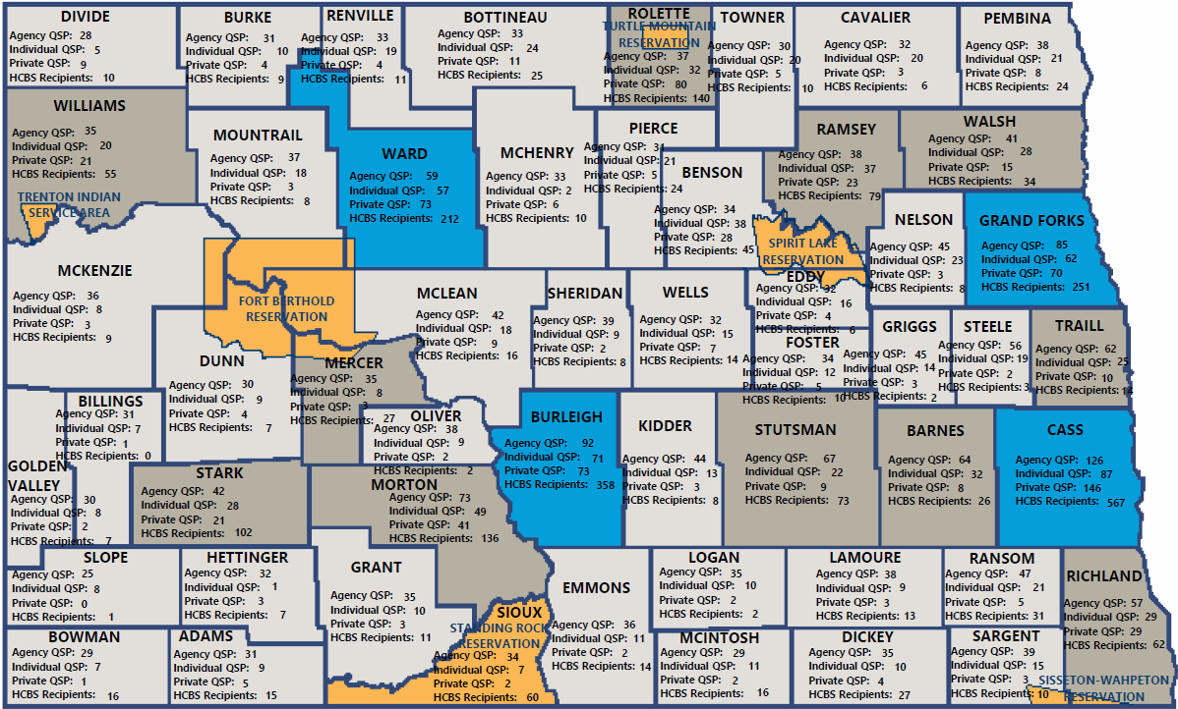
Hcbs Qualified service provider (qsp)
TOTALS BY servicing COUNTY
MAP COLOR LEGEND
 | Tribal Reservation or Service Area
 | Urban (Population >= 50,000 persons)
 | Rural (Population < 50,000 persons)
 | Frontier (Less than 7 persons per square mile)
UPDATED 06/16/2025
Notes:
This map displays how many QSPs are actively enrolled to serve the applicable county. There are some parts of ND where it is difficult to find enough QSPs to meet the demand for services. In some areas of western ND, the Government run Human Services Zone acts as one of the only agency QSPs in the area that have employees to provide care. The State is hopeful that the new enrollment portal and other workforce initiatives will increase the number of qualified providers in ND.
Please visit the Key Performance Indicators (KPI) Report section of the DHHS U.S. Department of Justice Settlement Agreement’s webpage, found at https://www.hhs.nd.gov/adults-and-aging/us-department-justice-settlement-agreement, to view the full QSPs Per County Map. Updated every DOJ quarter.
Please visit https://www.hhs.nd.gov/adults-and-aging/us-department-justice-settlement-agreement to view the full QSPs Per County Map.

