Slide 1

ND Medicaid Chiropractic Coverage Updates
March 21, 2024

Slide 2

Agenda
Overview of ND Medicaid Chiropractic Coverage
Change in ICD-10-CM diagnosis code requirements
Evaluation and Management Services (E/M codes)
General Medicaid Eligibility
Member Eligibility Overview – Dual Eligible Members

Slide 3
Overview of Covered and Non-Covered Chiropractic Services

Slide 4
Covered Chiropractic Services
Chiropractic Manipulative Treatment (CMT) Codes are limited to 20 per calendar year.
98940- Chiropractic manipulative treatment (CMT); spinal, 1-2 regions
98941- Chiropractic manipulative treatment (CMT); spinal, 3-4 regions
98942- Chiropractic manipulative treatment (CMT); spinal, five regions
When a member has met their yearly limit of 20 CMTs, additional CMT may be requested via service authorization. Additional unauthorized CMT performed and billed to ND Medicaid will be denied as patient responsibility, and the member may be billed.
Notes:
The limit was increased from 12 to 20 a couple years back.

Slide 5
Covered Chiropractic Services Overview
Payment for X-rays is limited to radiological exams of the spine and may not exceed two (2) per calendar year per region.
Cervical
Thoracic
Lumbar
Lumbosacral
Sacroiliac joints

Slide 6
Covered Chiropractic Services Overview
Current Covered Evaluation and Management Services
New Patient Evaluation and Management (E/M) services (99202 or 99203) are covered in addition to chiropractic manipulative treatment (98940-98942) only when the patient has not received any professional (face-to-face) services from the chiropractor or another chiropractor of the same group practice within the past three years.
  Billing outside this code range will be denied as a contractual obligation, and the member may not be billed.

Slide 7
Non-Covered Chiropractic Services Overview
Modalities and Therapeutic Procedures
Physical medicine modalities and therapeutic procedures, such as electrical stimulation, ultrasound, and therapeutic exercises, are only eligible for reimbursement to enrolled physical and occupational therapists when ordered by a licensed practitioner of the healing arts under a defined care plan.
The application of hot or cold packs is bundled into the payment made for any other service rendered that day.
These services will be denied as a contractual obligation to the billing provider and may not be billed to the member.

Slide 8
Non-Covered Chiropractic Services Overview
Maintenance Therapy – if chiropractic treatment becomes supportive rather than corrective in nature, the treatment is then considered maintenance therapy
Extraspinal Manipulations - Any joint manipulation outside of the spine.
Manipulation for non-neuromusculoskeletal conditions
  ADD/ADHD, breech or malpresentation of pregnancy, dysmenorrhea, otitis media, etc.
Chiropractic manipulation is used to treat idiopathic scoliosis or scoliosis beyond early adolescence unless the member exhibits pain or spasms or some other medically necessary indications for chiropractic manipulation are present.
  Please see the Chiropractic Services Policy on the website for a complete list of non-covered services or services that are considered not medically necessary.

Slide 9
Overview of Chiropractic Services
Paid Claims 2023
Procedures | Claim Lines Paid | Net Payment | Unique Members
Chiropractic Manipulations | 33,268 | $1,637,423.01
Evaluation and Management Services | 2,374 | $156,319.43
X-ray | 242 | $7,805.41
 | 35,884 | $1,801,547.85 | 8244

Slide 10
Overview of Covered Chiropractic Services

Slide 11
ICD-10-CM Code Requirement Changes

Slide 12
ICD-10-CM Code Requirement Changes
Previous Policy (prior to January 2024):
  Required the primary diagnosis code to be one of the following
    M99.00 Segmental and somatic dysfunction of head region
    M99.01 Segmental and somatic dysfunction of cervical region
    M99.02 Segmental and somatic dysfunction of thoracic region
    M99.03 Segmental and somatic dysfunction of lumbar region
    M99.04 Segmental and somatic dysfunction of sacral region
    M99.05 Segmental and somatic dysfunction of pelvic region
  Required the secondary diagnoses be one of the pre-defined associated neuromusculoskeletal condition codes listed in the Coding Guideline

Slide 13
ICD-10-CM Code Requirement Changes
New Policy Effective January 1, 2024
  The level of segmental and somatic dysfunction must be specified and must be listed as the primary diagnosis
    M99.00 Segmental and somatic dysfunction of head region
    M99.01 Segmental and somatic dysfunction of cervical region
    M99.02 Segmental and somatic dysfunction of thoracic region
    M99.03 Segmental and somatic dysfunction of lumbar region
    M99.04 Segmental and somatic dysfunction of sacral region
    M99.05 Segmental and somatic dysfunction of pelvic region

Slide 14
ICD-10-CM Code Requirement Changes
  The associated neurological or musculoskeletal condition necessitating treatment must be listed as the secondary diagnosis.
    The pre-defined list of allowed secondary diagnoses has been removed, allowing enrolled chiropractors to choose the secondary diagnosis that aligns with the patient's symptoms or condition.
    The claim should list a segmental and somatic dysfunction and associated neurological or musculoskeletal condition or symptom for each of the vertebral sections adjusted.
    If you are performing chiropractic manipulations of 3-4 areas, ND Medicaid would expect to see 3 diagnoses for segmental/somatic dysfunction and 3 diagnoses for associated symptoms and conditions.

Slide 15
ICD-10-CM Code Requirement Changes
Example
A patient comes in with a chief complaint of neck pain, lower back pain, and right-side sciatica. After the exam, it was determined that the patient would benefit from spinal manipulations of all three areas.
CPT® code selected
98941 - Chiropractic manipulative treatment (CMT); spinal, 3-4 regions
ICD-10-CM Codes Selected
M99.01 – Segmental and somatic dysfunction of the cervical region
M54.2 - Neck pain (cervicalgia)
M99.03 - Segmental and somatic dysfunction of lumbar region
M54.50 – Low back pain, unspecified
M99.04 - Segmental and somatic dysfunction of sacral region
M54.41 – Sciatica, right side
The diagnosis codes submitted on the claim should always match the diagnoses in the patient’s medical record.
All claims are subject to post-payment review by ND Medicaid.

Slide 16
Evaluation and Management Service Changes

Slide 17
Evaluation and Management (E/M) Services
An evaluation and management (E/M) service is allowed on the same service date as a spinal manipulation only if it is significant and separately identifiable from the procedure performed.
  Use modifier 25 to indicate that the patient’s condition required a significant, separately identifiable E/M service beyond the usual pre- and post-procedure care associated with the service performed.
  Do not use modifier 25 if the documentation shows that the work performed is consistent with that normally performed with the procedure.

Slide 18
Evaluation and Management (E/M) Services
New Patient Visits
  ND Medicaid covers new patient visits (CPT® 99202-99203) once every three years if the member has not received any services from the treating chiropractor in the last three years.
Established Patient Visits
  Starting April 1, 2024, ND Medicaid will cover established patient visits (CPT® 99211-99213)
    There is a limit of five (5) Established E/M services per calendar year. Additional visits will require an approved Service Authorization.
    For the most up-to-date code and documentation requirements, please refer to the most recent version of the AMA CPT® manual.
Billing E/M services other than the codes listed above will be denied as a contractual obligation.

Slide 19
Evaluation and Management (E/M) Services
Examples of situations where an established patient E/M would be appropriate to bill
A patient who is known to you for neck pain presents with a new onset of low back pain. You may need to glean some additional history, order X-rays, etc.
A patient who is known to you for low back pain sustained an injury, and their pain is much more severe. You need to do a more extensive exam and perhaps order an X-ray.
A member that has not been seen for a long time or has significant changes to their medical history that need to be taken into consideration before you move forward with an adjustment.

Slide 20
Service Authorization

Slide 21
Service Authorization
An SFN 481 – SERVICE LIMITS SERVICE AUTHORIZATION REQUEST may be submitted to the department to request :
Additional Chiropractic Manipulations (CMTs) after the limit of 20 has been met.
Additional Established Patient E/M Services after the five (5) visit limit has been met.

Slide 22
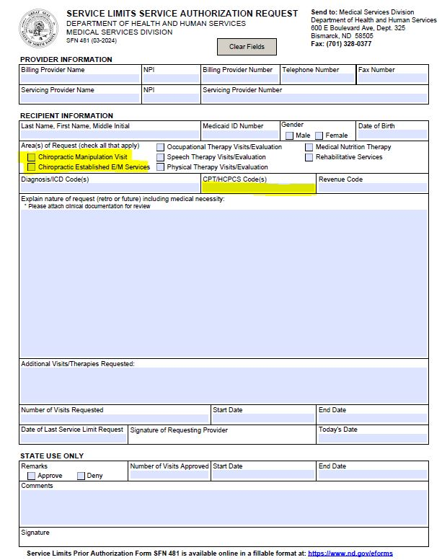
Service Authorization Tips
Complete the form entirely. This is a fillable PDF that can be completed, printed, signed, and faxed to the department.
Attach medical records to support the request for additional services.
You can request a range of codes. For CMT, you can request 98940-98942 x the number of CMT requested. For Established Patient E/M codes, you can request 99211-99213 x the number of visits.
Retrospective authorization requests must be submitted within 90 days from the service date, not the date of the denial.

Slide 23
Helpful URLs
ND Medicaid Provider Guidelines, Manuals and Policies:
https://www.hhs.nd.gov/healthcare/medicaid/provider/manuals-and-guidelines
SFN 481 – Service Limits Authorization Request form:
https://apps.nd.gov/itd/recmgmt/rm/stFrm/eforms/Doc/sfn00481.pdf

Slide 24
Jennifer Sanders, CPC
Business Analyst, Utilization Review
NDHHS Medical Services Division
jasanders@nd.gov

Slide 25

Who is covered by North Dakota Medicaid?
Notes:
Average monthly enrollment (Fiscal months July 2022 to June 2023) – 132,051
Fiscal reporting as of June 2023:
Medicaid total – 133631 (unduplicated eligible members from advantage suite 147182 – entire FY)
Children – 59305
Older Adults – 9709
People with disabilities – 11642
Expansion Adults – 36680
Other Adults - 16295

Slide 26






Who We Serve
Nearly 1 in 6 North Dakotans in any given month will have health coverage though Medicaid or CHIP.
1 of every 4 children under the age of 19 in North Dakota has health coverage through Medicaid or CHIP
35% of children born in North Dakota will be on Medicaid or CHIP during their first year of life.
Notes:
2022 Census data https://www.census.gov/quickfacts/fact/table/WY,VT,DC,ND - (779261 total population)
Average monthly Medicaid enrollment – 132051 (fiscal reporting – July 2022 to June 2023) / 1 in 5.90 people per month
2022 Census data - https://data.census.gov/table?q=age+by+state&g=010XX00US_040XX00US38&tid=ACSST1Y2021.S0101 - (Children under 20 - 209286)
Average monthly Medicaid children under 19 - 58682 (fiscal reporting – July 2022 to June 2023) / 1 in 3.55 children per month (note age differences)
2022 ND resident births - https://www.hhs.nd.gov/vital - 2022 Vital Event Summary (9557 births)
2022 Medicaid births – 3357 / .3512 percent

Slide 27
Who is eligible for Medicaid?
To be eligible for Medicaid, individuals must be part of a coverage group. Coverage groups in North Dakota include:
  Low Income Individuals
  Children in Foster Care or Subsidized Adoption
  Former Foster Care Children up to Age 26
  Children with Disabilities
  Pregnant Women & Infants
  Individuals with Breast or Cervical Cancer
  Worker with Disabilities
  Blind , Disabled and Aged Individuals
  Low-Income Medicare Beneficiaries (Medicare Savings Program)

Slide 28

Medicaid Eligibility
Coverages
Medicaid-Traditional Coverage
  Without a client share
  With a client share
Medicaid Expansion Coverage
  Blue Cross Blue Shield (managed care organization)
Medicaid-Medicare Savings Program
  Qualified Medicare Beneficiary (QMB)
  Specified Low-Income Medicare Beneficiaries (SLMB)
  Qualifying Individuals (QI)

Slide 29
Medicaid-Traditional
No Client Share
  Medicaid covered services with no out-of-pocket cost for individual
Client Share
  Individual’s out-of-pocket cost before Medicaid pays for covered services
    Individual is notified of the amount of client share when they receive their notice of eligibility
    Individual is notified from the Medicaid payment system who they need to pay their client share to.

Slide 30

Medicaid Expansion
Coverage is provided through a managed care organization contract
  Current vendor: Blue Cross Blue Shield of North Dakota
  ND Medicaid pays a monthly premium to the MCO, they pay for covered services

Slide 31
Medicaid-Medicare Savings Program
Qualified Medicare Beneficiaries (QMB)
  Covers Medicare premium
  Covers Medicare co-pays and co-insurances
  Individual could have Medicaid coverage
Specified Low-Income Medicare Beneficiaries (SLMB)
  Covers Medicare Premium only
  Individual could have Medicaid coverage
Qualified Individuals (QI)
  Covers Medicare Premium only

Slide 32
Medicaid and Medicare
Dual Eligible
Medicaid and Medicare are sometimes confused
Medicaid does not end when a person becomes eligible for Medicare.
What is the difference

Slide 33
Medicaid vs. Medicare
Medicaid
Joint state and federal entitlement program to cover medical costs for people with limited income and resources
People 65 and older
People with certain disabilities (any age with kidney failure or long-term kidney disease)
People who are currently disabled and cannot work
Offers coverage beyond Medicare
People either pay nothing or minimal amounts for covered medical expenses
Federal health insurance program for
Each state runs its own program and looks different
Federal so it looks the same in all states
People pay part of medical costs (premiums, deductibles, coinsurance)
Parts A (Hospital), B (Outpatient), and D (Prescriptions – must sign up for A or B before enrolling in D)
Medicare
Dual
Eligible
Low-income people who are disabled and cannot work
Low-income 65+
Entitled to Part A and/or B and some Medicaid

Slide 34

Why is dual eligibility important?
Medicaid is the payer of last resort.
Medicaid will pay the co-insurance and deductible after Medicare pays for covered services.

Slide 35

Presented by: Irene Karnopp
Email: ikarnopp@nd.gov or hccpolicy@nd.gov

Slide 36

Questions

