Slide 1

Home and Community Based Services – Federal Regulations/Title Goes Here
Developed by the Developmental Disabilities Section
2023

Slide 2

Where do the rules come from?
The Centers for Medicare and Medicaid Services (CMS) is a part of the federal government that oversees the federal funding used to pay for Home and Community Based waiver services.
States and providers are required to follow federal regulations in order to receive funding.
Notes:
Federal government policy change in 2014 made by CMS (Centers for Medicaid and Medicare). Originated from input from people receiving services and advocates for more choice, control, access, and options. CMS is the federal agency that oversees the program and pays for the services that states implement.
Home and community based services (HCBS) or waiver services help people with disabilities with their everyday life. This can include transportation, employment, residential supports, personal care, etc. These services are provided in the community versus nursing homes, institutions or settings that may isolate people from the community.
HCBS setting rule is a set of rules that providers, program managers, and states must follow. Requirements are put into action by providers and the state is responsible to ensure the rules are being followed. They are in place to make sure people received the best services and ensure people’s rights are promoted.
It’s more than just where people work and lives-it’s about experiences and living a great life that is important to them

Slide 3

What does this mean for people we support?
People have full access to the benefits of community living based on characteristics and individual experiences.
People receive service in the most integrated settings.
People have maximum choice and control over their lives making big and small life decisions.
Rights are respected and should be same as any citizen.
Notes:
Rights must be protected at places services are received, including where live and work. People have the same rights as anyone and support staff, program managers, and state are responsible for ensuring.
Rest of information presented will get to what this means in more detail

Slide 4

What does Community Mean to You?
Notes:
People may live in the community but they also should be PART of the community.
Community means different things to different people. Some areas may be more important than others. This is about each individual person.
When people are part of their community-they are more likely to make decisions for themselves, have friends, and have better lives.

Slide 5
Exploring Aspects of HCBS Video
Community, Independence and More: Exploring Aspects of HCBS
https://youtu.be/NhFMON-LRHQ
Acknowledgements:
Resources from CMS and CQL were used in putting together this presentation.
Notes:
Watch video titled “Exploring Aspects of HCBS” to put this information into perspective and through the lens of people with disabilities
CMS probes and questions-provided a list of questions for both residential and non-residential settings that can be used to assess/determine if setting meet the regulations

Slide 6


Settings are..
Any setting where home and community-based services are provided
Residential – group home, apartment
Non-Residential – work, day program
Private home- living with family, relative, or primary caregiver
Home and community based CANNOT be in
Nursing facility
Institution for mental diseases
ICF/IID
Hospital
A setting that is isolated from the broader community
A setting that has institutional characteristics (i.e. setting is not individualized to people’s preferences or is operated like an institution)
Notes:
Covers all settings where HCBS services are provided in (paid for)
Settings that cannot be HCBS-these are identified by CMS as institutions and typically have institutional characteristics (scheduled meals, white walls only with no ability to paint a color, everybody wears clothing protectors during meal time, assigned seating, etc.).
Isolating-people have limited if any opportunities for community interactions, setting restricts choice to receive services or engage in services in the community.
Federal HCBS (waiver) funds cannot be used in these settings.

Slide 7

It’s About Experiences!
Think about how this applies to you and your life.
Are people we support being provided similar opportunities and experiences?
Notes:
Rights must be protected at places services are received, including where live and work. People have the same rights as anyone and support staff, program managers, and state are responsible for ensuring.
Rest of information presented will get to what this means in more detail

Slide 8
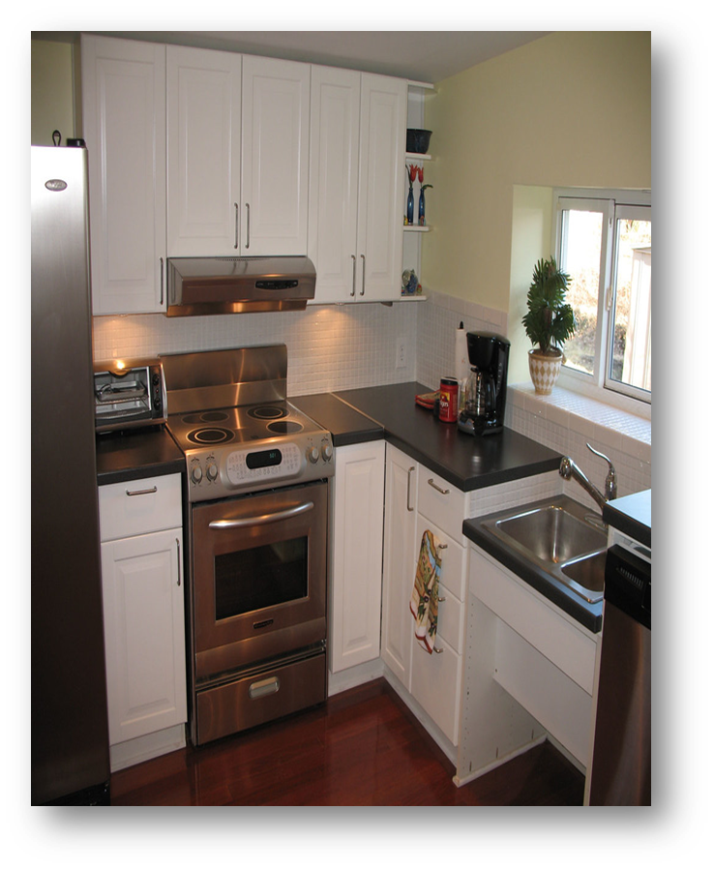
#1- The setting is integrated in the greater community AND supports full access to the greater community.
People live in neighborhoods and work with people with out disabilities.
People are supported to participate in their community.
Opportunity to get paid at least minimum wage.
Control their own money.
Engage in meaningful age-appropriate activities.
Home is accessible to meet their needs.
Notes:
Integrated means not far away from other homes, businesses, stores and people are supported to go to these places, visit friends, and interact with neighbors or other people in the community according to their wants, needs, and desired frequency.
People shop, attend religious services, schedule appointments, eat out, etc. in the community. People have access to kitchen, dining area, laundry, shared areas, amenities such as pool or gym. This includes being able to find a paying job where want, how much money want to earn, how money is spent, having own checking/savings accounts, and access to money (not locked).
Meaningful and age appropriate-activities are important and of interest to the person, jobs that are of interest to them, activities/work typical of other people the same age.
Accessible-people are able to use sinks, showers, and other items to go about their daily life. Use grab bars, ramps, have viable exits.

Slide 9

#2- The setting is selected from options that include people without disabilities.
People have choice of roommate or live alone.
People have choice of having own bedroom.
Choice of available living options and opportunities to visit.
Options in day activities including competitive employment, volunteering, etc.
Setting choices reflect peoples needs and preferences.
Notes:
Integrated means not far away from other homes, businesses, stores and people are supported to go to these places, visit friends, and interact with neighbors or other people in the community according to their wants, needs, and desired frequency.
People shop, attend religious services, schedule appointments, eat out, etc. in the community. People have access to kitchen, dining area, laundry, shared areas, amenities such as pool or gym. This includes being able to find a paying job where want, how much money want to earn, how money is spent, having own checking/savings accounts, and access to money (not locked).
Meaningful and age appropriate-activities are important and of interest to the person, jobs that are of interest to them, activities/work typical of other people the same age.
Accessible-people are able to use sinks, showers, and other items to go about their daily life. Use grab bars, ramps, have viable exits.

Slide 10

#3- Setting must ensure people’s rights are respected and promoted.
Have privacy – can be alone or spend time with other people.
Are treated with dignity and respect-do things that are important that person. People are treated as people first.
Can make own decisions without being coerced or forced to do what don’t want to do.
Have the right to be free from restraint… being held against will or kept from doing something you want. Setting doesn’t prevent people from coming and going.
Notes:
Privacy-people can be alone if want, whether it is in their bedroom or other areas of the house, confidential information such as schedules or medications are not shared or posted.
Dignity & respect-people feel good about themselves and treated like they are worth something; treating other people with kindness and consideration
Coercion-people cannot make you do something that don’t want to do
Freedom from restraint-holding someone to stop them from doing something, locking in room, keeping food away as a punishment, giving medicine to control actions.
Come and go-not restricted by curfews, scheduled returns, locked buildings.

Slide 11

#3- Setting must ensure people’s rights are respected and promoted.
People can lock and have a key to their own front door.
Choosing how to decorate and furnish their room or house.
People have access to food at any time i.e. snacks through out the day, food/drink when they want it.
People have visitors at any time.
People have access to their personal items i.e. TV, radio, computer, phone
Notes:
Lock their door themselves to their home and have a key. Instead of a key, people may have a code.
Get to have a say in how to decorate space, how bedroom and house looks like. People’s personal items, pictures, books, furniture, etc. are present and arranged as desired.
Food and drink whenever people want just like people without disabilities. Alternative meal if desired, meals at time/place of choosing, including eating in the living room. Open fridge or cupboard to view food options, have a snack anytime. Some people may have medical conditions that limit the amount and type of food/drink-this would then need to be written in the person’s service plan and reviewed through Human Rights Committee.
This is the person’s home and can invite other people/family members over when they want or invite people to stay overnight. There are no designated visiting hours. However, if there are roommates, their rights and preferences need to be considered too and making compromises.

Slide 12



#4- The setting encourages:
Individual initiative
Telling people what you want and deciding to do things on your own.
Autonomy
Doing things on own as much as possible.
Independence in making life choices
What do each day; choice in when go to bed, eat, do activities, work schedule, breaks at work, etc.
Where live, work, or spend time.
Who talk with.
Notes:
Choice in who they spend their time with and what their day looks like. However, there are times when visits with family members may be limited due to safety concerns-this would then be a restriction and need to be taken through Human Right Committee.
Providers cannot control people’s schedules. People get to decide what time to get up, go to bed, and what do during the day. This does not mean that people can sleep until whenever they wake up-this would be dependent on what time people work or attend day programs, just like people without disabilities. Additionally, compromises may be made if there is a roommate and the same TV show does not want to be watched.

Slide 13

#5- The setting provides choice about services/supports and who provides them.
Select the services received and providers of those services.
Opportunity to update, change preferences, and request a new provider.
Active roll in the development and updates of their plan.
Choice among community services (pharmacy, doctors, grocery store, salon, bank, etc.)
Notes:
Supports should be individualized to the person based on their needs, wants, preferences, etc. vs trying to “fit” the person into “system”.
Important that we ask and actively listen to the person and obtain input on their wants, likes, dislikes, preferences also with what doctor to see, which bank to have checking account, what salon to get haircut at, etc.
Choice among community services-people are not required to use a certain pharmacy, doctor, or bank-they are presented with what is available in their community.

Slide 14

These do not meet the requirements:
Only go into the community with a group as a “group trip” or outing.
Entire day spent at day program location.
All activities are scheduled by staff with out individual input.
Can only shower on certain days or times.
If chores not done, no other activities that day.
Schedules are posted.
No area to make private phone calls or have to ask to use the phone.
Staff talking about you in front of others.
Scheduled meal, bed, & waking times.
Set menus and people are not part of the meal planning
No food in bedrooms.
All checkbooks kept in staff office.
Can only use a certain bank or pharmacy determined by the provider.
Not permitted in certain parts of home.
Does not have own key to their house.
Home is decorated/furnished by provider only.
House rules set by the provider or staff.
Being told can only make changes at annual meeting.
Notes:
House rules-these are items that all people in the home MUST follow and are not based on individual needs/preferences. Items that speak to considerations are not necessary house rules. They are more guidelines on how to best treat other people such as; “if people leave the home without staff, they are encouraged to inform the staff where they are going and the approximate time they expect to return”, “People should visit another person’s room only if invited to do so”.

Slide 15



#6- Additional conditions for residential settings that are owned or controlled by a provider.
Provider owned or controlled setting:
Group home or apartment owned or run by a service provider
Each person must have a lease
Same responsibilities and protections from eviction as all tenants under ND landlord tenant law
Should not contain- house rules, visitor restrictions, access to food, etc.
People must have lockable bedroom doors
Staff can have keys but person’s plan identifies circumstances for use
Applies if someone lives alone
If not wanted by person must be addressed in plan
If unable to have a lock, it is considered a rights restriction
Notes:
Lease or other legal agreement which is an agreement or contract that lays out people rights
Also provides protection to being forced out of the home without a reason
It is acceptable for the lease to have “rules” to be followed, however they must be similar to people without disabilities that would have in their lease and not violate state law.
For example lease cannot tell a person they can’t eat in the living room. However could say that if holes are made in the walls the person needs to repair them.
People are able to lock their bedroom door and have a key to do so.
Appropriate people have access to the person’s key to their bedroom door. Access could be related to the need to unlock the door if person is not responsive.

Slide 16
#7- If extra support is needed to maintain health and safety.
People may not be able to take part in all of the freedoms the regulations provide. (i.e. Person may need food locked up due to health and safety.)
When that happens the provider has very strict rules they have to follow and document:
  Base the restriction on a specific individual need.
  Show that positive interventions have been tried but haven’t worked.
  Keep measuring with data collection to determine if restriction should continue.
  Show that any modification is TEMPORARY and includes a fading plan.
  Informed consent from person and legal decision maker.
  Show the intervention will cause no harm.
Notes:
These are rights restrictions and modifications needed to the requirements.
Some people need more support or have health and safety concerns which leads to rights being restricted or modified.
Before a provider can restrict any rights, they need to try everything else possible and provide justification/show that restrictions are needed.
For example: someone has prader willi syndrome and eating extra food either makes them sick or leads to morbid obesity-it may be best to keep food away. However, if there is no medical reason, the restriction is not justified.
Need to try other interventions and write these in the peoples plans. For example cannot take away knives just in case a person hurts themselves. Providers need to show that they tried other things, such as skill training or education how knife safety.
Provides need to collect data over time to show restrictions are working and continue to be needed. If there is no progress, other solutions need to be explored.
Rights cannot be in place forever, and it needs to be outlined how a person can get the right back and needs to be reviewed regularly.
Restrictions cannot harm a person in any way.
Restrictions, reasons, and risks need to be explained in a understandable way along with consent.

Slide 17

What’s Important to You & How Would You Want to Receive Services?

Slide 18
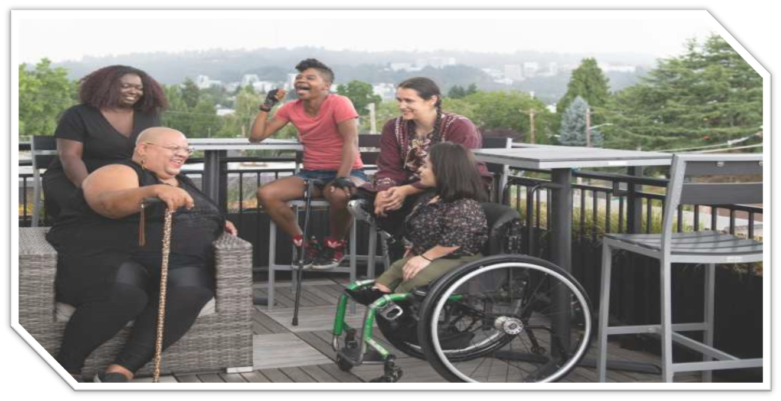
Person-Centered Planning Requirements

Slide 19

Person-Centered Planning Definition
Person-Centered Practices occur through the development and implementation of services and supports that are informed by a person’s preferences, strengths, and choices.
Every person should have the opportunity to define their happiness and the life they desire.
A person’s life is realized when family, friends, community members, and service providers actively listen to what matters to a person, by respecting and honoring their values, strengths, culture, hopes, and dreams.

Slide 20


Person-Centered Guiding Principles
Emphasize Person First, with Customized Supports and Services
Focus on the Person’s Strengths
Balance Choice and Risk
Meet the Person Where They Are
Regularly Review Goals
Build Equity of Voice
Equip the Person to Make Informed Decisions
Be Kind

Slide 21

Service Planning Involves:
Person leads own plan, includes people chosen by the person
Mtgs convenient time & location
Use of accessible & plain language
Reflect person’s values & culture
Focus on person vs system
Promotes independence
Provides informed choices (goals, services, providers, etc.)
Balances quality of life & health/safety

Slide 22
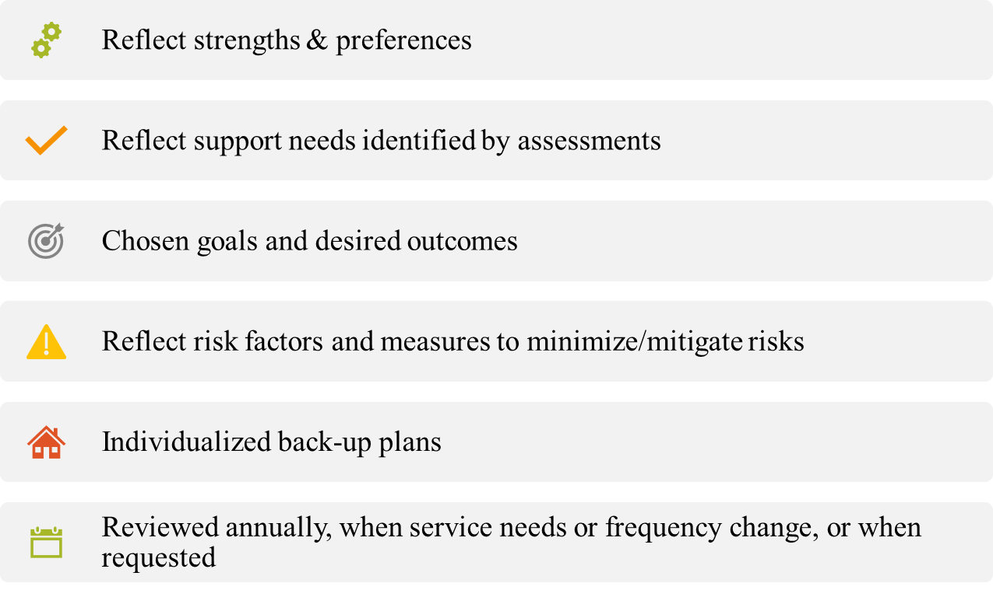
The Service Plan
Notes:
The service plan is developed by the person, legal decision maker, provider, DD Program Manager, and any others who the person wants to include. Services must be implemented according to the service plan and it provides basic information to direct support professionals on who the person is and how supports are delivered.

Slide 23

It’s About Me!
Think about how you would want your information presented in a service plan and what you want people to know about you.
Notes:
The service plan is developed by the person, legal decision maker, provider, DD Program Manager, and any others who the person wants to include. Services must be implemented according to the service plan and it provides basic information to direct support professionals on who the person is and how supports are delivered.

Slide 24

On-going Monitoring Activities

Slide 25
How provider staff ensure compliance
Self-assessment captures individual experiences to ensure the regulations are met.
Implement practices and procedures that are aligned with the regulation.
Utilize person centered service planning processes.
Maintain CQL accreditation and utilize the personal outcome measures.
Initial orientation and annual training for staff.
Initial setting review for new provider-owned residential or facility-based day program prior to setting being initiated, built or purchased

Slide 26
How DDPM/PAs ensure compliance
Environmental Scan to monitor physical environment and locked doors.
If person is not satisfied with living, work, other services, or provider, they will help find other options.
Review self-assessment to ensure people’s outcomes are being realized.
Approve plans that are developed according to peoples needs and preferences in line with regulations.
Conduct in-person visits to monitor service satisfaction and plan implementation.
Review future provider owned or controlled settings and facility-based day programs.
Notes:
Environmental scan-looks at physical characters such as accessibility of the setting and if there are lockable bedroom doors.
Self-assessment is provided prior to the service plan meeting for review and assurance that what people want is being addressed and the peoples experiences (privacy, visitors, etc.) are being met according to the regulations.
Face to face visits- DDPM’s have suggested list of questions to ask and areas to observe during visits to people’s home, work, and day programming.

Slide 27
How the State Office ensures compliance
HCBS Provider Survey
Initial training for DDPMs and New Providers
Annual training for DDPMs
Review future provider owned or controlled settings and facility based day programs.
Review provider policy and procedures for licensure (initially and annually as updated)
Quality assurance reviews of provider and DDPM activities.
Heightened Scrutiny review for settings potentially institution and/or isolating in nature.
Notes:
Survey is conducted every 3 years and looks at people’s opportunities to be independent, rights are being promoted and respected, access to money, ensures leases are in place, etc.
Conducts training on the HCBS regulations
Ensure provider policies do not conflict with the regulations during licensure

Slide 28

For More Information
CMS probes and questions to ensure compliance:
15.2.d. CMS Requirements for HCBS.pdf (nd.gov)
DD Section website
https://www.hhs.nd.gov/human-services/hcbs
CQL information
https://www.c-q-l.org/resources/projects/the-hcbs-act-project/

