Slide 1
NDCC Conference Call
February 22, 2016
Please MUTE phones and turn OFF computer speakers

Slide 2
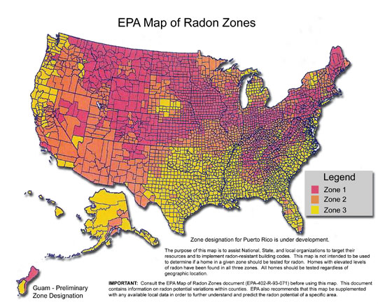

Efforts to Address Radon in Iowa
Hot Topics & Promising Practices in Radon Control
Allie Bain, MPH
Program Coordinator | Iowa Cancer Consortium
Iowa Radon Coalition

Slide 3
Organizational Profile
Membership:
  340 active members
  40 organizational members
Meetings:
  In-person
  Teleconference
Mission:
Reduce cancer incidence and mortality in Iowa through collaborative efforts that provide services and programs directed towards comprehensive cancer control.

Slide 4
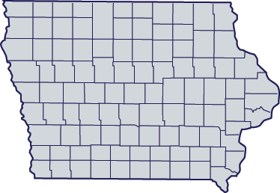

Membership Structure
Prevention
Tobacco
Radon
Screening
Physical Activity & Nutrition
Treatment
Sun-Safety
HPV
Quality of Life

Slide 5
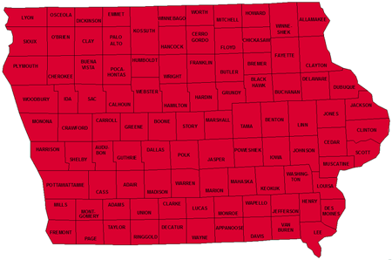
Radon Profile
7 in 10 homes in Iowa contain Radon concentrations above 4 pCi/L
Iowa leads the nation in the percent of homes over 4 pCi/L as well as percent of homes over 20 pCi/L
The average indoor radon concentration in Iowa is more than six times the national average

Slide 6
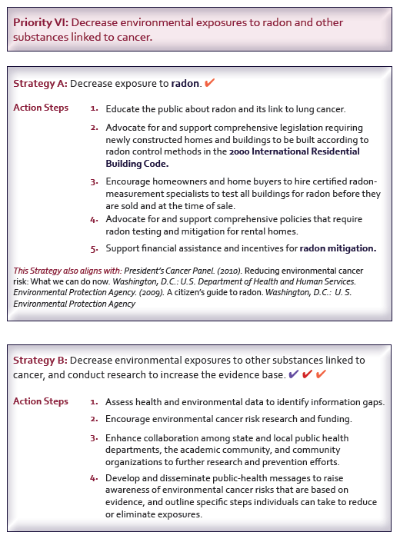

Slide 7
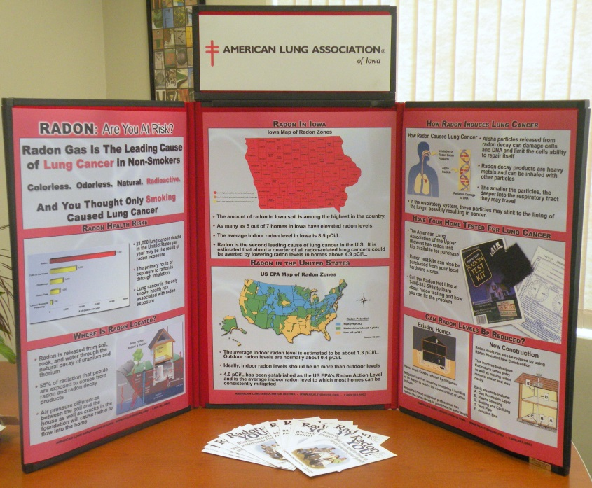

Iowa Radon Coalition
About:
  90+ Members
  Meet in-person/teleconference
  Interagency education/advocacy
  Policy

Slide 8













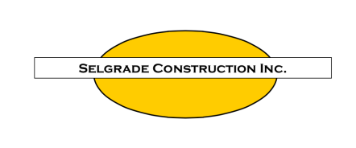



The Iowa Radon Coalition works collaboratively to
educate Iowans about the dangers of Radon exposure to
make all Iowa homes, schools and businesses
‘Healthy from the ground up.’

Slide 9



Education
Education
www.breathingeasier.info
Brochure: ‘Radon & You’
Iowa Radon Hotline
Video: Breathing Easier
Exhibits
Iowa Realtor Association
Iowa Primary Care Association
Iowa Rural Health Conference
Iowa Public Health Association
Legislators

Slide 10

Stories from Iowa
Lyon
Osceola
Dickinson
Emmet
Winnebago
Worth
Mitchell
Howard
Kossuth
Winneshiek
Allamakee
Sioux
O’Brien
Clay
Palo Alto
Hancock
Cerro Gordo
Floyd
Chickasaw
Bremer
Fayette
Clayton
Plymouth
Cherokee
Buena Vista
Pocahontas
Humboldt
Wright
Franklin
Butler
Webster
Grundy
Black Hawk
Buchanan
Delaware
Dubuque
Woodbury
Ida
Sac
Calhoun
Hamilton
Hardin
Tama
Jones
Jackson
Monona
Crawford
Carroll
Greene
Boone
Story
Marshall
Benton
Linn
Cedar
Clinton
Audubon
Polk
Jasper
Poweshiek
Iowa
Harrison
Shelby
Guthrie
Dallas
Poweshiek
Johnson
Scott
Marion
Muscatine
Pottawattamie
Madison
Warren
Mahaska
Washington
Cass
Adair
Keokuk
Louisa
Mills
Montgomery
Adams
Union
Clarke
Lucas
Monroe
Wapello
Jefferson
Henry
Des Moines
Fremont
Page
Taylor
Ringgold
Decatur
Wayne
Appanoose
Davis
Van Buren
Lee

Slide 11
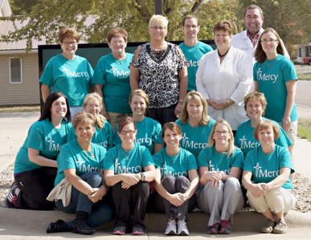
Radon Testing in Plymouth County
Goal: Educate the public about radon, test homes for radon, and correlate with features of the home.
Champions: Dr. Cindy Wolff & Dr. Barcey Levy
Results:
  14 Community Presentations (700+ Iowans)
  378 valid test results with mean result of 10.0 pCi/L
  Over 80% of homes tested had radon levels of 4 pCi/L or greater.
  Of 8 radon values above 30 pCi/L, the mean was 45.5 pCi/L
Acknowledgement: Iowa Cancer Consortium, NCI 1 RC4 CA153493-01, Akron Mercy Medical Clinic, and The University of Iowa Department of Family Medicine

Slide 12
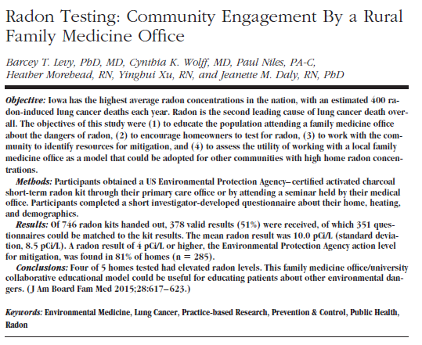
Journal of the American Board of Family Medicine

Slide 13

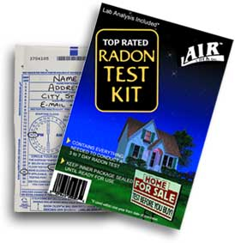
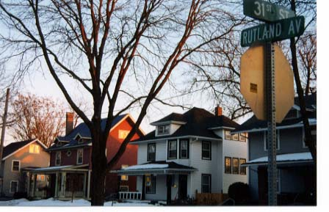
Radon-Free Homes Initiative
Radon testing & mitigation assistance for low-income neighborhood in Des Moines, Iowa.
Mitigation cost shared with HUD
Partners: Polk County Health Dept.

Slide 14
Community Education Sessions
An evening event open to the public to educate about radon and have test kits available for sale.
Agenda includes:
Survivor
Mitigator
Public Health
Healthcare

Slide 15
2015 Radon Testing Challenge
Provide education, distribute test kits & collect contact information from each recipient, follow-up if the test has not been completed.
12 Individuals and 17 Organizations
430 Test Kits Distributed
270 Homes Tested
248 Tests that produced results

Slide 16
2016 Radon Testing Initiative
Four organizations are currently working with healthcare providers to educate and distribute test kits. Follow-up is being provided to anyone not completing their test.
Results will be available June 2016

Slide 17

Local Level Policy
State of Iowa | No statewide code for RRNC
Johnson County | Adopted 2003 IRC Appendix F (2004)
Muscatine County | Winter 2007 adopted 2006 IRC, Appendix F; previously operated under 2000 IRC, which was originally adopted in 2004.
Shelby County | In August 2004, Ordinance 2004-3 outlined RRNC requirements in the county. www.shco.org/2004-3.htm
City of Coralville | Adopted IRC 2003, Appendix F all residential buildings
Cities of Harlan and Muscatine | IRC Appendix F
City of Iowa City | Ordinance No. 02-4033 passed in 2002 adopts Appendix F of the IRC. www.icgov.org/site/ (PDF)
City of North Liberty | Adopted IRC, including Appendix F (July 2005). Mandatory for all new residential buildings to include a passive system.

Slide 18
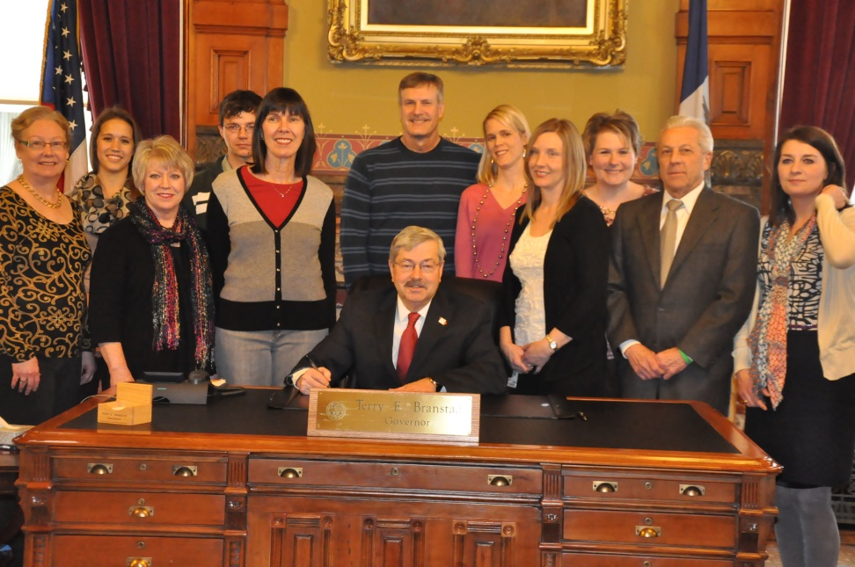

Current Statewide Policy
Iowa requires radon professionals to be licensed for radon testing and mitigation.
Testing is required for daycare and preschool facilities.
In 2009, Iowa established a requirement for home sellers to inform home buyers of previous radon testing during real estate transactions, and realtors are required to share the Radon Fact Sheet during a real estate transaction.
In 2015, Iowa amended disclosure language to include disclosure of results of a radon test, regardless of the level, to a both buyer and seller during the real estate transaction.
Radon Awareness Month Proclamation Signing, January 2013

Slide 19
Current Policy Work
School Testing
Radon Resistant New Construction

Slide 20
Questions?
Allie Bain, MPH
Iowa Cancer Consortium
ABain@canceriowa.org
319-335-4609

Slide 21
