Slide 1

MFP External Partner Meeting
September 10, 2025

Slide 2


Slide 3
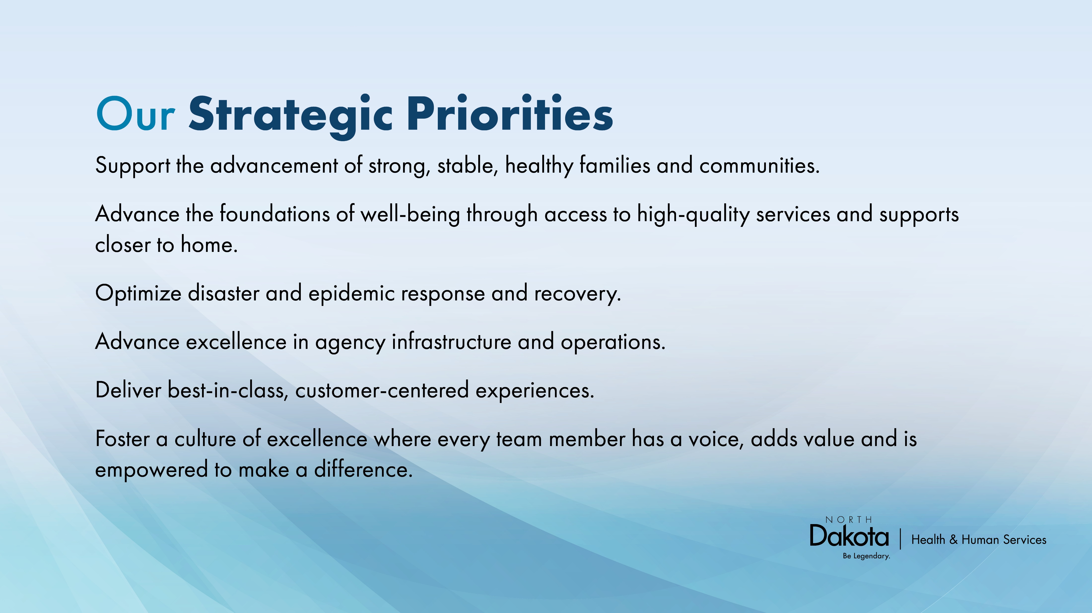

Slide 4
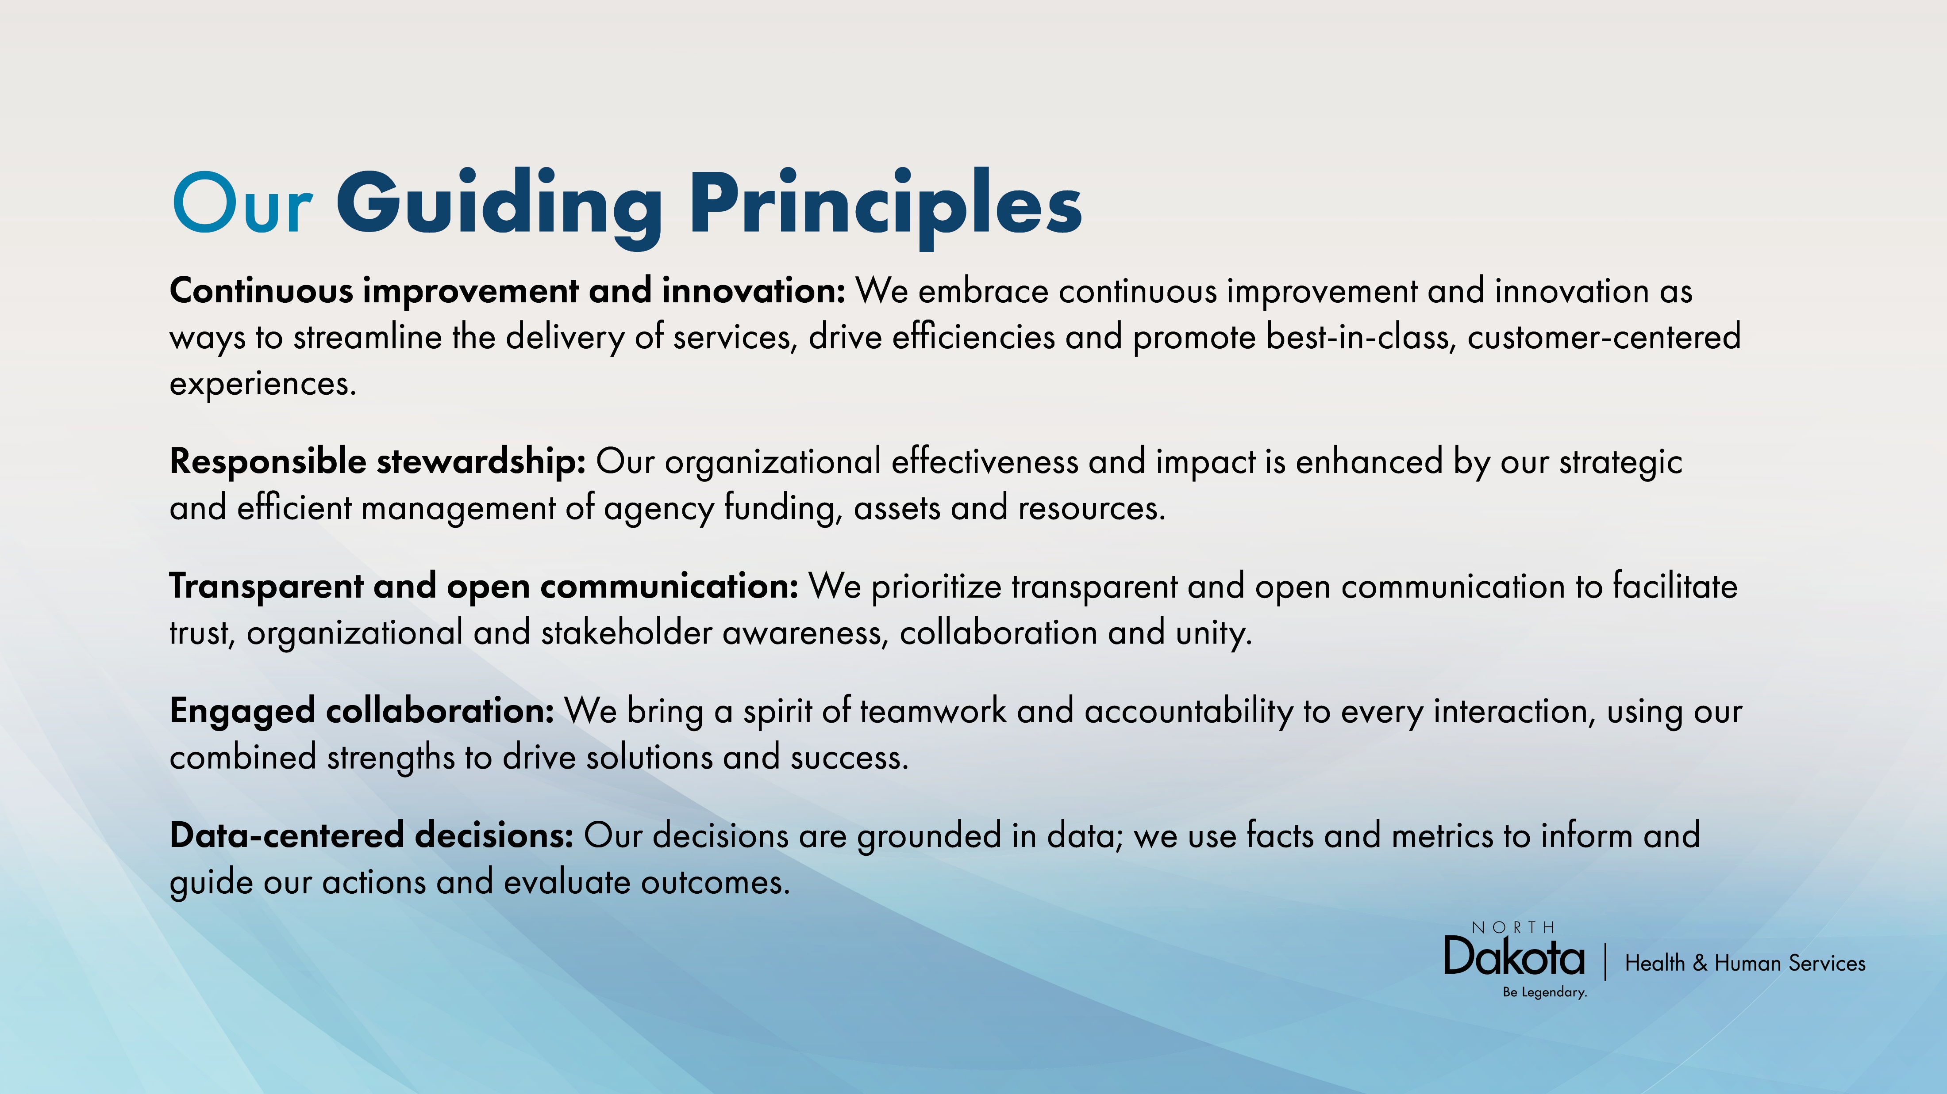

Slide 5

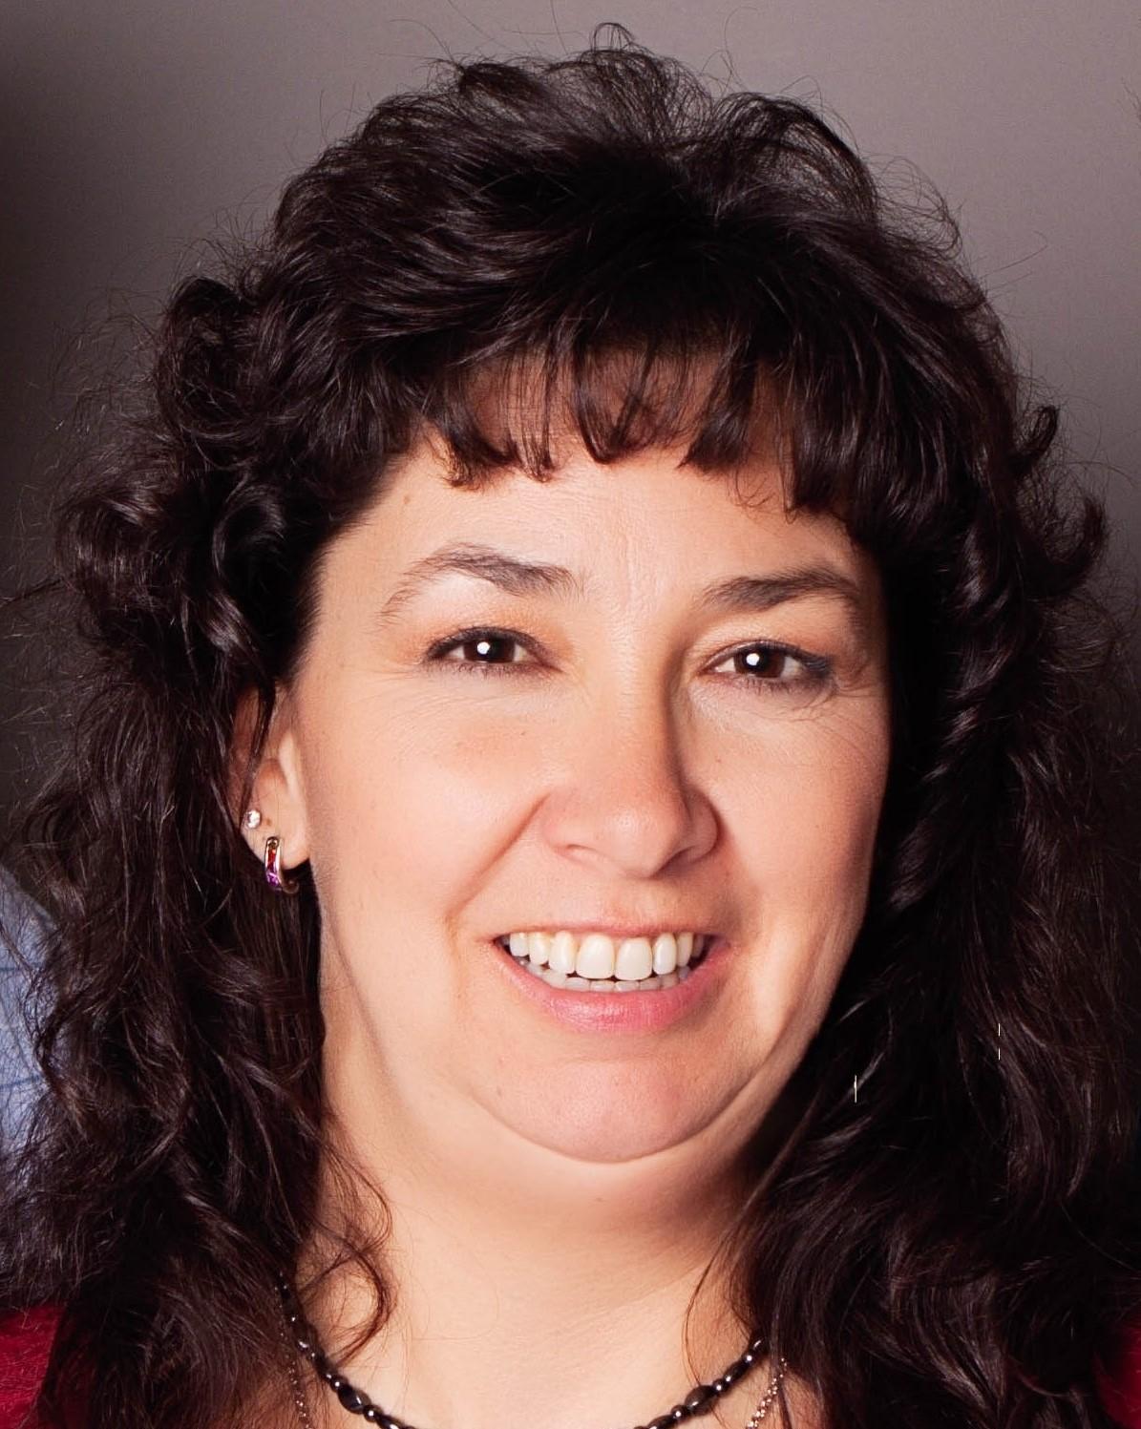


MFP Team Members
Kayla Trzpuc
Money Follows the Person Program Administrator
Gale Coleman
Money Follows the Person Data and Quality Analyst
Karen Wolf
Money Follows the Person Transition Services Specialist
Makayla Domagala
Money Follows the Person Referral Specialist

Slide 6
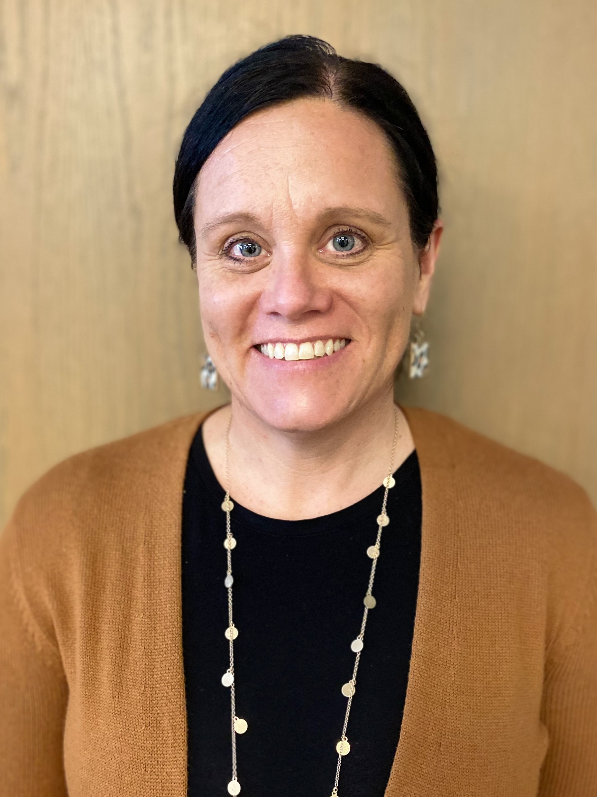


TDP Team Members
Heidi M Zimmerman
Transition and Diversion Services Program Administrator
Kate Rock
Transition and Diversion Services Referral Specialist
Sarah Nelson
Transition and Diversion Services Quality Specialist

Slide 7
Agenda
Life Skills and Transition Center Updates
Developmental Disability Section Updates
Medicaid Updates
  One Big Beautiful Bill Act
  Rural Health Transformation Program
Human Service Center transformation to Behavioral Health Clinics
Adult and Aging Services Updates
Housing partner updates
Tribal Initiative

Slide 8
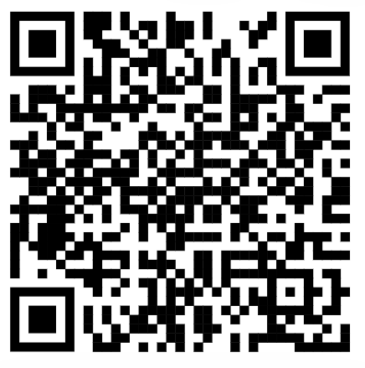
Opening Poll
Link
Name and Agency
What are you looking to gather from this meeting?

Slide 9
Life Skills and Transition Center
Keith Vavrovsky

Slide 10
DD Updates
DD Division Staff
Waiver open for public comment

Slide 11
Medicaid Updates
One Big Beautiful Bill Act
Rural Health Transformation Plan

Slide 12

ND Medicaid Impacts
One Big Beautiful Bill Act

Slide 13
Agenda
H.R. 1, One Big Beautiful Bill Act (OBBBA) Background
Implementation Timeline
No Impact on ND Medicaid
Sections In Compliance
Impacts on ND Medicaid

Slide 14
One Big Beautiful Bill Act
2025
Limit use of State-Directed Payments
Create Rural Transformation Program
2026
Change definition of “qualified alien”
2027
Increase frequency of redetermination checks
Decrease retroactive coverage period
Reduce duplicate enrollment
2028
Implement cost-share for expansion adults
Expand 1915 (c) waiver
2029
Remove good faith waiver for payment reductions
Require community engagement
H.R. 1, the One Big Beautiful Bill Act (OBBBA) was signed into law by President Trump on July 4, 2025.
North Dakota is well-positioned to respond to the changes outlined in the bill.
ND Medicaid is awaiting federal guidance from CMS to fully interpret the new law's provisions.
HHS will communicate changes to both members and the public.

Slide 15
OBBBA Provisions with
No Impact on ND Medicaid
Section | Policy
71113 | Prohibits Medicaid funds from being paid to certain abortion providers.
71114 | Sunsets temporary 5% point enhanced FMAP for states that newly expand Medicaid.
71115 | Establishes a moratorium on new or increased provider taxes. Changes hold-harmless provision on health care taxes from 6% to 3.5% with a 0.5% phase in over 5 years. Exempts NFs and ICFs from the reduction to 3.5%.
71118 | Requires HHS to certify budget neutrality for 1115 demonstration projects and specify methodology for accounting for savings generated under an 1115 demonstration in future approval periods
71110 | Requires FMAP to be the state's regular FMAP for all Emergency Medicaid expenditures.
71101 71102 71111 | Places a moratorium on implementation of eligibility rules and minimum nurse staffing requirement through September 30, 2034.

Slide 16
OBBBA Provisions where ND Medicaid Appears to be Already in Compliance
Section | Policy
71104 | Requires States to check the Death Master File to identify enrolled members who are deceased at least quarterly
71108 | Sets a maximum home equity limit of $1 million for determining eligibility for long-term care services
71103 | Requires states to submit SSN and other data to prevent duplicate enrollment
71105 | Requires states to check the Death Master File to determine if a provider or supplier is deceased upon enrollment and quarterly thereafter
71116 | Directs HHS to limit State Directed Payments (SDPs) to the Medicare payment rate or equivalent Medicare rate at 100% for expansion states; grandfathers in already approved SDPs and submitted SDPs initially with 10% reductions each year starting in 2028 until the payment meets the threshold. New SDPs must not exceed Medicare rate or Medicaid State Plan rate for expansion state.
71117 | Modifies methodology for determining whether provider taxes are redistributive

Slide 17
OBBBA Sections with Impacts on ND Medicaid

Slide 18


Section 71103: Reduce Duplicate Enrollment
Develop additional processes to obtain address information from enrollees
CMS must develop system to identify duplicate enrollment and notify states
States required to verify residency of member and disenroll if unable to verify
Estimated Impact:
Systems Modification
Effective Date:
January 1, 2027
Effective Date:
October 1, 2029

Slide 19

Section 71106: Good Faith Waiver Removal
Removes good faith waiver for payment reductions related to error rates in HHS and state audits
Reduces CMS' ability to waive reduction of payment in situations in which a state has an improper payment finding with more than a 3% error rate.
Effective Date:
October 1, 2029
Estimated Impact:
Dependent on Future Audits

Slide 20

Section 71107: Eligibility Redeterminations
Increases frequency of eligibility redeterminations from annually to every six months
Impacts Expansion members only
Tribal members excluded
Effective Date:
October 1, 2027
Estimated Impact:
20% of Medicaid Members
Notes:
increase automation as much as possible in the ND Medicaid eligibility system to assist with the increased workload.

Slide 21
Section 71109: Qualified Alien Definition
Change definition of “qualified alien” to include only lawful permanent residents, certain Cuban and Haitian immigrants, and Compact of Free Association (COFA) migrants.
Refugees, asylees, and certain other non-citizens would no longer be considered qualified aliens for purposes of Medicaid.
Refugees may be eligible to become Legal Permanent Residents after 1 year.
Effective Date:
October 1, 2026

Slide 22
Section 71112: Retroactive Coverage
Decrease retroactive coverage period from 3 months to:
  1 month for Expansion members
  2 months for all other members
Effective Date:
January 1, 2027
Estimated Impact:
1-2% of Medicaid Members

Slide 23
Section 71119: Work Requirements
Establish work/community engagement requirements for “able-bodied” adults
Expansion members ages 19-64
Complete 80 hours per month of qualifying community engagement
Good faith exemption extends effective
date to December 31, 2028
Effective Date:
December 31, 2026
Estimated Impact:
3-5% of Medicaid Members

Slide 24
Section 71119: Work Requirements
Qualifying Engagement Activities
Employment
Community service
Participation in work program
Enrollment in educational program at least half time
Combination of these activities for at least 80 hours
Seasonal workers may average income over previous six months
Individuals whose monthly income is not less than the federal minimum wage multiplied by 80 hours would be in compliance

Slide 25
Section 71119: Work Requirements
Mandatory Exemptions
Pregnant women
Tribal members
Individuals enrolled in or entitled to Medicare Part A; individuals enrolled in Medicare Part B
Veterans with total rated disabilities
Medically frail
Those meeting TANF/SNAP work requirements
Caregivers of a dependent child 13 years and younger or an individual with a disability
Those in AUD/SUD treatment
Incarcerated individuals or released within past 90 days
Foster and former foster youth under age 26
Individuals entitled to postpartum coverage

Slide 26
Section 71120: Cost-Sharing
Implement cost-sharing for adults with income greater than 100% federal poverty level
Expansion members
Requires system modification
Certain services exempt including – primary care, behavioral health, prenatal care, emergency services.
Effective Date:
October 1, 2028
Estimated Impact:
2-4% of Medicaid Members

Slide 27
Section 71121: 1915(c) Waiver
Create a new section 1915 (c) HCBS waiver option
Waiver does not require participants to be subject to a determination that, but for the provision of a HCBS, those individuals would require nursing home or ICF/IDD level of care.
Effective Date:
July 1, 2028

Slide 28
Section 71401: Rural Health Transformation Program
Appropriates $50 billion to a Rural Health Transformation Program from Federal Fiscal Year 2026 – 2030.
  50% of funding will be awarded equally among states. 40% based on a methodology determined by the Centers for Medicare and Medicaid Services (CMS).
  North Dakota expected to receive at least $100 million per year FFY 2026-2030.
  $500 million total funds.
One time application for all 5 years. Applications must be approved by CMS before December 31, 2025.
  Expect guidance from CMS in Fall 2025.

Slide 29
Section 71401: Rural Health Transformation Program
States must submit a one-time application to CMS, including a plan that outlines how the state will:
Improve access to hospitals, providers, and health care services for rural residents
Enhance health outcomes for rural communities
Use emerging technologies focused on prevention and chronic disease management
Strengthen partnerships between rural hospitals and providers to improve quality and financial stability
Support recruitment and training of rural health care clinicians
Prioritize data-driven solutions and technology to deliver high-quality care close to home
Address financial solvency and operating models of rural hospitals
Identify causes driving hospital closures, conversions, or service reductions

Slide 30
Section 71401: Rural Health Transformation Program
States must fund at least three or more designated activities.
Evidence-based prevention and chronic disease management interventions
Payments to providers for specified services
Consumer-facing technology solutions for chronic disease management
Training on advanced tech such as remote monitoring, AI, and robotics
Recruiting and retaining rural clinical workforce with service commitments
IT upgrades improving efficiency, cybersecurity, and outcomes
Helping communities optimize health care delivery systems
Expanding opioid use disorder, substance use, and mental health services
Innovative care models including value-based care and alternative payments
Other CMS-approved activities to ensure sustainable rural health care

Slide 31
Section 71401: Rural Health Transformation Program
North Dakota’s Outreach and Engagement
As we await CMS guidance, HHS is actively engaging with stakeholders to gather feedback on shaping the state's Rural Health Transformation Plan.
Anticipate ND HHS Listening Sessions in Fall 2025.
Take the Survey
We invite rural patients and residents; hospitals, clinics and provider networks; community-based organizations, tribal partners and other stakeholders to participate in our survey and share your input. Your feedback is critical to shaping the plan to best serve North Dakota’s rural communities. The survey takes 15-20 minutes to complete. The information gathered will be used for planning and information-gathering purposes only. Deadline to respond is Sept. 12, 2025.

Slide 32
Thank you!

Slide 33
Human Service Center Transformation to Behavioral Health Clinics
Dr Dan Cramer

Slide 34
Adult and Aging Updates
Nancy Maier

Slide 35
MFP DATA
Updated 09/03/2025

Slide 36
RUNNING TRANSITION NUMBERS
Updated 09/03/2025

Slide 37
MFP Facts - 2025
57% of all individuals transitioned in 2025 are in the elderly population.
MFP’s biggest transition quarter this year was quarter two with 27 transitions.
74% of all individuals who transitioned, went into an apartment
77% of MFP transitions are coming from nursing facilities
Updated 09/03/2025

Slide 38
Benchmarks
Grant Year | Older Adults | Individuals with a physical disability | Individuals with an Intellectual disability | Children | TOTAL
2021 | 31/20 | 42/25 | 14/15 | 7/5 | 94/65
2022 | 64/40 | 57/60 | 11/15 | 3/5 | 135/120
2023 | 59/55 | 50/55 | 25/15 | 6/5 | 140/130
2024 | 55/60 | 61/50 | 27/23 | 5/7 | 148/140
2025 | 35/55 | 12/55 | 10/20 | 4/5 | 61/135
2026 | / | / | / | /
Updated 09/03/2025

Slide 39
Transition Diversion Program Updates
Utilize the 10% funding first
3 full time state staff
6 housing facilitators
8 transition coordinators

Slide 40
TDP Data
2025 Specific TDP Referral Data Stats
Total Referral Summary
Running TDPP Referral count | 476
Quarter One | 180
Quarter Two | 171
Quarter Three | 125
Quarter Four | 0
Updated 09/03/2025

Slide 41
TDP Running Transitions
Updated 09/03/2025

Slide 42
TDP Running Diversions
Updated 09/03/2025

Slide 43
Housing Partner updates
Open discussion

Slide 44
Tribal Initiative
Melissa Reardon, NDSU Tribal Liaison

Slide 45
Tribal Initiative
Mandan Hidatsa & Arikara Nation
Turtle Mountain Band of Chippewa Indians
Government to Government happened last week in Bismarck
5 state workgroup
  2025 Learning Collaborative: scheduled for October 22-24th in Washington State

Slide 46
MFP Programmatic Requirements
Submitted new operational protocol
General feedback
Wrapping up MFP Capacity Funding Projects, granted no-cost extension

Slide 47

Quality Measure Set
MFP states need to report no earlier than Sept 2026
NCI-AD survey
  Adult and Aging Services
  1915i State Plan Amendment
NCI-IDD survey
Draft report is back
States are to select two measures to report on

Slide 48
Meeting dates for 2025
Mark your calendars
  Tuesday December 9th, 2025
    Southeast Human Service Center

Slide 49

Questions

Slide 50
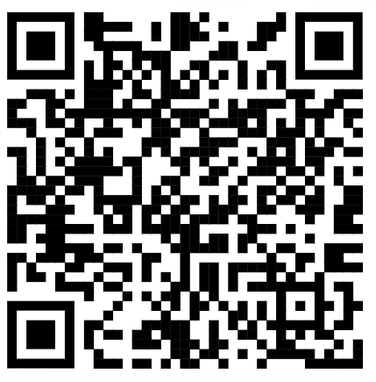
Final Poll
Post Survey
Rebalancing ideas
Suggestions for the future
Any additional comments/feedback

Slide 51
Thank you
Kayla Trzpuc
  kbtrzpuc@nd.gov
MFP/TDP team
  hhsmfpreferrals@nd.gov
ADRL Intake
  Carechoice@nd.gov

