Slide 1

MFP External Partner Meeting
February 18, 2026

Slide 2
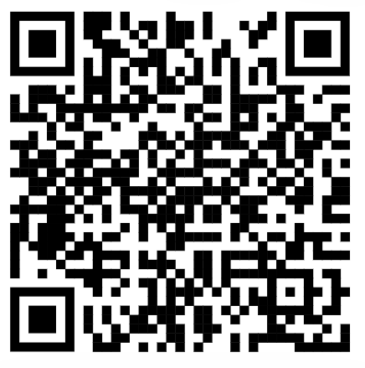
Opening Poll
Link
Name and Agency
What are you looking to gather from this meeting?

Slide 3


Slide 4
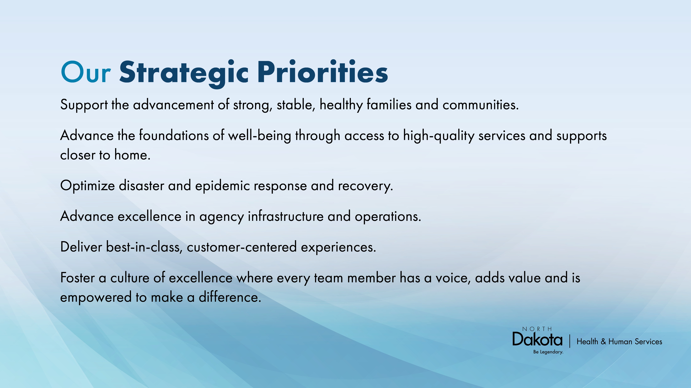

Slide 5
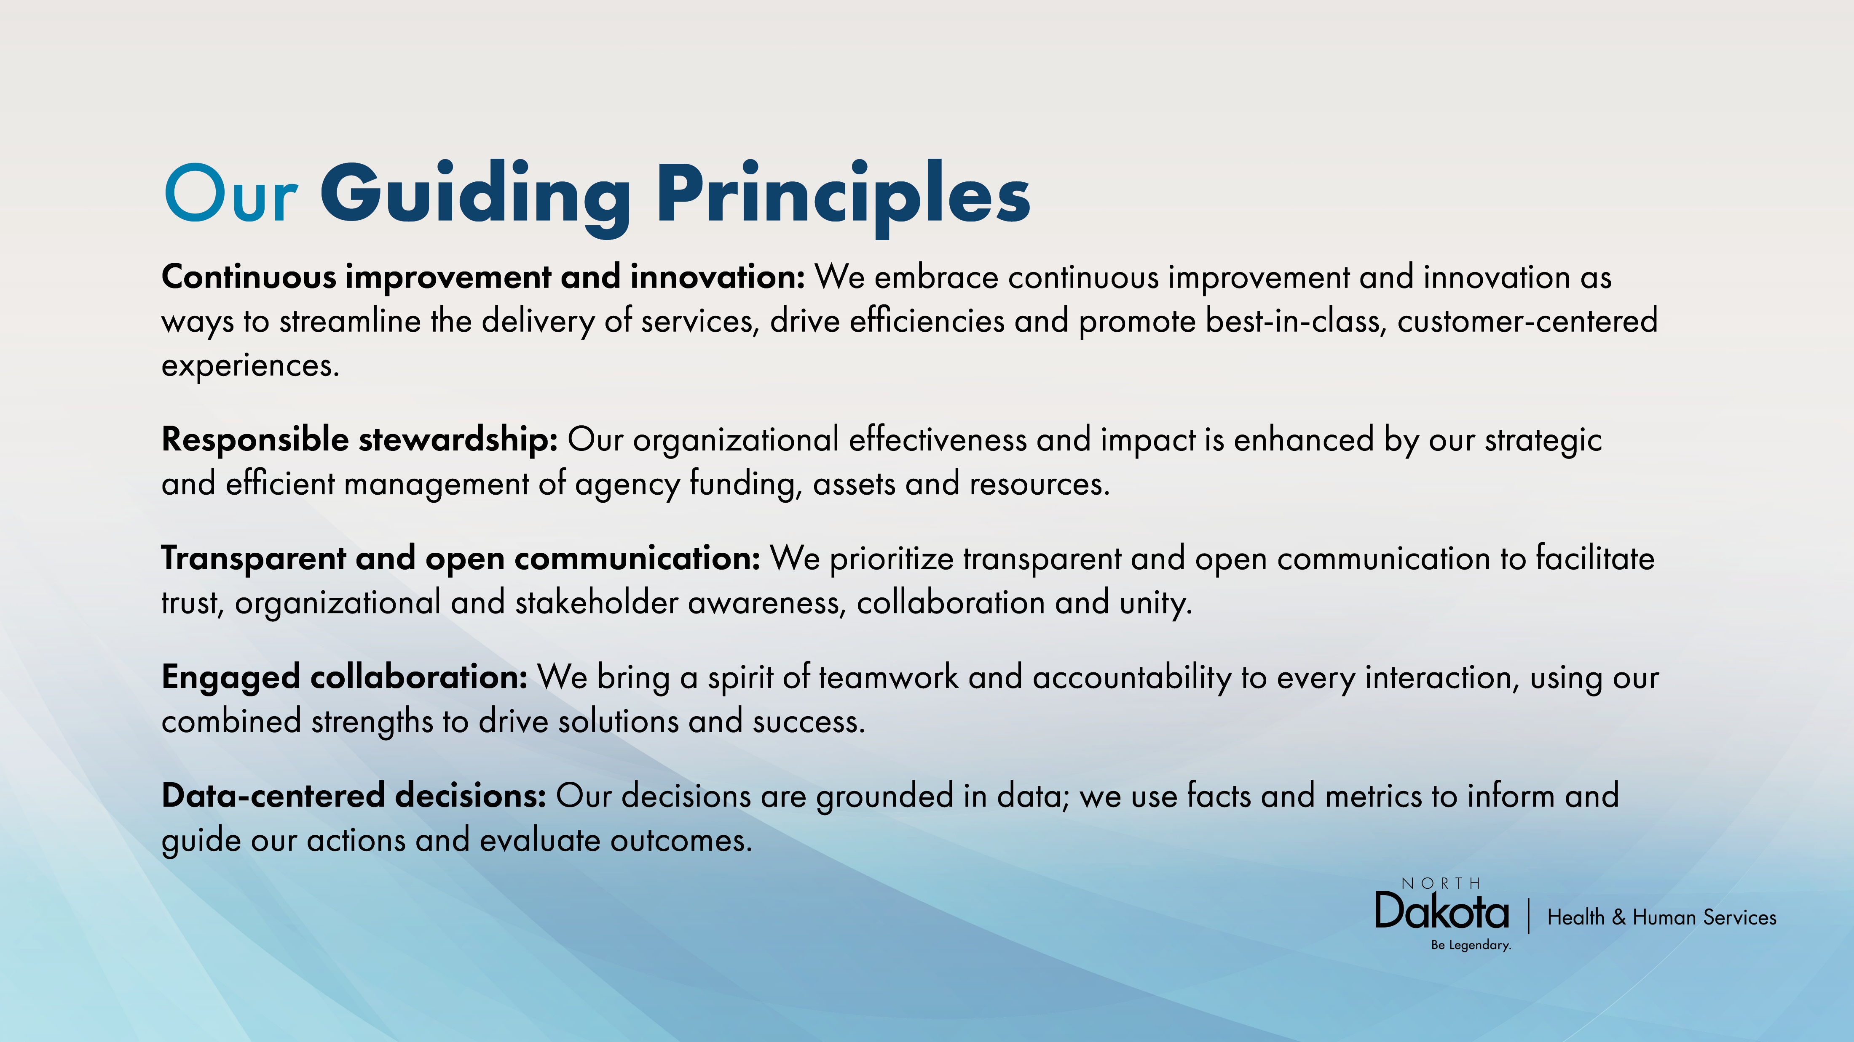

Slide 6




MFP Team Members
Kayla Trzpuc
Money Follows the Person Program Administrator
Gale Coleman
Money Follows the Person Data and Quality Analyst
Karen Wolf
Money Follows the Person Transition Services Specialist
Makayla Domagala
Money Follows the Person Referral Specialist

Slide 7



TDP Team Members
Heidi M Zimmerman
Transition and Diversion Services Program Administrator
Kate Rock
Transition and Diversion Services Referral Specialist
Sarah Nelson
Transition and Diversion Services Quality Specialist

Slide 8
Agenda
Life Skills and Transition Center Updates
Developmental Disability Section Updates
Department of Justice Comparison Dashboard
Master Plan on Aging
Quality Measure Set Updates
Tribal Initiative
Housing Partner Updates
Round Table Topics

Slide 9
Life Skills and Transition Center
Keith Vavrovsky
30 adults
16 youth
One set discharge
3 pending discharges
No pending admissions

Slide 10
DD Updates
DD Section Staff
Travis Schmidt
Karla Kalanek

Slide 11
Adult and Aging Updates
Nancy Maier
Department of Justice Dashboard Comparison
Jaci Seefeldt
Master Plan on Aging

Slide 12
MFP DATA
Updated 02/18/2026

Slide 13
2022 – 2026 Referrals
Updated 02/18/2026

Slide 14
RUNNING TRANSITION NUMBERS
Updated 02/18/2026

Slide 15
2021 to 2026 MFP Transitions
Updated 02/09/2026

Slide 16
MFP Facts - 2026
2026 MFP benchmarks – 100 Total
40 Physically Disabled
40 Elders
15 Developmental Disabilities
5 Children
Updated 02/09/2026

Slide 17
Benchmarks
Grant Year | Older Adults | Individuals with a physical disability | Individuals with an Intellectual disability | Children | TOTAL
2022 | 64/40 | 57/60 | 11/15 | 3/5 | 135/120
2023 | 59/55 | 50/55 | 25/15 | 6/5 | 140/130
2024 | 55/60 | 61/50 | 27/23 | 5/7 | 148/140
2025 | 54/55 | 25/55 | 19/20 | 6/5 | 104/135
2026 | 7/40 | 4/40 | 1/15 | 0/5 | 12/100
Updated 02/09/2026

Slide 18
MFP Programmatic Requirements
Submitted revised operational protocol
General feedback
2 technical assistance meetings, scheduling an additional one
Wrapping up MFP Capacity Funding Projects, granted no-cost extension 9/30/2027

Slide 19

Quality Measure Set
MFP states need to report no earlier than Sept 2026
NCI-AD survey
Adult and Aging Services
1915i State Plan Amendment
NCI-IDD survey
Draft report is back (look for it’s release)
States are to select two measures for quality improvement

Slide 20
Quality Measure Set updates
Mike McCloud

Slide 21
Home and Community-Based Services Quality Measure Set

Slide 22
Talking Points
What is the Access Rule
What is the HCBS Quality Measure Set
What is the HCBS Priority
How does MFP and the QMS relate
QMS 1 to 8
What are the QMS goals

Slide 23
What is the access rule?
CMS created the Access Rule to increase transparency and accountability, standardize data and monitoring, and create opportunities for states to promote active beneficiary engagement in their Medicaid programs. To improve overall access to care, the CMS Access Rule requires the following items:
Adopt the HCBS Quality Measure Set
Review Person-Centered service plans annually
Implement a grievance and electronic incident management system
Website Transparency
Establish Beneficiary Advisory Council
Report on waiting list and service delivery timelines
Publish FFS Medicaid payment rates for public access

Slide 24
What is the HCBS Quality measure set?
The HCBS Quality Measure Set is a set of nationally standardized quality measures for Medicaid-funded HCBS. The intention is to promote more common and consistent use within and across states of nationally standardized quality measures in HCBS programs. It also creates opportunities for CMS and states to:
Have comparative quality data on HCBS programs
Drive improvement in quality of care and outcomes for people receiving HCBS
Support states’ efforts to promote equity in their HCBS programs

Slide 25
What is the HCBS Priority?
Within the HCBS Quality Measure Set, there are three key priorities which enhance the HCBS programs. These priorities emphasize the importance of satisfaction and quality of life and highlight the need for equity in service delivery. Key priorities include:
Access: The level of access that the beneficiary is aware of and their ability to access resources that support overall well-being.
Rebalancing: Striving to create a more balanced distribution of spending and utilization of services between home and community-based settings, relative to institutional care.
Community Integration: Ensures the empowerment and full inclusion of children and adults with disabilities in all parts of society.
These priority areas collectively aim to improve the overall effectiveness and responsiveness of HCBS programs, fostering better outcomes for individuals and their communities.

Slide 26
How do MFP and HCBS Quality Measure sets relate?
MFP is a demonstration program that supports states while they rebalance their LTSS systems from institutional to home and community-based care.
Through this program, states are empowered to support individuals—primarily older adults and people with disabilities—as they transition from institutional settings to the community.
In 2024, CMS directed MFP grant recipients to use the HCBS QMS to report on all Medicaid HCBS under section 1915(c), (i), (j), and (k) authorities, and section 1115 HCBS demonstrations. These reporting requirements begin in the fall of 2026 and will occur biannually after the first reporting period.
MFP grant funds may be used to support states in implementing the HCBS QMS. This funding flexibility extends to developing a quality management strategy and plan, conducting experience of care surveys, and collecting and analyzing data for measures constructed from claims and/or encounter data and assessment and case management records.

Slide 27
The Quality Measure Set
The HCBS QMS used to fulfill the requirements of the Access Rule may differ from the QMS currently in use for reporting under the MFP program. While both reporting frameworks aim to enhance quality and accountability in Medicaid-funded HCBS, they have distinct policy purposes and timelines. As a result, the measures included, data collection methods, and reporting expectations may vary between the two programs. States participating in both initiatives will need to align their quality measurement strategies carefully to meet the specific requirements of each, while minimizing duplication and administrative burden. Recent use of medical services (e.g., emergency department services, hospitalization, home health, skilled nursing facility, paid home healthcare).
As the HCBS QMS continues to evolve, aligning its design and implementation with multiple federal initiatives presents both opportunities and challenges. In response, CMS and its partners are working to ensure that the QMS remains adaptable, efficient, and aligned with strategic priorities. This work includes engaging expert stakeholders and workgroups to refine the measure set and prepare for QMS implementation.

Slide 28
The Quality Measure Set
Experience of care survey for each of the major population groups
LTSS 1 Comprehensive Assessment and Update – Mandatory
Within 90 days of enrollment or during the measurement year
LTSS 2 Comprehensive Plan and Update – Mandatory
Person Centered Plan documented within 120 days of enrollment or during the measurement year
LTSS 3 Shared Care Plan with Primary Care Provider – Voluntary
LTSS 4 Reassessment/Care Plan Update after Inpatient Discharge – Voluntary
30 days after discharge a reassessement with the Case Manager
LTSS 5 Not Applicable

Slide 29
The Quality Measure Set
LTSS 6 Admission to a Facility from the Community – Mandatory
Admission to a facility from the community or hospital
Age groupings – 18-64, 65-74, 75-84, and 85 and older
Separated by short term, medium term, and long term stay
LTSS 7 Minimizing Facility Length of Stay – Mandatory
Discharges from a facility within 100 days back to the community
LTSS 8 Successful Transition after Long Term Facility Stay – Mandatory
Discharges from a long term stay back to the community

Slide 30
The Quality Measure Set GOALS
The goal of the CMS HCBS Quality Measure Set is to improve the quality and accountability of Medicaid funded Home and Community Based Services (HCBS).
This initiative aims to provide a standardized set of measures that can be used by States to assess and enhance the quality of HCBS programs.
The measure set is designed to promote health equity, reduce health disparities, and ensure that individuals with disabilities and older adults enrolled in Medicaid receive high quality services in their communities.
The measure set also aims to create opportunities for states to measure quality, close quality gaps, and drive high quality outcomes across their Medicaid programs.

Slide 31
THANK YOU
Mike McCloud
701-857-7657
mmccloud@nd.gov

Slide 32
Transition Diversion Program Updates
Administrative Code published at the beginning of the year
Continuation of 10% funds, will use that funding structure first

Slide 33
TDP Referral Data
Notes:
2023-812
2024-1404
2025-655
2026-70

Slide 34
TDP Running Transitions

Slide 35
TDP Running Diversions

Slide 36
Data for TDP
What items should we capture for the biennium?
What is important data that you as partners would want to hear about?

Slide 37
Housing Partner updates
Open discussion
Cheryl Merck

Slide 38
Tribal Initiative
Melissa Reardon, NDSU Tribal Liaison

Slide 39
Tribal Initiative
Mandan Hidatsa & Arikara Nation
Turtle Mountain Band of Chippewa Indians
5 state workgroup

Slide 40
Meeting dates for 2026
Wednesday, May 20th (virtual and in-person)
Fargo-1350 32nd St S
Wednesday, August 19th (virtual and in-person)
Bismarck-
Wednesday, November 18th

Slide 41

Questions

Slide 42
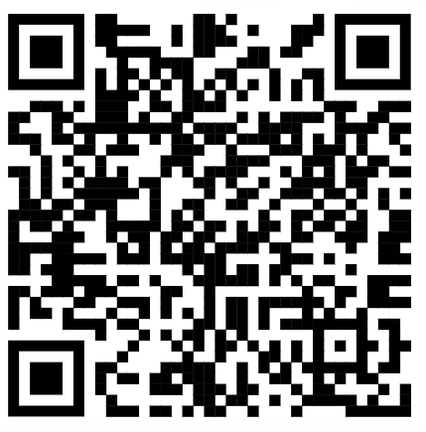
Final Poll
Post Survey
Rebalancing ideas
Suggestions for the future
Any additional comments/feedback

Slide 43
Thank you
Kayla Trzpuc
kbtrzpuc@nd.gov
MFP/TDP team
hhsmfpreferrals@nd.gov
ADRL Intake
Carechoice@nd.gov

