Slide 1
Community Connect
Portal Training
Notes:
ID=d924773e-9a16-4d6d-9803-8cb819e99682
Recipe=text_billboard
Type=TextOnly
Variant=0
FamilyID=AccentBoxWalbaum_Zero

Slide 2

Agenda
Resources
Access
Portal Layout
Application Case File Layout
Show & Share- Referral
Show & Share- Care Plan & Case Notes
Show & Share- Outcomes Billing
Show & Share- Participant Update

Slide 3
Resources
Provider Portal Guidance
Provider Portal Quick Reference
Comprehensive, complete step-by-step instructions
Quick reminders of priorities and required steps
Resources will be posted to the Community Connect website in January

Slide 4
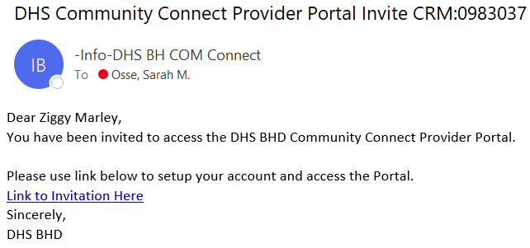
Portal Access
Agency Administrators submit contact details to the CC team
CC Team creates the contact and generates an email invitation
New user follows the email link to establish access (set username and password)

Slide 5
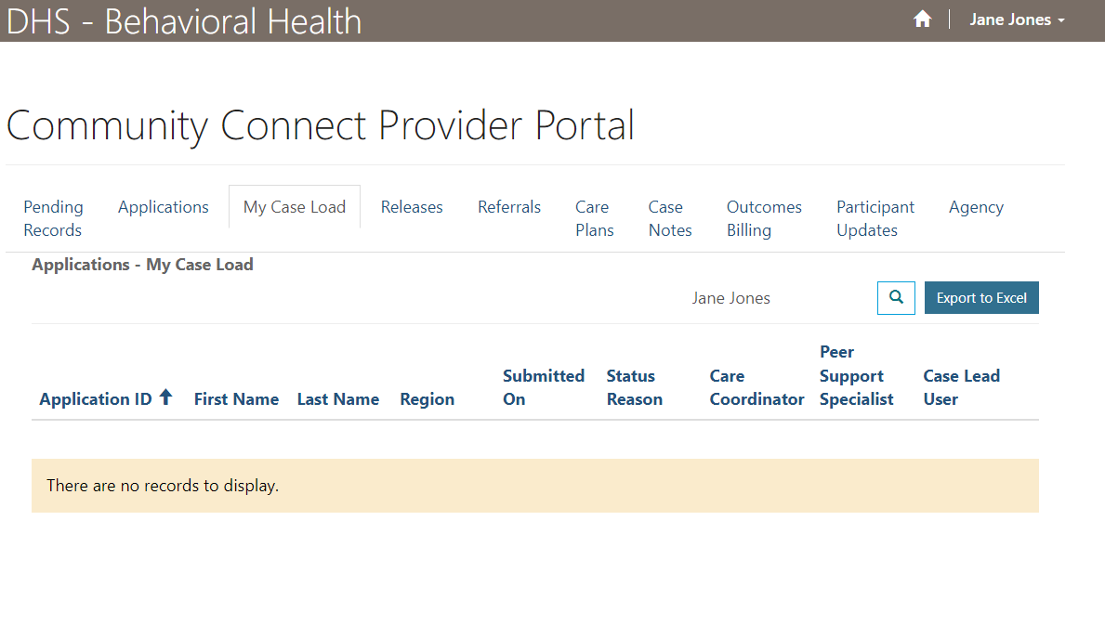
Provider Portal Layout

Slide 6
Tab Name | What’s in It
Pending Records | List of Pending Referrals and Outcomes Billings requiring review *This tab is primarily for Administrators
Applications | List of ALL applications ever served by your organization, split between Active, Transferred (out), and Closed *It is recommended to use the Active list to verify Outcomes Billings have been submitted for all participants active in a billing month.
My Case Load | List of the signed-in user’s applications assigned to them (either as the Care Coordinator or the Peer Support Specialist) *This is the default view
Releases | List of all Releases of Information for your organization, split between Active and Inactive
Referrals | List of all Referrals for your organization, split between Active and Inactive
Care Plans | List of all Care Plans for your organization, split between Active and Inactive
Outcomes Billings | List of all Outcomes Billings for your organization, split between Pending and Paid *It is recommended to use the Pending list to verify Outcomes Billings have been submitted for all participants active in a billing month.
Participant Updates | List of all Participant Updates submitted by your organization, split between Active and Inactive
Agency | Contains agency-level data and a listing of all agency Contacts (portal users)

Slide 7
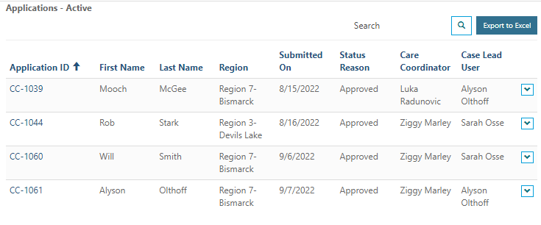

Features for all Tabs
Search
(Use the * to perform a wildcard search)
Sort by Column
Export to Excel
View Details & Print

Slide 8
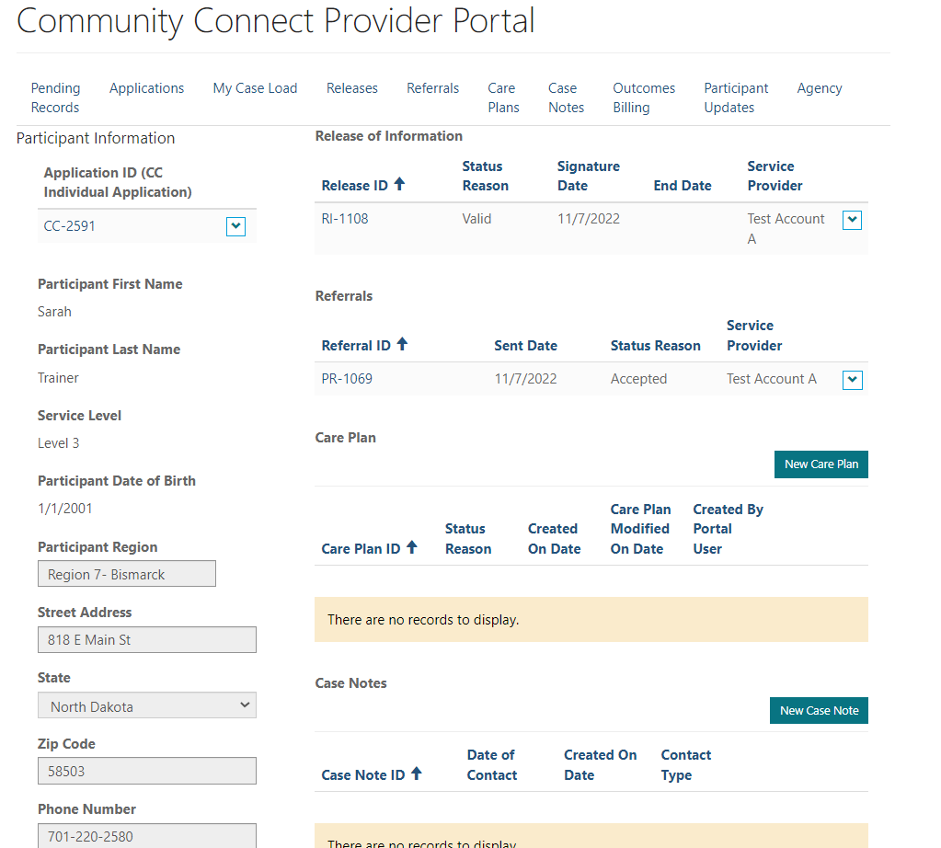
Application Case File Layout

Slide 9
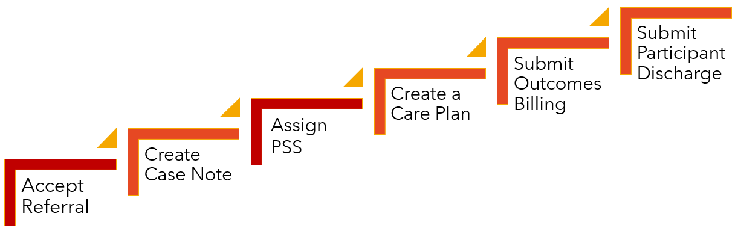
Accept a Referral
Master and Support Administrators

Slide 10
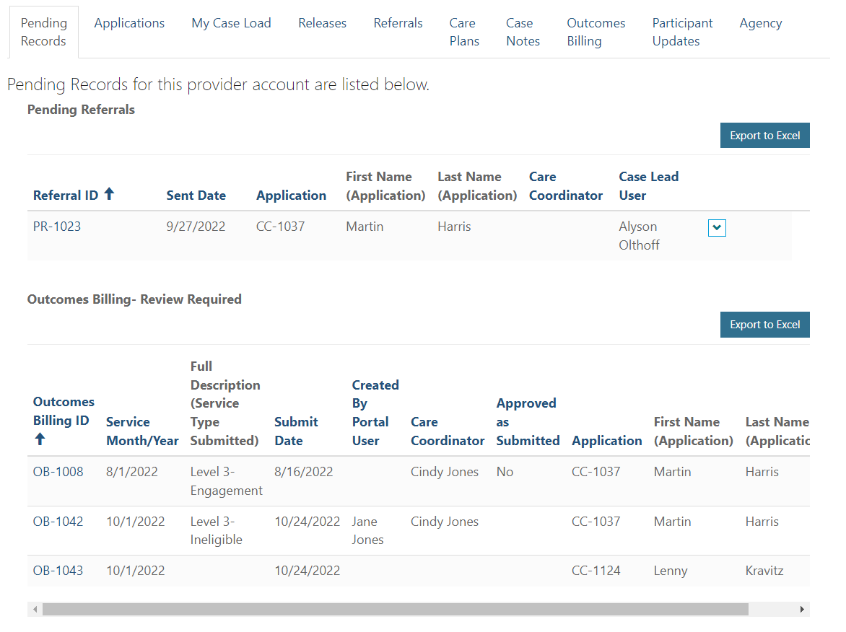
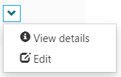
Referral Response

Slide 11
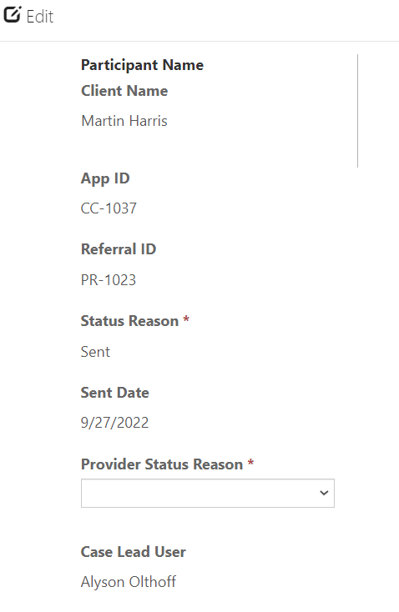
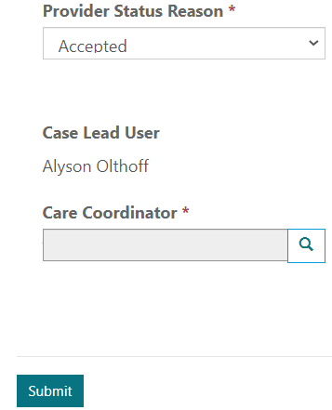
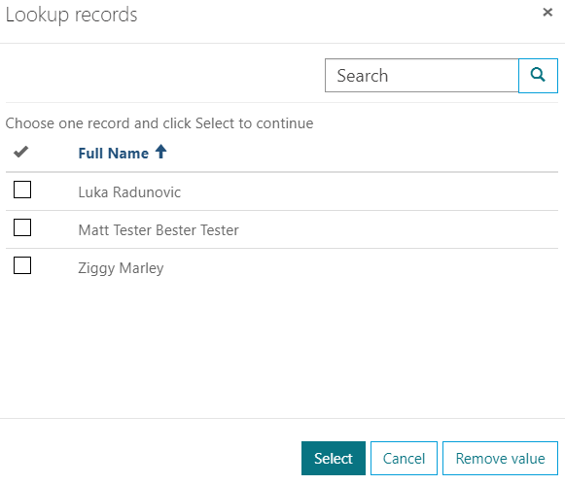

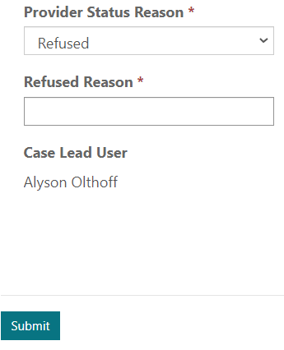
Referral Response
continued

Slide 12
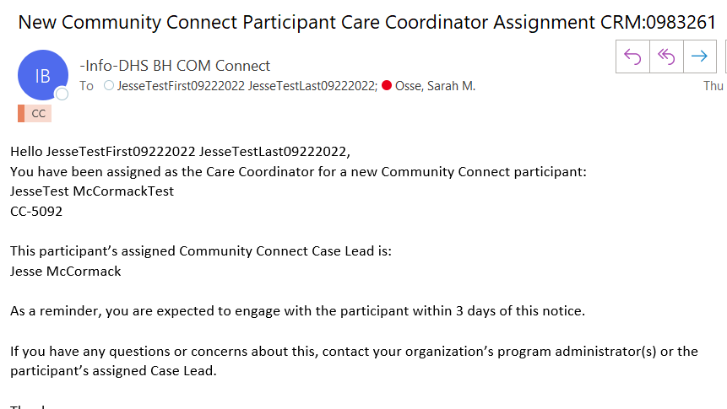
System will send a notification to the assigned Care Coordinator and cc: the agency’s email address

Slide 13
Submit Case Note
Care Coordinators and Peer Support Specialists

Slide 14
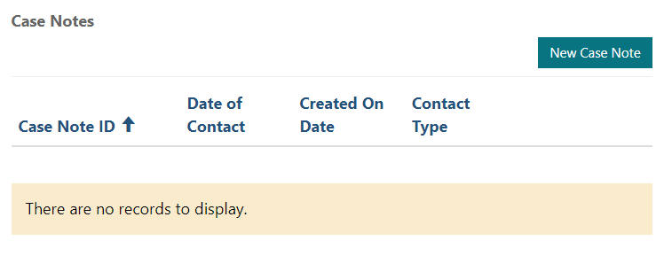
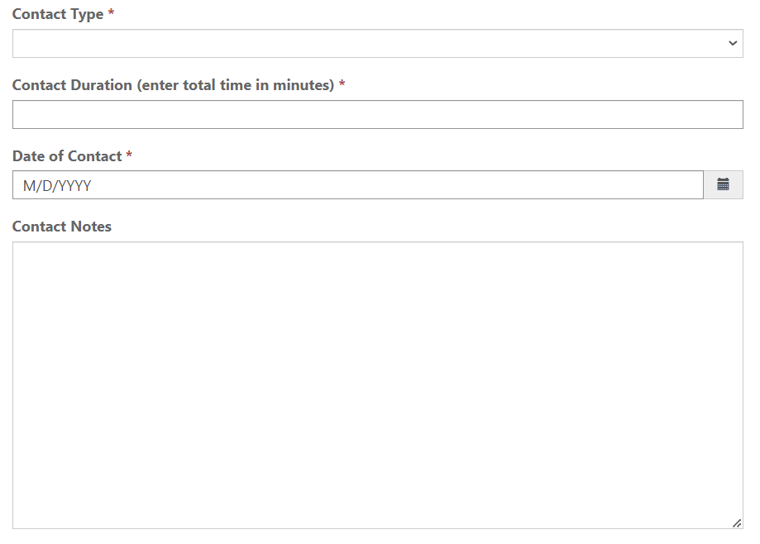
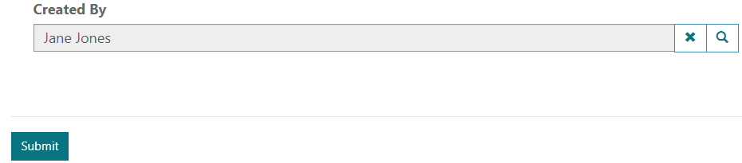
Text message
15
11/1/2022
Click New Case Note
Texting about housing applications
Select Contact Type
Enter Contact Duration
Enter Date of Contact
Add Contact Notes
Click Submit

Slide 15
Assign Peer Support
Master and Support Administrators

Slide 16
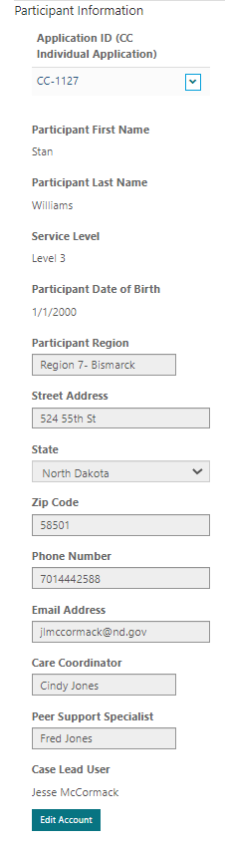
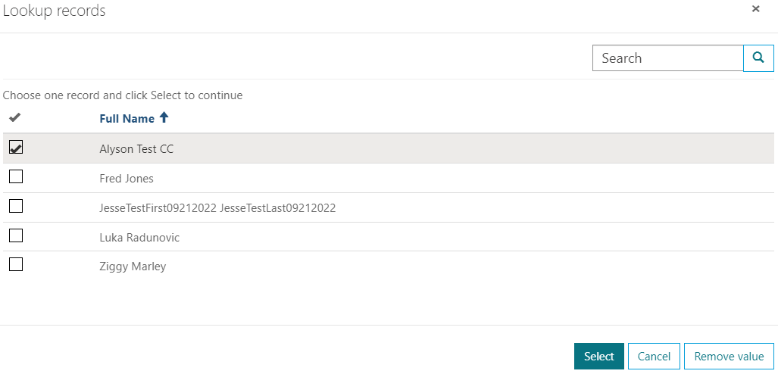

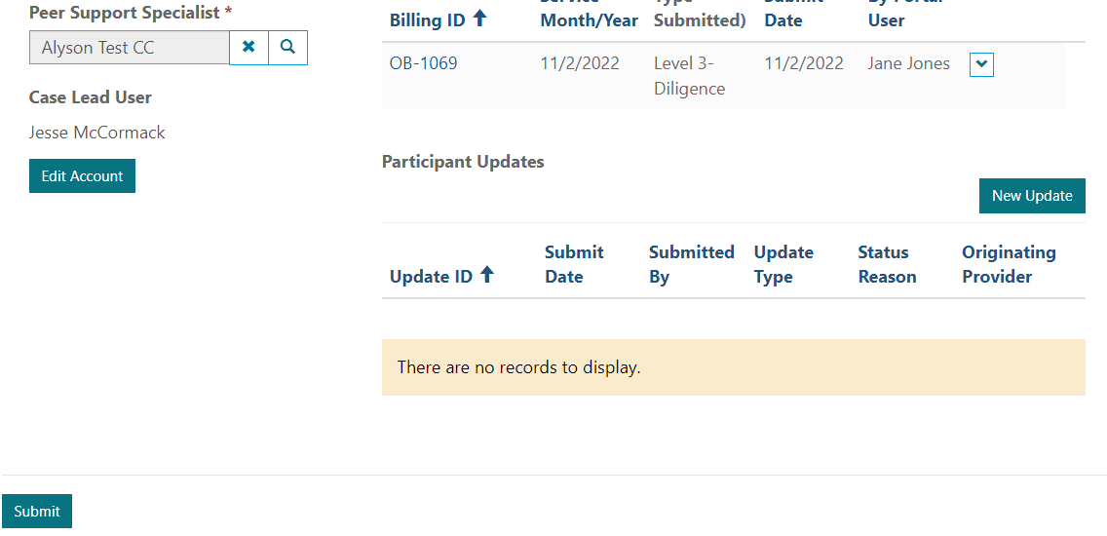
Launch Lookup by Clicking Magnifying Glass
Select PSS and hit Select
Click Submit
Click Edit Account

Slide 17
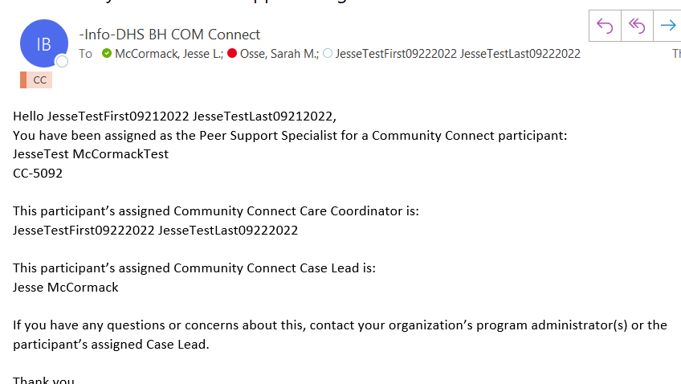
System will send a notification to the assigned Peer Support Specialist and cc: the Care Coordinator and the agency’s email address

Slide 18
Create a Care Plan
Care Coordinators

Slide 19
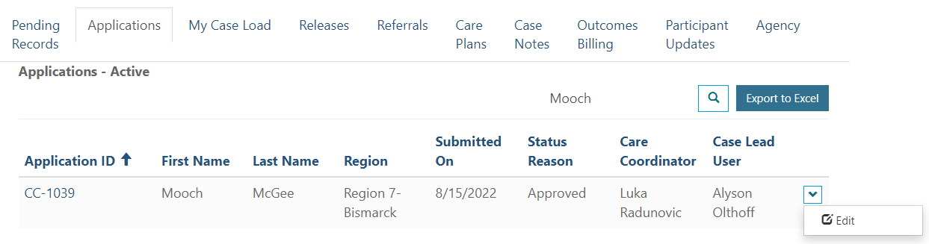
1. Navigate to the Applications Tab
2. Enter your First Name into the Search Bar
3. Click the Magnifying Glass
4. Click the Down Arrow and Click Edit

Slide 20
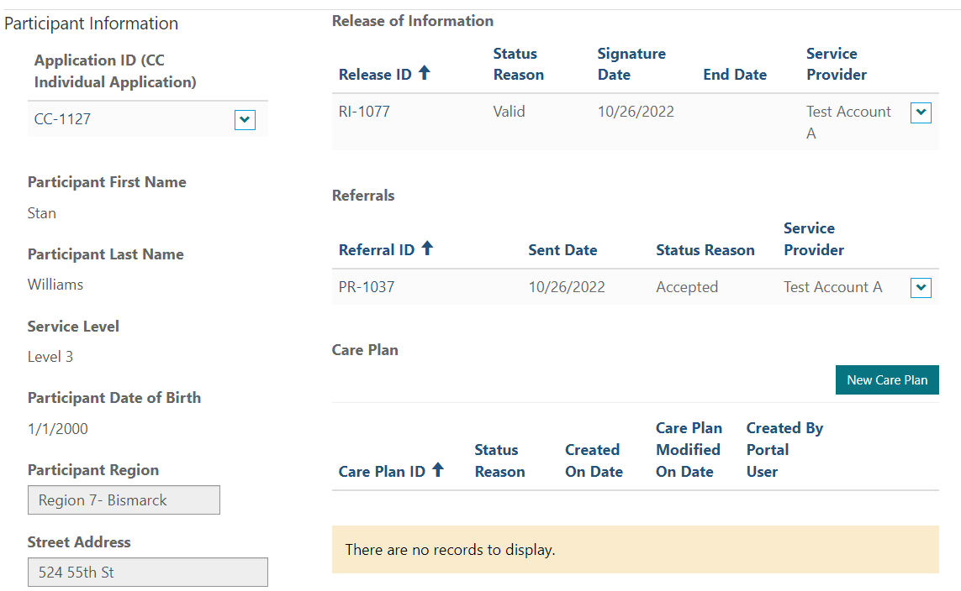
5. Click New Care Plan

Slide 21
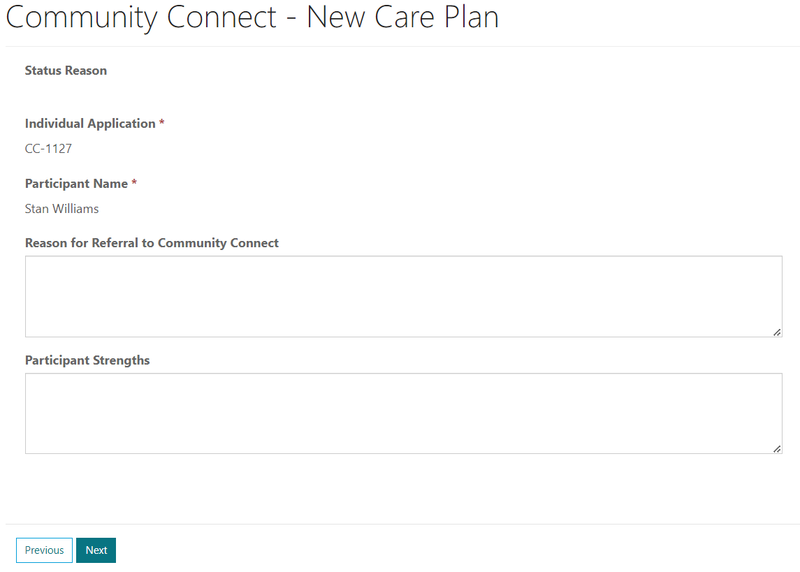
6. Enter Reason for Referral and Participant Strengths
Click Next

Slide 22
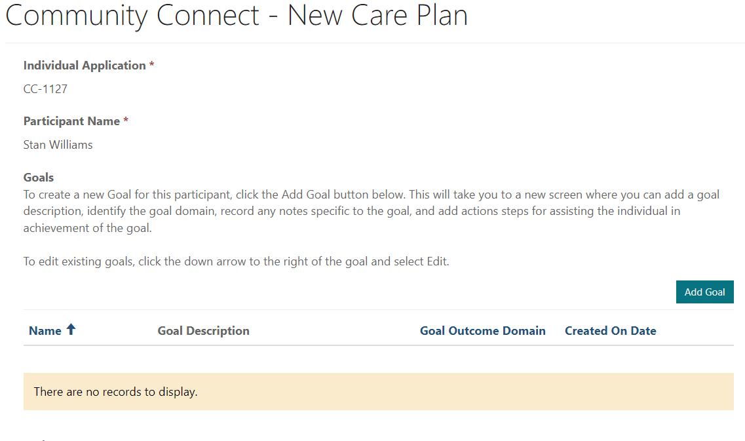
7. Click Add Goal to start adding participant goals

Slide 23
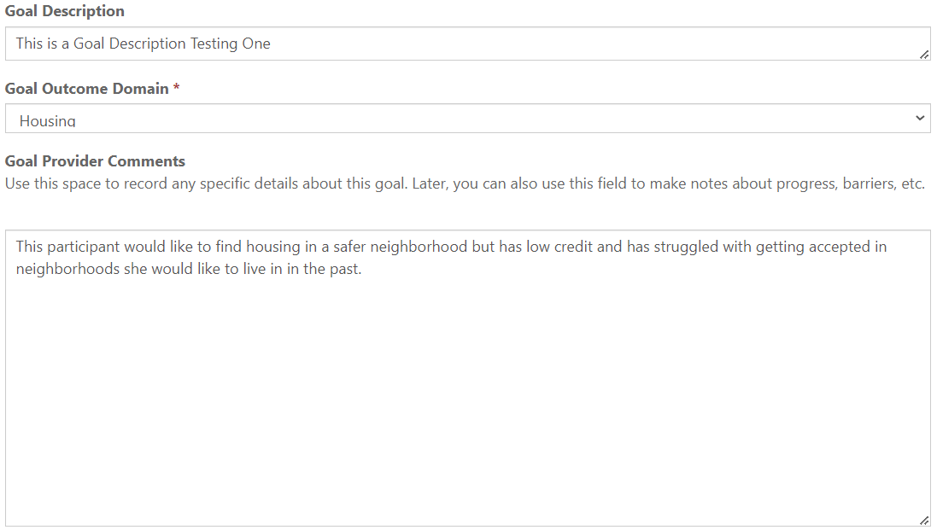
8. Enter a Goal Description, Select the Domain, and add Comments

Slide 24
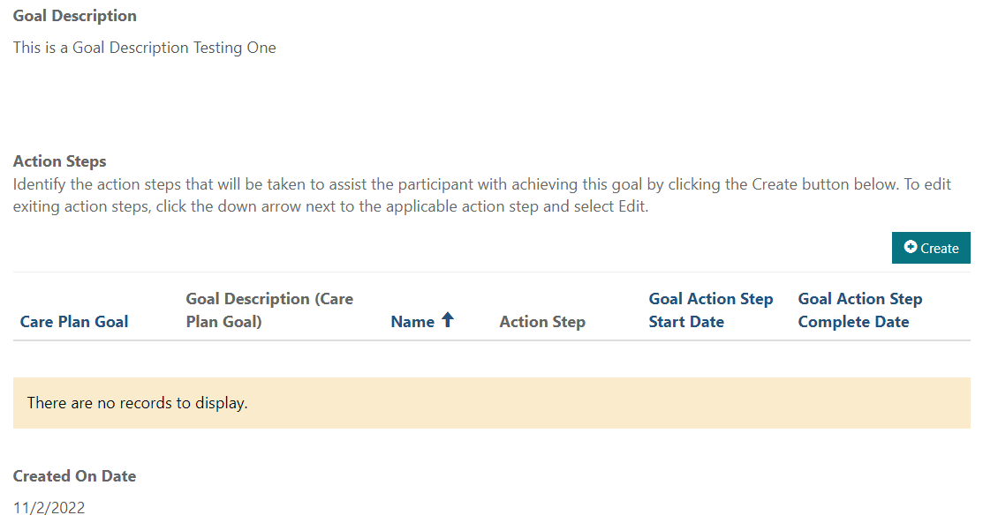
9. Click on the Create Button to begin adding Action Steps

Slide 25
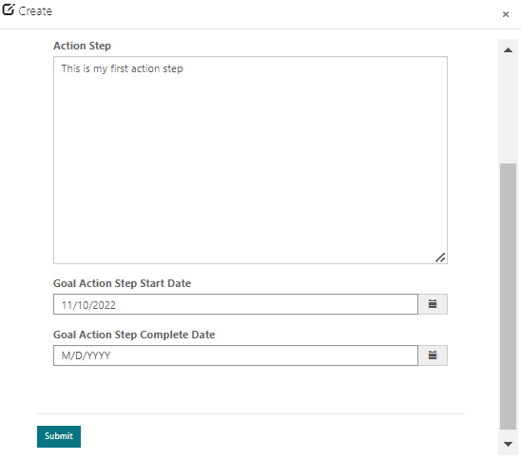
10. Enter Action Step
11. Add Action Step Start Date
This can be the day they want to start OR the day they start
Click Submit

Slide 26
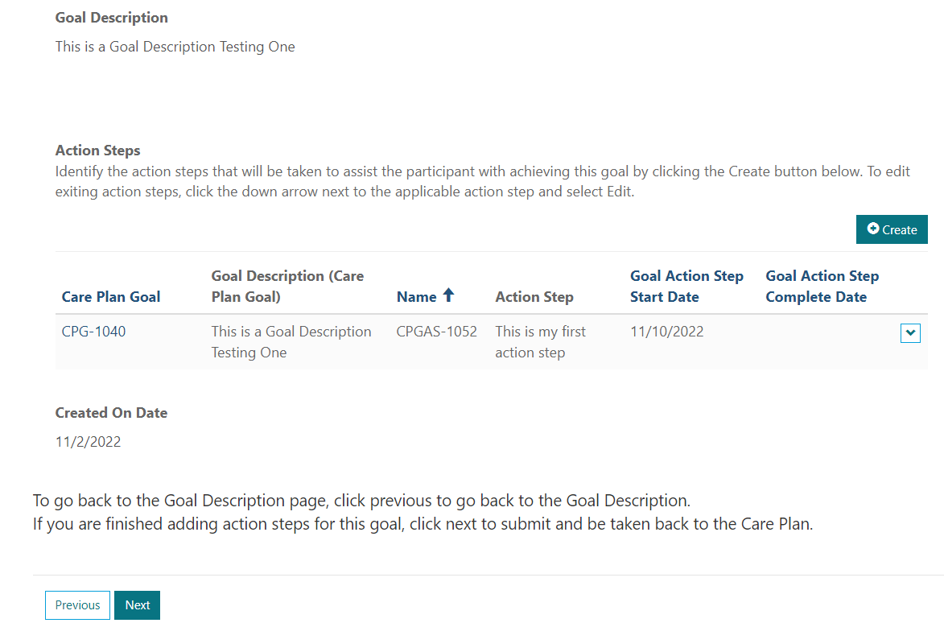
Decide what’s next:
Add another Action Step
Edit existing Action Step
Finish with this Goal and go back to the Care Plan main page

Slide 27
Modify a Care Plan

Slide 28
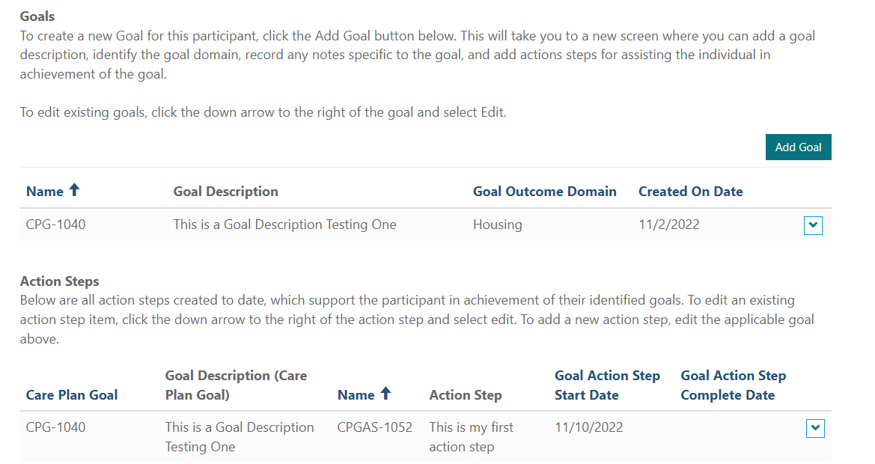
Modify the Care Plan
View all current Goals
Edit Current Goal
Add New Goal
Review all Action Steps
Edit existing Action Steps
Add Action Steps to Current Goal

Slide 29
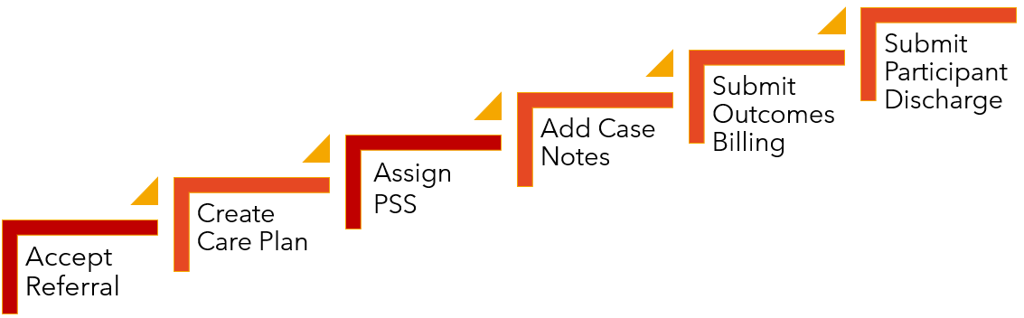
Submit Monthly Outcome
Care Coordinators and Administrators

Slide 30
Providers will now use their Care Plan, Case Notes, and Provider Guidance to determine the level of service provided each month.
Community Connect Administration will then review submissions along with the guidance for service levels to determine if they agree with the service level as submitted or will change the service level to something else.
Major Change
!

Slide 31

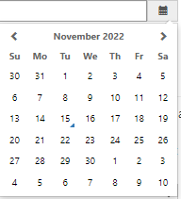
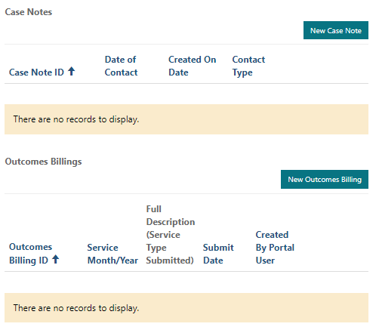
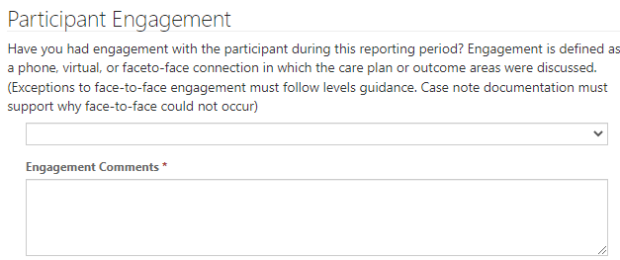
Click New Outcomes Billing
Enter first date of Service for billing month
Determine if Participant Engagement achieved & provide supporting comments

Slide 32
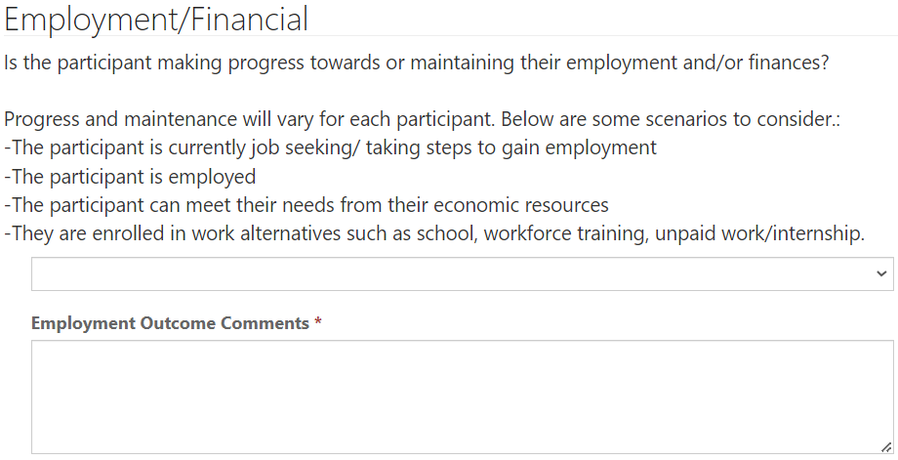
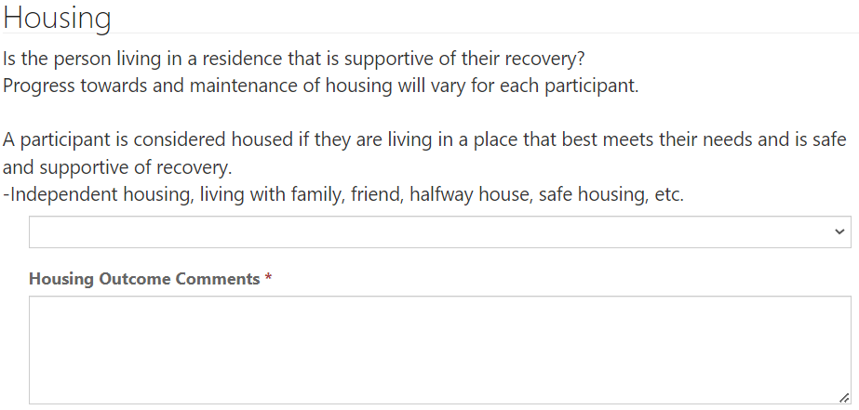
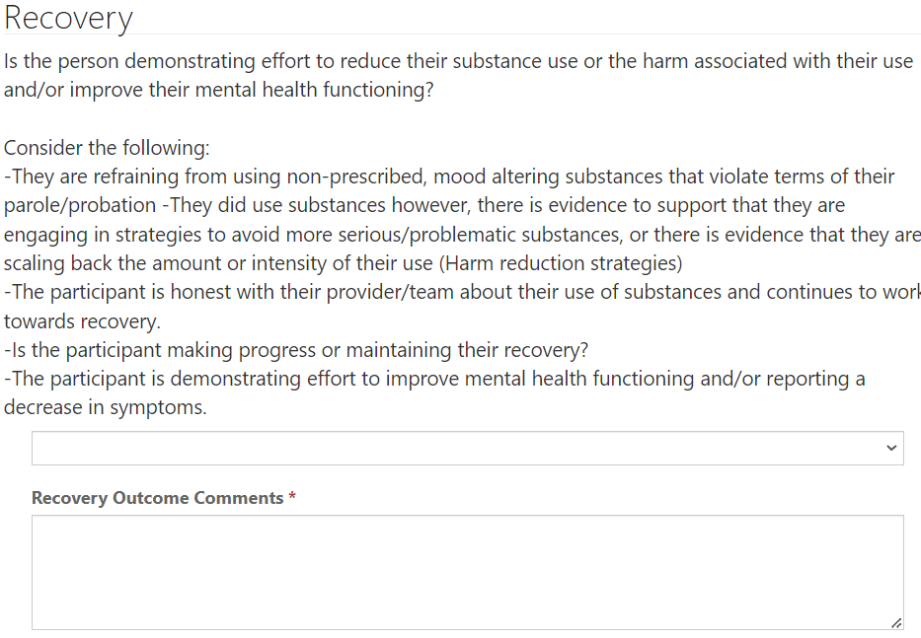
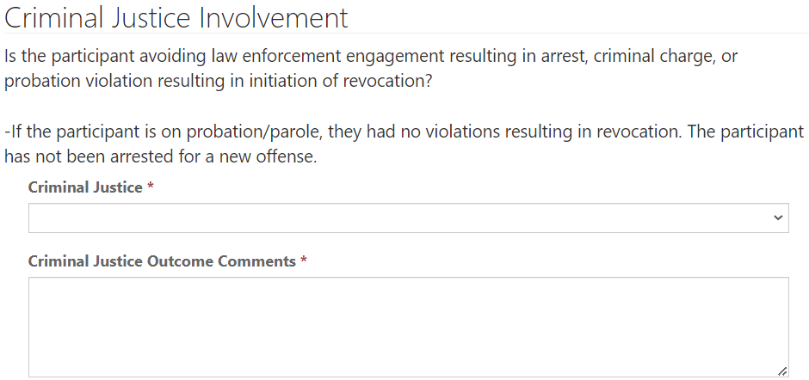
Answer Questions and Enter supporting Comments for each Outcomes Area
Options are Yes/No or N/A
  N/A should only be used when Engagement is not achieved for the reporting month
System is monitoring for Yes values to assist with selecting appropriate Level of Service for the participant

Slide 33
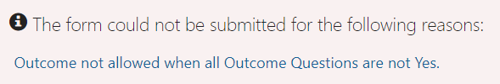

Engagement | Positive Outcome # | Level of Service Allowed
No | 0 | Ineligible
No | 0 | Diligence (only if case notes demonstrate effort to contact participant unmet for Levels of Care 1 and 2)
Yes | 1-2 | Engagement
Yes | 3-4 | Outcomes
System will prohibit selection of Level of Service that does not align with the following:

Slide 34
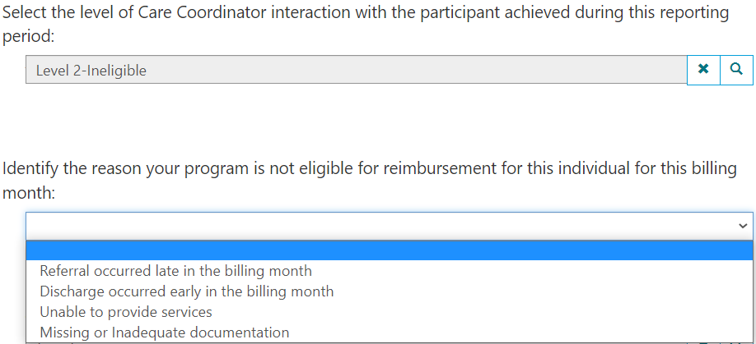
For any Ineligible Level of Service, the user will have to select a reason for ineligibility

Slide 35
Providers will be given opportunity to review all Outcomes Approved Other Than Submitted (Pending Records Tab) before payments finalized

Slide 36
Submit Participant Update
Care Coordinators

Slide 37
Providers will now use a Participant Update Form within the portal to notify the Case Lead of the following:
Major Change
!
Request to change the level of care
Request to discharge a participant
Request a provider transfer for a participant
NOTE- provider administrators will be able to change a participant’s region within the portal, so these requests will no longer need to be managed through the Case Lead

Slide 38
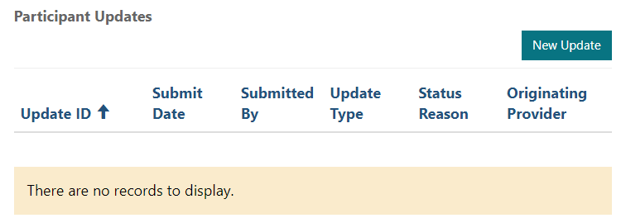
Click New Update

Slide 39
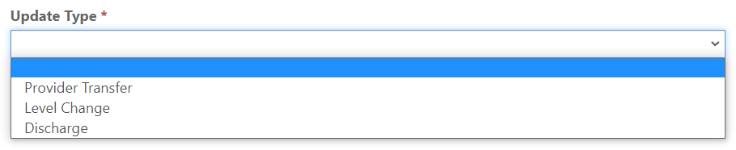
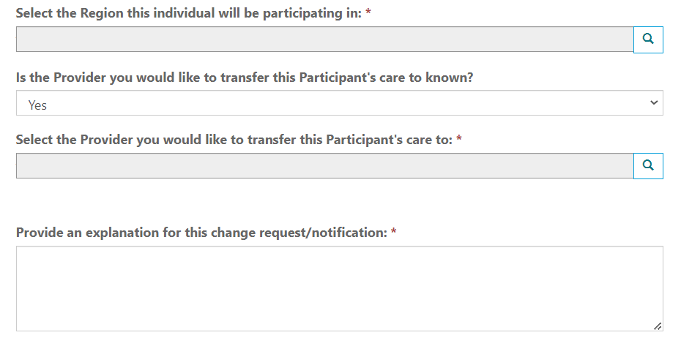
Select the applicable Participant Update Type & Answer Branched Questions

Slide 40
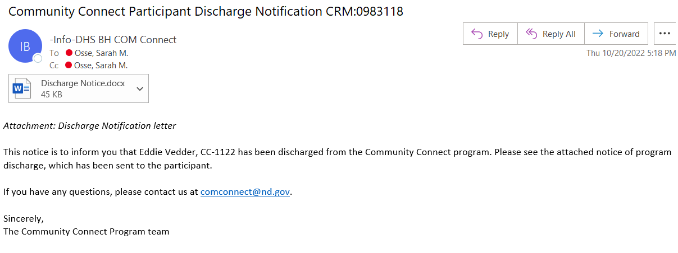
When a Case Lead discharges a participant from the program, an automated notice is sent to the participant, Care Coordinator, Peer Support Specialist (if assigned), and the agency email address.

Slide 41






Thank you!
Alyson Olthoff
aolthoff@nd.gov

