Slide 1


Update on Treatment Courts Supported by the Opioid Settlement Fund Grant
John Gourde, Program Manager
ND Department of Corrections and Rehabilitation
Notes:
---
This presentation provides an update on the progress and impact of treatment courts funded by the opioid settlement grant. We will examine the grant's objectives, the districts involved, and the collaborative efforts made to enhance treatment initiatives.

Slide 2


Purpose and Objectives of the Grant
Funding for Treatment Courts
  The grant aims to provide essential funding for treatment courts, enhancing access to substance use treatment resources.
Promoting Recovery Support
  The grant also focuses on promoting recovery through comprehensive support services for individuals seeking help.
Reducing Recidivism Rates
  A key objective is to reduce recidivism rates among individuals with substance use disorders through effective treatment.
Notes:
The main purpose of the grant is to provide necessary funding for treatment courts to improve access to substance use treatment. Key objectives include reducing recidivism rates among individuals with substance use disorders and promoting recovery through comprehensive support services.

Slide 3

Programs Receiving Funding
Northeast Central Judicial District Treatment Court-Grand Forks
North Central Judicial District Treatment Court-Minot
South Central Judicial District Treatment Court-Bismack
Notes:
Today, we will cover the purpose and objectives of the Opioid Settlement Grant, the role of the Department of Health and Human Services, and how funds are allocated to treatment courts. We will then review the progress in the Northeast Central, North Central, and South Central Judicial Districts, and conclude with a comparative analysis and future outlook.

Slide 4
Northeast Central Judicial District in Grand Forks
Notes:
This section will focus on the initiatives and progress made in the Northeast Central Judicial District, highlighting partnerships and achievements that have contributed to the treatment court's success.

Slide 5
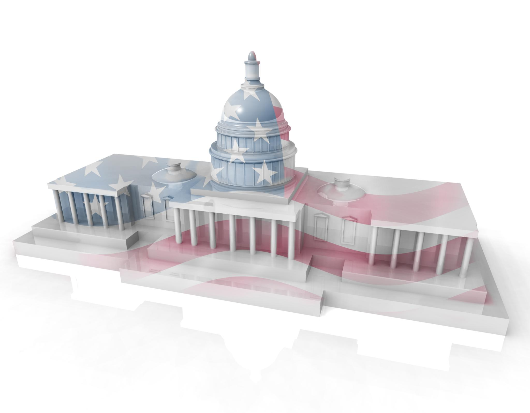
Introduction to the Northeast Central Judicial District
Service Area
  The Northeast Central Judicial District serves Grand Forks and nearby communities, ensuring access to justice and support.
Integrated Approach
  The district emphasizes an integrated approach to treatment, focusing on substance use disorders through collaboration and rehabilitation.
Treatment Court Program
  The treatment court program aims to support individuals with substance use disorders, promoting recovery and reducing recidivism.
Notes:
The Northeast Central Judicial District serves Grand Forks and surrounding areas. It focuses on providing an integrated approach to addressing substance use disorders through its treatment court program.

Slide 6
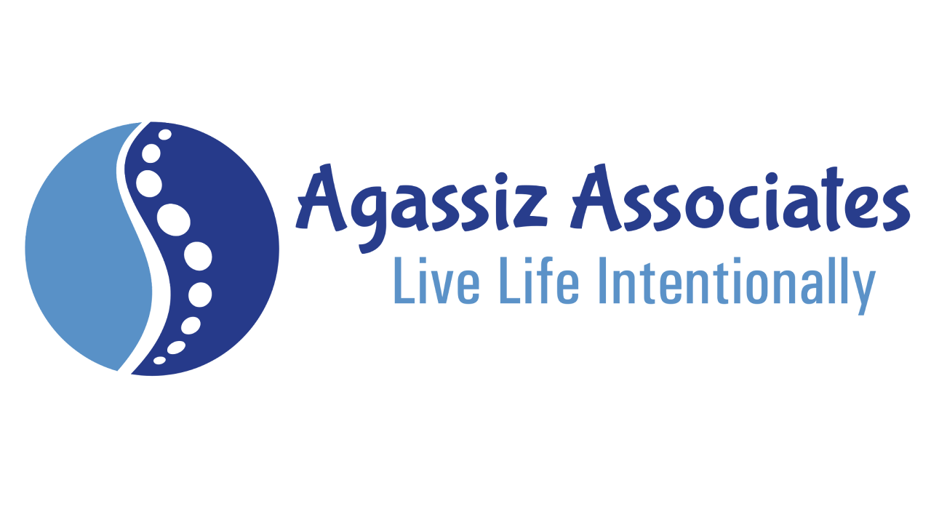
Agassiz Associates
Serving the NECJD Treatment Court Program since 2024
Providing outpatient Treatment services (Levels1 and 2).
Currently Serving 24 participants in the community.

Slide 7
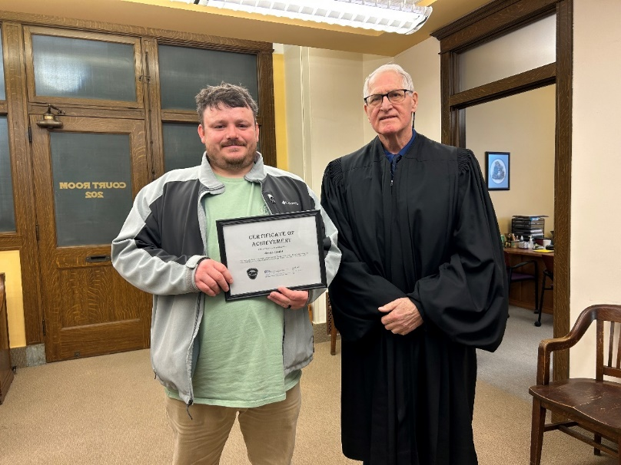
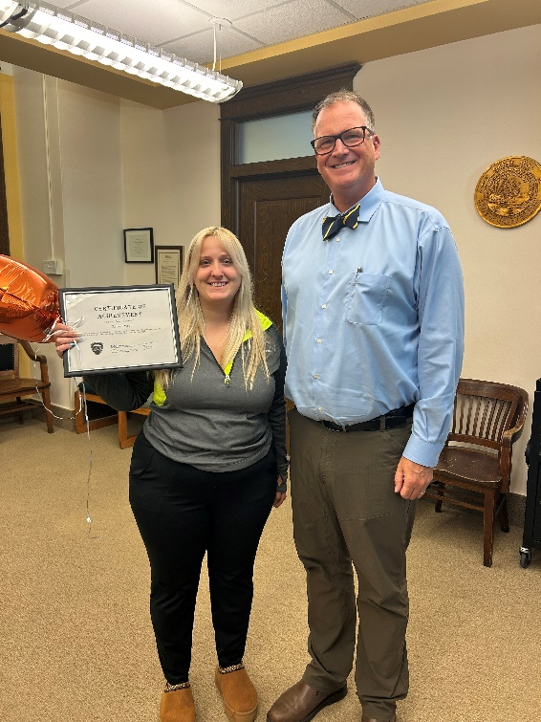

Slide 8
North Central Judicial District in Minot
Notes:
The North Central Judicial District has also made substantial progress in its treatment court initiatives, emphasizing collaboration and successful outcomes.

Slide 9
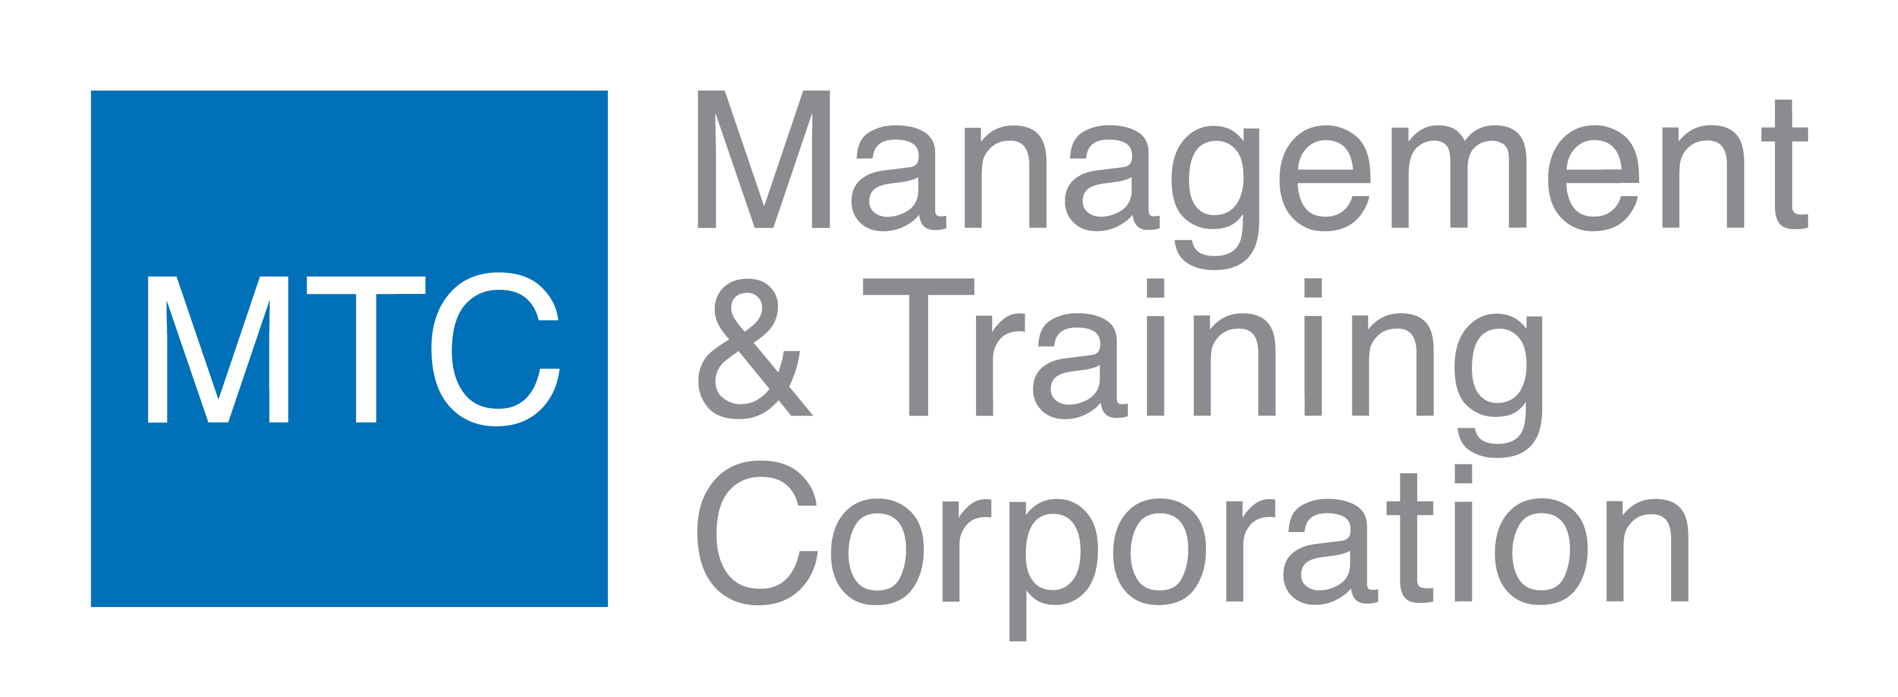
Management & Training Corporation
Supporting the NEJD Treatment Court Program since 2024.
Providing outpatient treatment services ( levels 1 and 2).
Currently serving 14 participants within the community.
Notes:
Collaboration with the Management Training Corporation has been instrumental in delivering training and resources to the treatment court. This partnership has enhanced the quality of services provided.

Slide 10
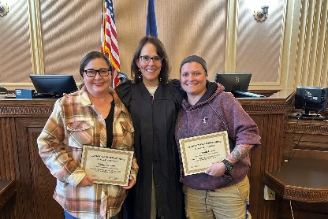
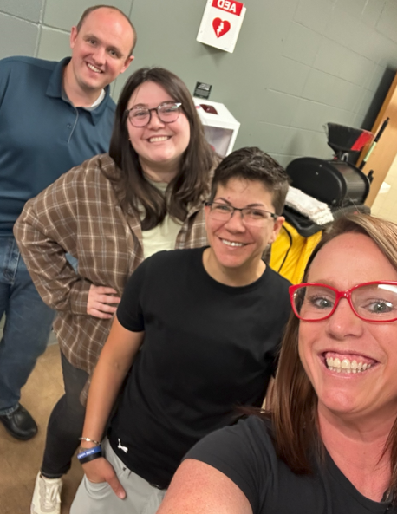

Slide 11
South Central Judicial District in Bismarck
Notes:
In the South Central Judicial District, the treatment court has provided essential services and support to individuals seeking recovery from substance use disorders.

Slide 12

Heartview
Supporting the SCJD Treatment Court Program since 2022.
Providing outpatient and inpatient treatment services (levels 1, 2 and 3).
Currently serving 35 participants within the community.
Notes:
Heartview, a key service provider in the district, offers comprehensive treatment options, including counseling and educational programs, which are vital to the recovery process.

Slide 13
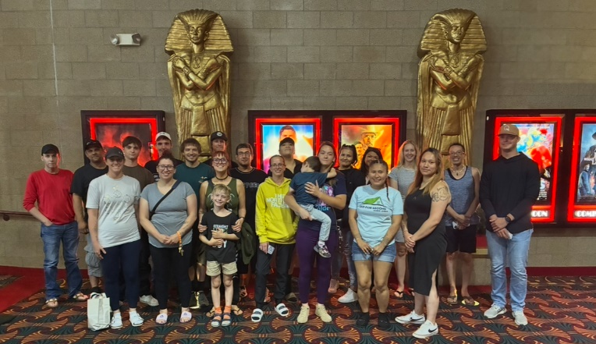

Slide 14


Conclusion
Opioid Settlement Impact
The opioid settlement grant has provided funding to help sustain treatment services, which has assisted participants in their recovery journey.
Collaboration Importance
Ongoing collaboration among stakeholders is crucial for addressing substance use disorders effectively and ensuring future success.
Commitment to Success
A strong commitment to addressing substance use disorders is vital for maintaining progress and achieving long-term outcomes.
Notes:
In summary, the opioid settlement grant has enabled significant advancements in treatment courts across various districts. Continued collaboration and commitment to addressing substance use disorders are essential for future success.

Slide 15
