Slide 1

OSF Grant Project Update – MHASL
Tiffany Dickens
Female Supervisor, MHASL
OSF Grant Advisory Committee

Slide 2
Purpose of Today’s Update
Share our journey, progress, and readiness
Highlight healing, inclusion, and sustainability

Slide 3
Our Vision
Inclusive recovery for tribal and non-tribal individuals
Strengthening healing in rural communities

Slide 4
Our Biggest Hurdle
Gaining approval to serve both tribal and non-tribal guests
Required trust, dialogue, and persistence

Slide 5
The Work Behind the Approval
Multiple presentations and conversations
Education, patience, and relationship-building

Slide 6
Breakthrough Moment
Approval achieved through Executive Action
Allowed project to move forward

Slide 7
Why This Matters
Long-term sustainability
Sharing recovery with the entire populace

Slide 8
Choosing the Lodge Location
Rural tribal community
Intentional placement to meet unmet needs

Slide 9
Remodel Complete
Safe, welcoming, healing environment
Lodge is fully ready

Slide 10

Staffing & Readiness
Currently advertising for positions
Building a compassionate recovery team

Slide 11
Building the Waiting List
Working with stakeholders and referral partners
Preparing residents for success

Slide 12
Opening Timeline
First guests arrive the first Monday of March

Slide 13
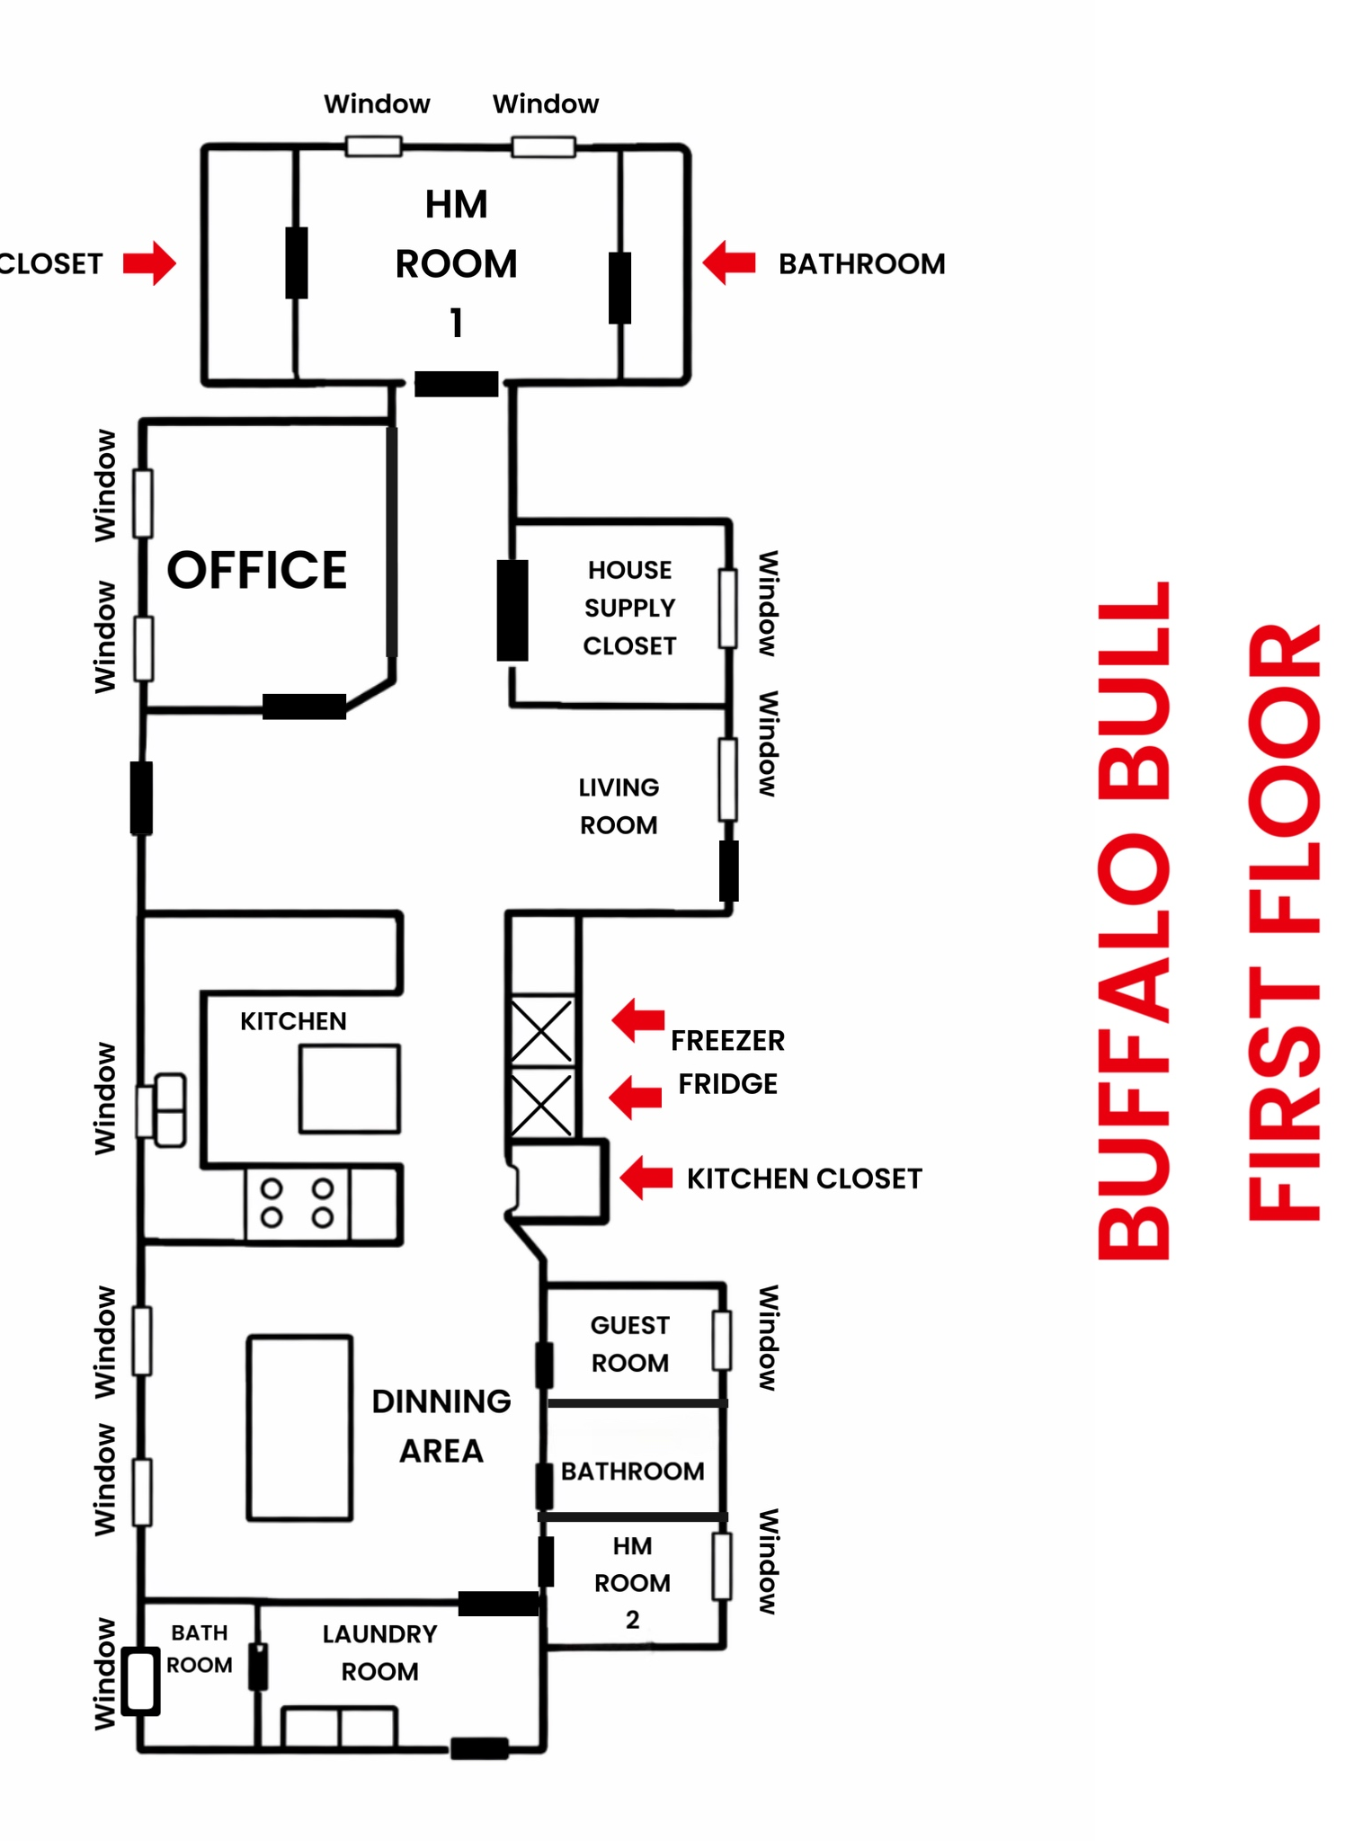
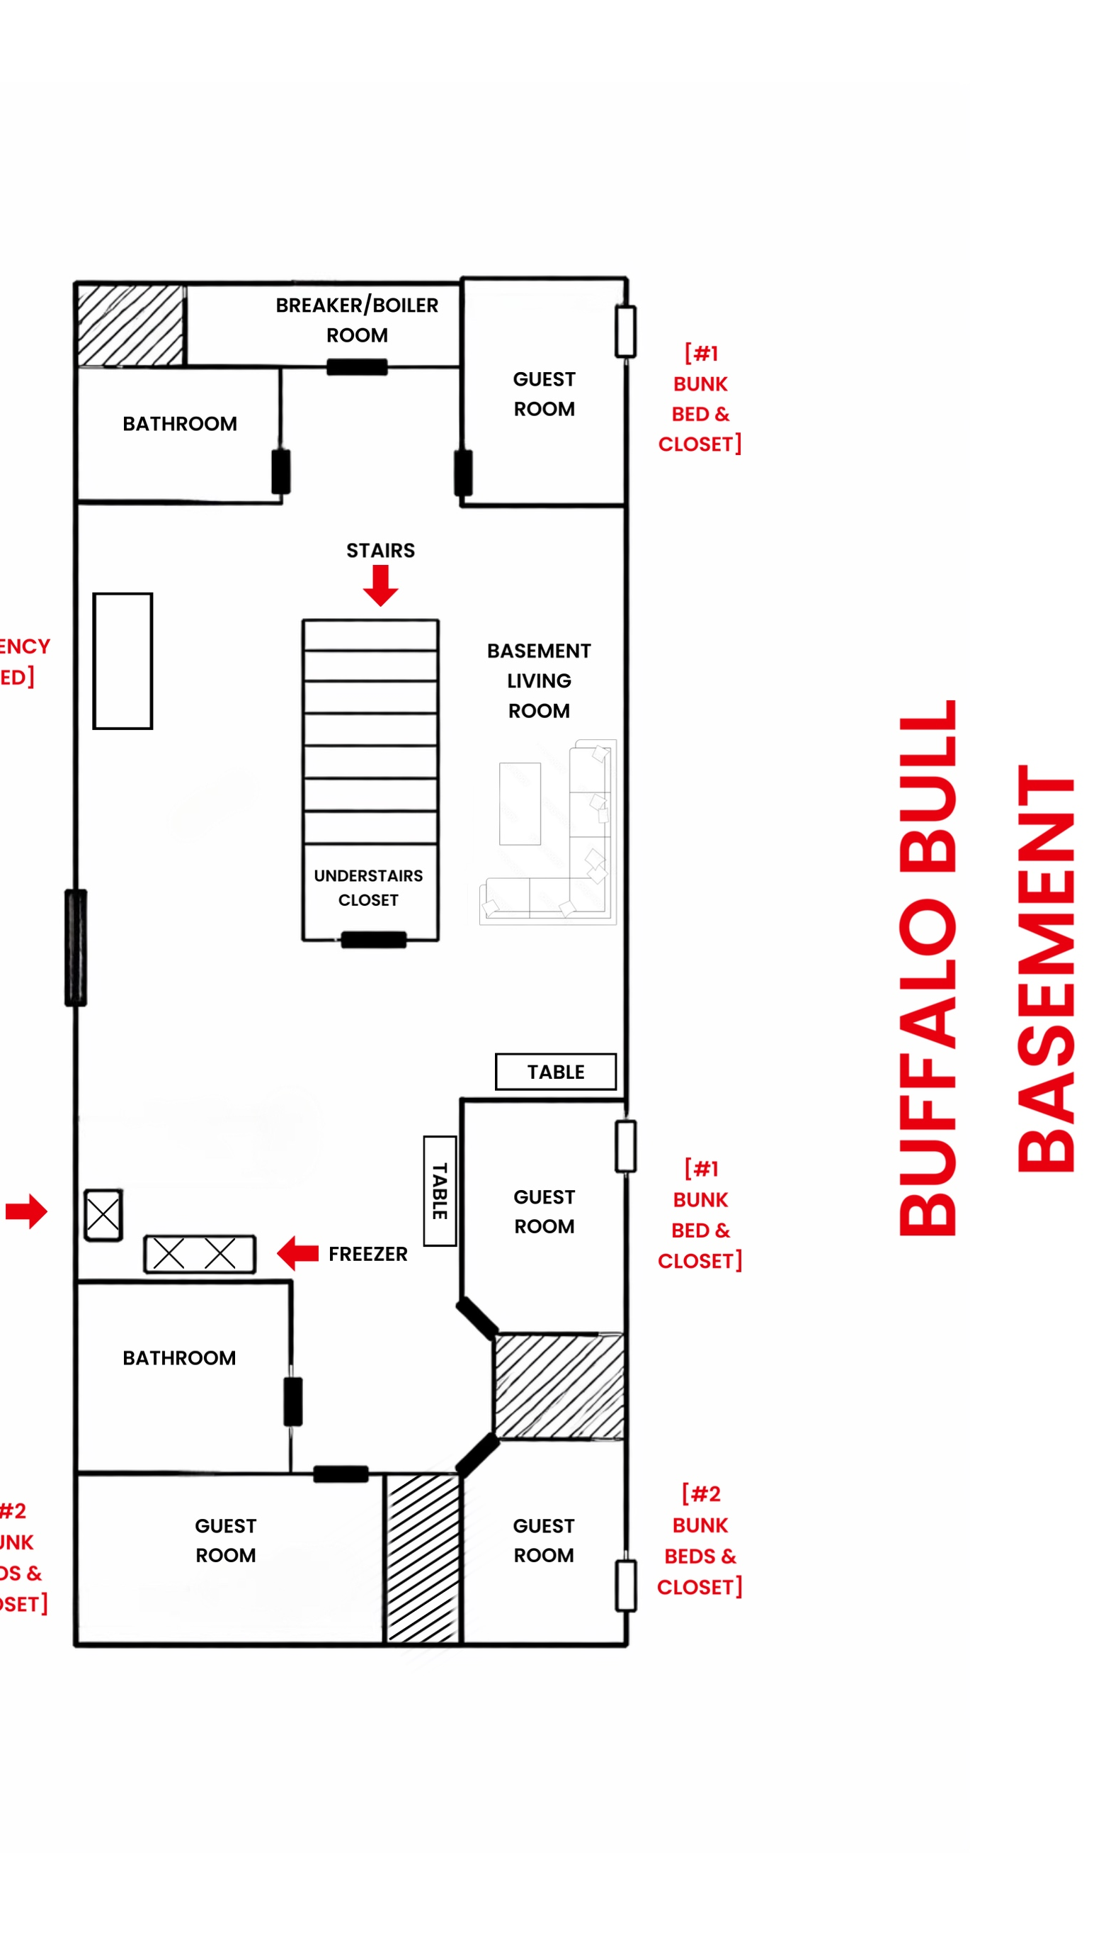
House description
[1st Floor- 2 Beds, 1 Bunk Bed. 3 Bathrooms. 3 Bedrooms with closets.]
[2nd Floor- 7 Bunk Beds. 2 Bathrooms. 4 Bedrooms with closets.]

Slide 14

Gratitude & Closing
Thank you to OSF and community partners
Honored to walk this healing journey together

