Slide 1

Medications for Opioid Use Disorder(MOUD) Program
Ward County Detention Center

Slide 2

Presenters
Major Paul Olthoff
Ward County Detention Center
MOUD Officer Ashley Clouse
Ward County Detention Center

Slide 3
MOUD Program
Background
Program Description

Slide 4
Background

Slide 5
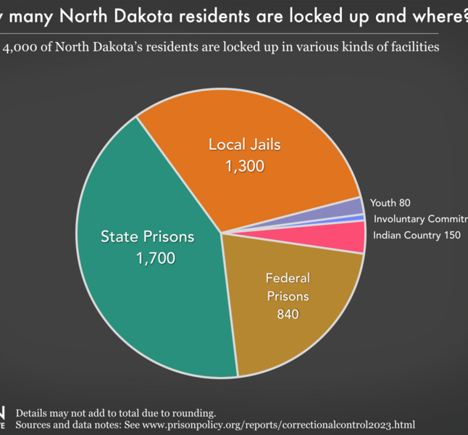
North Dakota Statistics
20.8% of adults meet criteria for Substance Use Disorder (SUD)
77.62% did not receive treatment
3.46% adult illicit drug use in ND compared to the nation’s average 3.48%
Drug/narcotic violations increased 2.54%
*National Survey on Drug Use and Health, North Dakota 2021-2022 Estimates

Slide 6
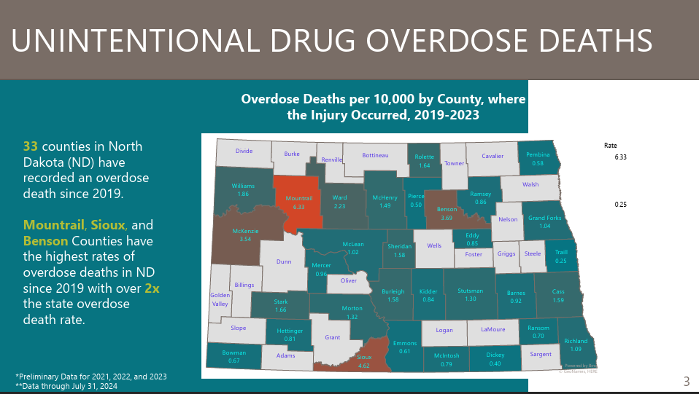
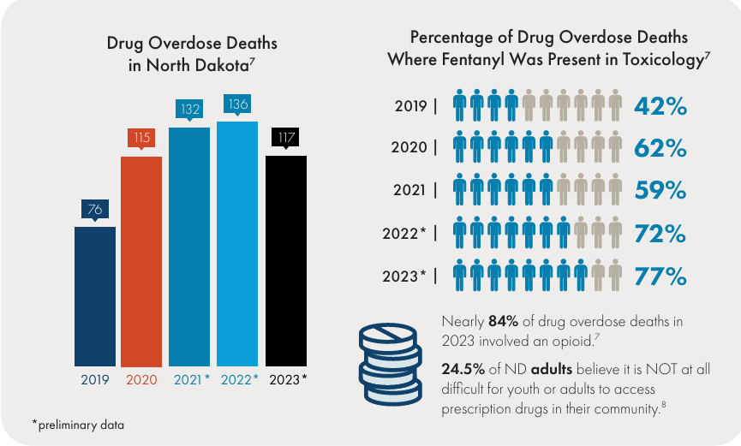
Ward County has the fifth highest rate for overdose deaths in North Dakota.
2024 City of Minot had 74 calls for reported overdoses.
2025 City of Minot had 33 calls for reported overdoses, with 5 resulting in death.
This is a 55.4 % decrease

Slide 7
WCDC MOUD Program

Slide 8
The Beginning
Developed collaboratively through the Ward County Opioid (WCO) Task Force
Best use of Opioid Settlement Funds Received by Ward County & the City of Minot
MOUD Program-screen inmates for Substance Use Disorder
Refer to MOUD treatment as applicable
Accessible Peer Support (group or individual)
Harm reduction education
Continuity of care

Slide 9
Community Support
First District Health Unit
Community Medical Services (CMS)
Ideal Options
North Central Human Service Center
Minot Area Recovery Community Organization ( MARCO)
ONE(Opioid and Naloxone Education) created by North Dakota State University
Area Law Enforcement

Slide 10
The Process
Incarceration
Screening and assessment
Medication administration
Peer support and reentry services
Notes:
ONE program screening tool for screening, telehealth meeting with clinic staff for assessment. MARCO and CMS for peer support and reentry services EX. Medicaid, treatment apps, treatment plans with counselor.

Slide 11
Notes:
Unscreened is 2,429 individuals. That is 76.3% of the bookings with potential for Substance Use Disorder.

Slide 13
Medications
Methadone
Buprenorphine-Naloxone
Sublocade
Vivitrol

Slide 15

Funding
Ward County and the City of Minot Opioid Settlement Funds
ND Opioid Settlement Fund Grant
SUD Vouchers ( if eligible)

Slide 16
Post release payors

Slide 17

First year in review
During the first year, an estimated 6,551 doses of medication were administered to 148 individuals across 241 jail stays. Of these individuals, 60 were initiated on MAT while incarcerated, and 88 continued their previously established MAT. The Ward County MOUD Program also supported multiple agencies across North Dakota by courtesy holding inmates on MAT when other facilities were unable to meet their medical needs.

Slide 18
Highlights
Achieved local, statewide, and national recognition within the first year of operation
Major Olthoff awarded a commendation by the NDDOCR for innovation in correctional- based MOUD services
MOUD Officer Clouse featured in a docuseries highlighting corrections- based treatment
Emerging model for corrections and recovery support
Peer site visits to Franklin County, OH and Chesterfield County, VA- Medication assisted treatment best practices and HARP( Helping Addicts Recover Progressively)
Applying lessons learned to advance and strengthen Ward County’s MOUD program

Slide 19
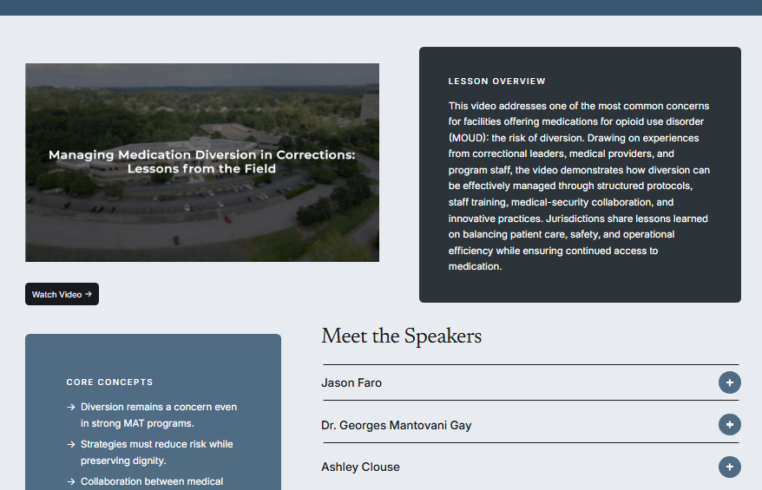
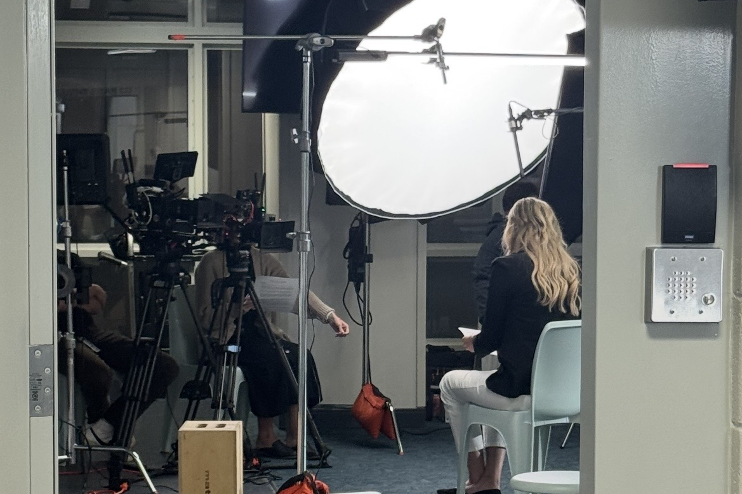
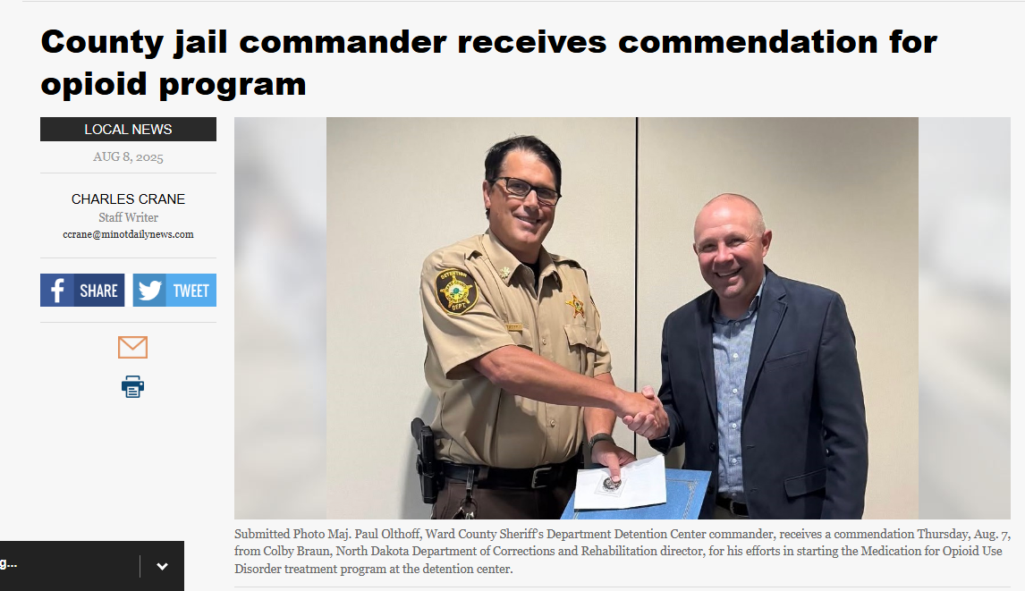
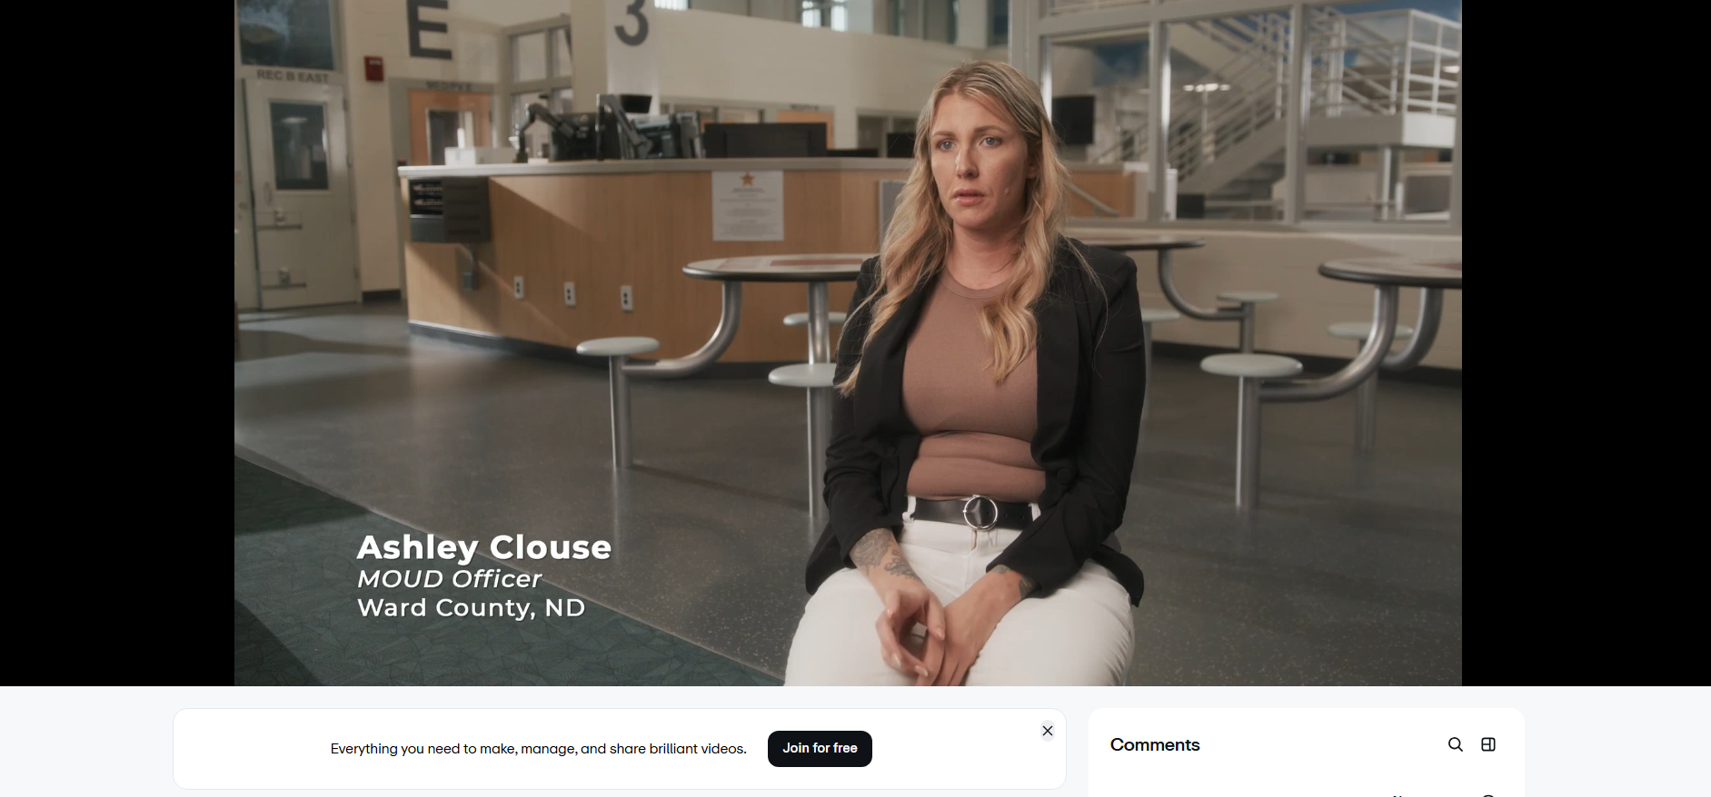

Slide 20
Thank you
Thank you to everyone that has supported myself and Ward County’s MOUD Program during its first year. Your leadership, collaborations, and commitment has made it possible to build a successful corrections-based program serving our community.
The achievements and recognition earned in year one reflect the dedication of all involved. I am grateful for continued support as we move forward.
- Ashley Clouse

