Slide 1

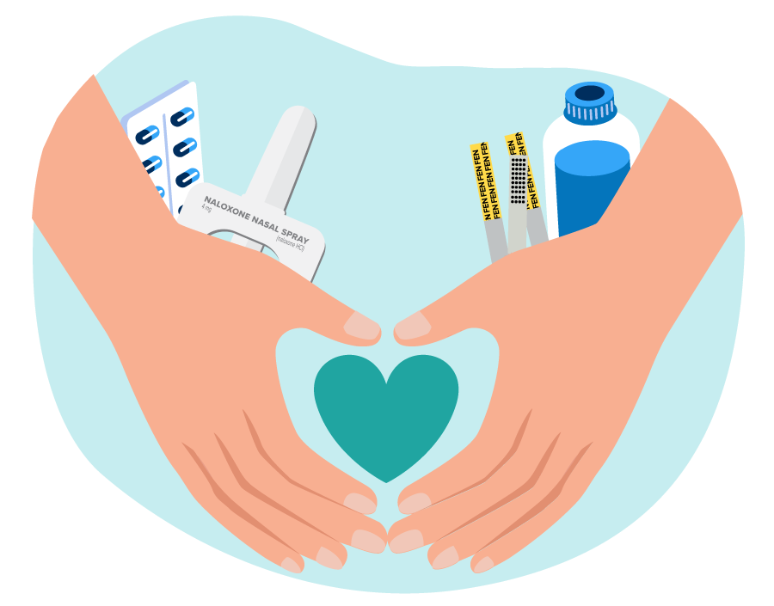


HARM REDUCTION:
MORE THAN MEETS THE EYE
Good Neighbor Project Syringe Service Program (SSP)
May 11, 2026

Slide 2
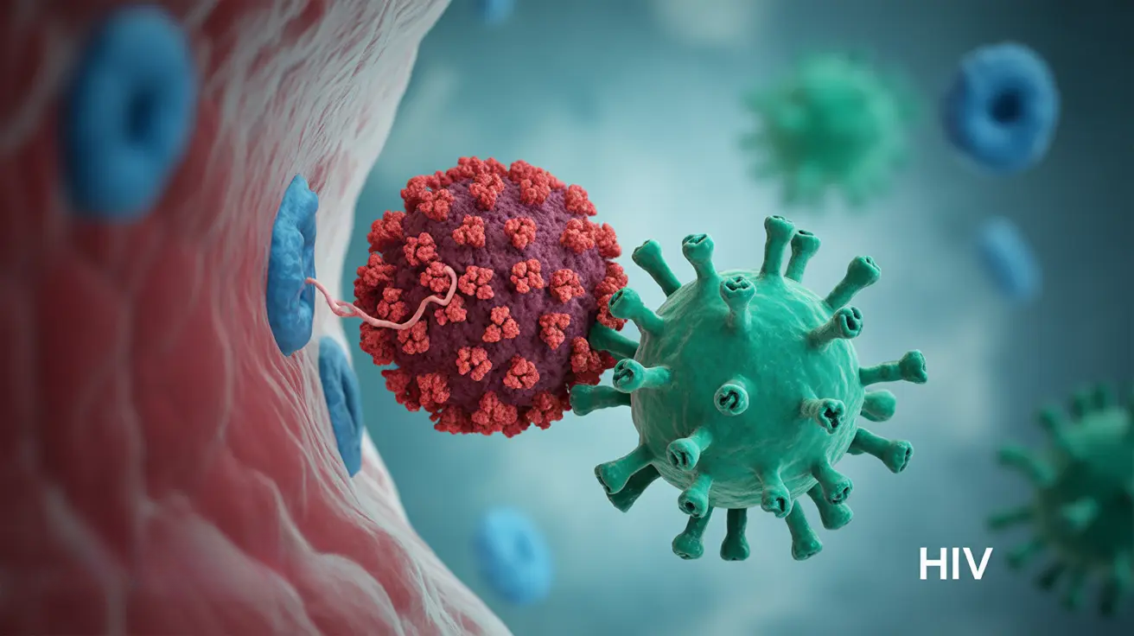
SSPs are a harm reduction intervention authorized by ND Century Code 23.01.44.
Scientifically proven to reduce the transmission of HIV, hepatitis B & C, and other bloodborne pathogens in persons who inject drugs.
Protect the public and first responders by facilitating the safe disposal of used needles and syringes.
Hep C and HIV

Slide 3




What we provide to our SSP clients:
Maintain the health of people in active substance use
Provide peer support services
Help program particpants get connected to optional services
  HepC/HIV testing - upon enrollment and every 6 months following
  Provides naloxone and education
  Provides safe sex kits and education
  Lived experience of recovery
  Provides a safe space
  Provides education
  Treatment - including tobacco
  Employment/Job listings
  Housing
  Legal services
  Medicaid
  Other community services

Slide 4


Outcomes
Encounters
240 individuals with 1965 visits
Referrals
19% of individuals were referred to treatment
13% of individuals were referred for healthcare treatment
Reduction in usage
22% of individuals reported a reduction in their usage
Employment
25% of individuals reported they gained employment

Slide 5
Care Closet
Infection Prevention/
Control
Impacts
Referrals to Ryan
White Program
Relationship building -
continuity of care
Meeting people where
they are at

Slide 6
Testimonials

Slide 7

THANK YOU
FOR MORE INFORMATION
fdhu.org
jlclark@nd.gov
701-852-1376

