Slide 1
Children In Need of Services North Dakota Children’s Cabinet August 20, 2024

Slide 2

Agenda
Introductions
Background
What is CHINS
Goals and Roles of CHINS
Referrals to CHINS
Challenges and Wins
Statistics
Questions

Slide 3

Juvenile Justice Reforms in ND

Slide 4

Developmental Considerations
Universal adolescent milestones
Brain Development: Impulse control, anticipating consequences
Testing Limits/boundaries
Primary influence becomes peers vs. adults
Asserting independent identity

Slide 5
What is a Child In Need of Services
Youth exhibiting negative behaviors that are NOT criminal in nature; commonly referred to as “status offenses”. Previously deemed “Unruly” in Juvenile Court proceedings
CHINS, as defined in NDCC 27-20.3:
Using/possessing tobacco and related products (vaping) under the age of 14.
Truancy: 3 or more days, unexcused.
Running away
Disobeying lawful and reasonable commands of parent/guardian; “ungovernable”
*age range of 10-17 (16 for truancy)

Slide 6
What CHINS is not:
Emergency Response:
If there are immediate safety concerns, call 911; encourage use of 988 for other non-emergency situations
Placement Team:
CHINS is a voluntary service; CHINS does not have removal or placement authority
The Juvenile Court no longer has authority for adjudication/disposition of CHINS population. Youth exhibiting solely CHINS behaviors can not be referred to the Juvenile Court. Coordination with the Human Service Zones and Juvenile Courts can occur to determine whether or not a youth can be considered a Child In Need of Protection.

Slide 7
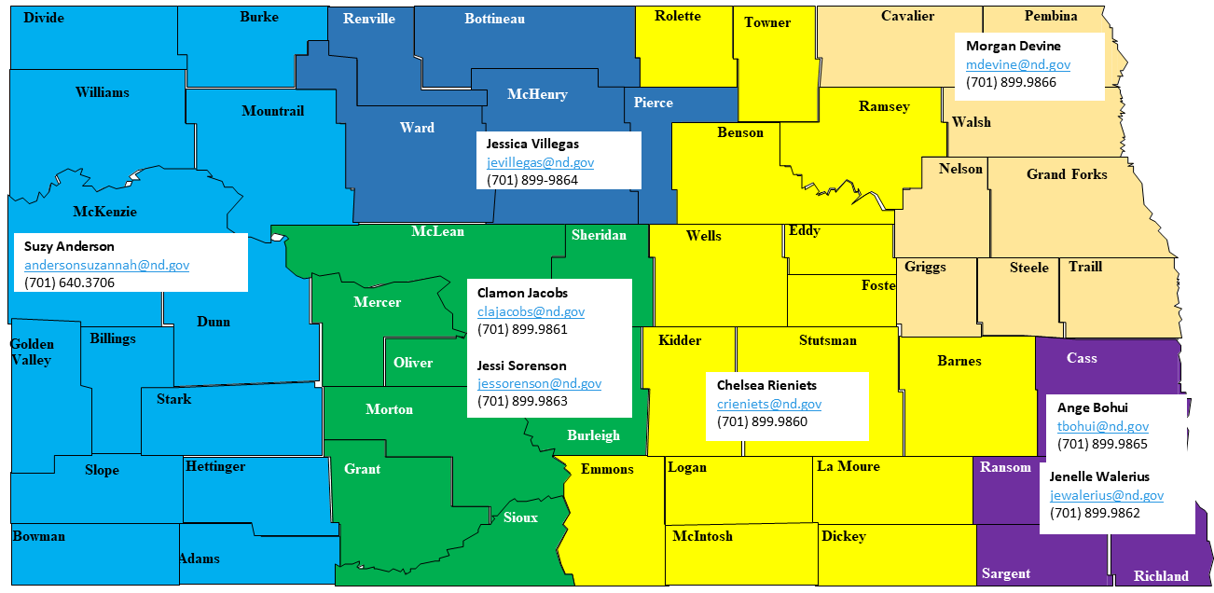
CHINS Team Members:
Statewide Unit of 8
7 full time Specialists and 1 Supervisor
Employed by RSR Human Service Zone
Administrative support from Cass Human Service Zone
Central referral inbox: CHINS@nd.gov

Slide 8

Goals and Roles
The primary goal is to focus on prevention, treatment and support to divert youth from further entering the juvenile justice or child welfare systems.
Discontinue treating non-criminal behavior in a criminal justice model.
Research indicates that a “light touch” and service connection for youth lead to more positive outcomes and less likelihood to appear in the adult criminal justice system.
To Engage, Empower and Educate Parents/ Caregivers to be actively involved in their children’s lives and activities.
To focus on connecting youth and family to community supports and resources earlier, preventing deep systems involvement.
“Navigator” role vs. service provider
Dual Status Youth Liaisons; facilitating coordination between Human Service Zones and Juvenile Courts for youth with multi-systems involvement.

Slide 9
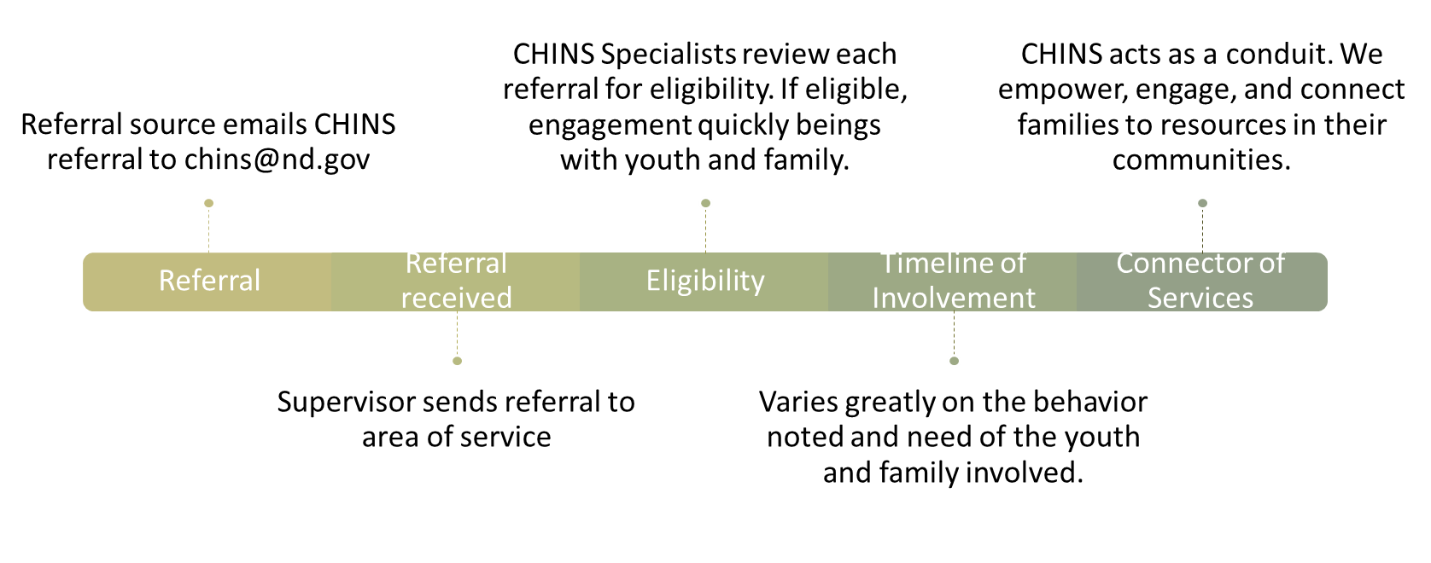
Referral Process:

Slide 10
Determining Level of Intensity
Age of child
Frequency or historical pattern of behaviors and referrals
Documented risk of harm to self or others
Documented prior services and efforts by family or school
Length of time child is missing
Physical/mental/emotional health of child
Documented results of screening tools
Documented results of assessments
In public custody /not in custody
Safety of the child
Caregiver engagement or willingness

Slide 11

Wins and Challenges
Consistent response and prioritization of referrals
Stability in staff/workforce; partnerships
Preventative in nature
Ability to modify policy/procedure to meet need
New and uncharted service provision; ND is one of the first states to implement a CHINS model
Varying community supports/services, particularly in rural areas
Varying local policies/community standards (law enforcement, school districts)
Misconceptions of service provision & target population

Slide 12
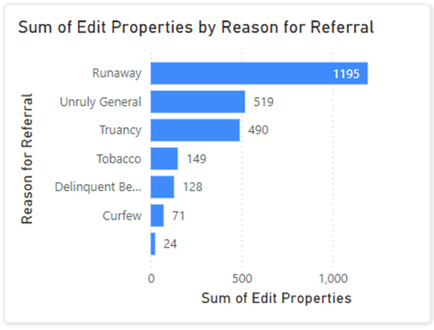
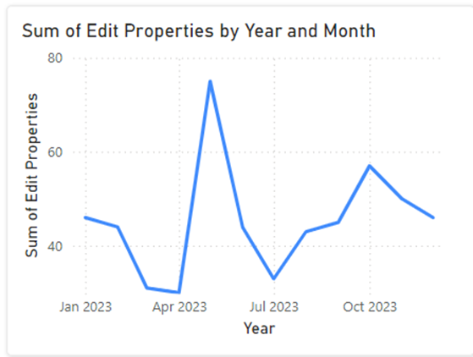
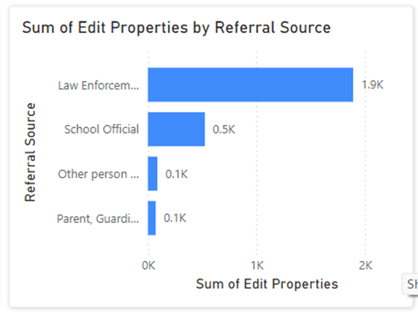
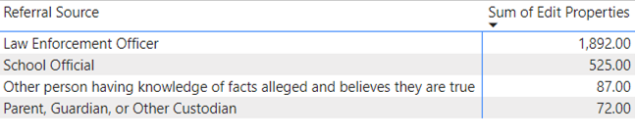
High Level Statistics CY 2023

Slide 13


Questions:
Lynn Flieth, Director
RSR Human Service Zone
lflieth@nd.gov
701.642.7751
Jessica Villegas, CHINS Supervisor
jevillegas@nd.gov
701.899.9864

