Slide 1
HCBS Statewide Transition Plan Update
Aging Services, Medical Services, and Developmental Disabilities
November 16 & 17 2022

Slide 2
Agenda
Introduction to the Regulation
Setting Requirements
Person-Centered Service Plan Requirements
Community Integration
Examples
Statewide Transition Plan
Update on the Regulation

Slide 3
Overview
A final rule by Centers for Medicare and Medicaid (CMS 2249F) was issued in January 2014 for home and community-based services (HCBS) provided through Medicaid waivers. The new regulations:
Provided requirements of a home and community-based setting
Defined person-centered planning requirements
Required states to develop transition plans for bringing all HCBS settings into compliance
Ensures that HCBS waiver participants can enjoy the benefits of living, working, and participating in the most integrated setting.
Settings are more about the nature and quality of individual’s experiences, not only about buildings where the services are being delivered.
People have maximum choice and control over their lives
Rights are respected and should be same as any citizen

Slide 4
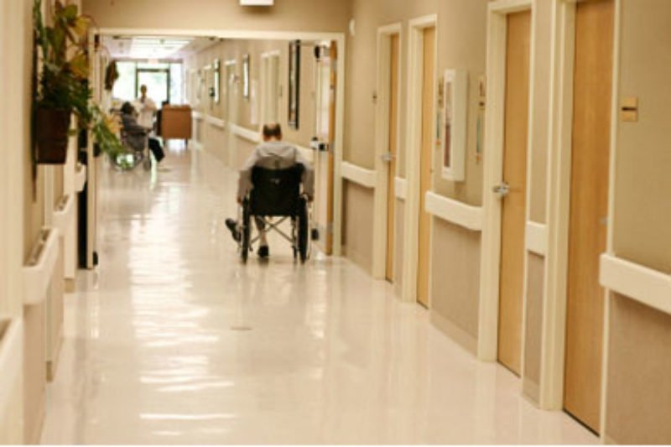
Definition of Settings
HCBS Settings Include:
Cannot be Provided in:
Homes
Apartment Units
Day Programs
Work Locations
Nursing Facility
Institution for mental diseases
Intermediate care facility for individuals with intellectual disabilities (ICF/IID)
Hospital
Any setting that has “institutional” characteristics or isolates from the broader community

Slide 5
HCBS Requirements are about:
Physical environment where people live & work
Individual experiences & preferences

Slide 6
HCBS Requirements:
People participate & live in the community
Full access & integrated
Settings selected by the person from among multiple setting options
Includes living options of people without disabilities
People have choice of services & supports
People choose their roommate(s)

Slide 7
HCBS Requirements:
People’s rights are respected & promoted
People make their own daily/life choices, develop their schedules, & have independence
People are free from restraint & not pressured into choices
People have privacy & dignity

Slide 8
HCBS Requirements:
People decorate & furnish their home as they wish
People have access to food & personal items at any time
People have visitors at any time
People control their own money & have opportunities to get paid at least minimum wage

Slide 9
Provider Owned & Controlled Residential Settings
People have a legally enforceable agreement or lease
Landlord-tenant responsibilities
Provides protections from eviction according to state law
Cannot contain “house rules”
Lease similar to any lease agreement in the community
People have lockable bedroom doors for privacy

Slide 10
Person-Centered Planning Requirements
Individual to leads the process
Includes selected family members, friends, & others
Reflects strengths, cultural considerations preferences, goals & desired outcomes
Reflects support needs & mitigate risks, including emergency back-up plans
Reflect paid & unpaid services, including natural supports
Provide necessary information to make informed decisions
Be understandable and in plain language
*Taken from Charting the LifeCourse, Integrated Supports Star

Slide 11
Person-Centered Planning Requirements
If people are not able to experience all afforded rights due to health/safety document:
The specific and individualized need
Positive interventions and other less restrictive methods that were prior but not successful
Include collection and review of data to measure if the modification should continue or be discontinued
Time limits and periodic reviews
Informed consent
Assurance that interventions will cause no harm to the person
*Also referred to modifications or right restrictions

Slide 12
Community Integration
Community integration- assimilating and welcoming – people with disabilities into the larger community
Allows person with disabilities to fully participate in life at the same level as nondisabled individuals
Need to find meaningful ways to engage individuals in activities outside of the facility, home, etc.
Activities should be person-centered and based on the needs and interests of the individual.
Once per week bus trip is not enough

Slide 13
Community Integration
Consider local activities
Parades, farmer’s market, craft fairs, car shows, high school sporting events, church programs
Participate in meal serving at a local event
Attending an art class, petting zoo, go to the library to check out books, go to the coffee shop once per week
Local schools often have plays, sporting events, fundraisers, craft fairs, and other activities people may enjoy
Partner with what is already available in your community

Slide 14
Community Integration
What to do for those who become overstimulated or anxious in crowds:
Go to an event when it first opens, before it becomes crowded
Meet 1:1 with an expert or another person that shares their interest
Shop smaller stores
Check for sensory friendly options in the community
Join small group activities (e.g., animal shelters, food pantries, homeless shelters to serve meals, etc.)
Bring calming items with
Visit in smaller time increments

Slide 15
Community Integration
It takes staff and preplanning to make events like this happen but that is the expectation of true community integration and recreational programs.
Not every event is right for everyone. Activities should be based on the interests and needs of each person.
Volunteers and family may help with these activities.
Plans should address personal preferences, including modifications based on people’s comfort level, needs, etc.

Slide 16
Examples
Do NOT Meet Requirements
Do Meet Requirements
Only go into the community with a group as a “group trip” or outing
Entire day spent at day program location
All activities are scheduled by staff with out individual input
Can only shower on certain days or times
If chores not done, no other activities that day
Personal schedules are posted
Individualized activities in community based on personal interest
Activities also include social or volunteer activities in coffee shops, library, senior center, etc.
People are involved in choosing their activities
Can choose to shower when they want
May choose not to wash supper dishes that night, but still go out with friends
Personal schedules are kept in a binder or own private space/bedroom

Slide 17
Examples
Do NOT Meet Requirements
Do Meet Requirements
Scheduled meal, bed, & waking times
Set menus & people are not part of the meal planning
No food in bedrooms
All checkbooks kept in staff office or locked
Home or room is already furnished & decorated
Choose when wake up, go to bed, have meals
If menus are developed people have input, based on food preferences, or other food choices available
Eat food in living room, or other areas & not confined to the kitchen
Keep their checkbooks & money in their private space
Can furnish home/room with personal items

Slide 18
Examples
Do NOT Meet Requirements
Do Meet Requirements
Does not have own key to bedroom/house
No area to make private phone calls or have to ask to use phone
Staff talking about you in front of others
House rules-where provider implement “blanket” procedures for everyone
Being told can only make plan changes at annual meeting
Have own key, code, fab, etc. to use
Use of a cordless phone, option to have cell phone, ability to take phone to private area
Staff conduct conversations in a separate room or other private manners
Procedures are based on individual need or roommate discussion/agreement
Plans can be updated or requested anytime by the person & guardian

Slide 19
Statewide Transition Plan
States were allowed some time to come into compliance. States had to assess provider settings and state policies, then develop a Statewide Transition Plan (STP) to describe how its programs meet the rules and how it will fix the areas that do not comply.
ND submitted their STP for all Medicaid Waivers
HCBS Waiver (serves Aged and Disabled)
Autism Spectrum Disorder (ASD) Waiver
Children’s Hospice Waiver
Medically Fragile Children’s Waiver
Technology Dependent Waiver
Traditional IID/DD HCBS Waiver

Slide 20
Ongoing Monitoring and Compliance
States must ensure continued compliance with the requirements.
ND ensures this by:
Reviewing future settings
Monitoring person-centered service plans through quality reviews
Monitoring people’s experiences are consistent with those of the general public
Implementation of Policy and Procedures
Case Management oversight activities
Licensing requirements

Slide 21
STP Update and CMS Expectations
May 2022 CMS announced strategy for implementation of the HCBS requirements for states to continue to receive federal reimbursement
All states must receive final Statewide Transition Plan by March 17, 2023
ND achieved final approval by CMS February 2019
https://www.hhs.nd.gov/sites/www/files/documents/DHS%20Legacy/nd-approved-statewide-transition-plan-ada.pdf

Slide 22
STP Update and CMS Expectations
2. By March 17, 2023: all states and providers must be in compliance with requirements not directly impacted by the COVID-19 PHE disruptions (includes workforce challenges)
Privacy, dignity, respect
Freedom from coercion & restraint
Control of personal resources
Lease or other legally enforceable agreement (provider owned or controlled settings)
Lockable doors (provider owned or controlled settings)
Freedom to furnish or decorate their home
Access to food & visitors at any time
Physical accessibility of home
Person-centered service plan documentation of modifications (right restrictions)

Slide 23
STP Update and CMS Expectations
ND presumes that previously approved setting assessments continue to be in compliance with the setting requirements (listed in previous slide)
This is in anticipation of CMS completing future on-site visits

Slide 24
STP Update and CMS Expectations
3. By December 1, 2022: States may submit time-limited corrective action plans (CAPs) to authorize additional time to achieve full compliance with requirements that are directly impacted by PHE disruptions
Access to the broader community
Opportunities for employment
Option for a private unit and/or choice of a roommate
Choice of non-disability specific settings

Slide 25
STP Update and CMS Expectations
ND Aging will be submitting a CAP for any providers who are not in compliance with community integration

Slide 26
STP Update and CMS Expectations
4. By January 1, 2023: states must submit their process for waiver participants to notify the state of provider noncompliance
States can identify their processes through a variety of methods such as:
case management
call-in center
state administration, etc.

Slide 27
Grievance/Complaint
Concerns with provider staff, provider performance, service delivery, people’s experiences, etc.
Person receiving services, legal decision maker, or any other interested person can submit
Can be submitted anytime
Submit to Case Manager/Program Manager or Administration at state office
Notification of right to submit a Grievance/Complaint initially & annually
Policy will identify process & contact information

Slide 28
Grievance/Complaint
Potential Actions or Resolutions
Contact with other entities
Human Service Centers or Zone
P&A, VAPS, Child Protection Services
Accreditation organization
Team meeting
Service plan revisions
Service or provider changes
Review or investigation
On-site visit
Monitoring
Plan of Correction
Licensure status change

Slide 29
Resources
ND Information
https://www.hhs.nd.gov/human-services/hcbs
Federal Information
https://www.medicaid.gov/medicaid/home-community-based-services/index.html
https://www.medicaid.gov/medicaid/home-community-based-services/guidance/home-community-based-services-final-regulation/index.html
https://www.medicaid.gov/medicaid/home-community-based-services/guidance/home-community-based-settings-requirements-compliance-toolkit/index.html
This intensive is about 3 hours, but it does have a lot of good information:
https://youtu.be/OYFarI7aVVY - CMS Intensive: Time is of the Essence: Countdown to Compliance with the HCBS Settings Rule

Slide 30
Thank you!

